Slide 1






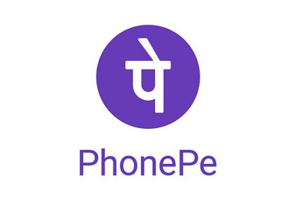
Phonepe
Phonepe Pulse Data Analysis (2018-2022) Using Power Bi
Ramya Raghavan
MB28

Slide 2



Phonepe
Introduction
PhonePe Pulse is an innovative product in India that presents insights into digital payment transactions.
It showcases data on transactions exceeding ₹2000 crore conducted by consumers.
The platform provides data-driven insights and trends based on PhonePe transaction data across India.
The dataset includes digital payment trends from 2018 to 2022, covering all quarters.
It offers a detailed view of patterns and behaviors in the Indian digital payments landscape during this period.

Slide 3



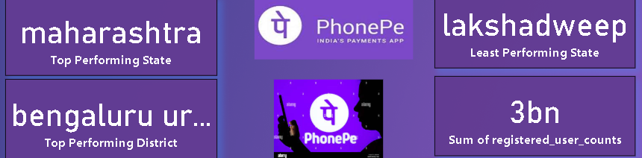


Phonepe
Key Performance Indicators (KPIs) Overview
Top Performing State: Maharashtra has emerged as the highest-performing state in terms of digital transactions and user engagement on the PhonePe platform.
Top Performing District: Bengaluru Urban leads as the top-performing district, showcasing its strong adoption of digital payments.
Least Performing State: Lakshadweep ranks the lowest in terms of PhonePe usage, indicating the need for further digital financial inclusion in the region.
Total Registered Users: PhonePe has recorded an impressive 3 billion registered user accounts, highlighting its extensive reach and growing popularity in India’s digital payment ecosystem.

Slide 4
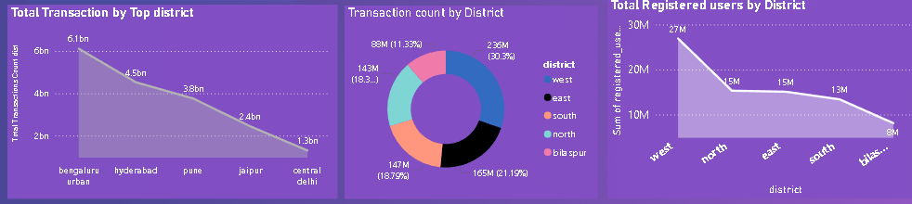

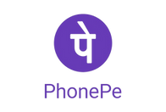
Phonepe
Top Transactions
Total Transactions by Top Districts – Bengaluru Urban leads with 6.1 billion transactions, followed by Hyderabad, Pune, Jaipur, and Central Delhi.
Transaction Count by District – A pie chart displaying the proportion of transactions across five districts, with the West region having the highest share (30.5%).
Total Registered Users by District – West has the most registered users (27M), with numbers decreasing across North, East, South, and Bilaspur.
These visualizations highlight regional transaction trends and user engagement on the platform.

Slide 5
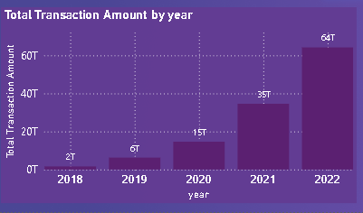



Phonepe
Total Transaction Amount by Year
2018: Transaction amount was 2T.
2019: Tripled to 6T.
2020: More than doubled, reaching 15T.
2021: Continued upward trend to 35T.
2022: Significant rise to 64T.
Key Insight: Consistent and steep increase indicates growing usage and service expansion.

Slide 6
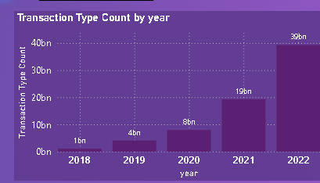
Phonepe
Total Transaction Amount by Year
2018: 1B transactions
2019: Increased to 4B
2020: Doubled to 8B
2021: Significant rise to 19B
2022: Peaked at 39B
This chart highlights the exponential growth in transaction types over the years, indicating increasing adoption and digital payment expansion.

Slide 7
Phonepe
Phone Pe 2018-2022 Insights
Transaction Volume Growth (2018-2022)
📊 2018: 2T
📊 2019: 6T (3x growth)
📊 2020: 15T (2.5x growth)
📊 2021: 35T
📊 2022: 64T (Rapid acceleration)
💡 Key Insight: Consistent and exponential growth reflects increasing digital payment adoption and service expansion.
Transaction Type Growth (2018-2022)
📈 2018: 1B transactions
📈 2019: 4B
📈 2020: 8B
📈 2021: 19B
📈 2022: 39B
💡 Key Takeaway: The surge in transaction types highlights PhonePe’s growing role in India's digital economy.
Performance Overview
📌 Top Performing State: Maharashtra leads in digital transactions and user engagement.
📌 Top Performing District: Bengaluru Urban ranks highest in digital payment adoption.
📌 Least Performing State: Lakshadweep, indicating the need for enhanced digital financial inclusion.
User Base & Adoption
📌 Total Registered Users: 3 billion, reflecting PhonePe’s extensive reach and growing popularity.
Regional Transaction Trends
🔹 Top Districts by Transactions:
Bengaluru Urban (6.1B), followed by Hyderabad, Pune, Jaipur, and Central Delhi.
🔹 Transaction Count by District:
West region leads with 30.5% of total transactions.
🔹 Registered Users by District:
West: 27M, followed by North (15M), East (15M), South (13M), and Bilaspur (8M).

Slide 8
Phonepe
Phone Pe 2018-2022 key Take away
Driving Financial Inclusion: Expanding digital payment access in underserved regions like Lakshadweep can accelerate financial inclusion.
✅ Urban-Led Growth: Maharashtra and Bengaluru Urban lead the way, highlighting the role of metropolitan areas in fintech adoption.
✅ Rapid Market Expansion: The exponential rise in transactions and user base reflects PhonePe’s dominance in India’s digital payment ecosystem.
✅ Towards a Cashless Economy: Increasing transaction volumes indicate a strong shift towards a digital-first financial landscape.
✅ Regional Growth Potential: Strengthening digital infrastructure in emerging markets can unlock new opportunities for growth.
✅ Innovation & Scalability: Sustained growth signals the potential for further innovations in digital finance and scalability across industries.
✅ Future Outlook: Continued investment in technology, security, and user experience will drive long-term success and market leadership.
🚀 PhonePe is shaping the future of digital payments in India!

Slide 9


Phonepe
Thank YOU !

