Slide 1
Movie Dataset Analysis
R.V. College of Engineering, Bangalore
Team Name : BollyBuff
Team Members : Ramya Ramanathan
Aakanksha Ashok
Malika Makker

Slide 2
Problem Statement
Movie dataset analysis
To draw intelligence and trends from the Bollywood Dataset consisting of poster, trailer, wikipedia and script data.
Components :
Character Analysis
Predicting Climax
Predicting emotion in future years
Tracking male and female centrality
Genre Prediction
Technologies/Platforms/APIs used : Python 3.5, IBM Watson, nltk, wordcloud, scikit, matplotlib, shapely, keras etc.

Slide 3
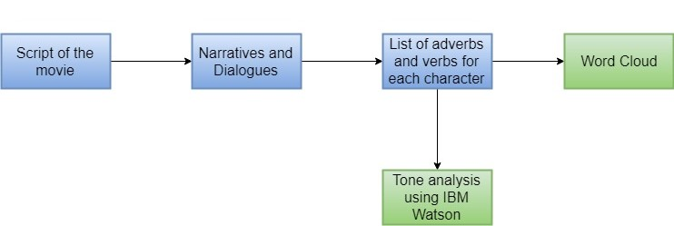
Character Analysis
APIs used : IBM Watson, wordcloud

Slide 4
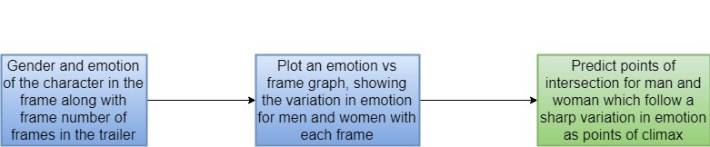
Predicting Climax
APIs used : Shapely

Slide 5
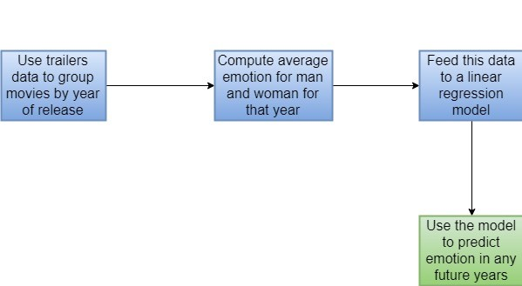
Predicting emotion in future years
APIs used : Vader, LinearRegressor

Slide 6
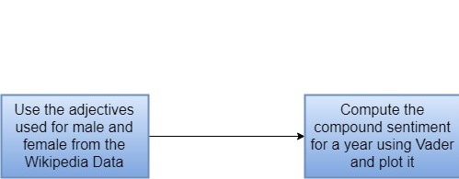
Tracking male and female centrality

Slide 7
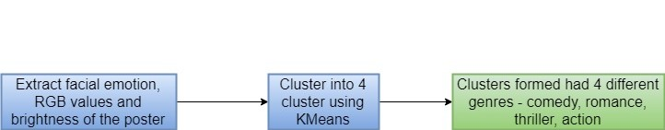
Genre Detection using posters
APIs used: Keras, KMeans

Slide 8
Male female singers analysis
SongsDB.csv file was used for the analysis.
The movies were grouped by the year of release.
The male and female singers count for each of those movies was summed and plotted for that particular year.

Slide 9
Business Value
Male centrality analysis
The genre classification module
The climax detection module
Character Analysis
A change in adjectives

Slide 10
Thank you.

