Slide 1
Movie Dataset Analysis
R.V. College of Engineering, Bangalore
Team Name : BollyBuff
Team Members : Ramya Ramanathan
Aakanksha Ashok
Malika Makker

Slide 2
Problem Statement
Movie dataset analysis
To draw intelligence and trends from the Bollywood Dataset consisting of poster, trailer, wikipedia and script data.
Components :
Character Analysis
Predicting Climax
Predicting emotion in future years
Tracking male and female centrality
Genre Prediction
Technologies/Platforms/APIs used : Python 3.5, IBM Watson, nltk, wordcloud, scikit, matplotlib, shapely, keras etc.

Slide 3
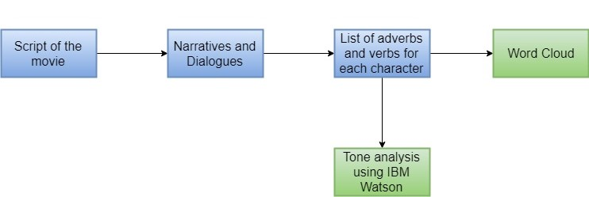
Character Analysis
APIs used : IBM Watson, wordcloud

Slide 4
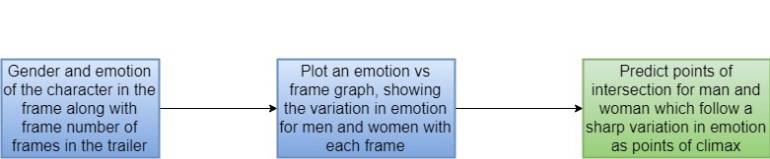
Predicting Climax
APIs used : Shapely

Slide 5
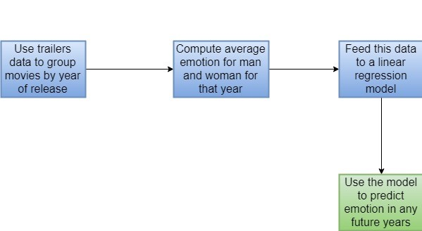
Predicting emotion in future years
APIs used : Vader, LinearRegressor

Slide 6
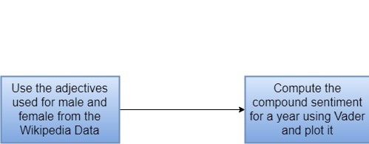
Tracking male and female centrality

Slide 7
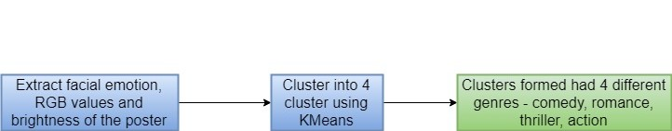
Genre Detection using posters
APIs used: Keras, KMeans

Slide 8
Male female singers analysis
SongsDB.csv file was used for the analysis.
The movies were grouped by the year of release.
The male and female singers count for each of those movies was summed and plotted for that particular year.

Slide 9
Business Value
Male centrality analysis
The genre classification module
The climax detection module
Character Analysis
A change in adjectives

Slide 10
UI
The UI is built using Python flask based framework as backend
The templates are made using html, css, javascript and jquery
The datasets are in the form of text, csv or images.
Multiple different tabs are created to represent each component including trends, climax, genre and character analysis.

Slide 11
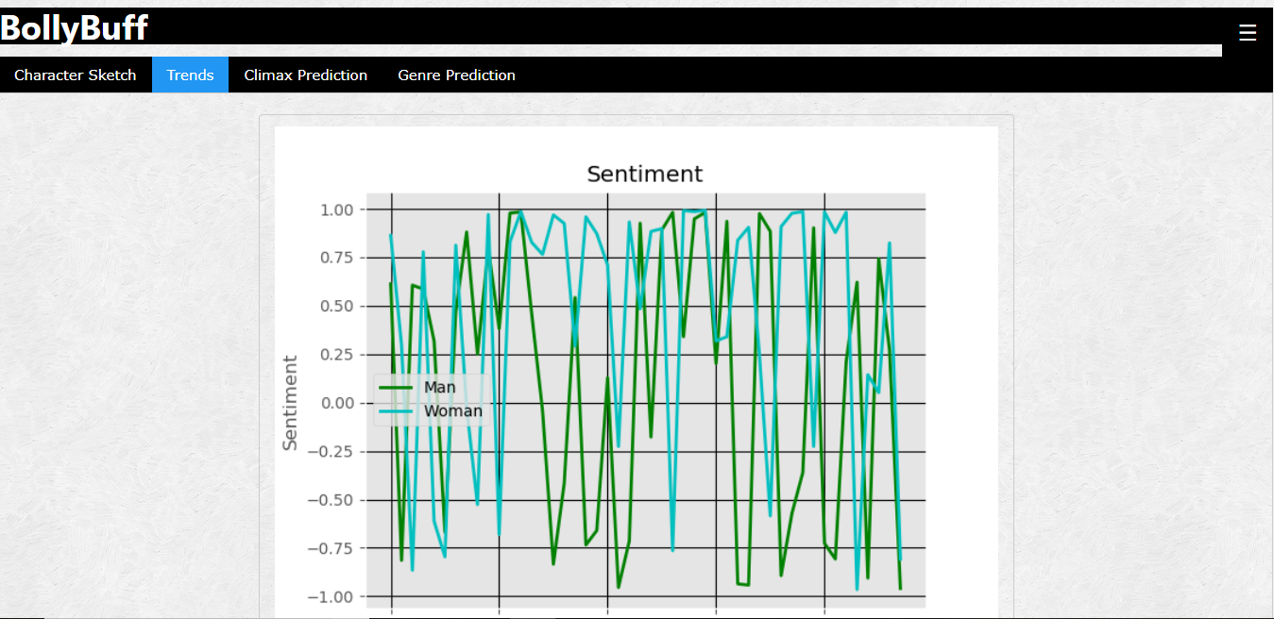
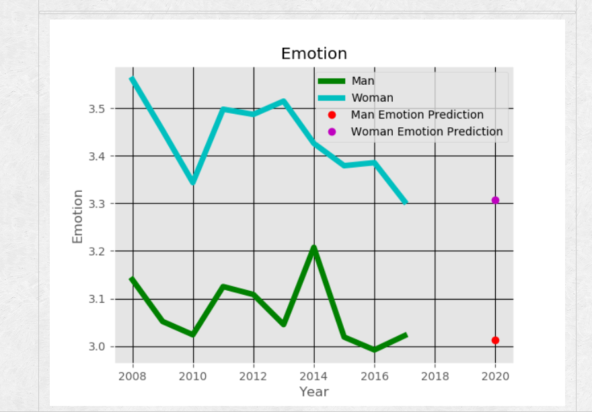
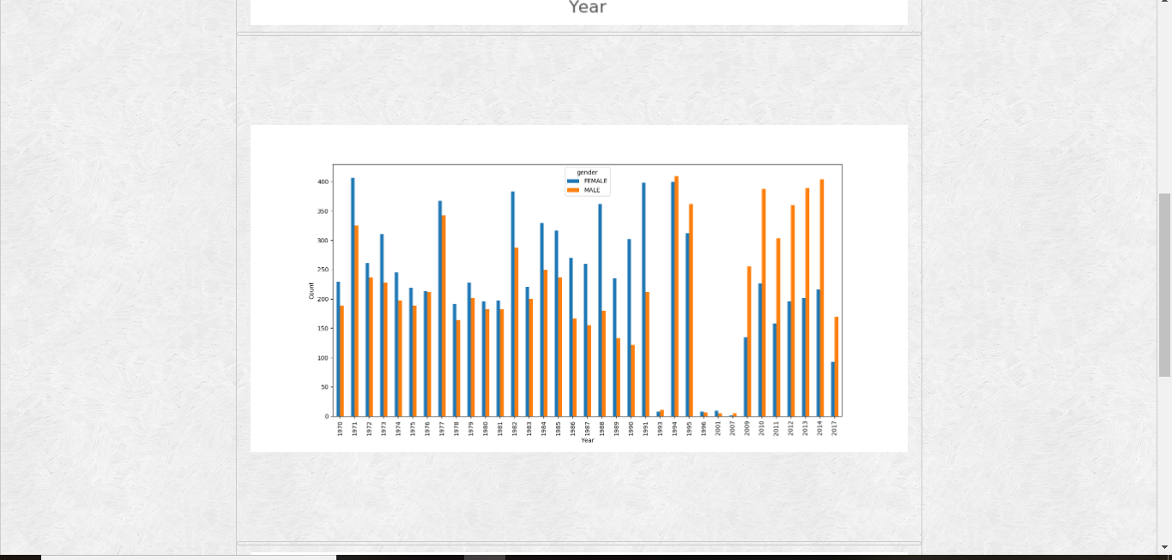
UI Screenshots - Trends

Slide 12
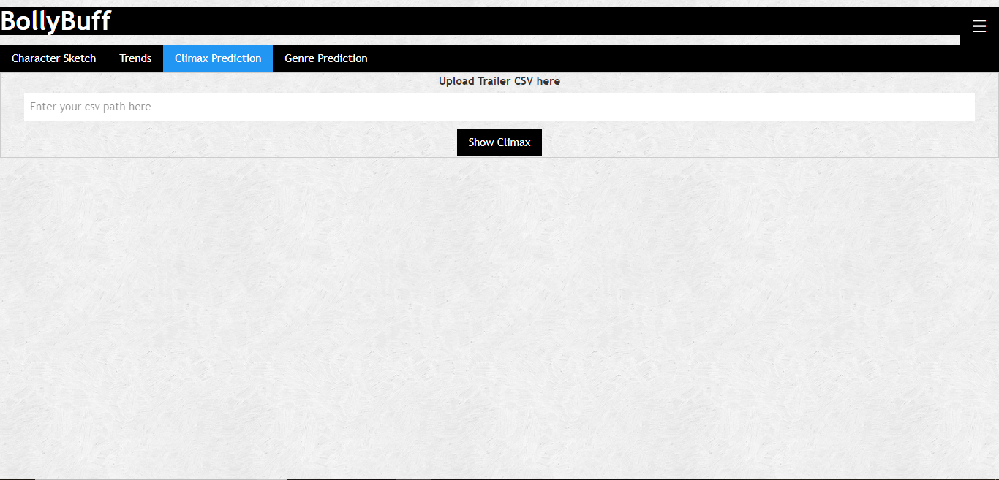
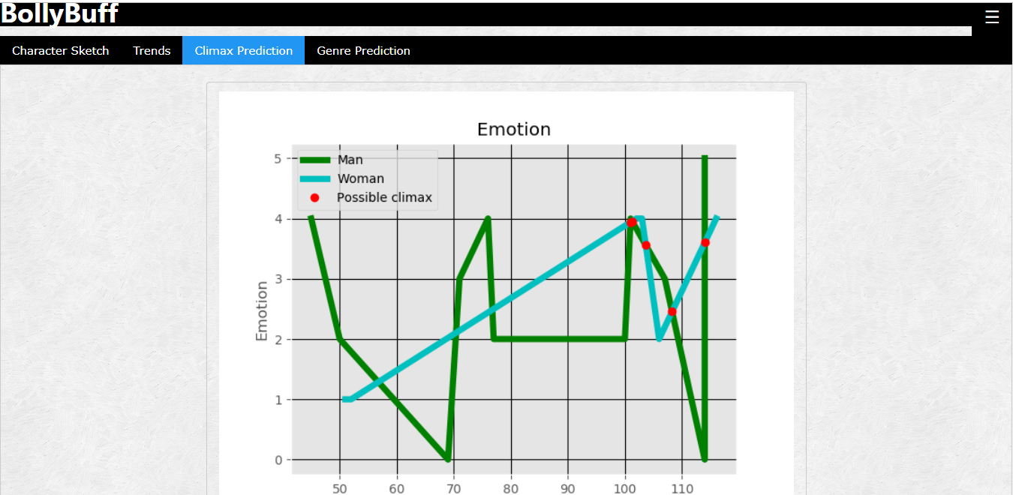
UI Screenshots – Climax Prediction

Slide 13
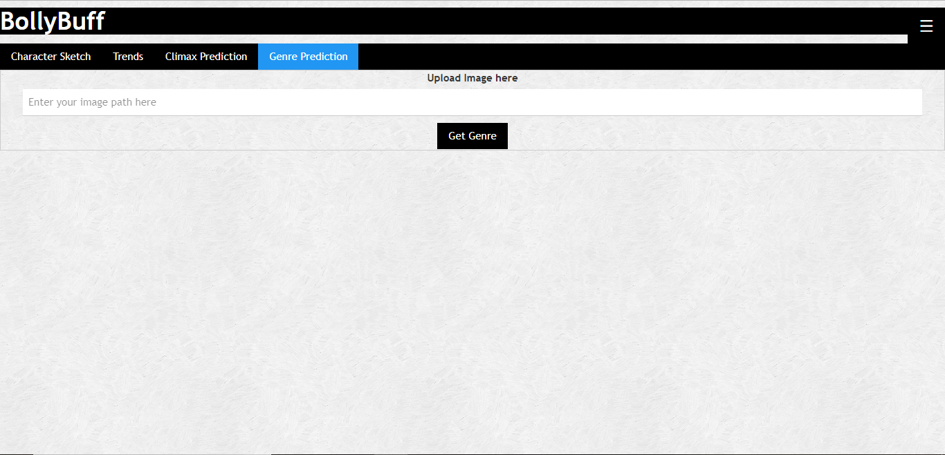
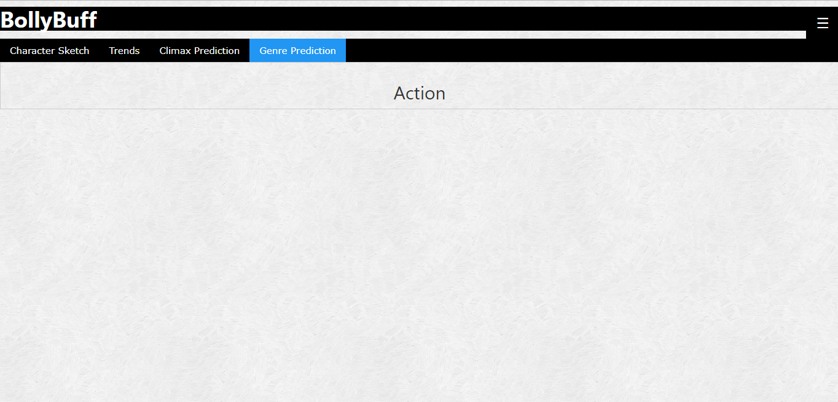
UI Screenshots – Genre Prediction

Slide 14
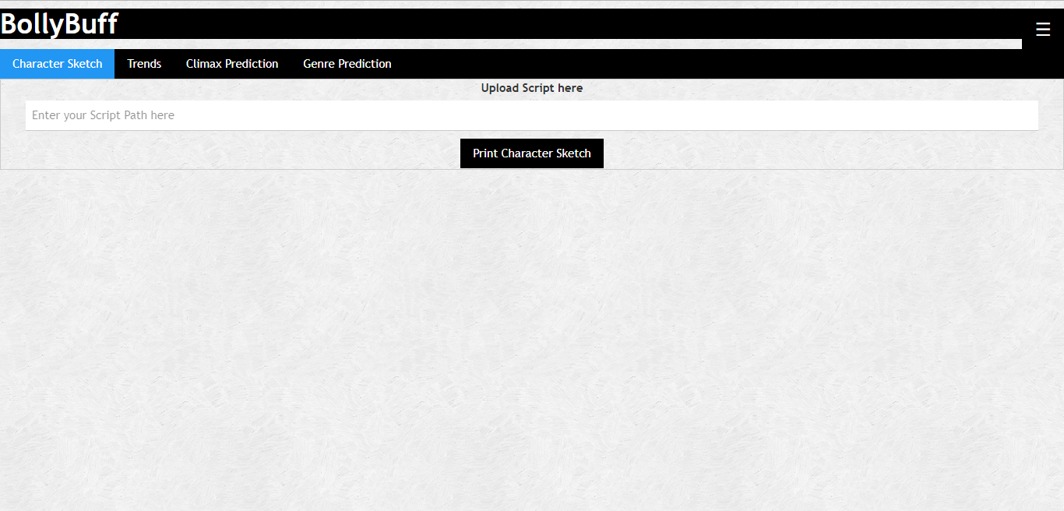
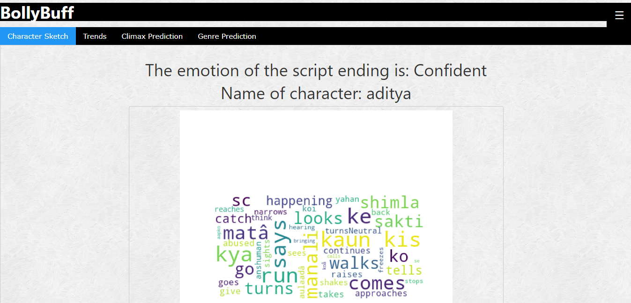
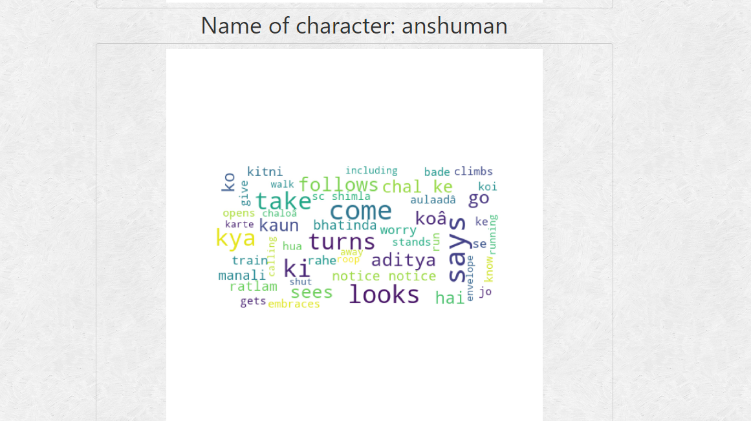
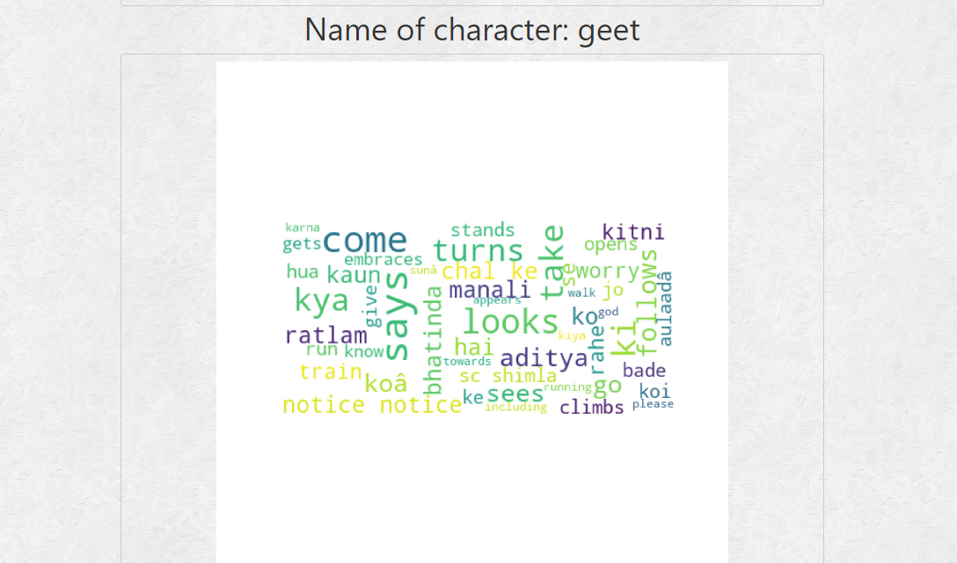
UI Screenshots – Character Analysis

Slide 15
Thank you.

