Slide 1
Data Analysis Project on New York City Airbnb Open Data-set
Airbnb, Inc. is San Francisco, California based company which act as a broker and provides an online marketplace for short-term homestays. The company charges a commission from each bookings. Aibnb providing it premium service and experience to customers since 2008. This data can be use for business decisions, marketing, implementations of initiatives, additional services and much more.
Dataset: https://www.kaggle.com/datasets/dgomonov/new-york-city-airbnb-open-data

Slide 2
Columns Present in dataset are
Id : Listing ID of the property
Name : Name of the listed property.
host_id : ID of the property owner.
host_name : Name of the property owner.
neighbourhood_group : Location at which property located.
Neighbourhood : Area in which property located.
Latitude : Latitude coordinate.
Longitude : Longitude coordinate.
room_type : Type of the room (Entire Home/ Appt, Private Room, Shared Room)
Price : Price in Dollars.
Minimum_nights : Amounts of minimum night stay at property
number_of_reviews : No. Of reviews
last_review : last review on which date.
reviews_per_month : Numbers of reviews per months.
calculated_host_listings_count : Count of properties listed on that host.
availability_365 : Number of days when listing is available for booking

Slide 3
Steps involved in Data Transformation
Replaced all the blank spaces present in the columns with value zero
Replaced all the null values with zero
Removed the errors present in the dataset

Slide 4
Questions resolved
In which Neighbourhood group there is maximum number of properties listed ?
Which host has maximum number of properties listed ?
Which host has maximum properties listed in neighbourhood groups having maximum properties listed ?
What is the average price in different properties listed ?
What may be the reason of having high price in that neighbourhood groups ?
What is the most prefered room type in the every neighbourhood groups ?
Total availability of properties having different room type?
Which one is the busiest host ?
Which property has maximum number of reviews ?

Slide 5
Analysed the following
Count of reviews per month
Shown the total room types
Found out the total number of shared rooms, private rooms, entire home/apt
Created a slicer for dates to show last reviewed information
Found out the prices for each neighborhood group
Created a table for host to check the count of properties been listed for each neighborhood group

Slide 6
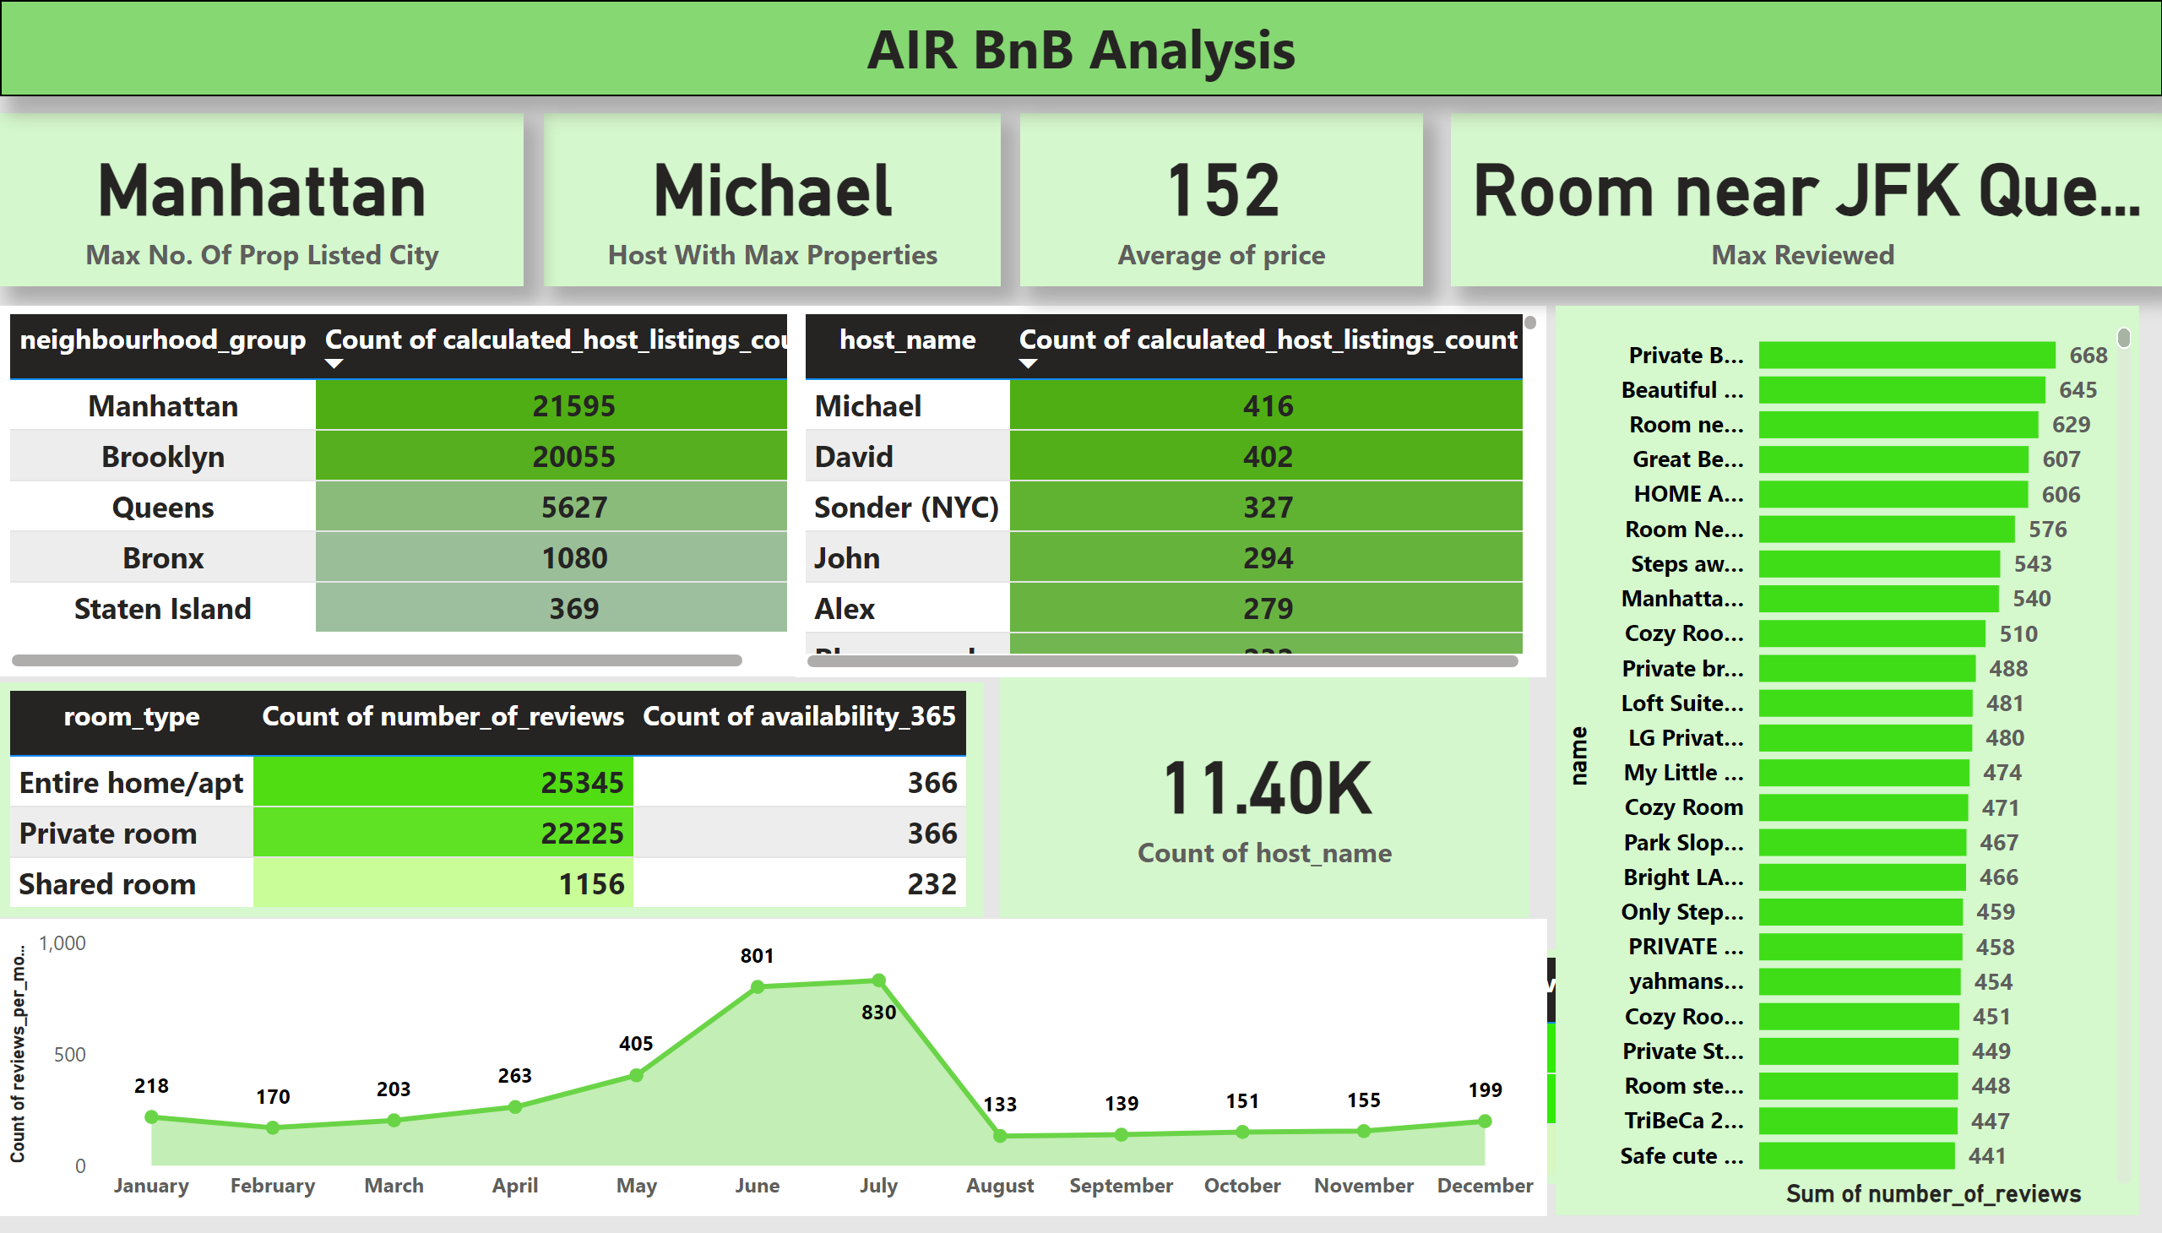
Overview
Notes:
card
No alt text provided
card
No alt text provided
tableEx
No alt text provided
tableEx
No alt text provided
card
No alt text provided
tableEx
No alt text provided
tableEx
No alt text provided
card
No alt text provided
areaChart
No alt text provided
barChart
No alt text provided
textbox
No alt text provided
card
No alt text provided

Slide 7
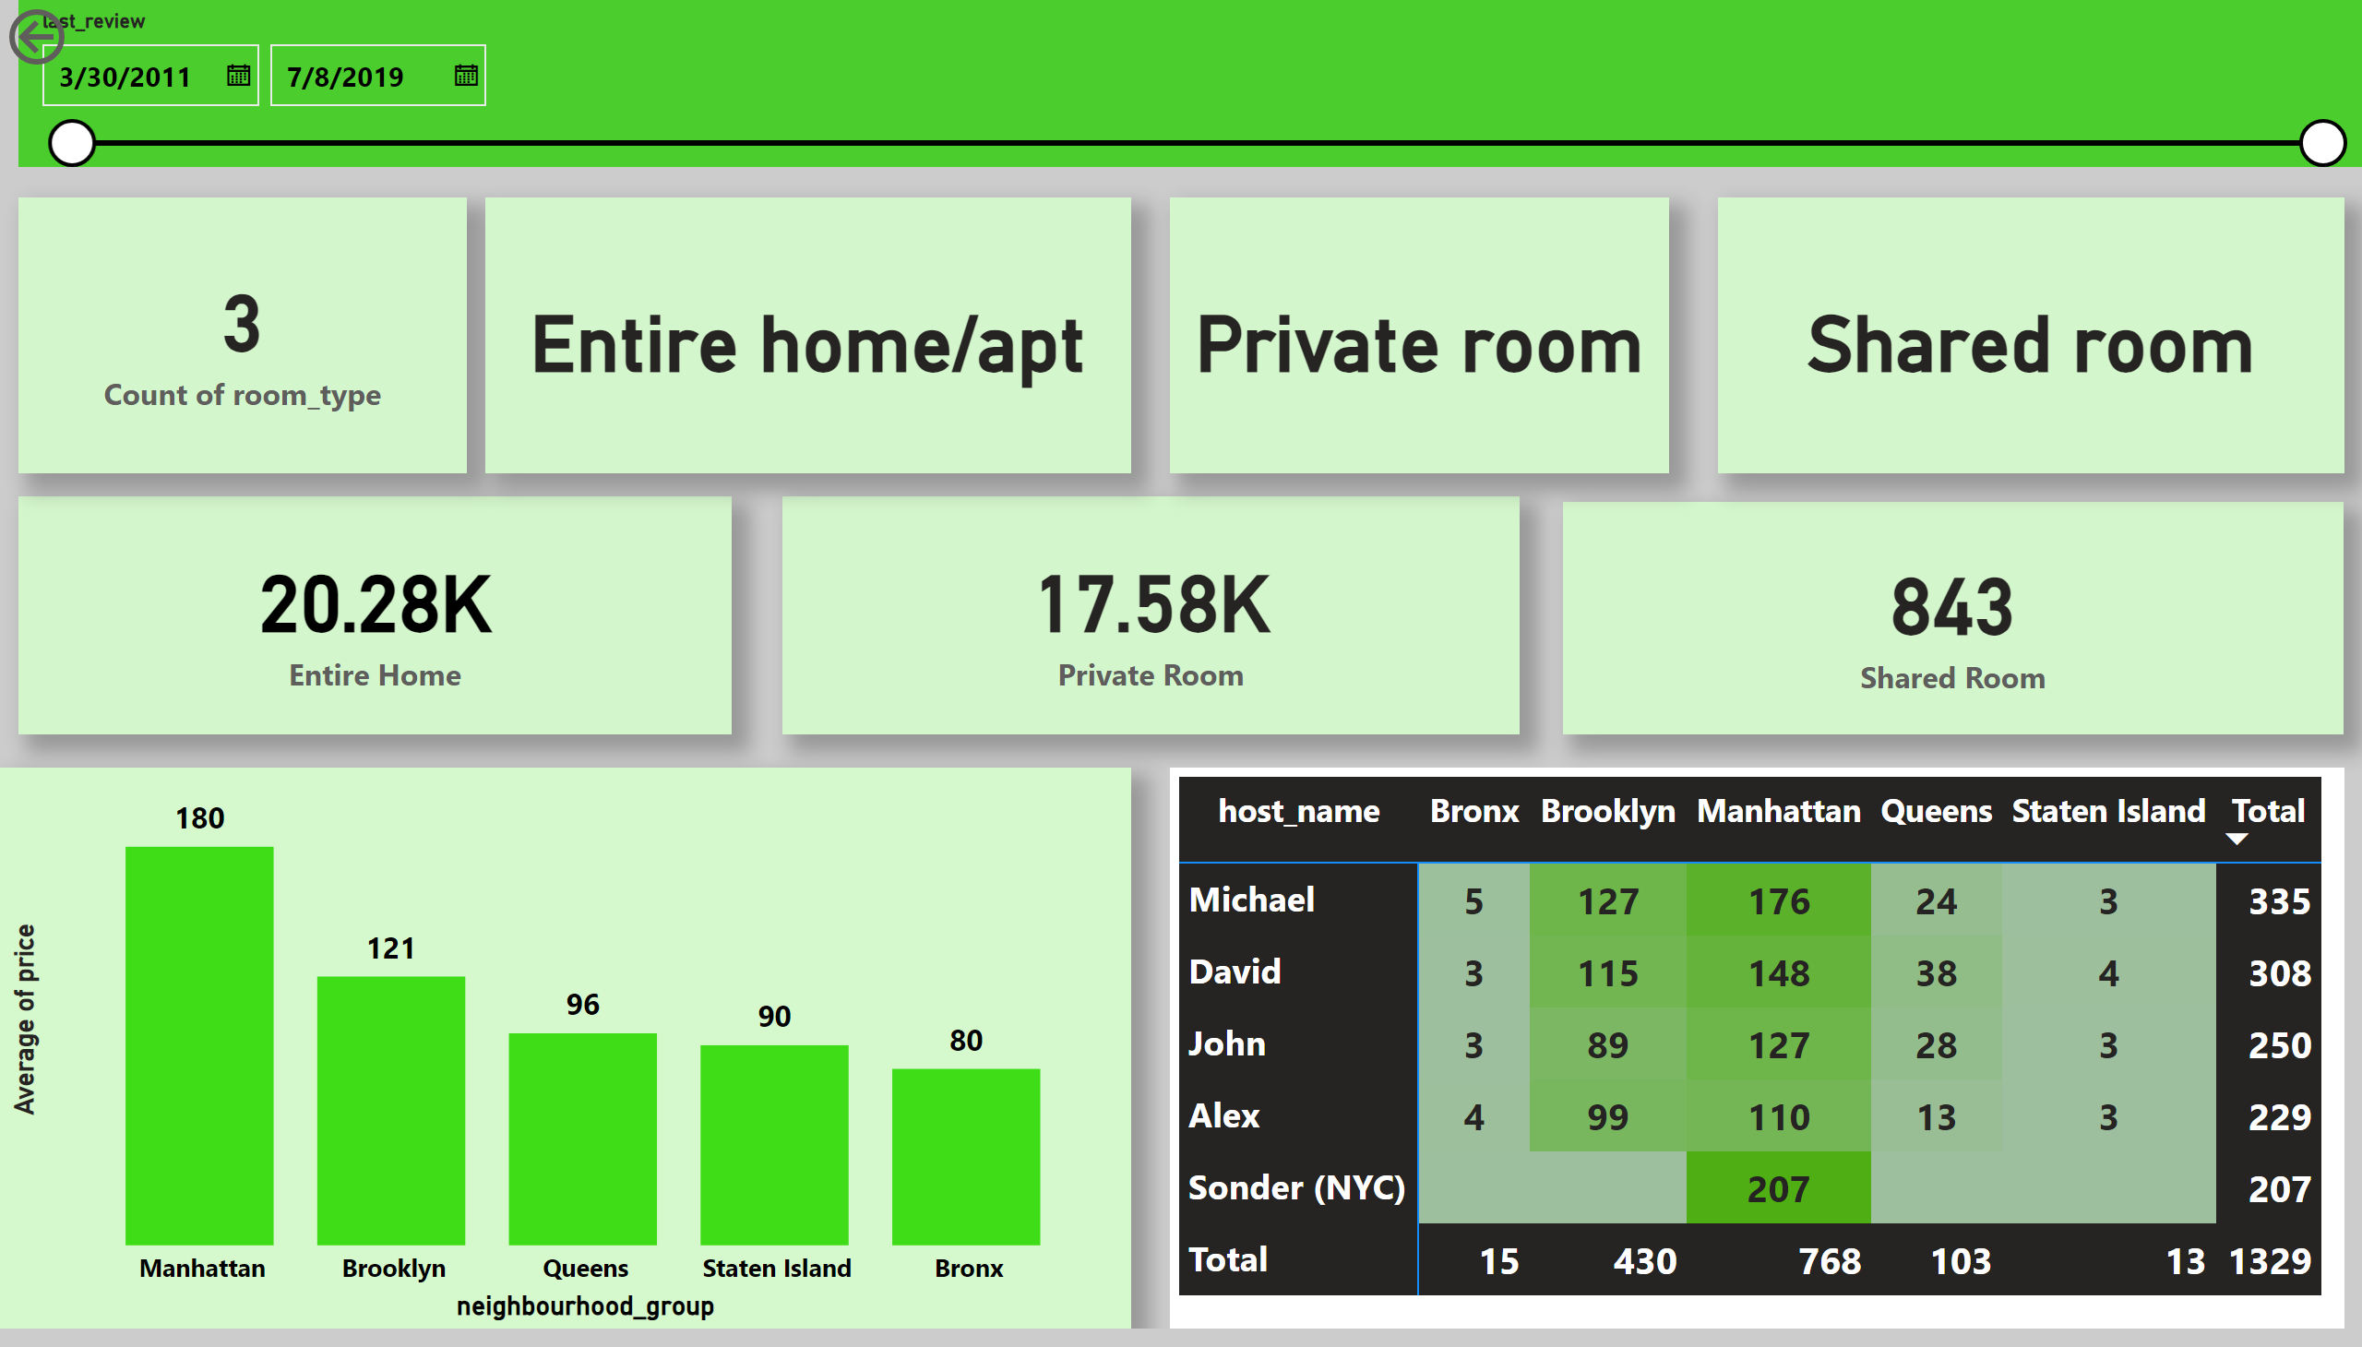
Analysis
Notes:
card
No alt text provided
card
No alt text provided
card
No alt text provided
card
No alt text provided
columnChart
No alt text provided
slicer
No alt text provided
pivotTable
No alt text provided
actionButton
No alt text provided
card
No alt text provided
card
No alt text provided
card
No alt text provided

