Slide 1
AI Methods for Classification of Production Errors on Camera Images of Additive Manufacturing Processes A Systematic Review
Ramya Subramanian Porselva Bharathi Matriculation Number: 224201309
08. February 2026

Slide 2
Presentation Outline
1. Introduction: Context and Importance of AM
2. Problem Statement and Research Objectives
3. Theoretical Background: AM Processes and Defects
4. Camera-Based Monitoring Systems
5. AI Approaches: Traditional → Classical ML → Deep Learning
6. Comparative Analysis of Methods
7. Case Studies and Performance Results
8. Strengths and Weaknesses Analysis
9. Challenges and Future Research Directions
10. Conclusions and Key Findings

Slide 3
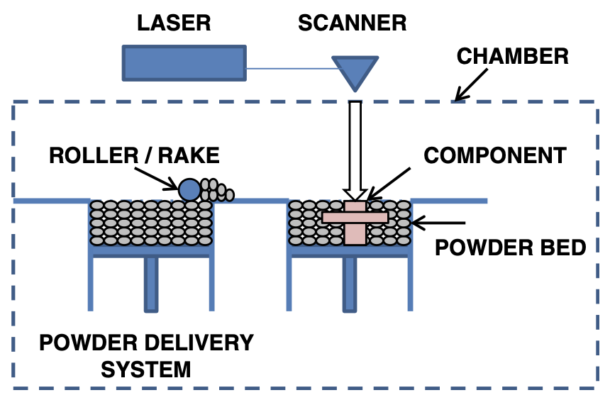
Introduction: Context and Importance
What is Additive Manufacturing?
Additive Manufacturing (AM) builds parts layer by layer from digital models, enabling complex geometries, reduced material waste, and design freedom beyond conventional manufacturing methods [4].
Key Applications
Aerospace: Lightweight structures, complex components
Automotive: Customized parts, rapid prototyping
Biomedical: Patient-specific implants, prosthetics
Critical Challenge
Defects compromise structural integrity, significantly increasing production cost and time [5,7].
Fig. 1: Layer-by-layer AM build process showing material deposition. Adapted from [4]

Slide 4
Problem Statement
Challenges in Visual Data Interpretation
Despite advances in camera-based monitoring, reliably interpreting AM visual data remains challenging. Defect appearance is influenced by process conditions, lighting variability, material types, and defect morphology, making rule-based methods unreliable [7].
Traditional threshold-based approaches achieve only 65–75% accuracy due to sensitivity to illumination changes and environmental factors [14].
Domain Shift Problem
Domain shift - degraded performance when models trained on one system are applied to different hardware, represents a significant deployment barrier [7]. Most studies utilize proprietary or small-scale datasets from single machines, inadequately representing real-world production diversity [1].
Key Research Gap
Limited publicly available benchmark datasets complicates systematic method comparison and reproducibility, necessitating systematic examination of AI methods, dataset characteristics, and deployment constraints [1].

Slide 5
Research Objectives
Primary Objectives
1. This seminar paper critically reviews AI methods for classifying production errors from camera images in AM, focusing on deep learning approaches applied to real-time visual data.
2. The scope encompasses CNN architectures, YOLO-based object detection, and semantic segmentation networks [13], examining publications from 2018–2025.
Secondary Objectives
• Compare AI techniques regarding methodological features, dataset requirements, and evaluation results
• Address classification accuracy, detection precision, computational requirements, data annotation burden, and robustness to domain shift [12]
• Synthesize insights highlighting open research directions for advancing AI-enabled visual monitoring, particularly regarding generalization, dataset diversity, and industrial integration

Slide 6
Major Additive Manufacturing Processes
AM Process | Thermal Characteristics | Resolution | Key Characteristics
Material Extrusion (FDM) | Heated thermoplastic extrusion | Moderate | Molten thermoplastic deposited via nozzle
Powder Bed Fusion (SLM/SLS) | High-temp melting with rapid cooling | High | Laser-based melting producing dense metal parts
Vat Photopolymerization | UV or laser-induced curing | High lateral | Excellent surface finish; shrinkage challenges
Directed Energy Deposition | Focused energy melting | Variable | Repair and large component fabrication

Slide 7
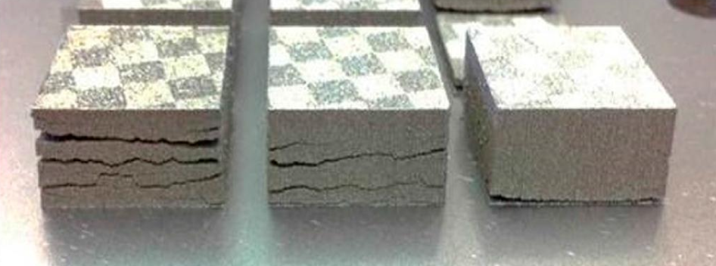
Common AM Defects: Visual Signatures
Porosity: Spherical/irregular voids (μm to 100s μm) appearing as dark circular/irregular voids
Lack of Fusion: Incomplete bonding between tracks/layers showing irregular bonding patterns
Surface Roughness: Striated patterns/textured appearances visible as textured/striated patterns
Layer Shifting & Delamination: Spatial discontinuities and separation between layers
Thermal Distortion: Warping or curvature due to residual stresses
Fig. 2: (a): Porosity - dark circular voids, (b): Lack of fusion - irregular patterns, (c): Surface roughness - striated texture

Slide 8
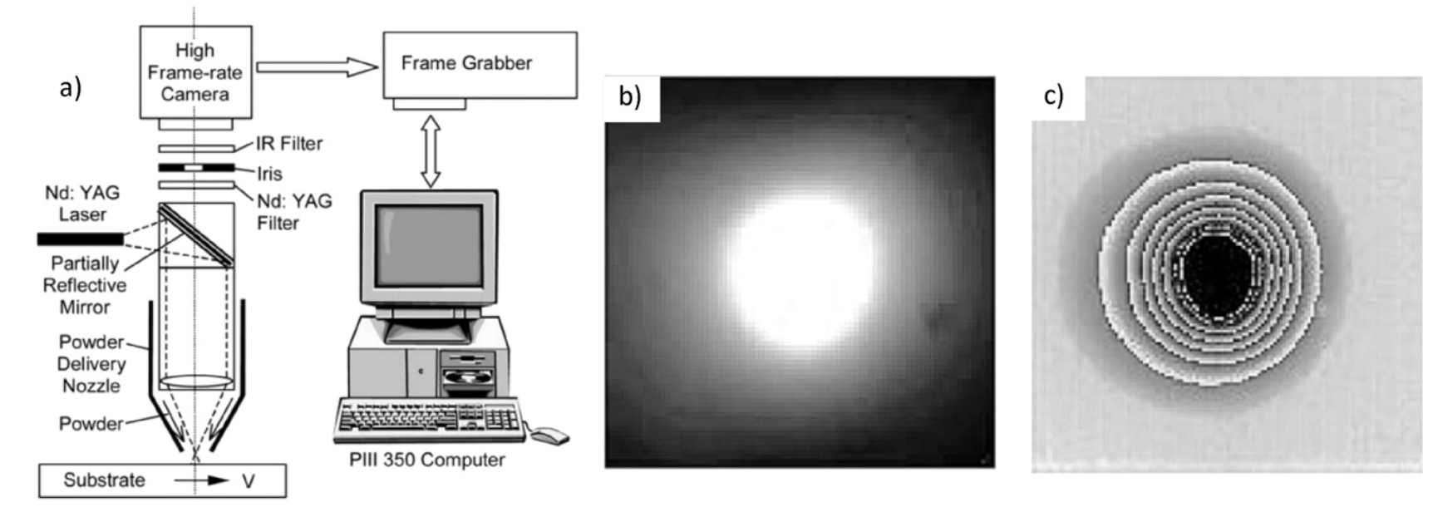
Camera-Based Monitoring in AM
In-Situ Process Monitoring
In-situ process monitoring has become central to AM research as manufacturers transition from reactive post-process inspection toward proactive real-time quality control [7].
Camera-based systems are widely adopted due to their non-contact nature, relatively low cost, and ability to capture high-resolution spatial and temporal information [7].
Key Advantages
Observation of surface morphology, layer uniformity, and melt pool behaviour [14]
Early process instability identification enabling real-time corrective actions [8]
Key Challenges
Lighting variation, metallic surface reflections, motion blur, sensor noise, environmental factors [7]
Requires automated analysis to extract quality indicators [6]
Fig. 3: (a): Porosity - dark circular voids, (b): Lack of fusion - irregular patterns, (c): Surface roughness - striated texture

Slide 9
Camera-Based Monitoring Modalities
Modality | Capabilities | Relative Cost | Limitations
2D RGB Camera | Surface geometry, layer completeness | Low | Lighting sensitivity, no depth
Thermal/IR Imaging | Temperature distribution, melt pool dynamics | Medium–High | Calibration, emissivity sensitivity
Coaxial Imaging | Direct melt pool observation | Variable | Limited field of view
3D Imaging | Geometric reconstruction, depth information | High | Higher computation, lower temporal resolution

Slide 10
AI Foundations Relevant to Classification
Evolution of AI-Based Defect Detection
AI has transformed defect detection from manual inspection toward intelligent automated systems [12]. Early approaches relied on traditional machine learning with handcrafted features (texture descriptors, intensity histograms), struggling to generalize across varying defect morphologies [6].
Deep learning methods learn hierarchical feature representations directly from raw images through end-to-end optimization, thereby eliminating the need for manual feature engineering [6].
Convolutional Neural Networks (CNNs)
CNNs are most widely used for image-based defect classification due to strong feature extraction via spatially invariant filters [1]. Popular variants include ResNet, VGG, and MobileNet [15].
Key Challenges
Limited dataset sizes (deep learning requires hundreds to thousands of examples), class imbalance causing poor detection of rare critical defects, and domain shift degrading performance across machines/materials [1,7].

Slide 11
Traditional Image Processing Approaches
Methodology & Pipeline
Earliest approaches relied on handcrafted features and deterministic rules [12], following sequential pipelines: acquisition → preprocessing → feature extraction → threshold-based classification [14].
Preprocessing includes grayscale conversion, noise reduction, and contrast enhancement to stabilize image quality [5]. Feature extraction focuses on edges, contours, texture statistics, and geometric properties [7].
Common techniques include binary thresholding, morphological operations, and edge detection algorithms such as Sobel and Canny [7].
Performance Characteristics
✓ Computationally efficient (>100 fps on CPUs)
✓ Transparent and interpretable decision-making
✗ Limited accuracy (65-75%) and robustness
✗ Sensitive to illumination changes and environmental factors
✗ Frequent manual recalibration limits scalability [7]

Slide 12
Classical Machine Learning Methods
Method | Performance Trend | Characteristics
Support Vector Machines (RBF kernel) | Moderate accuracy (80-87%) | Multi-class defect categorization in powder bed fusion
Random Forest | Moderate to high accuracy | Interpretable feature importance rankings
Gradient Boosting Machines | Effective for non-linear relationships | Sensitive to feature engineering and dataset size
k-Nearest Neighbor | Dependent on feature scaling | Computationally inefficient for large datasets

Slide 13
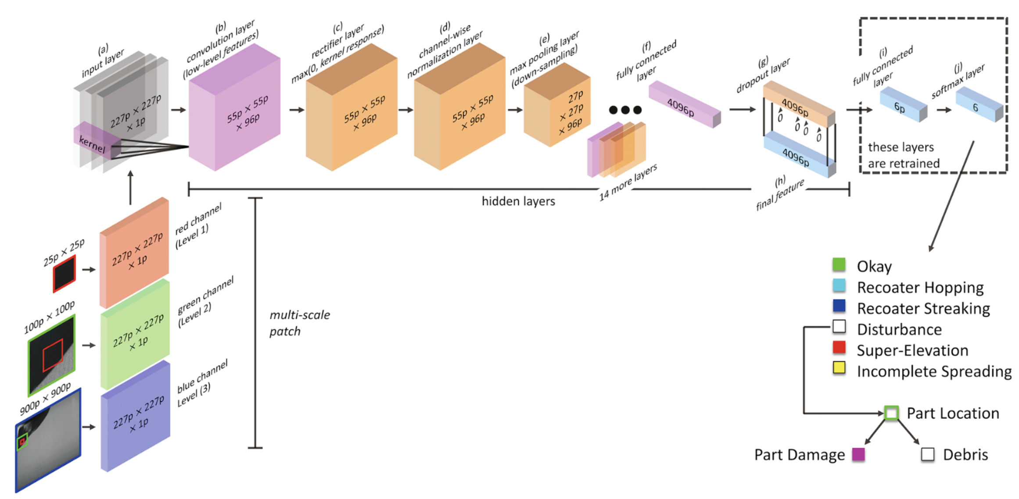
Deep Learning Approaches
Convolutional Neural Networks
Deep learning dominates image-based defect detection due to automatic hierarchical feature learning from raw images through end-to-end training via backpropagation [6] and eliminates manual feature engineering.
Popular architectures include:
ResNet: Residual connections enabling 50+ layer networks
VGG: Sequential convolutional blocks
MobileNet: Optimized for resource-constrained hardware [15]
YOLO Object Detection
YOLOv5 and YOLOv8 demonstrate >96–97% mean average precision at 11–15 fps on GPUs [2].
Single-stage regression: direct bounding box + class prediction
Semantic Segmentation
U-Net Segmentation: Pixel-level classification achieving 93–95% IoU [1]
Fig. 4: CNN architecture for AM defect detection showing hierarchical feature extraction from raw images. Adapted from [6]

Slide 14
Comparative Analysis of AI Methods
Approach | Typical Accuracy | Relative Speed | Key Limitations
Traditional Image Processing | Low–moderate accuracy | Very fast (>100 fps) | Illumination sensitivity, manual recalibration
Classical ML (SVM, RF) | Moderate accuracy | Moderate (20-50 fps) | Feature engineering, limited generalization
Deep Learning (CNN) | High accuracy | Moderate | Data requirements, interpretability challenges
Object Detection (YOLO) | High localization accuracy | Real-time capable (11-15 fps) | Computational cost, domain shift

Slide 15
Performance Evolution: Traditional → Deep Learning
Accuracy Improvements Across Methods
Deep learning achieves the highest accuracy (92–97%) and robustness, representing 10–15 percentage point improvements over classical ML and 20–30 points over traditional methods [2].
Key Performance Metrics:
• Traditional Image Processing: 65-75% accuracy, >100 fps
• Classical ML (SVM, RF): 80-87% accuracy, 20-50 fps
• Deep Learning (CNN): 92-97% accuracy, moderate speed
• YOLO Object Detection: >90% mAP@0.5, 11-15 fps real-time
Transfer Learning Impact
Transfer learning from ImageNet reduces data requirements by 10–50× and accelerates convergence, enabling strong performance with datasets containing hundreds rather than thousands of examples [3].

Slide 16
Case Studies and Performance Results
Study | Dataset Size | Imaging Modality | Method | Performance Metrics
Wang et al. [2] | >3,500 annotated instances | RGB | YOLOv8 | mAP@0.5 >90%, mAP >97% (4 defect categories), ~15 fps
Baumgartl et al. [9] | Not specified | Thermal IR (off-axis) | Deep learning classifier | Real-time defect ID with k-fold cross-validation
Jia et al. [3] | Hundreds of images | RGB | Transfer learning (ResNet, VGG) | Improved performance over training from scratch
Smoqi et al. [11] | Process-specific | Thermal/melt-pool images | Physics-informed ML + CNN | F1 >0.95 (physics features), 0.89–0.97 (CNN)
Yang et al. [10] | CFD simulation + experimental | Thermal imaging (>100 Hz) | Hybrid neural network | Performance exceeded either data source alone

Slide 17
Case Study: YOLOv8 for Real-Time Detection
Study Overview [2]
Wang et al. demonstrated an improved YOLOv8-based detector trained on >3,500 annotated instances across four defect categories, achieving >97% mAP at approximately 15 fps, demonstrating practical feasibility for continuous monitoring [2].
Key Innovations
• Real-time defect detection strategy based on deep learning and machine vision technologies
• Simultaneous localization and classification during build processes
• Provides defect category labels and spatial coordinates
Performance Metrics
• mAP@0.5: >90% (mean Average Precision at 0.5 IoU threshold)
• Overall mAP: >97% across four defect categories
• Processing speed: ~15 frames per second on GPU hardware

Slide 18
Strengths and Weaknesses Analysis
Key Strengths of Deep Learning Methods [1,2,6]
• High classification accuracy (92-97%) when CNNs and object detection models are trained on well-curated datasets [2]
• Deep learning models applied to camera/thermographic data show strong performance identifying porosity, surface irregularities, and melt pool anomalies, often outperforming traditional techniques by 20–30 percentage points in accuracy [6]
• Automatic feature extraction from raw images without extensive manual engineering, particularly advantageous where defect patterns are complex and process-dependent [1]
• Multi-scale convolutional architectures capture both local defect features and global process variations [6]
• Real-time detection demonstrated in controlled settings [2]
Critical Weaknesses [3,5,7,10]
• Strong dependence on dataset size, quality, and representativeness. Insufficient training data or datasets not adequately sampling defect types lead to poor generalization [3]
• Limited transferability across machines, materials, and sensing setups (domain shift). Variations significantly alter defect appearance, degrading classification accuracy [7,10]
• Black-box nature with millions of learned parameters challenges debugging, regulatory validation, and industrial acceptance [5]

Slide 19
Challenges and Future Research Directions
Critical Challenges Limiting Industrial Implementation
1. Dataset Availability: Scarcity of large-scale, publicly available, well-annotated defect image datasets. Manual annotation is labour-intensive and requires expert knowledge for accurate ground-truth labels [1,12]
2. Domain Shift & Generalization: Variations in camera hardware, illumination, imaging geometry, material properties, and process parameters substantially alter visual defect appearance, causing trained models to exhibit degraded performance on different equipment/materials [7]
3. Real-Time Processing Requirements: Real-time in-situ monitoring requires inference speeds compatible with high-frequency image acquisition during AM processes. Deployment on resource-constrained embedded or edge platforms remains challenging [2]
4. Interpretability & Explainability: Current deep learning models operate largely as black boxes, making it difficult to understand which image features drive classifications, critical for safety-critical applications in aerospace and medical device manufacturing [5]
Future Research Priorities
• Standardized benchmark datasets and evaluation protocols [1]
• Domain adaptation methodologies and transfer learning strategies [3,7]
• Physics-informed neural networks for improved interpretability [11]
• Integration with closed-loop process control architectures [2]

Slide 20
Future Research Priorities: Timeline
Short-term Priorities (1–2 years)
• Establishing standardized benchmark datasets and evaluation protocols enabling systematic method comparison across diverse AM processes, materials, and defect types [1]
• Developing publicly accessible datasets with comprehensive annotations covering multiple imaging modalities and process conditions [3]
• Lightweight model architectures optimized for edge deployment [2]
Medium-term Directions (2–5 years)
• Integrating AI-based detection with closed-loop process control architectures, enabling automated corrective actions [2]
• Self-supervised learning approaches leveraging large volumes of unlabelled image data generated during normal manufacturing operations
• Multi-modal sensor fusion strategies combining visual imaging with thermal, acoustic, or complementary sensing modalities [9]
Long-term Priorities (>5 years)
• Physics-informed neural network architectures integrating fundamental understanding of heat transfer, fluid dynamics, and solidification phenomena [11]
• Fully autonomous quality assurance frameworks integrating defect detection with predictive process modelling and adaptive control

Slide 21
Conclusion
Key Findings from Systematic Review
Deep learning approaches, particularly convolutional neural networks (CNNs) and YOLO-based object detection models, consistently outperform traditional and classical methods in defect classification and localization tasks under controlled experimental conditions [1,2].
Real-time object detection frameworks, particularly YOLO-based architectures, emerged as the most promising for industrial deployment. Single-stage detectors achieve >90% mAP while maintaining inference speeds compatible with in-situ monitoring [2].
Transfer learning strategies significantly reduce labelled data requirements, allowing strong performance even with domain-specific datasets limited to hundreds of annotated examples, reducing data collection burdens by factors of 10–50 [3].
Remaining Challenges for Industrial Deployment
Despite significant progress, challenges including limited availability of annotated datasets, domain shift across machines and materials, limited interpretability, and integration complexity continue to constrain industrial deployment.
This review identifies key research gaps and outlines directions for advancing AI-driven defect detection to improve quality assurance and support wider industrial adoption of additive manufacturing.

Slide 22
References
Deshpande, S., Venugopal, V., Kumar, M., Anand, S.: Deep learning-based image segmentation for defect detection in additive manufacturing: an overview. International Journal of Advanced Manufacturing Technology 134, 2081–2105 (2024). https://doi.org/10.1007/s00170-024-14191-6
Wang, W., Wang, P., Zhang, H., Chen, X., Wang, G., Lu, Y., Chen, M., Liu, H., Li, J.: A Real-Time Defect Detection Strategy for Additive Manufacturing Processes Based on Deep Learning and Machine Vision Technologies. Micromachines 15(1), 28 (2024). https://doi.org/10.3390/mi15010028
Jia, X., Li, S., Wang, T., Liu, B., Cui, C., Li, W., Wang, G.: High-Performance Defect Detection Methods for Real-Time Monitoring of Ceramic Additive Manufacturing Process Based on Small-Scale Datasets. Processes 12(4), 633 (2024). https://doi.org/10.3390/pr12040633
Frazier, W.E.: Metal Additive Manufacturing: A Review. Journal of Materials Engineering and Performance 23, 1917–1928 (2014). https://doi.org/10.1007/s11665-014-0958-z
Grasso, M., Colosimo, B.M.: Process defects and in situ monitoring methods in metal powder bed fusion: a review. Measurement Science and Technology 28(4),044005 (2017). https://doi.org/10.1088/1361-6501/aa5c4f
Scime, L., Beuth, J.: A multi-scale convolutional neural network for autonomous anomaly detection and classification in a laser powder bed fusion additive manufacturing process. Additive Manufacturing 24, 273–286 (2018). https://doi.org/10.1016/j.addma.2018.09.034
Everton, S.K., Hirsch, M., Stavroulakis, P., Leach, R.K., Clare, A.T.: Review of in-situ process monitoring and in-situ metrology for metal additive manufacturing.Materials&Design95,431–445(2016). https://doi.org/10.1016/j.matdes.2016.01.099
Holzmond, O., Li, X.: In situ real time defect detection of 3D printed parts. Additive Manufacturing 17, 135–142 (2017). https://doi.org/10.1016/j.addma.2017.08.003
Baumgartl, H., Tomas, J., Buettner, R., Merkel, M.: A deep learning-based model for defect detection in laser-powder bed fusion using in-situ thermographic monitoring. Progress in Additive Manufacturing 5(3), 277–285 (2020). https://doi.org/10.1007/s40964-019-00108-3
Yang, W., Qiu, Y., Liu, W., Qiu, X., Bai, Q.: Defect prediction in laser powder bed fusion with the combination of simulated melt pool images and thermal images. Journal of Manufacturing Processes 106, 214–222 (2023). https://doi.org/10.1016/j.jmapro.2023.10.006
Smoqi, Z., Gaikwad, A., Bevans, B., Kobir, M.H., Craig, J., Abul-Haj, A., Peralta, A., Rao, P.: Monitoring and prediction of porosity in laser powder bed fusion using physics-informed meltpool signatures and machine learning. Journal of Materials Processing Technology 304, 117550 (2022). https://doi.org/10.1016/j.jmatprotec.2022.117550
Razvi, S.S., Feng, S., Narayanan, A., Lee, Y.-T.T., Witherell, P.: A Review of Machine Learning Applications in Additive Manufacturing. Proceedings of the ASME 2019 International Design Engineering Technical Conferences and Computers and Information in Engineering Conference, DETC2019-98415. ASME, Anaheim, CA (2019). https://doi.org/10.1115/DETC2019-98415
Redmon, J., Divvala, S., Girshick, R., Farhadi, A.: You Only Look Once: Unified, Real-Time Object Detection. 2016 IEEE Conference on Computer Vision and Pattern Recognition (CVPR), pp. 779–788. IEEE, Las Vegas, NV (2016). https://doi.org/10.1109/CVPR.2016.91
Gobert, C., Reutzel, E.W., Petrich, J., Nassar, A.R., Phoha, S.: Application of supervised machine learning for defect detection during metallic powder bed fusion additive manufacturing using high resolution imaging. Additive Manufacturing 21, 517528 (2018). https://doi.org/10.1016/j.addma.2018.04.005
Jin, Z., Zhang, Z., Demir, K., Gu, G.X.: Machine Learning for Advanced Additive Manufacturing. Matter 3(5), 1541–1556 (2020). https://doi.org/10.1016/j.matt.2020.08.023
Aminzadeh, M., Kurfess, T.R.: Online quality inspection using Bayesian classification in powder-bed additive manufacturing from high-resolution visual camera images. Journal of Intelligent Manufacturing 30, 2505–2523 (2019). https://doi.org/10.1007/s10845-018-1412-0

Slide 23
Thank You!
Questions and Discussion

