Slide 1


CAPSTONE PROJECT Customer churn data analysis Using Tableau
Name :- Settibathula Ramya
Mentor :- Jaya Pandey

Slide 2
Project Introduction
The Customer churn project about examining and understanding customer behavior to identify patterns and factors that contribute to customer attrition or churn.
By analyzing customer churn, businesses can gain valuable insights into the reasons why customers leave, which helps them take proactive measures to retain customers and improve customer loyalty.
The credit card division of the bank is experiencing poor performance. What are the underlying factors contributing to this outcome that we can cover through this project.
This analysis will help the bank evaluate the customers who have stopped purchasing the credit card of the bank and figure out measures to reduce the bank’s customer loss rate.
For this analysis I am using both Tableau and python. Tableau for data visualization and python for data pre-processing.
Analyze the data to understand patterns, correlations, and trends related to churn. Visualizations and statistical techniques can help uncover insights about customer behavior and identify potential drivers of churn.

Slide 3
Description of the Dataset
Customer Churn data set is related to bank customers. There are two types of customers existing and attrited customers.
Existing customers refers who currently hold credit cards issued by the bank and maintaining the relationship with the bank.
Attrited or Churn refers to the rate at which customers stop doing business with a company or cancel their subscriptions or services.
The customer churn data set contains 10127 records and 20 columns
In my analysis I am using most of the important columns in the data set
The attrition flag column is very important for my analysis and every columns analyzed based on this attrition flag column.
Analyze the data to understand patterns, and trends related to churn. Visualizations and statistical techniques can help uncover insights about customer behavior and identify potential drivers of churn. It will helpful to bank to reduce the customers loss rate.

Slide 4
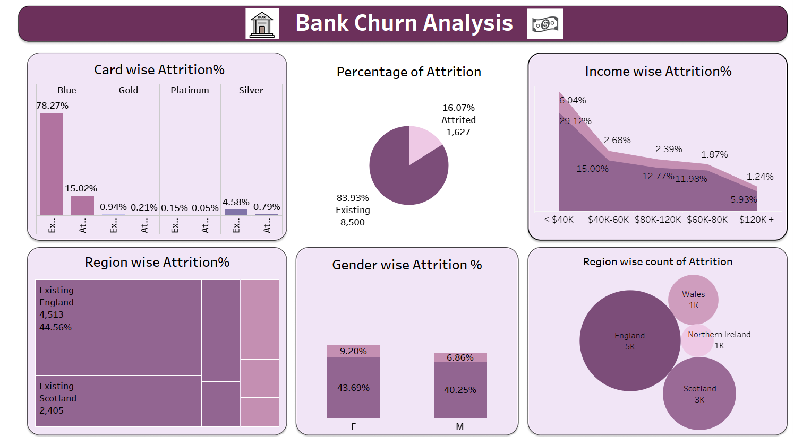
Task 1 :- Display the percentage of the attrited and the existing customers from the data.
Interpretation :- 1) The data displays the percentage of customers, with the attrited and existing groups represented by green color box.
2) The existing customer group outweighs the churned customers, with a higher proportion of 67% compared to the attrited customers.

Slide 5
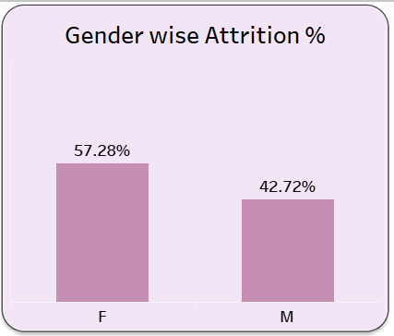
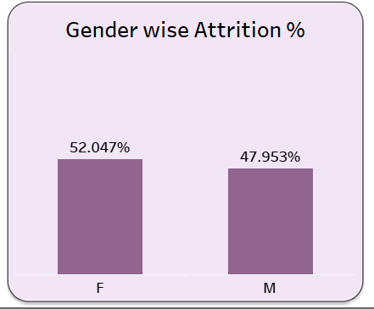
Task 2 :- Display gender-wise percentage of the attrited and the existing customers from the data.
Interpretation:- Female attrited and existing customers are high in both categories of attrition. Above 50% are available in both attrition categories.

Slide 6
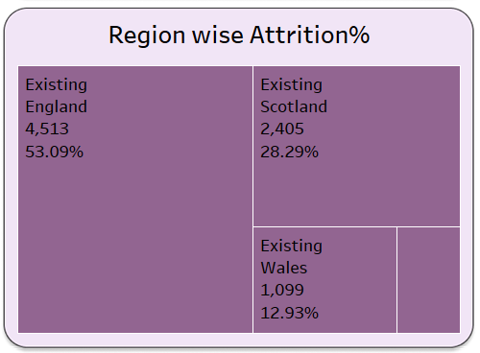
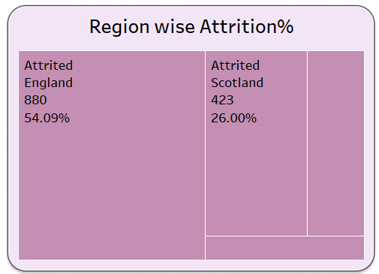
Task 3 :- Display region – wise percentage of the attrited and the existing customers from the data.
Interpretation:- England have highest customers compare to Scottland, Wales and Northern Ireland. There are 44% existing customers and 8% attrited customers.

Slide 7
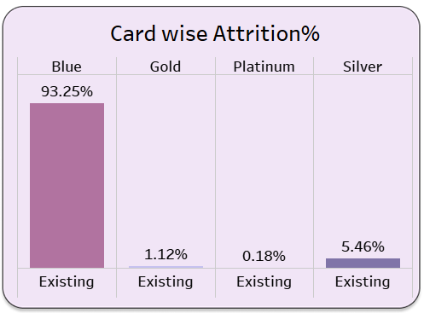
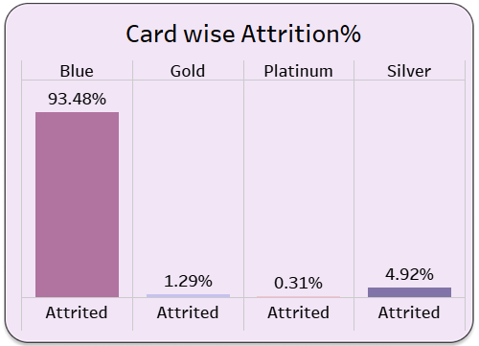
Task 4 :- Display the percentage of the attrited and the existing customers for each card category.
Interpretation:-Blue card customers are very high with 78%. We can see separately compare then existing with 93.25% and Attrited 93.48% customers who have blue card.

Slide 8
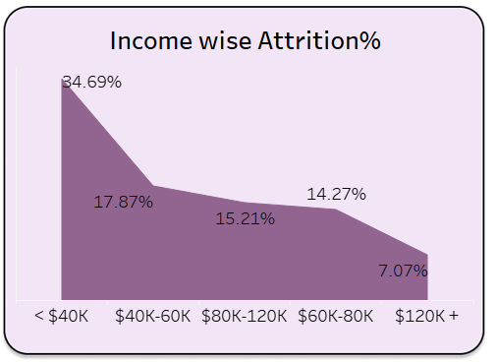
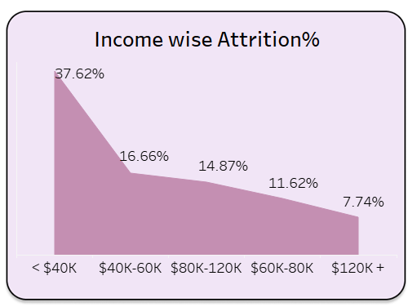
Task 5 :- Display the percentage of the attrited and the existing customers for each income category.
Interpretation:- < $40K dollars income category is more than other income categories in this category existing are 29% and attrited are 6%.

Slide 9
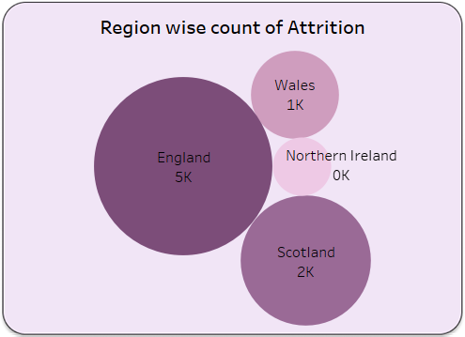
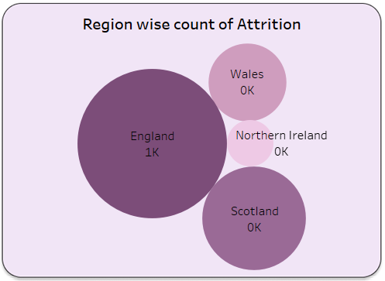
Task 6 :- Display region-wise count of customers. Identify the region that has the maximum number of customers.
Interpretation:- England have highest customers compare to Scottland, Wales and Northern Ireland. There are

Slide 10
Conclusion
If the bank manages to reduce the churned customer rate by 16%, it will subsequently decrease the rate at which customers are lost.
There is a higher proportion of female customers in both the attrited and existing customer segments, the bank should prioritize targeting females for loan offerings with reduced interest rates. By doing so, the bank can maintain stronger relationships with female customers, thereby increasing the likelihood of maintaining their loyalty for a longer duration.
Considering that the attrited and existing customers are evenly distributed across regions, the bank will place a particular emphasis on England and Scotland. These two regions boast the highest customer count, making them a priority for the bank's focus and attention.
Since a significant portion of customers prefer blue credit cards, increasing the production of blue cards would be advantageous for the bank to new customers.
The bank observes a substantial number of customers falling within the income category of less than $40K, surpassing the count of customers in other income categories. These customers with incomes below $40K focusing then more advantageous to the bank.

Slide 11
Conclusion
Some suggestions to bank management to decreases the churn customers.
Enhance customer experience: Focus on providing exceptional customer services, personalized interactions, this can create a positive experience for customers. This can increase their satisfaction and loyalty to the bank.
Improve communication: Regularly contact with customers through emails, newsletters, and social media. Informed about new offers, updates, and improvements to the bank's commitment to their needs.
Offer incentives and rewards: Implement referral bonuses, or exclusive benefits for long-standing customers. Encourage them to stay with the bank by providing incentives for their continued support.
Conduct customer surveys: Obtain feedback from churned customers to understand the reasons behind their departure. Use this information to identify areas for improvement and address any pin points or issues that led to their departure.

Slide 12

Thank you

