Slide 1




CAPSTONE PROJECT
Movie Rental Data Analysis – SQL
Name :- Settibathula Ramya
Mentor :- Jaya Pandey

Slide 2
Project Agenda
Sakila Database represents a DVD rental store.
The main Objective of this Project is Analyze the data of movie rental store for further growth and improved business.
Calculating the total number of rentals, average rental duration, most popular films, or the distribution of rentals by customer demographics.
Also, finding the most popular genres, top-rated films, or films with the highest rental revenues. This analysis can guide decisions on inventory management, content acquisition, and marketing campaigns.
Customers based on factors like rental history, rental frequency, and rental duration. Identify patterns and trends that can help optimize marketing strategies and tailor offerings to specific customer segments.
Using functions and operations for data manipulation, aggregation, filtering, and joining, subqueries enabling you to extract meaningful insights from the Sakila database and make data-driven decisions for the movie rental store's growth and improvement.

Slide 3
Data Description
Sakila Database represents a DVD rental store.
This Database contains 18 tables. All are connected to each other with help of the constraints.
This data mainly categorized into 3 parts. That are Customer Data, Customer Related Data and Inventory Data. Views also available in this database.
The important tables for analysis are Customer, Film, Category, Actor, Inventory, Rental, Payment.
Film, Customer and Staff Tables are highly connected with other tables directly.
Using all these aspects will analyze on this sakila database and extract meaningful insights to improve growth of the movie rental store.

Slide 4
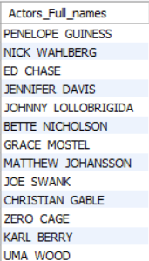
TASK 1:- The Management wants to know the full names of all the actors in the database. Display the full names of the actors available in the database.
Techniques :-
OUTPUT :-
SELECT
CONCAT
AS
FROM
EXPLAINATION :- Observing from output There are 200 actors are available in the database. . Many actors are changing their names and adopted attractive names because they get unique identification from audience. Here we see some of attractive full names of actors. I displayed sample output.
Notes:
Here using SELECT command and CONCAT method for retrieving the full names of the actors and using one table that is ACTOR.

Slide 5
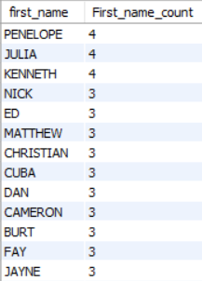
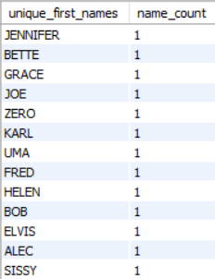
TASK 2i :- Display the number of times each first name appears in the database.
2ii :- What is the count of actors that have unique first names in the database?
Display the first names of all these actors
Techniques :-
OUTPUT :-
2i) 2ii)
SELECT
COUNT
AS
FROM
ORDER BY
GROUP BY
DESC
SELECT
COUNT
AS
FROM
GROUP BY
HAVING
EXPLAINATION :-i) Penelope,Julia,Kenneth are the most first name repeated actors. They adopted these names as screen names to attract audience and get fame.
ii) There are 76 unique first name of actors available in the database.
Notes:
2i) Using SELECT command, COUNT method and GROUP BY, ORDER BY Clauses for retrieving repeated first names and its count from ACTOR table.
2ii) Here same methods are using like above query but using HAVING clause for condition to retrieving the unique first names.

Slide 6
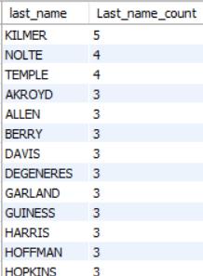
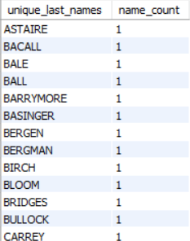
TASK 3i :- Display the number of times each last name appears in the database.
TASK 3ii :- Display all unique last names in the database.
Techniques :-
OUTPUT :-
3i) 3ii)
SELECT
COUNT
AS
FROM
ORDER BY
GROUP BY
DESC
SELECT
COUNT
AS
FROM
GROUP BY
HAVING
EXPLAINATION :- i) KILMER is the most popular last name of the actors. Mostly at the Behest of directors and producers gave last names of actors for Unique recognition.
ii) There are 66 unique last name of actors available in the database.
Notes:
3i) Using SELECT command, COUNT method and GROUP BY, ORDER BY Clauses for retrieving repeated first names and its count from ACTOR table.
3ii) Here same methods are using like above query but using HAVING clause for condition to retrieving the unique last names.

Slide 7
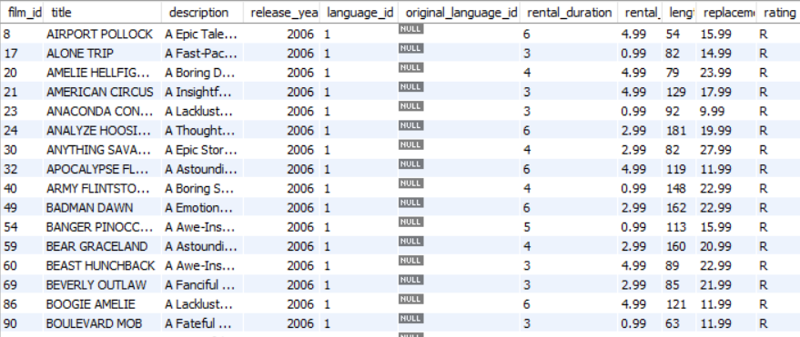
TASK 4i :- Display the list of records for the movies with the rating 'R'.
Techniques :-
OUTPUT :-
SELECT
FROM
WHERE
EXPLAINATION :- R rating movies are 195 available in this database. R rating means Restricted - Restricted to viewers over the age of 17, unless accompanied by a parent or guardian.
Notes:
Using SELECT command ,WHERE clause from the FILM table for retrieving the R rating movies. Here Using * symbol for retrieving all columns in the table.

Slide 8
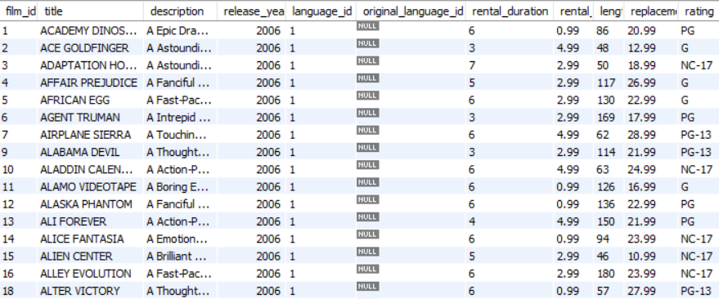
TASK 4ii :- Display the list of Records for the movies that are not rated 'R'
Techniques :-
OUTPUT :-
SELECT
FROM
WHERE
EXPLAINATION :- 805 movies are not rated to R. That means 805 movies are rated different ratings like PG-13, PG, G,NC-17
Notes:
Using SELECT command ,WHERE clause from the FILM table for retrieving without R rating movies. Here Using * symbol for retrieving all columns in the table.

Slide 9
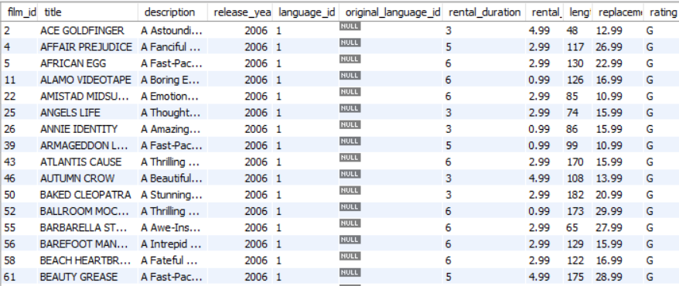
TASK 4iii :- Display the list of records for the movies that are suitable for audience below 13 years of age.
Techniques :-
OUTPUT :-
SELECT
FROM
WHERE
EXPLAINATION :- Here I retrieve G rating movies only. G means General Audience - Suitable for all ages. PG means Parental Guidance - Some material may not be suitable for children. PG-13 means Parents Strongly Cautioned - Some material may be inappropriate for children under 13. R means Restricted - Restricted to viewers over the age of 17, unless accompanied by a parent or guardian. NC-17 means No One 17 and Under Admitted - Restricted to viewers over the age of 17 only. “G Rating is only one suitable for children.”
Notes:
Using SELECT command ,WHERE clause from the FILM table for retrieving G rating movies. Here Using * symbol for retrieving all columns in the table.

Slide 10
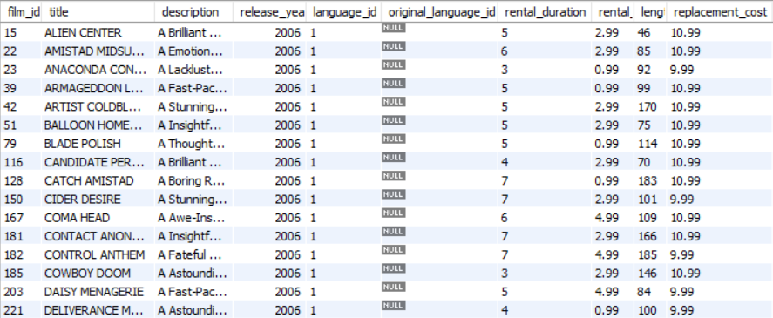
TASK 5i :- Display the list of records for the movies where the replacement cost is up to $11.
Techniques :-
OUTPUT :-
SELECT
FROM
WHERE
EXPLAINATION :- Only 90 records are available where the replacement cost is up to 11 because replacement cost is less then that movies not getting profit. Replacement Cost means we have replaced the existing cost of that movie related things and assign new cost at current market for gain.
Notes:
Using SELECT command, WHERE clause for condition Replacement cost up to 11 only. Here Using * symbol for retrieving all columns in FILM table

Slide 11
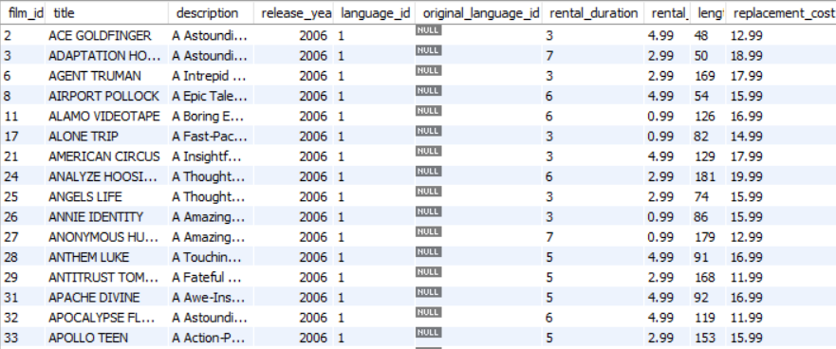
TASK 5ii :- Display the list of records for the movies where the replacement cost is between $11 and $20.
Techniques :-
OUTPUT :-
SELECT
FROM
ORDER BY
BETWEEN - AND
EXPLAINATION :- Getting lot of records(424) where the Replacement Cost between $11 and $20.In current market. The replacement cost is mostly lie between $11 to $20 that’s why we get many records under this condition. The management get Good profits under this replacement cost so major of the movies under replacement cost between $11-$20.
Notes:
Using SELECT command, WHERE clause for condition Replacement cost between 11 to 20. Here Using * symbol for retrieving all columns in FILM table

Slide 12
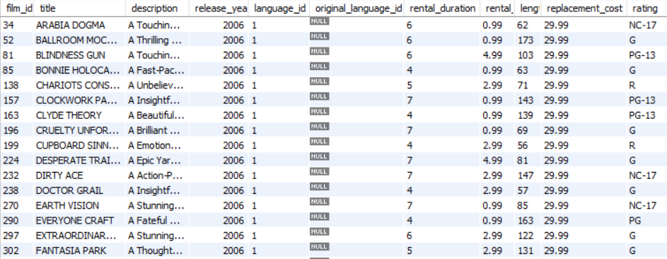
TASK 5iii :- Display the list of records for the all movies in descending order of their replacement costs.
Techniques :-
OUTPUT :-
SELECT
FROM
ORDER BY
DESC
EXPLAINATION :- Observing that output Replacement cost 29.99 is the highest replacement cost and in this cost all rating movies are available. 53 records are there with highest replacement cost. The lowest replacement cost is 9.99 there are 41 movies with lowest replacement cost.
Notes:
Using SELECT command, ORDER BY clause for sorting the records and DESC for descending order of Replacement cost. Here Using * symbol for retrieving all columns in FILM table

Slide 13
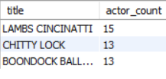
TASK 6 :- Display the names of the top 3 movies with the greatest number of actors.
Techniques :-
OUTPUT :-
SELECT
COUNT
AS
FROM
JOIN
ON
GROUP BY
ORDER BY
DESC
LIMIT
Notes:
Using SELECT command for retrieving, COUNT for counting the records, JOIN for joining tables based on common column GROUP BY, ORDER BY clauses and LIMIT for limiting the records.

Slide 14
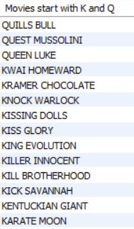
TASK 7 :- 'Music of Queen' and 'Kris Kristofferson' have seen an unlikely resurgence. As an unintended consequence, films starting with the letters 'K' and 'Q' have also soared in popularity. Display the movies starting with the letters 'K' and 'Q'
Techniques :-
OUTPUT :-
SELECT
AS
FROM
WHERE
LIKE
OR
ORDER BY
EXPLAINATION :- I represented here the movie names start with the letter “K” and “Q”. Movies starting with ‘k’ = 12, ‘Q’ = 3. These are more Popular movies because of two musicians are ‘Music of Queen and Kris Kristofferson’ with the unintended consequence these are Soaring popularity . So the management find another movie names starting with K and Q . They believe or luckily it will also give success and make popular movies.
Notes:
Using SELECT command for retrieving, WHERE clause for condition, LIKE operator for pattern matching, OR operator for getting any one of the condition and ORDER BY for sorting the movie titles.

Slide 15
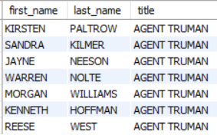
TASK 8 :- The film 'Agent Truman' has been a great success. Display the names of all actors who appeared in this film
Techniques :-
OUTPUT :-
SELECT
FROM
JOIN
ON
WHERE
EXPLAINATION :- ‘AGENT TRUMAN’ Movie got great success and that management wants to know all the actors in that movie and organize some success meet or else.7 actors are working in this ‘AGENT TRUMAN’ movie and got popularity. All are acting well in that movie.
Notes:
SELECT command for retrieving the records, JOIN method for joining the tables based on some common criteria and WHERE clause for condition.Tables used in this query is film, actor, film_actor.

Slide 16
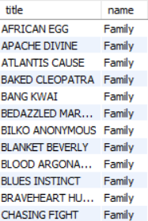
TASK 9 :- Sales have been lagging among young families, so the management wants to promote family movies. Identify all the movies categorized as family films.
Techniques :-
OUTPUT :-
SELECT
FROM
JOIN
ON
WHERE Sub Query
SELECT
FROM
WHERE
IN
EXPLAINATION :- There are 69 movies are related to FAMILY category movies. These family category movies sales are down so they want to promote these 69 movies in other category movies.
Notes:
SELECT command for retrieving the records, JOIN method for joining the tables based on some common criteria and WHERE clause for condition.
Tables used in this query film, film_category and category.

Slide 17
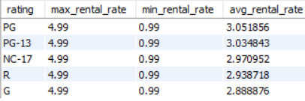
TASK 10i :- Display the maximum, minimum and average rental rates of movies based on their ratings. The output must be sorted in descending order of the average rental rates.
Techniques :-
OUTPUT :-
SELECT
MAX()
AS
MIN()
AVG()
FROM
GROUP BY
ORDER BY
DESC
EXPLAINATION :- Observing the in every Rating category maximum rental rate is same that is 4.99 and also minimum rental rate is same that is 0.99 and with slight changes in average of rental rate of rating categories.
Notes:
SELECT command, MAX(), MIN(), AVG() functions are using for finding maximum, minimum and average values of rental rate GROUP BY, ORDER BY clauses also used. DESC for descending order on the film table

Slide 18
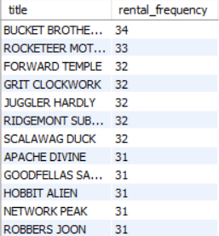

TASK 10ii :- Display the movies in descending order of their rental frequencies, so the management can maintain more copies of those movies
Techniques :-
OUTPUT :-
SELECT
COUNT
AS
FROM
JOIN
ON
ORDER BY
GROUP BY
DESC
EXPLAINATION :- The BUCKET BROTHERHOOD, ROCKETEER MOTHER have high rental frequency and its related to Travel and Foreign genre and their ratings are PG and PG-13 respectively.
Notes:
By using tables film, inventory and rental Using SELECT command for retrieving, COUNT for counting the records, JOIN for joining tables based on common column GROUP BY, ORDER BY clauses for grouping and sorting.

Slide 19
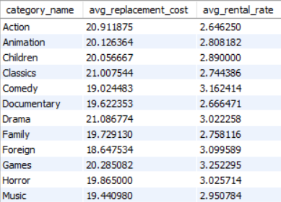
TASK 11 :- In how many film categories, the difference between the average film replacement cost and the average film rental rate is greater than $15?Display the list of film categories identified above, along with the corresponding average film replacement cost and average film rental rate.
Techniques :-
OUTPUT :-
SELECT
AS
AVG()
FROM
JOIN
ON
GROUP BY
HAVING
Notes:
Using film, film_category and category tables SELECT command for retrieving the data, AVG() method to calculate average of replacement cost and rental rate GROUP BY and HAVING clauses for grouping and condition respectively.

Slide 20

TASK 12 :- Display the film categories in which the number of movies is greater than 70.
Techniques :-
OUTPUT :-
SELECT
AS
COUNT
FROM
JOIN
ON
GROUP BY
HAVING
Notes:
Using SELECT command for retrieving, COUNT method for counting the movies, GROUP BY, HAVING clauses for condition and I use JOIN for joining the tables film and film category.

Slide 21
CONCLUSION
Most repeated first and last names of the actors are there. They are more popular in movies and people are easily identify and lovable actors so the management takes these repeated then audience more attract to that movies.(task 2,3)
G rating movies are lowest number of movies but these rating movies are appropriate for people of all ages if they make movies in different genres then the management get more profits.(from task 4iii)
The replacement cost is good between $11and $20 so here I suggest that replacement cost with these costs have more movies 424 movies are there so management maintain this range of replacement cost.(task5ii)
41 movies have lowest replacement cost so these movies should increase their replacement cost these 41 movies are related to different categories.(task 5iii)
53 movies have highest replacement cost and 341 movies lowest rental rate so the management to increase the rental rate to lowest ones then they will get more profit.(task5iii)

Slide 22
CONCLUSION
The movies starting with ‘k’ and ‘q’ are popular and the movies starting with ‘k’ are 12 and ‘q’ are 3. the management make more movies starting with ‘k’.(task 7)
There are 69 family category movies and I suggested here these family category movies are promote in children category movies because most of the children movies are watching whole family.(task9)
The average rental rate is lowest for G rating movies so management will increase the rental rate of G rating movies it will give profits.(task 10i)
BUCKET BROTHERHOOD, ROCKETEER MOTHER are most frequently Rented movies so I suggest to make more copies of it then it will useful of management and customers also.(task 10ii)
I performed that tasks and give information according to management requirements. I think my analysis will helpful to management.

Slide 23
Thank you

