Slide 1

CAPSTONE PROJECT tmdb movie data analysis Using python
Name :- Settibathula Ramya
Mentor :- Jaya Pandey

Slide 2
Project Introduction
The aim of this project is to conduct an in-depth analysis of the TMDB dataset, focusing on identifying the types of movies that exhibit strong performance at the box office and determining the specific genres to which they belong.
The project endeavors to assist the company in making predictions about a movie's potential commercial success and audience ratings, thereby providing valuable insights for decision-making.
By understanding the varying interests of movie lovers, filmmakers and storytellers can tailor their upcoming movies or develop captivating storylines that align with the preferences and interests of the target audience. This allows them to create content that is more likely to resonate with viewers and attract a loyal following.
Taking into account the diverse interests of movie enthusiasts, production companies can shape their future film projects or craft engaging narratives that cater to the specific preferences and tastes of the movie-going audience.
This analysis is valuable in understanding the reasons behind the potential failure of movies with a budget of $100 million despite significant investment.

Slide 3
Description of Dataset
The TMDB (The Movie Database) is that provides information and data related to movies, TV shows, and other forms of visual entertainment.
It serves as a valuable resource for movie enthusiasts, professionals in the film industry, and researchers interested in studying various aspects of the cinematic world.
The dataset contains 4803 records and 20 columns related to movies.
Important columns in this data set for my analysis are 1. Budget, 2. Title, 3. Revenue 4. Runtime, 5. Genres, 6. popularity.
I analyzed that
Understand movie popularity trends,
Explore genre preferences,
Investigate budget , runtime and revenue outlier analysis.
By conducting a thorough analysis of the TMDB dataset, we can gain a deeper understanding of the film industry, identify factors that contribute to movie success, and potentially make informed predictions about future movie trends.

Slide 4

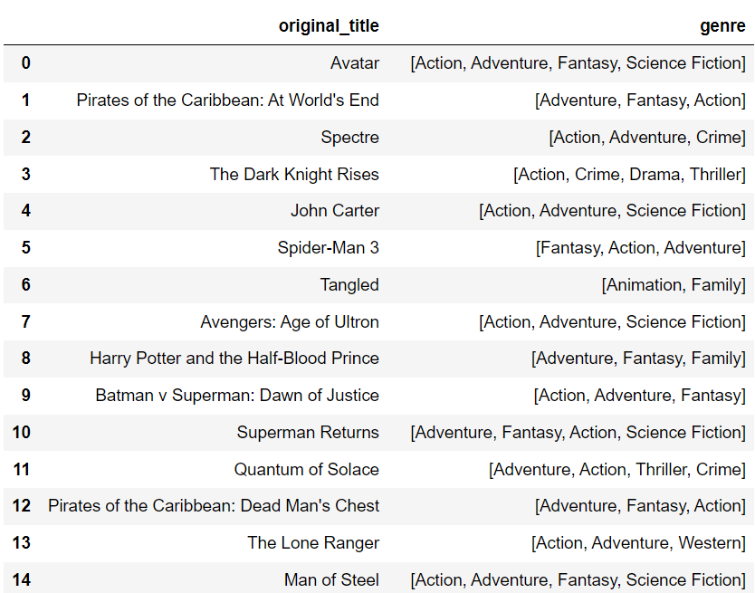
Task- 1 :- Load the data set and Display the number of rows and columns and Display first 50 title and genres in the dataset
Techniques :-
Output :-
Importing pandas library, Json module
Len()
Apply()
Lambda()
For loop
Head()

Slide 5
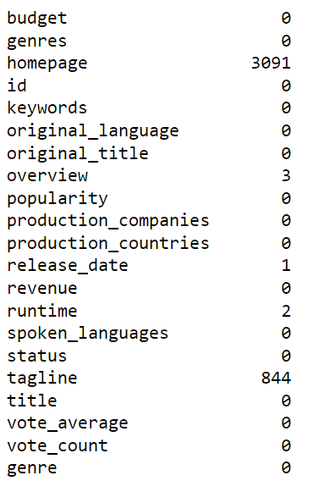
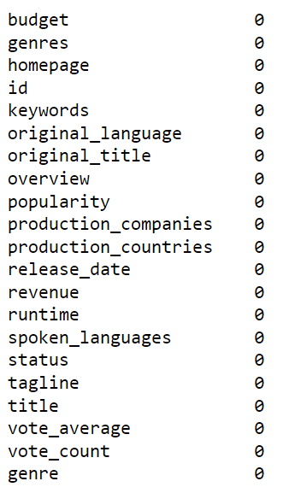
Task- 2 :- Identify the columns that have null values and perform the null value treatment(Choose the imputation method based on the type of data in the columns of interest)
Techniques :-
Output :-
Info( )
Fillna( )
Dropna( )
Import tabulate, statistics library
Mean( )
Median ( )
Mode( )
Isnull( )
Sum( )

Slide 6
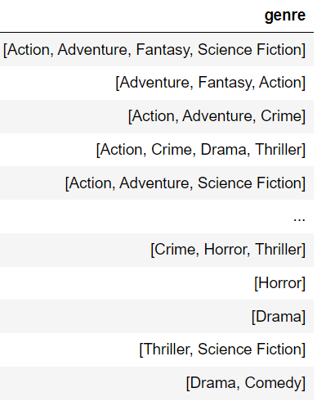
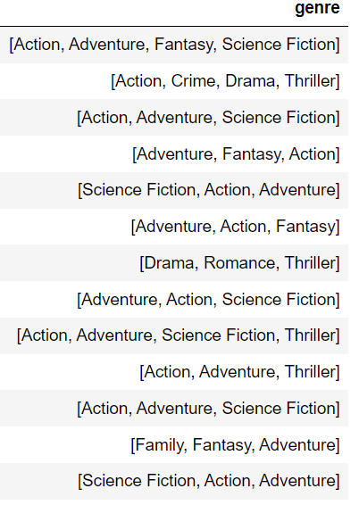
Task- 3 :- Display the movie categories that have budget greater than $220,000
Task 4:- Display the movie categories where the revenue is greater that $961,000,000
Techniques :-
Output :-
Filtering the data
Explaination : -
Budget greater than 220000, getting 3682 records.
Revenue greater than 961000000, getting only 24 records.
Budget > 220,000
Revenue > 961000,000

Slide 7
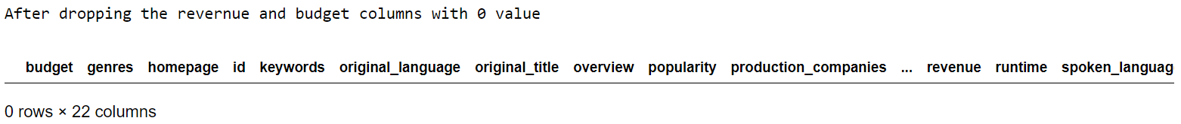
Task- 5 :- In the dataset, there are some movies for which the budget and revenue columns have the value 0, which mean unknown values, Remove the rows with value = 0 from both the budget and revenue columns
Output :-
Techniques :-
Filtering budget and revenue with 0 value, getting 1571 records.
Using Drop( )
Again filtered for checking.

Slide 8
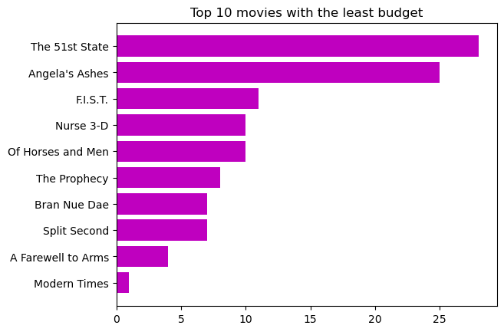
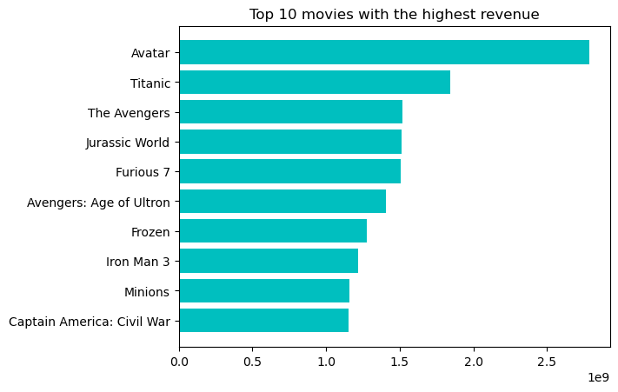
Task- 6 :- List the top 10 movies with the highest revenues and the top 10 movies with the least budget.
Techniques :-
Output :-
Sort_values( )
Head( )
Barh( )
Title( )
Show( )
Import
Matplotlib.pyplot

Slide 9
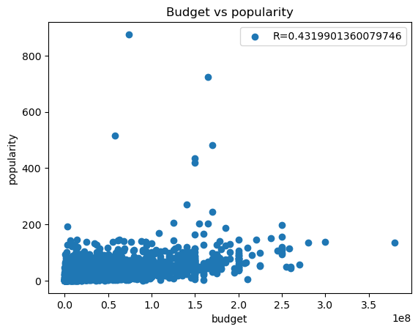
Task- 7 :- How are popularities of movies related with the movie budgets? Are they correlated or totally uncorrelated with each other? Write the interpretation of your analysis.
Techniques :-
Output :-
Corr( )
Scatter( )
Title( )
Legend( )
Show( )
Import Matplotlib.pyplot
Interpretation :-
Budget and Popularity is slightly positively correlated to each other. Its correlation co-efficient is 0.43
Sometime popularity is depends on budget.

Slide 10
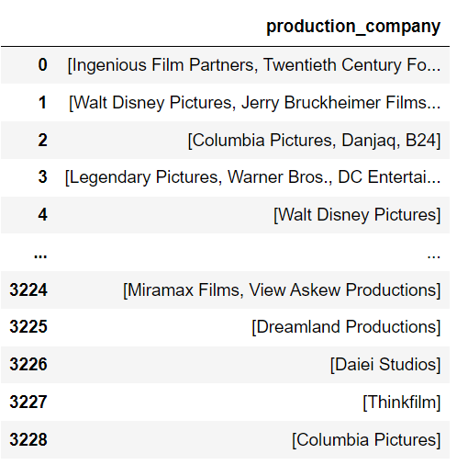
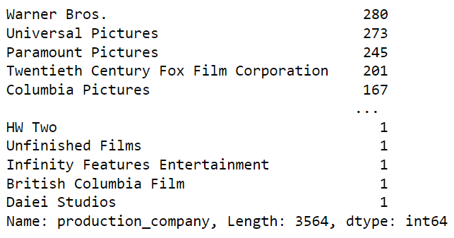
Task- 8 :- Identify and display the names of all production companies along with the number of times they appear in the dataset
Techniques :-
Output :-
Apply()
Lambda()
For loop
Explode()
Lambda()
Value_counts()

Slide 11
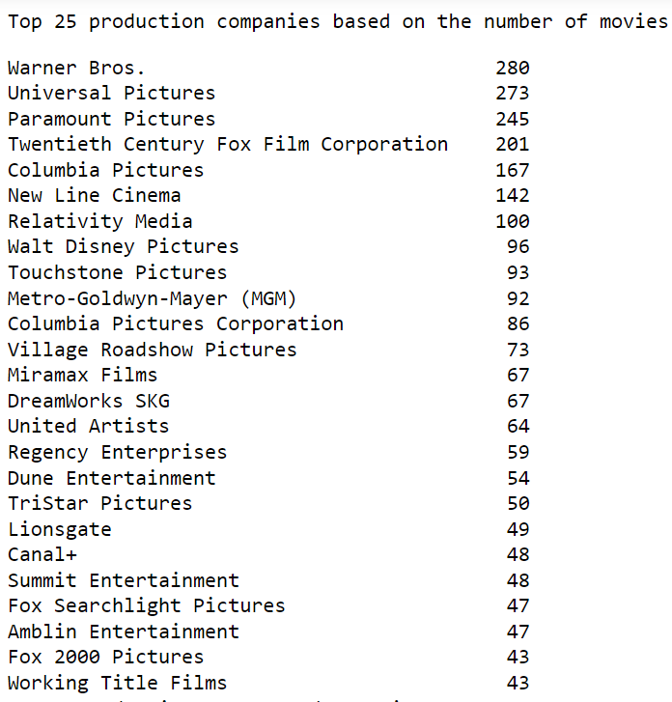
Task- 9 :- Display the names of the top 25 production companies based on the number of movies they have produced in descending order of the number of movies produced.
Techniques :-
Output :-
Head( )
Or
Nlargest( )

Slide 12
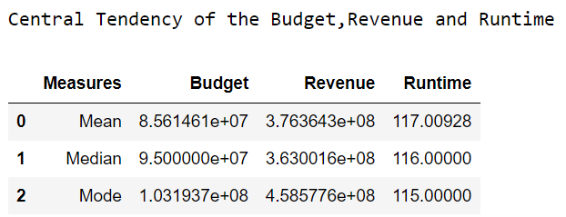
Task- 10 :- Sort the data in descending order based on revenue and filter the top 500 movies. Find the measures of central tendency for the following columns using the filtered data:
1. Budget,2. Revenue, 3. Runtime.
Techniques :-
Output :-
Import tabulate, statistics library
Insert( )
Mean( )
Median ( )
Mode( )
Sort_values( )
Head( )

Slide 13
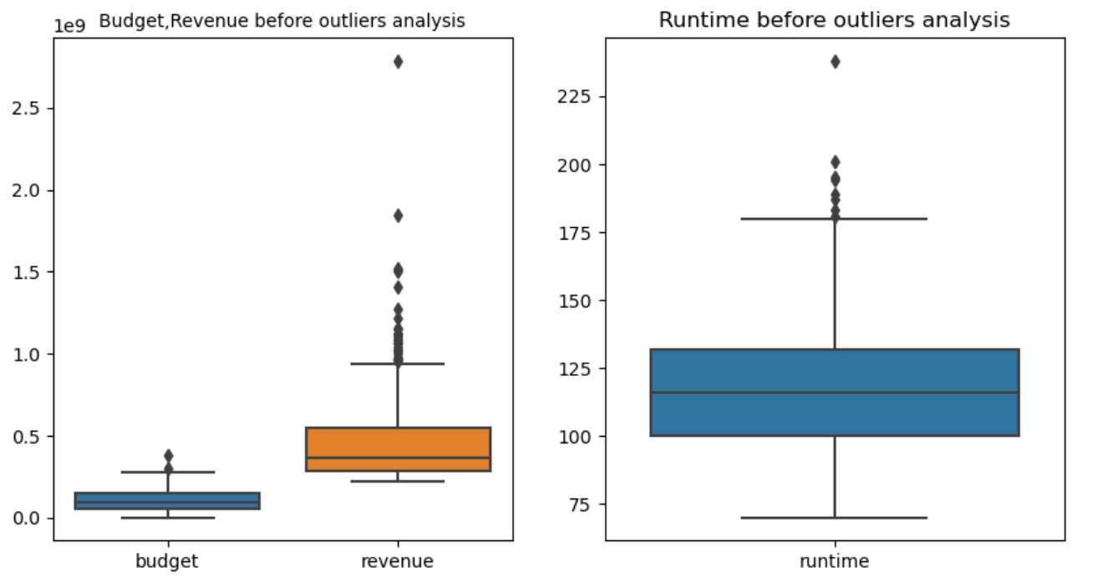
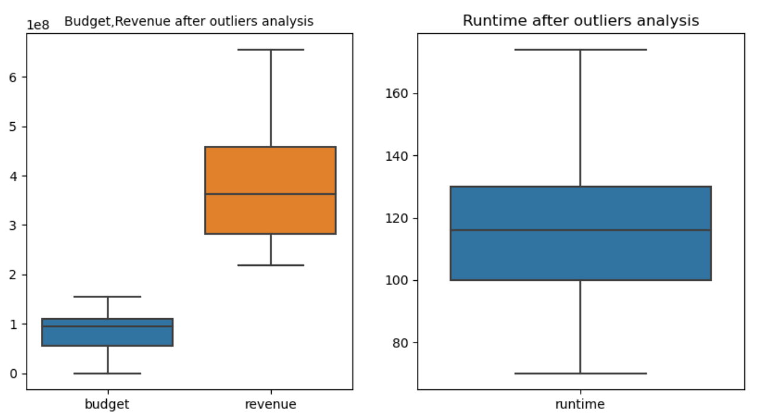
Task- 10 (continuation) :- . Perform outlier analysis for the (Budget, Revenue and Runtime) three columns using box plots.
Output :-
Techniques :-
Boxplot( )
Set_title( )
Sub_plots( )
Loc[ ]

Slide 14
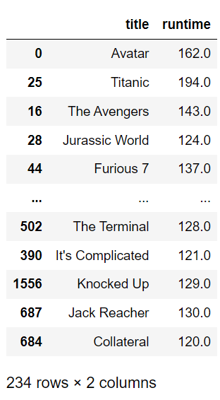

Task- 11 :- Identify and display the names of the movies along with their runtimes for those movies that have above average runtime, using the data from the previous task.
Techniques :-
Output :-
Filtering

Slide 15
Conclusion
It is important to acknowledge the limitations of the TMDB dataset, such as unknown values missing or inaccurate information. These limitations might have influenced the outcomes of our analysis. It is recommended to ensure the TMDB dataset is consistently refreshed with the most up-to-date information.(Task 2,5)
Action, Adventure, and Science fiction genre movies tend to generate high revenue, it is advisable to prioritize the production of films belonging to these genres as they have a higher likelihood of achieving success.(Task 4)
Some movies with relatively lower budgets have managed to generate significant revenue and achieve financial success(task 6 )
Considering that Warner Bros and Universal Pictures are the production companies with the highest frequency of movie releases, it is evident that these companies exhibit a strong track record and consistently engage in film production. This observation suggests that there is a positive trend in their performance, indicating that filmmakers may find it beneficial to collaborate with or seek opportunities from these reputable production companies.(task 9)

Slide 16
Conclusion
The availability of 234 records with a greater than average runtime, In future if they make high runtime movies, there are a few suggestions, considering these things will helpful(task 11)
Review and edit longer movies to streamline the narrative.
Analyze the script for areas to tighten without compromising the story.
Consider the target audience's attention span and preferences.
Gather feedback through test screenings and create alternative versions if necessary.
Within the action and adventure genres, explore unique themes or settings that differentiate your movies from others. This can help create a distinct identity and attract audience attention.
The popularity of action and adventure genres, consider developing and producing movies that align with these genres. This can potentially attract a larger audience and increase the chances of commercial success

Slide 17

Thank you

