Slide 1
Data-Driven Strategies Using Sql for RSVP Movies Insights for a Successful Global Film Release
BY: RAMYA PANCHATCHARAM

Slide 2
Table of contents
01
02
03
04
05
06
Introduction
Solution Overview
Data Description
Findings
Data Insights
Conclusion

Slide 3
Introduction
RSVP Movies is a successful Indian film production company renowned for its super-hit movies catering primarily to the domestic audience. The company is now preparing for a global movie release in 2025.
Goal: Analyze movie data from the last three years to derive actionable insights that will inform the global release strategy.
Role: Provide data-driven insights using SQL queries to help RSVP plan their global release.

Slide 4
Business Problem
Chellenge
Objective
To ensure success, the company must utilize data-driven insights from past movie performances and analyze current industry trends and audience preferences.
Develop actionable recommendations to optimize production, marketing, and distribution strategies for the international market.

Slide 5
Solution Overview
Analyzes the dataset, focusing on tables like 'movies', 'genre', and 'names' to identify structure and missing values.
Calculates yearly movie releases, monthly distribution, and production counts for the USA and India.
Explores unique genres, their total movie counts, and average durations.
Reviews the ratings table for minimum/maximum values and lists the top 10 movies by average rating.
Ranks actors and directors based on release counts and average ratings in the drama genre; calculates genre-wise running totals and moving averages for movie duration.

Slide 6
Data Description
The database includes six tables: genre, movies, director mapping, role mapping, names, and ratings.
Genre table: 2 columns, 14,662 rows.
Movies table: 5 columns, 7,997 rows.
Director mapping table: 2 columns, 3,867 rows.
Role mapping table: 3 columns, 15,615 rows.
Names table: 5 columns, 25,735 rows.
Ratings table: 4 columns, 7,997 rows.
Overall, the database contains various information, including titles, duration, ratings (average and median), IDs, votes, and more.

Slide 7
Findings

Slide 8
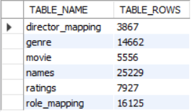

Findings …
The outputs reveal each table's structure, null values, and the number of movies released per year.
The Movies table has null values in its last four columns, with world_gross_income having the highest count of 3,724 nulls.
In terms of movies released per year:
2017: 3,052 movies (highest)
2018: 2,944 movies (second)
2019: 2,001 movies (least)

Slide 9
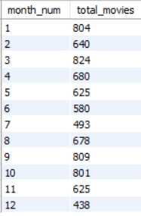
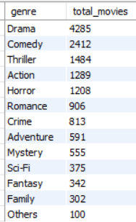

Further Findings …
Monthly Movie Releases:
Highest: March with 824 movies.
Lowest: December with 438 movies.
Movie Genre Distribution:
Highest: Drama with 4,285 movies.
Lowest: Others with 100 movies.
Movies produced in the USA or India in 2019:
887 Movies

Slide 10
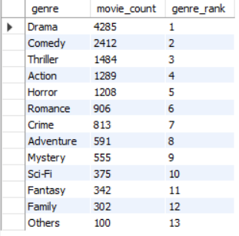
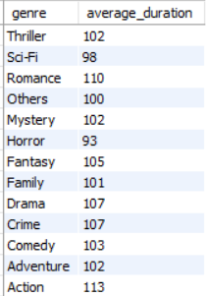
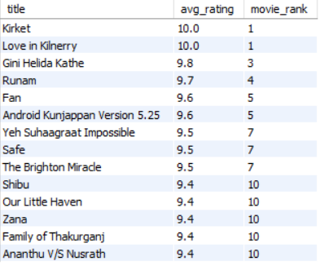
Further Findings …
Genre Distribution:
Drama is the most produced genre, indicating strong potential, with over 3,000 movies in a single genre highlighting a significant market.
Average Movie Duration by Genre:
Drama: 106.77 minutes
Top 10 Movies by Average Rating:
Kirket: 10.0
Love in Kilnerry: 10.0
Gini Helida Kathe: 9.8
These ratings reflect exceptional quality.
Ratings Insights:
Analyzed average ratings and total votes to ensure no outliers.

Slide 11

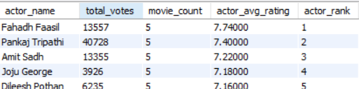
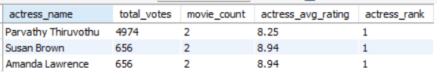
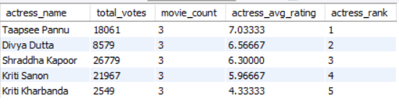
Further Findings …
Top Actors & Actresses:
Mamooty and Mohanlal: Top actors with median ratings 8+.
Fahadh Faasil: Average rating of 7.7400 in Indian movies.
Taapsee Pannu: Average rating of 7. 0333 in Hindi films.
Top actresses in drama (rating > 8): Amanda Lawrence, Densie Gough, Parvathy Thiruvothu.

Slide 12
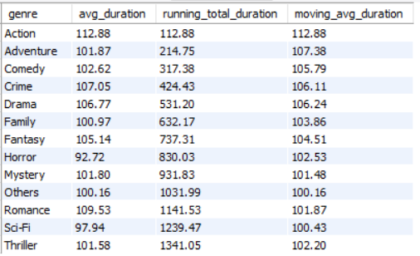

Further Findings …
Top Production Houses:
Marvel Studios, Twentieth Century Fox, and Warner Bros. lead in audience engagement.
Genre Duration Analysis:
Analyzed average movie durations and trends across genres.

Slide 13
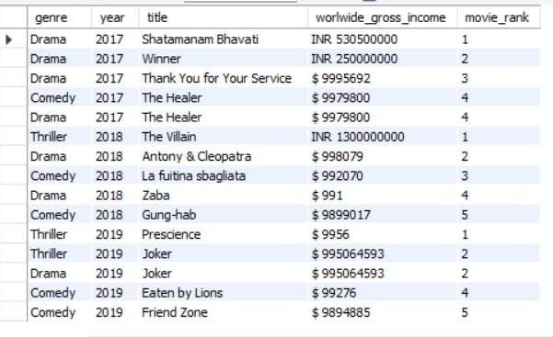

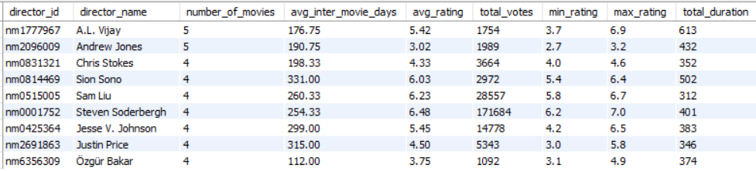
Further Findings …
Top Grossing Movies:
Highlights the five highest-grossing films each year in the top three genres.
Top Production Houses:
The Star Cinema and Twentieth Century Fox lead in multilingual hits (median rating >= 8).
Director Insights:
A.L. Vijay and Andrew Jones are the top directors, each with 5 films.

Slide 14

Data Insights

Slide 15
Insights
Genre Focus: Prioritize thriller, drama, and comedy to align with audience preferences and maximize viewership.
Production Collaborations: Partner with top companies like Star Cinema, Twentieth Century Fox, Marvel Studios, and Warner Bros. for resources and distribution.
Talent Collaboration: Work with popular actors like Fahadh Faas and Taapsee Pannu to enhance appeal and attract fans.
Quality Directors: Collaborate with successful directors like James Mangold, A.L. Vijay, and Andrew Jones for high-quality productions.
Multilingual Opportunities: Explore multilingual films to reach diverse audiences and leverage regional successes.

Slide 16
Conclusion
The data-driven analysis offers insights to guide RSVP's movie strategies.
By prioritizing popular genres, collaborating with top talent, and forming strategic partnerships, RSVP can succeed in the competitive film industry.
Leveraging these insights will enable RSVP to produce audience-centric films that achieve critical acclaim and commercial success.

Slide 17
Thanks!
Do you have any questions?
samramya@gmail.com
Please keep this slide for attribution

