Slide 1
Analyzing Retail Sales Data Using Tableau
Project: Superstore Sales Data
Presented by: Ramya Panchatcharam Date: 28/09/2024

Slide 2
Table of contents
01
02
03
04
05
06
Objectives
Data Overview
Key Visualizations
Advanced Visualization
Dashboard Insights & Recommendations
Conclusion

Slide 3

01
Objectives of the project

Slide 4
Objectives
Aim
Goal
To utilize Tableau for in-depth analysis and visualization of retail sales data from the Superstore dataset, enabling data-driven decision-making.
To gain actionable insights into regional sales performance, product profitability, and customer segments in order to identify opportunities for improving sales, optimizing inventory, and enhancing business growth strategies.

Slide 5
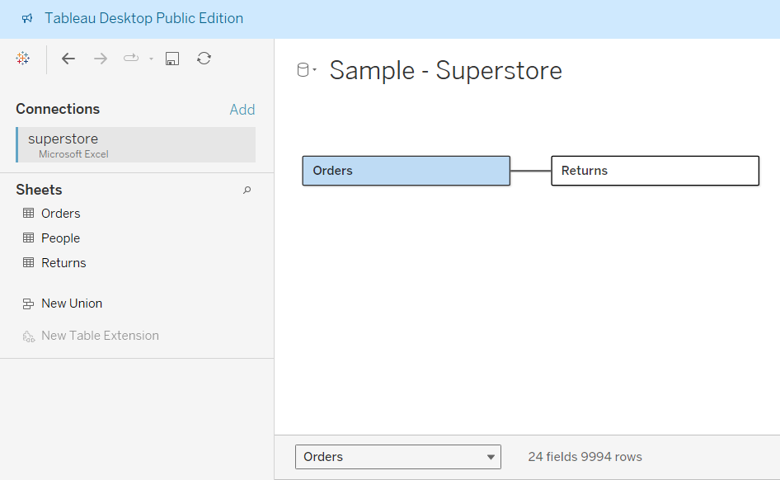
Data Overview
Data Import and Overview
The Superstore dataset (.xls file) includes three tables:
Orders: 21 fields, 9,994 rows. Key fields are:
Sales (numeric) : Total sales
Profit (numeric) : Profit margin
Region (string) : Geographical regions
People: 2 fields, 4 rows (regional managers).
Returns: 2 fields, 296 rows (returned orders).
These fields help analyze sales performance and profitability across regions.

Slide 6
Data Cleaning
Data Cleaning
Checked for missing data in key fields, specifically Sales and Profit.
Profit Null Check:
Formula: IF ISNULL([Profit]) THEN "Null" ELSE "Not Null" END
Sales Null Check:
Formula: IF ISNULL([Sales]) THEN "Null" ELSE "Not Null" END
This confirms the data is complete and reliable for analysis.
Result: "Not Null" (no missing values in Profit)
Result: "Not Null" (no missing values in Sales)

Slide 7

3. Key Visualizations
First-year revenue of the project

Slide 8
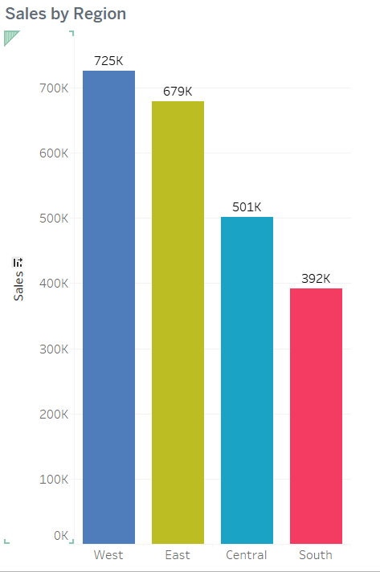
Sales by Region
Insights:
Sales Performance:
West: Highest at $725K.
South: Lowest at $392K; room for improvement.
Regional Strengths and Weaknesses:
West: Effective strategies or favourable demographics.
South: Challenges such as competition or lower demand.
External Factors:
Market Presence: Number of stores/online reach.
Competition: Analyze strategies in each area.
Consumer Behavior: Local trends and economic conditions.

Slide 9
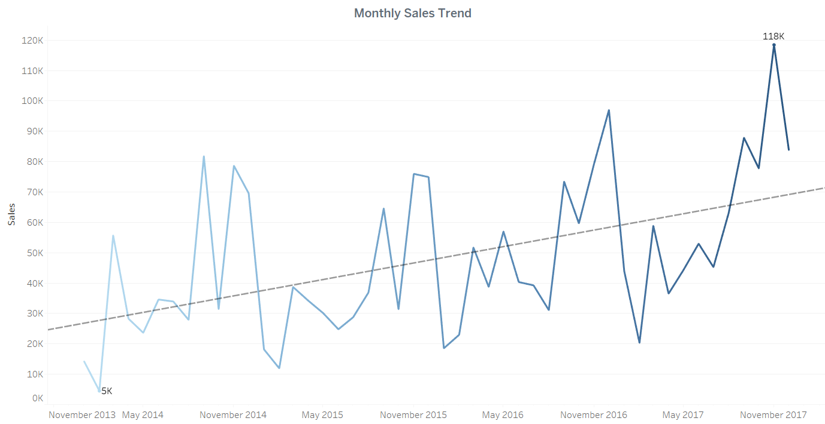
Monthly Sales Trend
Display a line chart showing sales from January 2014 to December 2017.
Key Points:
Highlight min sales ($5K)in February 2014.
Highlight max sales($118k) in November 2017.
Insight: Higher sales in the holiday season
Actionable: Implement targeted marketing campaigns during peak seasons

Slide 10
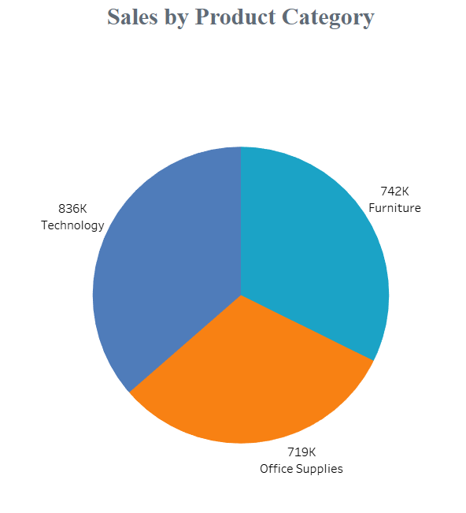
Sales by Region
Insights:
Technology Dominance:
Top-selling category, indicating strong customer preference.
Office Supplies & Furniture:
Significant, but lower sales contributions compared to technology.
Strategic Recommendations
Promote Technology Products:
Invest more in marketing and product development.

Slide 11
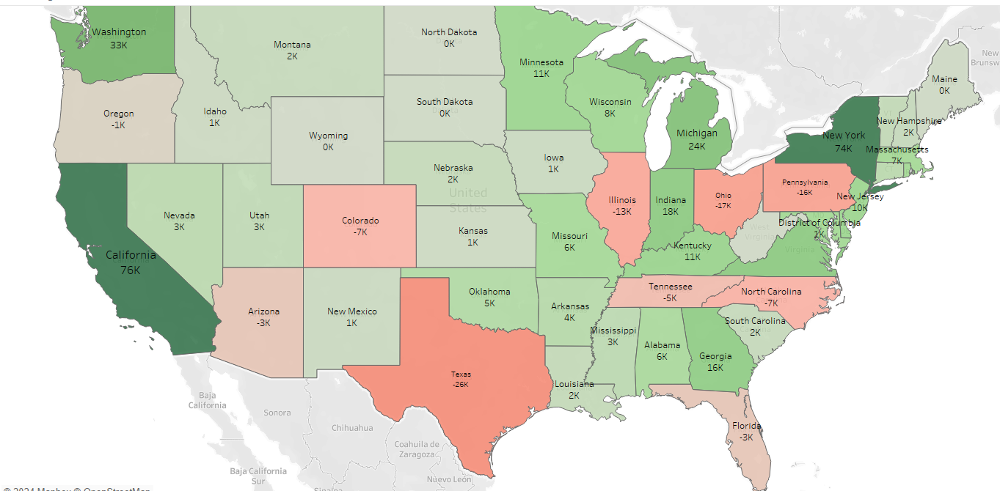
Profit by State
Insight: High profits in California and New York, losses in Texas and Pennsylvania
Actionable: Address factors influencing profitability in underperforming states

Slide 12
4. Advanced Visualizations

Slide 13
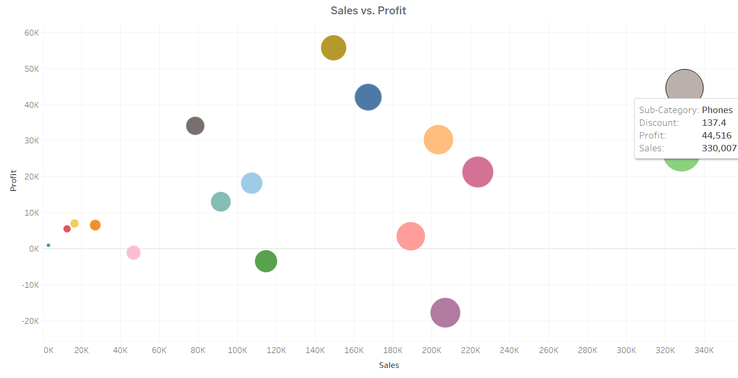
Sales VS Profit
Key Insights:
Positive Correlation: Higher sales typically lead to higher profits.
Top Performers: Categories with large sales and profits (e.g., $44.5K profit on $330K sales) stand out.
Outliers: Some categories, like one with $206.9K sales but $-17.7K profit, have high sales but negative profitability.
Negative Profit: Bubbles below the x-axis indicate unprofitable categories.
This plot highlights the relationship between sales and profitability across product categories.

Slide 14
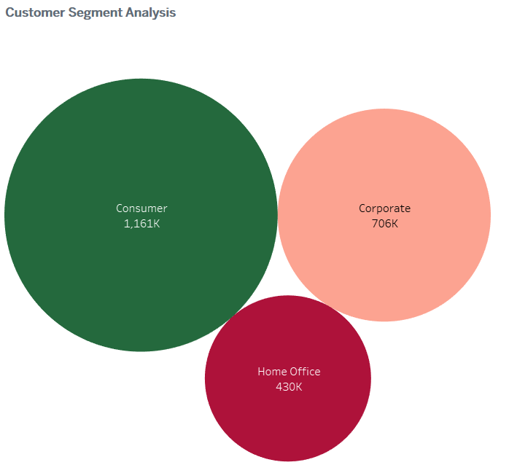
Customer Segment Analysis
Key Insights:
Consumer Segment: Highest sales ($1,161K). Opportunity: Leverage strong demand with targeted marketing.
Corporate Segment: Sales of $706K. Opportunity: Focus on upselling and tailored solutions.
Home Office Segment: Lowest sales ($430K). Opportunity: Targeted promotions and product bundling for growth.
Strategic Recommendations:
Prioritize high-sales, high-profit segments.
Customize marketing for each segment.
Invest in home office growth if profitability is promising.
Conclusion: Maximize profitability across all segments for sustainable growth.

Slide 15
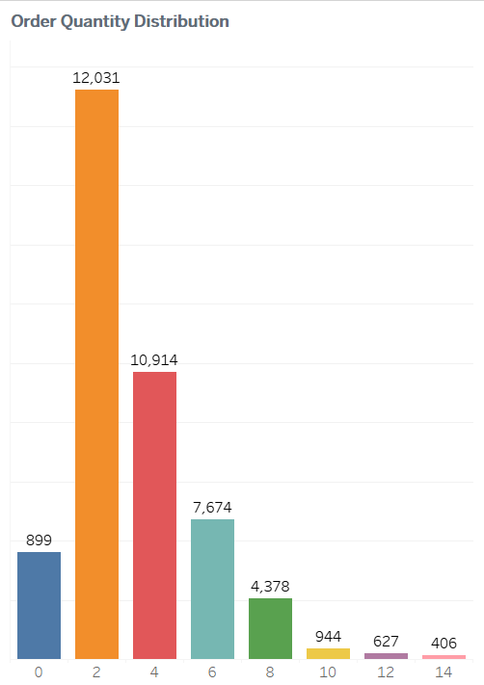
Order Quantity Distribution
Key Insights:
Small Orders Dominate: Most orders are for 2 (12,031) and 4 items (10,914).
Declining Trend: Significant drop in orders for quantities above 4.
Action: Optimize inventory for 2-4 item orders and encourage bulk purchases.

Slide 16
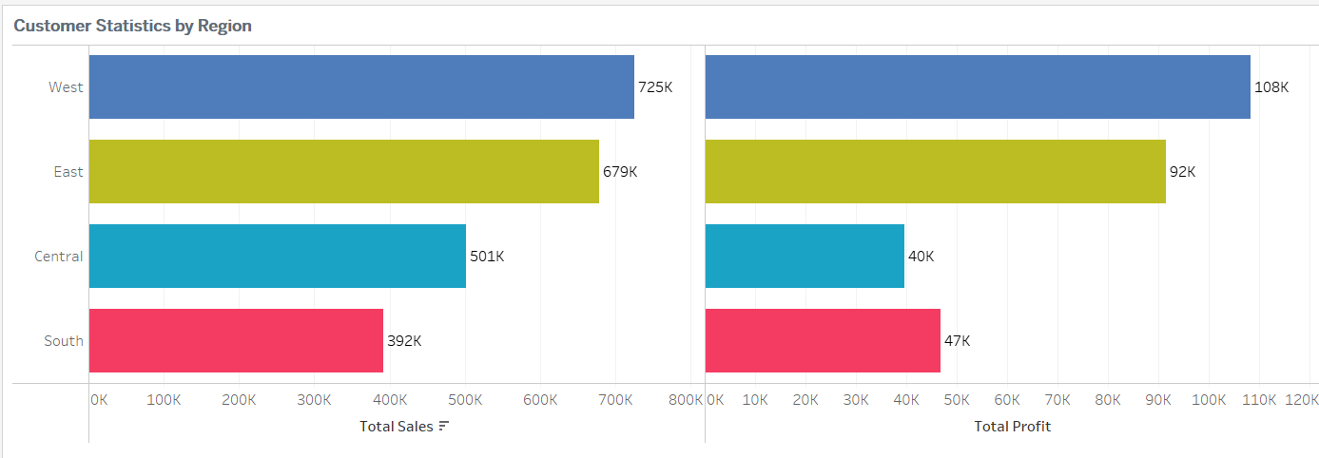
Customer Statistics by Region
Insights:
Disparity: West leads in sales; East has better profitability.
Opportunities: Central and South regions require attention.
Recommendations:
Target growth in Central and South.
Optimize costs in West.
Analyze regional performance factors.

Slide 17

5. Dashboard Insights & Recommendations

Slide 18
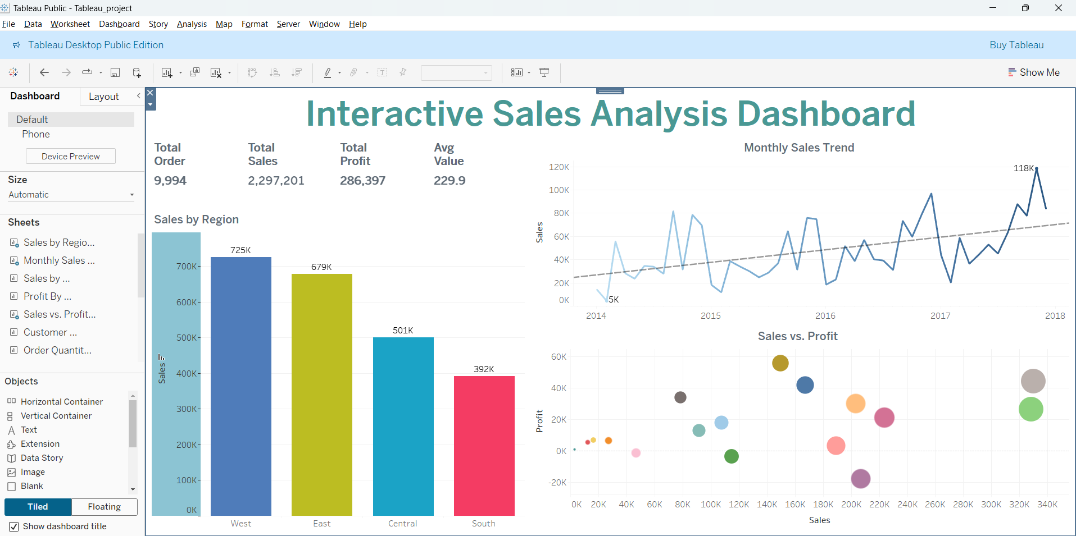
What to show in a mockup
Interactive Sales Analysis Dashboard
Summary
Total Sales: Sales increased significantly over the last quarter, indicating strong demand.
Total Profit: Profit reflects effective cost management and positive margins.
Average Order Value: Higher average order value indicates successful upselling.
Sales Trend Analysis: Seasonal sales trends present targeted marketing opportunities.
Regional Performance Insights: Sales by region reveal areas for expansion and resource allocation.
Profitability Insights: Sales and profit correlation suggests a review of pricing strategies.
Insights
Components: Sales by Region, Monthly Sales Trend, Sales vs. Profit
Filters: Region, Product Category
Purpose: Explore data interactively to gain specific insights

Slide 19
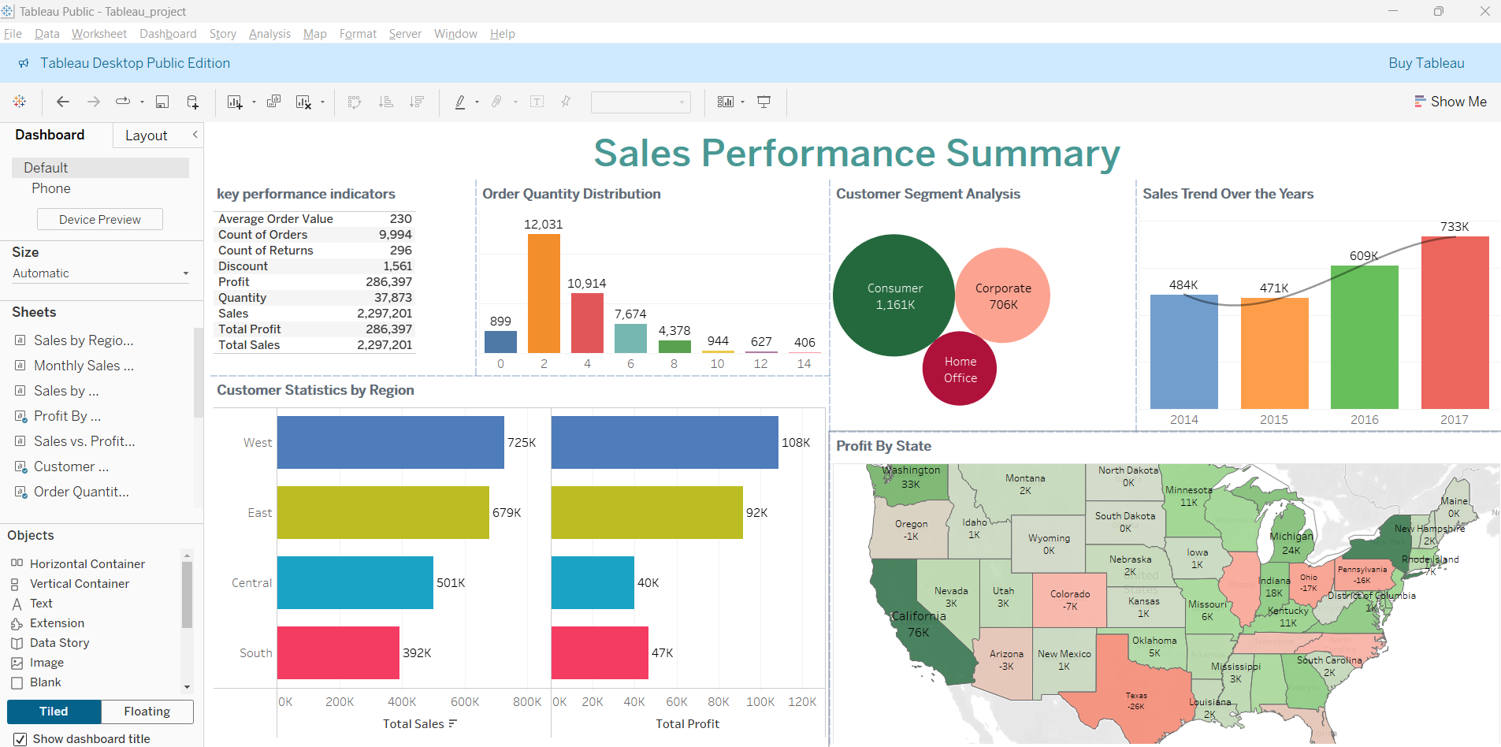
What to show in a mockup
Sales Performance Summary
Regional Performance: West region outperforms others
Product Categories: Technology products drive sales
Profitability: Some categories need pricing or cost optimization
Customer Segments: Targeted strategies needed for each segment

Slide 20
$2,297,201
$286,397
9,994
Total Sales
Total Profit
Total Order

Slide 21
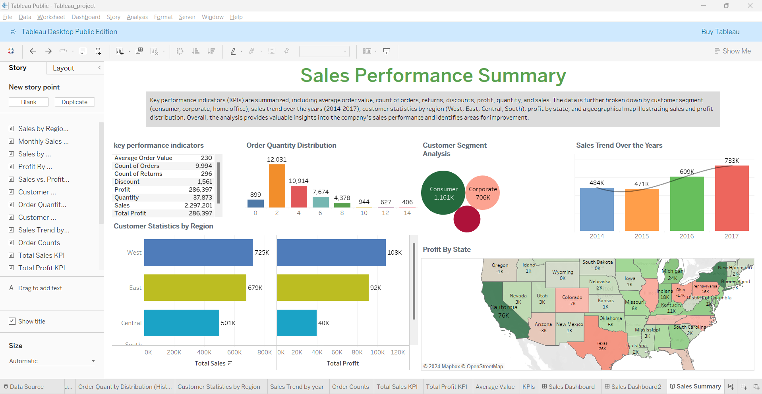
Sales Performance Storyboard

Slide 22
Key Insights and Recommendations
Key Insights
Recommendations
Regional Performance: West region outperforms others
Product Categories: Technology products drive sales
Profitability: Some categories need pricing or cost optimization
Customer Segments: Targeted strategies needed for each segment
Invest in marketing and sales efforts in the South region
Optimize pricing strategies for unprofitable categories
Implement targeted marketing campaigns by customer segment
Improve inventory management based on order distribution

Slide 23
Conclusion
Tableau analysis revealed key insights on sales, profitability, and customer behavior.
Takeaways:
West leads in sales, but cost optimization is needed.
Growth potential in South and Central regions.
Tailored strategies for customer segments and inventory optimization.
By leveraging these insights, businesses can improve performance and drive growth.

Slide 24
Thanks!
Do you have any questions?
samramya@gmail.com

