Slide 1

21BIO112 INTELLIGENCE OF BIOLOGICAL SYSTEMS-2
UNDER THE GUIDANCE OF:
DR.AMRITA THAKUR

Slide 2
PROJECT TOPIC: BRUGADA SYNDROME BATCH 4

Slide 3
TEAM MEMBERS: M Ramya Sree – BL.EN.U4AIE21072 Poli Vamsi Vardhan Reddy – BL.EN.U4AIE21101 Mettu Siddhartha –BL.EN.U4AIE21080

Slide 4
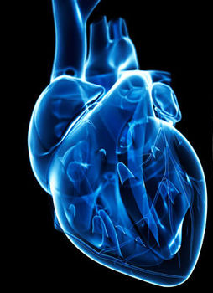
CONTENTS:
Introduction
History
Symptoms
Prevention and Treatment
Diagnosis
Reference

Slide 5
Introduction:
Brugada syndrome ( BrS) is a genetic disorder in which the electrical activity within the heart is abnormal.
It increases the risk of abnormal heart rhythms and causes sudden cardiac death.
This syndrome is a rare but potentially a life threatening heart syndrome.
People with Brugada syndrome have an increased risk of irregular heart rhythms beginning in the lower chambers of the heart.
Most of those with Brugada syndrome have a family member who also has the condition. Some cases may be due to a new genetic mutation or certain medications.

Slide 6
History
Brugada syndrome is named after the Spanish cardiologists Josep and Pedro Brugada, who identified the illness in 1992.
In 1997, Brugada syndrome was identified as a cause of sudden unexplained cardiac death .
Studies in the 2000s led to competing theories surrounding the mechanisms by which abnormal heart rhythms were generated.
Research into Brugada syndrome is ongoing, identifying new genetic variants, exploring mechanisms of arrhythmias, and searching for better treatments.

Slide 7
Causes
Brugada syndrome may be caused by:
A structural problem in the heart, which may be hard to detect
An imbalance in chemicals that help send electrical signals through the body (electrolytes)
Use of certain prescription medications or cocaine

Slide 8
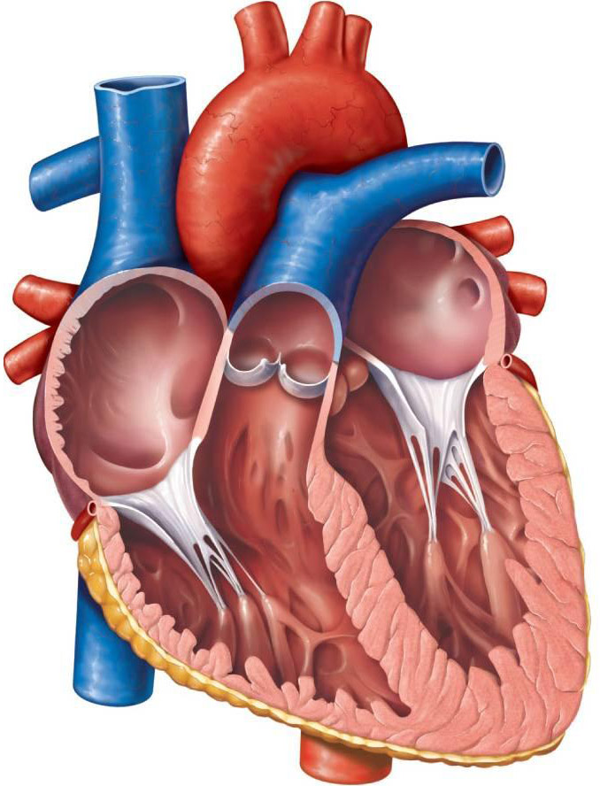

Slide 9
Symptoms
Signs and symptoms that may be associated with Brugada syndrome include:
Dizziness
Fainting
Gasping and labored breathing, particularly at night
Irregular heartbeats
Extremely fast and chaotic heartbeat
Seizures
A major sign of Brugada syndrome is an irregular result on an electrocardiogram (ECG),
a test that measures the electrical activity of the heart

Slide 10
Risk Factor
Risk factors for Brugada syndrome include:
Family history of Brugada syndrome
Hypokalemia
Fever

Slide 11
Prevention
Brugada syndrome signs and symptoms are similar to those of some other heart rhythm disorders.
It's important to see a health care provider to find out if Brugada syndrome or another heart rhythm disorder is causing symptoms.
If someone is faint and thinking that it may be because of a heart condition, seek emergency medical attention.
If a parent, sibling, or child has been diagnosed with Brugada syndrome, all family members should be tested as a preventive precaution because it is a hereditary illness.

Slide 12
Treatment
There's currently no cure for Brugada syndrome, but there are things you can do to reduce your risk of experiencing serious problems.
Some of the actions to be taken while treating:
Treat a fever aggressively.
Avoid drugs that may trigger an irregular heartbeat. Avoid playing competitive sports.
One should tell their health care provider about the medications that take, including drugs and supplements bought without a prescription.

Slide 13
Diagnosis
Brugada syndrome usually is diagnosed in adults and sometimes in adolescents.
It's rarely diagnosed in young children because the symptoms are often unnoticed.
To diagnose Brugada syndrome, a health care provider should perform a physical exam and listen to the heart with a stethoscope.
Once Tests are done to check the heartbeat and diagnose one can confirm Brugada syndrome or not.

Slide 14
Medication
Quinidine is an antiarrhythmic drug that may reduce the chance of serious abnormal heart rhythms occurring in some people with Brugada syndrome.
It is most frequently used in people with Brugada syndrome. who have experienced several episodes of life-threatening arrhythmias
It can be also be used in people at high risk of arrhythmias.
Isoprenaline, a drug that has similarities with adrenaline,
It can be used in an emergency for people with Brugada syndrome who are having frequent repeated life-threatening arrhythmias, known as an "electrical storm".
This drug must be given as a continuous infusion into a vein and therefore is not suitable for long-term use.

Slide 15
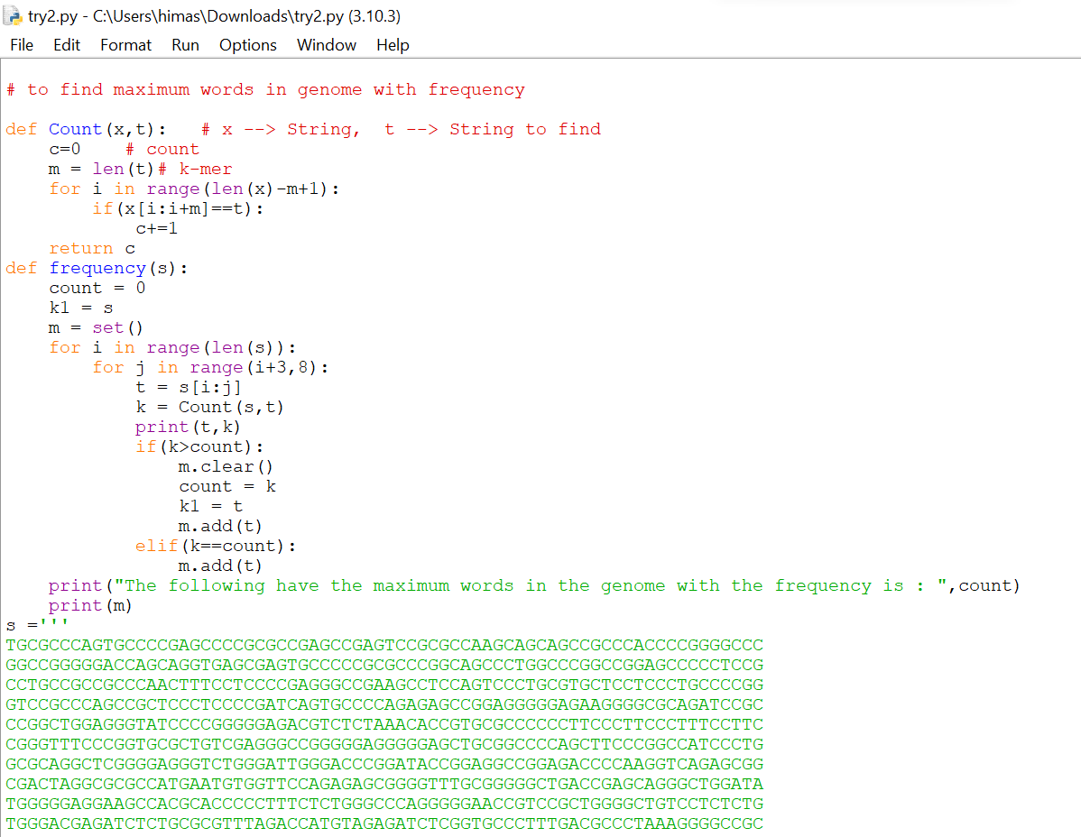
Code

Slide 16
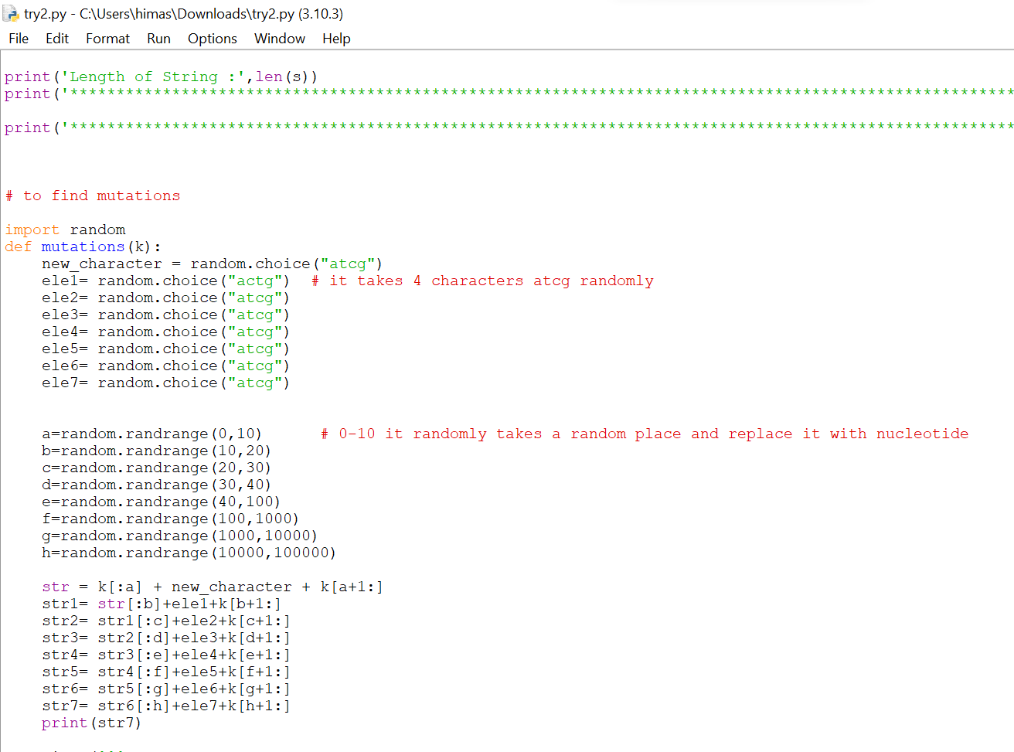

Slide 17
Reference
https://www.mayoclinic.org/diseases-conditions/brugada-syndrome/symptoms-causes/syc-20370489
https://www.ncbi.nlm.nih.gov/books/NBK519568/

Slide 18
THANK YOU

