Slide 1
21AIE203
Data Structures and Algorithms - 2

Slide 2
Team members:
M RAMYA SREE (BL.EN.U4AIE21072)
METTU SIDDHARTHA (BL.EN.U4AIE21080)
POLI VAMSI VARDHAN REDDY (BL.EN.U4AIE21101)
Under the guidance of:
Ms. Aiswarya Milan
Batch : E4

Slide 3

Secure Password Management System using Java HashMap and SHA-256 Hashing

Slide 4
CONTENTS
INTRODUCTION
HASHING
APPLICATION
SHA-256 ALGORITHM
WORKING
CODE
IMPLEMENTATION
OUTPUT
REFERENCE
CONCLUSION

Slide 5
Introduction
A password generating process using hashing involves taking a user's desired password and running it through a one-way hashing algorithm.
It produces a fixed-length string of characters, known as the hash.
The original password cannot be reconstructed from the hash, making it more secure.
When the user enters their password for verification, the entered password is hashed and compared to the stored hash.
If they match, the user is granted access.
Hashing is a common method for securely storing passwords as it ensures that even if a hacker gains access to the stored hashes, they will not be able to determine the original passwords.

Slide 6
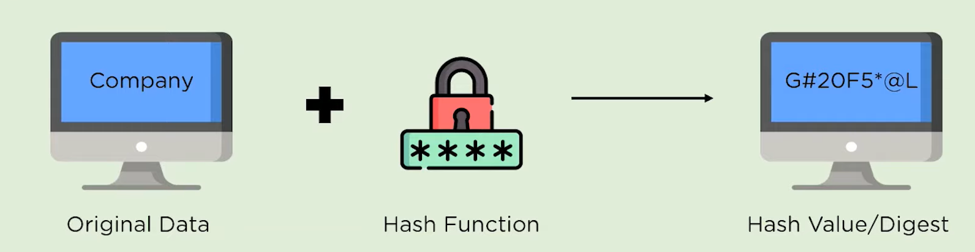
Hashing
Hashing allows for efficient insertion, deletion, and retrieval of data by mapping the data to an index in an array using a hash function.
Inserting data into a hash table involves taking the data and running it through a hash function that produces a hash value or index.
This is used to improve the performance of these operations by reducing the number of comparisons needed to find a specific piece of data.

Slide 7
A good hash function should be fast, and deterministic and provide a uniform distribution of hash values.
A good hash table also should have a good collision resolution mechanism to handle the case where two different keys have the same hash value.
Even if an attacker manages to obtain the hashed password, they will not be able to easily determine the original password.
This is a useful technique for securely storing sensitive information such as passwords.

Slide 8
Applications
Hashing is used in many real-life applications, including:
Cryptography, where hash functions are used to create digital signatures and verify the integrity of data.
File integrity checking, where a hash of a file is compared to a stored value to ensure that the file has not been tampered with.
Password storage, where a hash of a password is stored instead of the password itself to protect against unauthorized access.

Slide 9
Applications
Blockchain, where hash functions are used to link blocks of transactions together in a secure and tamper-proof manner.
Indexing large data sets, where a hash function can be used to map data to a smaller number of buckets for efficient retrieval.
In computer security, intrusion detection systems and antivirus software may use hash values to identify known malicious files.
In digital forensics, hash databases are used to identify known files and to detect duplicates.

Slide 10
SHA -256 Algorithm
SHA-512
SHA-384
SHA 0
SHA Family
SHA-256
SHA 1
SHA-224

Slide 11
SHA -256 Algorithm
Secure Hash Algorithm 256-bit is a cryptographic hash function that is commonly used to generate a unique fixed-size output from a variable-size input.
The SHA-256 algorithm is a 256-bit (32-byte) hash value.
SHA-256 is considered a “strong” hash function, meaning it provides a high level of security.
SHA-256 password hash value is a process in which the output of the SHA-256 hash function, which is a fixed-size binary value, is converted to a human-readable format such as hexadecimal or Base64.

Slide 12

The length of the original message should be less than 2^64 bits.
Length of the hash digest should be 256 bits in the SHA -256 .
Digest or the value should not be able to produce the original message.

Slide 13
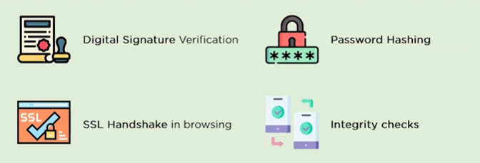
APPLICATIONS OF SHA

Slide 14
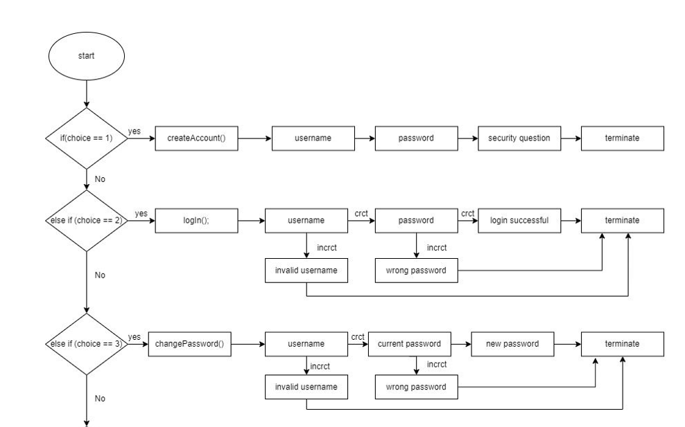
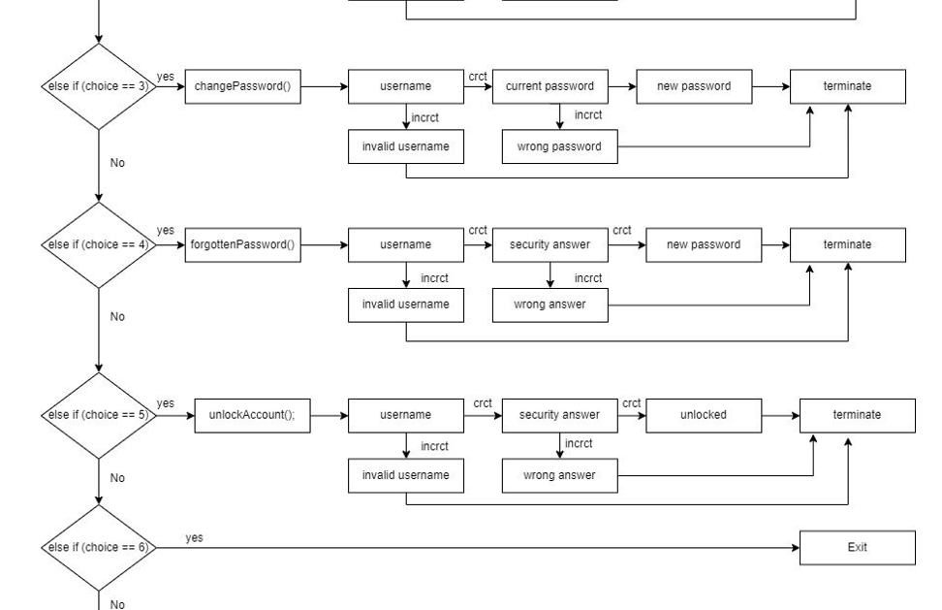
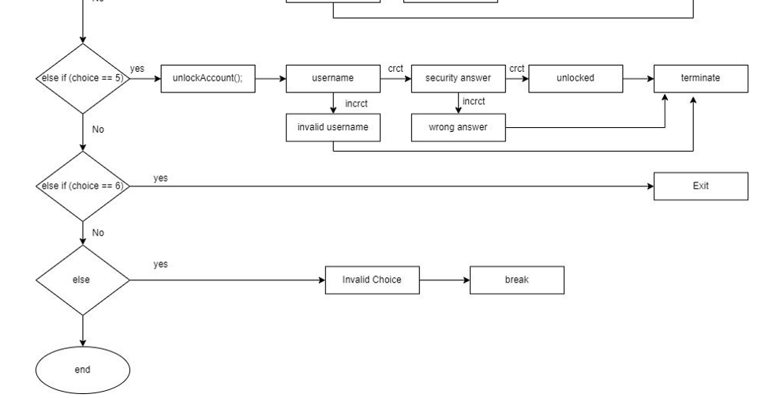
Working

Slide 15
CODE
https://docs.google.com/document/d/1IGl7003uoUIQYHEbHLCcgywpwKn2Ogd6/edit?usp=share_link&ouid=113942177500573789268&rtpof=true&sd=true

Slide 16
Implementation

Slide 17
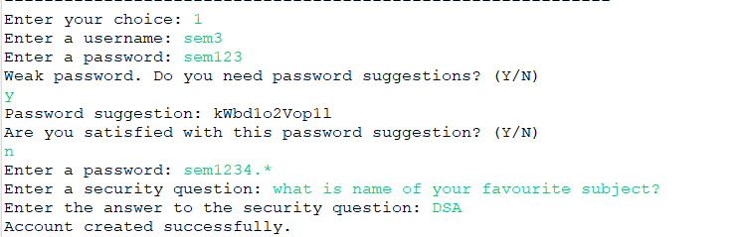
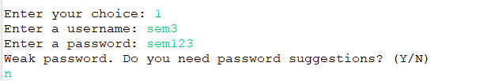
Output
Creating an account

Slide 18
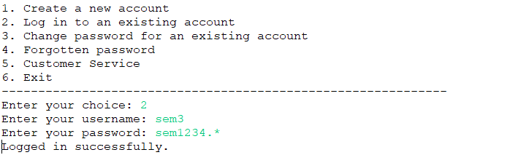
2. Logging in

Slide 19


Slide 20
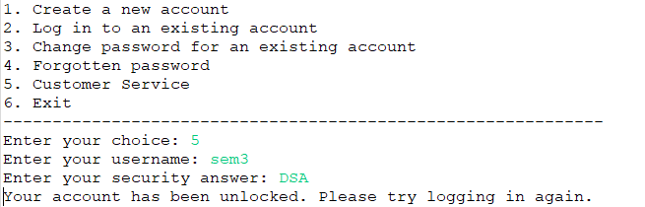
3. Contacting customer service

Slide 21
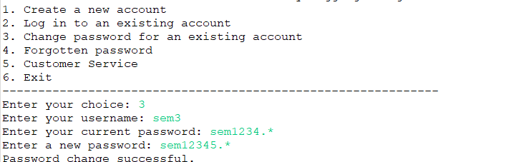
4. Changing the password

Slide 22
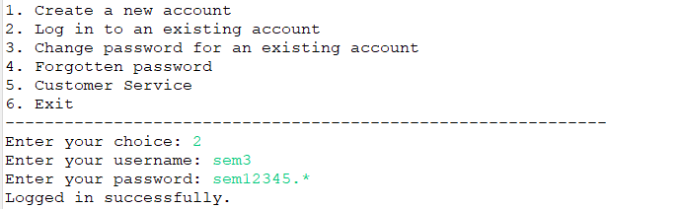
5. Logging in again after changing the password

Slide 23
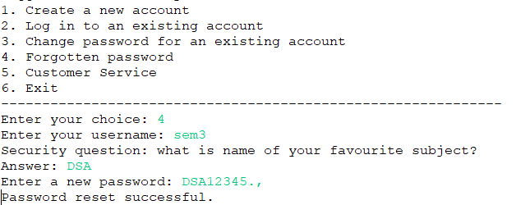
6. Resetting when we forgot our password

Slide 24
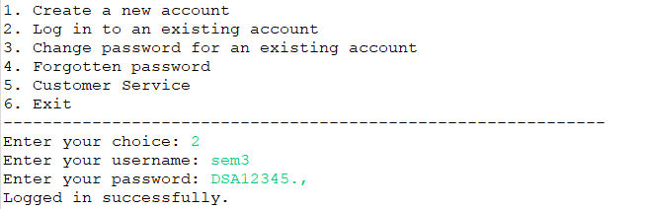
7. Logging in again after resetting

Slide 25
Conclusion
Through this project we can implement strong password for the user this provides high security and the insertion, deletion and searching takes place in O(1) time this makes the user’s job easier and the password will be implemented fastly.. and the SHA algorithm provides high security and hash value will be the hexadecimal format.

Slide 26
Reference
Xiao Luo, Haixin Wang, Daqing Wu,Chong Chen, Minghua Deng, Jianqiang Huang, Xian-Sheng Hua (2022). A Survey on Deep Hashing Methods.
https://dl.acm.org/doi/abs/10.1145/3532624
J. Deepakumara, H.M. Heys, R. Venkatesan FPGA implementation of MD5 hash algorithm
https://ieeexplore.ieee.org/abstract/document/933564
ZEYAD A. AL-ODAT, MAZHAR ALI , ASSAD ABBAS, SAMEE U. KHAN(2020). Secure Hash Algorithms and the Corresponding FPGA Optimization Techniques.
https://dl.acm.org/doi/pdf/10.1145/3311724

Slide 27
Thank you

