Slide 1

21AIE111 DATA STRUCTURES AND ALGORITHMS
UNDER THE GUIDANCE OF:
Mr. Ullas S.

Slide 2
project title: Train MANAGEMENT SYSTEM batch-4

Slide 3
TEAM MEMBERS:
M RAMYA SREE – BL.EN.U4AIE21072
METTU SIDDHARTHA- BL.EN.U4AIE21080
POLI VAMSI VARDHAN REDDY – BL.EN.U4AIE21101

Slide 4
contents
Description about Linked list
Introduction
Services
Booking of ticket
Canceling the reservation
With respective methods
Code
Output

Slide 5
LINKED LISTS
A linear data structure used to store the elements in contiguous locations is called a Linked List.
Each element in the linked list is called node and it consists of two parts, namely the data part and the address part.
The data part is the value of the element.
The address part consists of the pointers and addresses that are used to link the elements.

Slide 6
working
A linked list in JAVA is a dynamic data structure whose size increases on adding the elements and decreases on removing the elements from the list.
The elements in the linked list are stored in containers.
The list holds the link to the first container.
All the containers have a link to the next container in the list.
Whenever we add an element to the list, a new container is created, and this container is linked to the other containers in the list

Slide 7
types of linked lists
Singly Linked List
Doubly Linked List
Circular Linked List

Slide 8
Singly linked list
The type of linked list consisting of a sequence of nodes where each node consists of data and a link to the next node, that can be traversed from the first node of the list to the last node of the list and is unidirectional is called Singly Linked list.
The first node in the list is referred to as the head of the list.
The last node in the list is the tail, and it points to NULL.
head
data
next

Slide 9
syntax
public class SinglyLinkedList
{
class Node
{
int data;
Node next;
public Node(int data)
{
this.data = data;
this.next = null;
}
}
}

Slide 10
doubly linked list
This type of a linked list consists of a sequence of nodes where each node consists of data and two pointers, namely the previous pointer pointing to the previous node and the subsequent pointer that points to the next node that is part of the list. This can be traversed from the first node of the list to the last node of the list and vice versa, and this is called Doubly Linked list.
NODE
head
prev
data
next

Slide 11
circular linked list
It is the type of linked list consisting of a sequence of nodes where each node consists of data and a link to the next node and the last node in the list that points to the first node in the list is called as Circular Linked List.
last
data
next
data
next
data
next

Slide 12
INTRODUCTION
The Train Reservation and Management System handles train reservations for public interactions and services.
The project's objective is to learn how to utilize a railway booking system and manage passenger’s travel arrangements.
This project's interface also offers a simple method to book and cancel reservations.

Slide 13
Services
Inquiring about the availability of the selected destination location.
Booking tickets for the trip.
Choosing the passengers' preferred coach.
Cancelation of pre-booked reservations
Complaints about any difficulties faced when purchasing or cancelling tickets.

Slide 14
Booking a ticket
Firstly, choose the book a reservation option from the given choices.
Choose the destination place.
After Choosing the destination place, a train id will be given which helps for further process.
Then enter the number of passengers and their names by entering the train id.
Finally choose the seating class.
Following the conclusion of the booking, you will be notified that "Your Ticket Was Confirmed."

Slide 15
Canceling a reservation
To begin, select the cancel a reservation option from the available options.
Enter the train id that the client was given during the booking procedure.
Then type in the names of the passengers whose reservations to be cancelled.
A message indicating the passenger's reservation has been cancelled will be displayed.

Slide 16
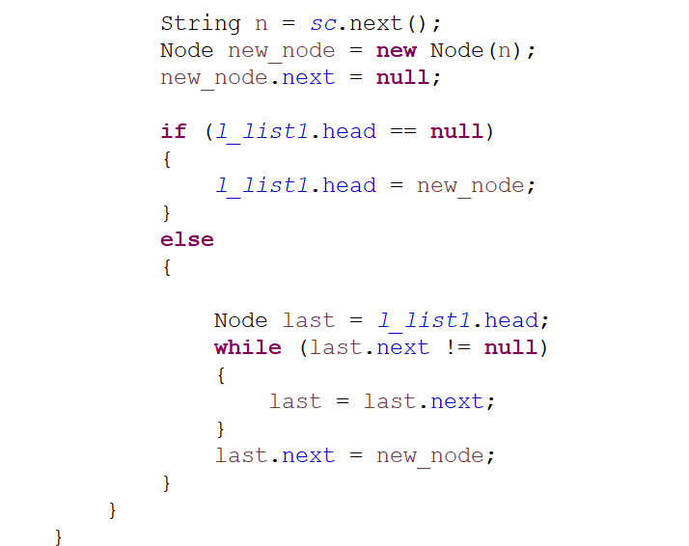
insertion of elements

Slide 17
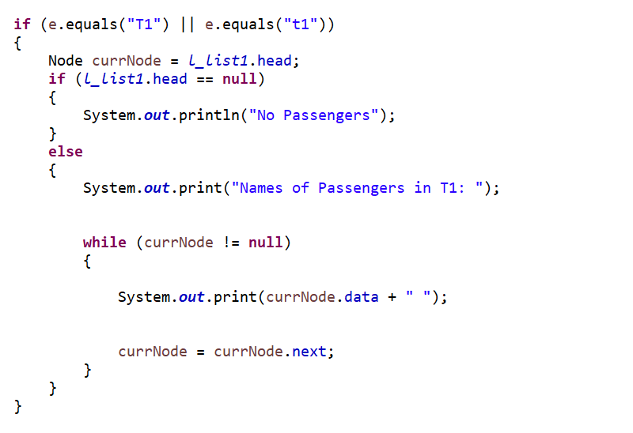
Displaying the elements

Slide 18
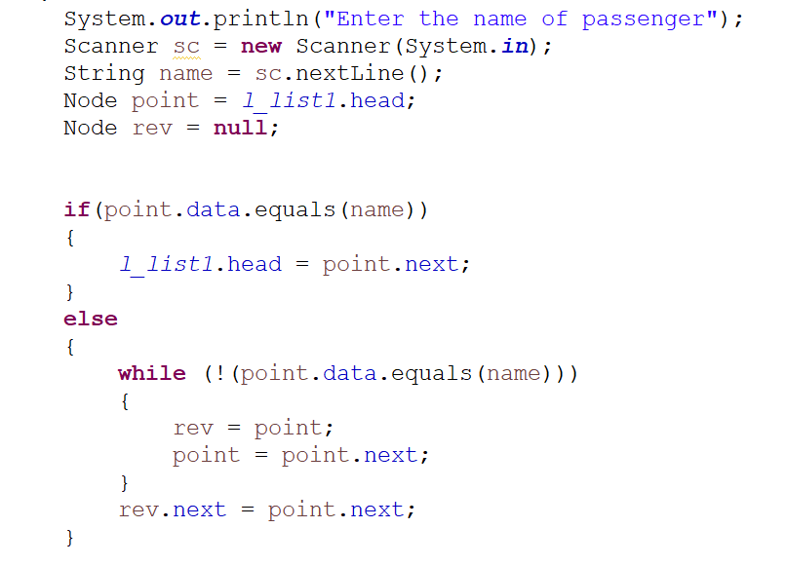
Deleting an element

Slide 19
Code simulation

Slide 20
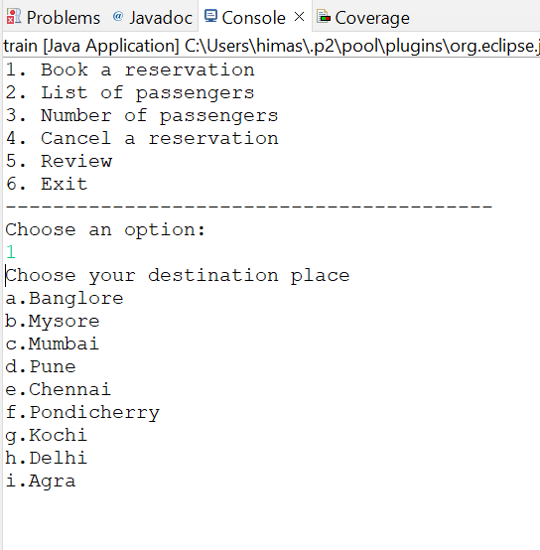
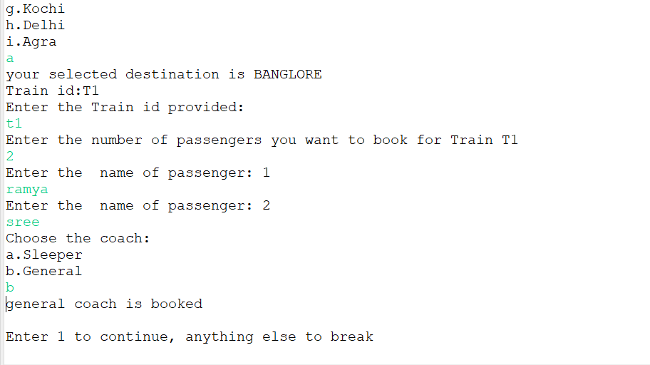
OUTPUT:

Slide 21
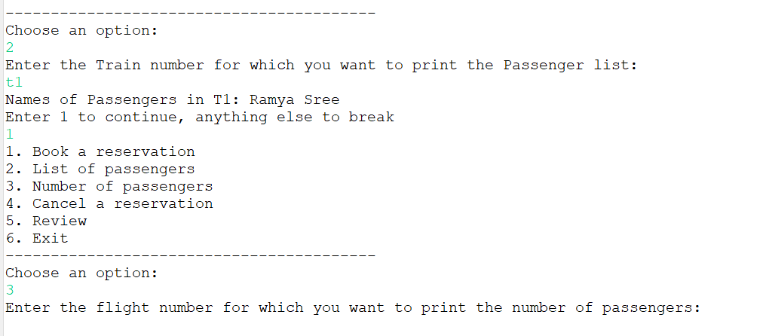
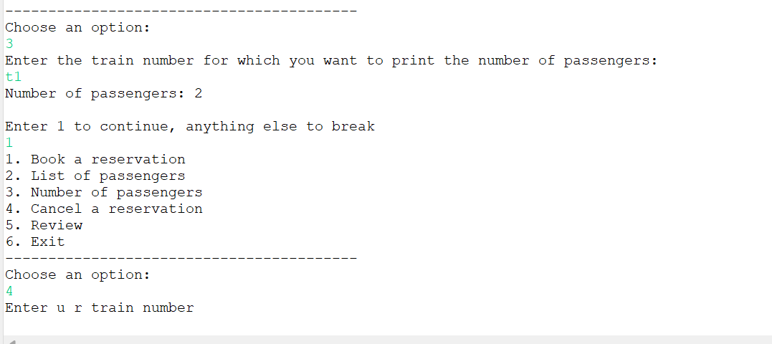

Slide 22
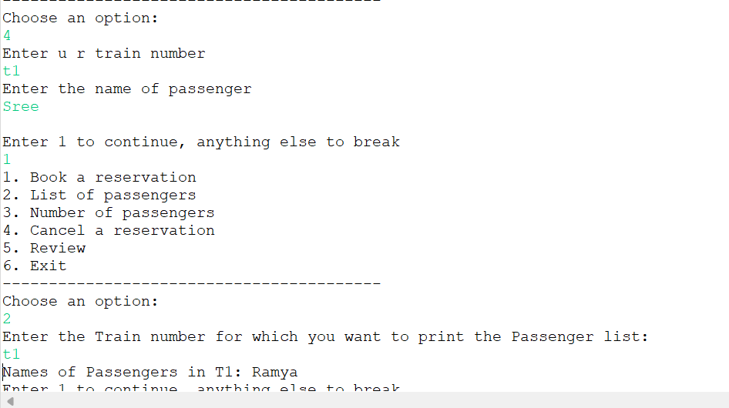
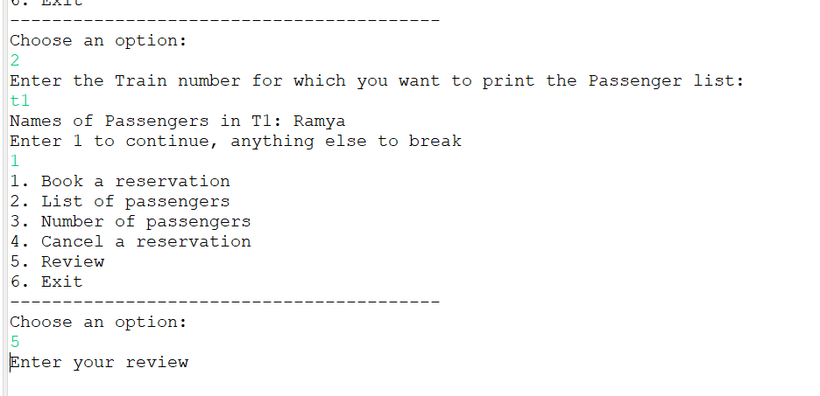
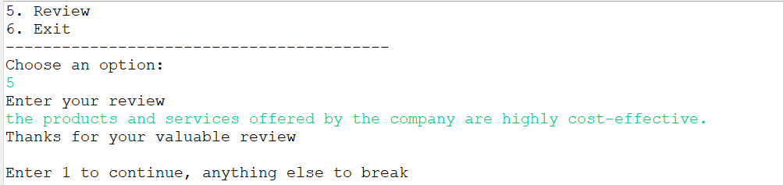

Slide 23
Thank you..!!

