Slide 1
Logocraft

Slide 2
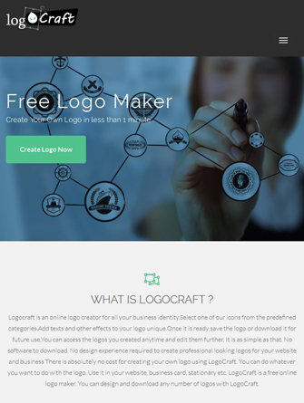
Introduction to LogoCraft
LogoCraft is a user-friendly platform designed for creating unique logos.
It caters to both professionals and beginners in graphic design.
The goal is to streamline the logo creation process and enhance creativity.
Notes:
Image source: https://dlrvetgp71ck5.cloudfront.net

Slide 3
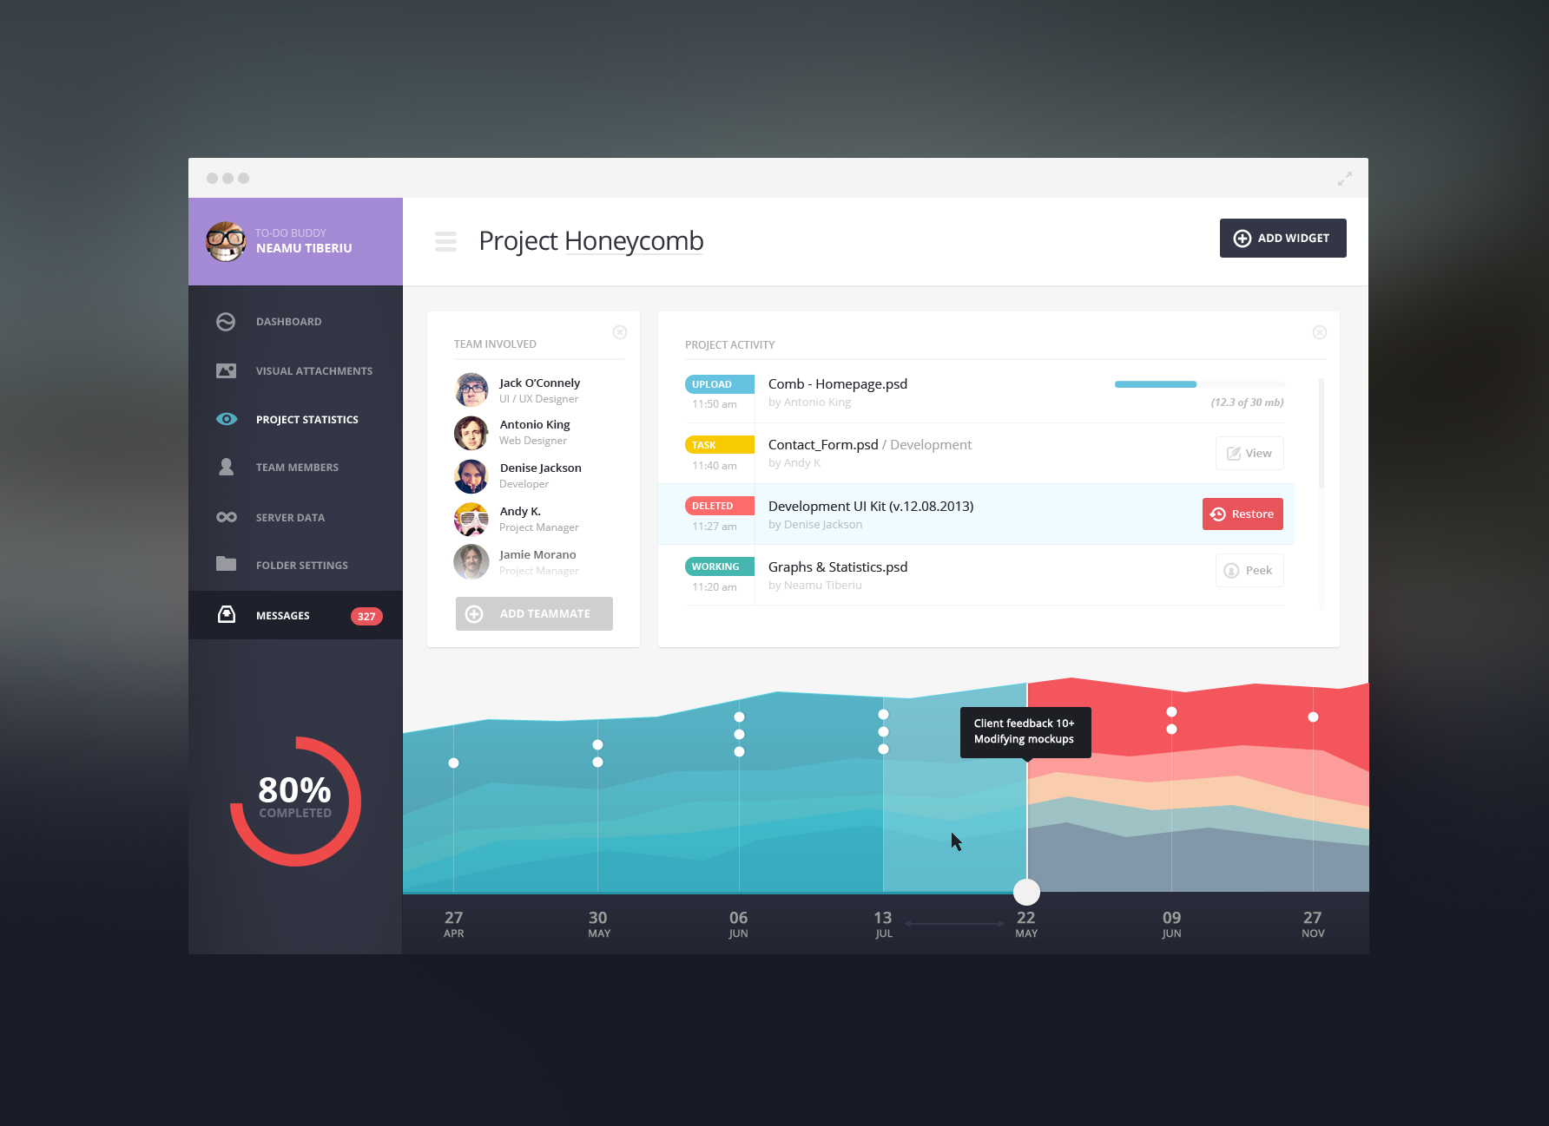
Key Features
LogoCraft offers a vast library of customizable templates for users.
Users can access a variety of design tools to manipulate text, colors, and shapes.
The platform supports high-resolution downloads for professional use.
Notes:
Image source: https://www.templatesperfect.com

Slide 4

User Experience
The interface is intuitive, allowing users to navigate easily without prior experience.
Tutorials and design tips are embedded within the platform for user guidance.
Real-time previews enable users to see changes instantly as they design.
Notes:
Image source: https://evocom.net

Slide 5
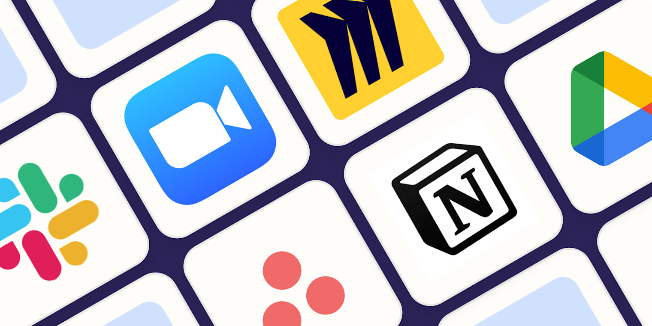
Collaboration Tools
LogoCraft includes features for team collaboration on logo designs.
Users can share designs directly through the platform for feedback.
The platform enables version control, allowing users to track design iterations.
Notes:
Image source: https://images.ctfassets.net

Slide 6
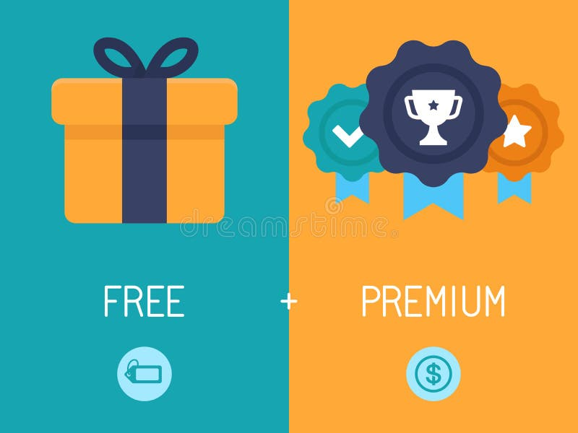
Pricing and Accessibility
LogoCraft offers a freemium model, providing basic features at no cost.
Premium subscriptions unlock advanced features and additional assets.
The platform is accessible on various devices, including tablets and smartphones.
Notes:
Image source: https://thumbs.dreamstime.com

Slide 7

Future Developments
LogoCraft plans to integrate AI-driven design suggestions to enhance creativity.
There are ongoing efforts to expand the library of templates and assets.
User feedback will continuously shape the platform's evolution and improvements.
Notes:
Image source: https://www.visily.ai

Slide 8
References
LogoCraft Official Website.

Slide 9
Thankyou

