Slide 1
KEYLOGGER AND SECURITY
CAPSTONE PROJECT
Presented By:
1.RAMYAA.R - College of Engineering Guindy Anna University-Information Science and Technology

Slide 2
OUTLINE
Problem Statement
Proposed System/Solution
System Development Approach
Algorithm & Deployment
Result (Output Image)
Conclusion
Future Scope
References

Slide 3
PROBLEM STATEMENT
In today's digital age, where cybersecurity threats loom large, one of the significant concerns is the proliferation of keyloggers, stealthy software tools designed to monitor and record keystrokes on a user's computer without their knowledge. Keyloggers pose a severe threat to individuals and organizations as they can capture sensitive information such as passwords, credit card details, and other personal data, leading to identity theft, financial loss, and privacy breaches.

Slide 4
PROPOSED SOLUTION
Design and Planning:
Objectives and Scope: Clearly define the purpose of the keylogger system and its intended use..
Determine the target platform(s) for the keylogger (e.g., Windows, macOS, Linux) and the programming language to be used (e.g., Python, C++).
Data Collection:
Outline the types of data to be collected by the keylogger, including keystrokes, timestamps, and window titles.
Describe methods for securely capturing and storing collected data while addressing privacy and security concerns.
Data Preprocessing:
Data Cleaning, the process of cleaning and preprocessing captured data to remove sensitive or irrelevant information..
Encryption is of encrypting stored data to ensure confidentiality and integrity.
Stealth Mode Implementation:
Stealth Techniques present various techniques for running the keylogger in stealth mode to evade detection by users and antivirus software.
Process hiding describe methods for hiding the keylogger process from task managers and system monitoring tools.

Slide 5
PROPOSED SOLUTION
Logging and Storage:
Logging mechanism describe the mechanism developed to store captured data, discussing options for local or remote storage based on requirements.
Data upload explain features for periodically uploading logged data to secure servers or cloud storage for remote access and analysis.
Error Handling and Reliability:
Robust error handling present strategies for implementing robust error handling mechanisms to manage exceptions and ensure the reliability of the keylogger.
Resource monitoring discuss the importance of monitoring system resources and disk space to prevent crashes or data loss due to resource exhaustion.
Testing and Evaluation:
Testing procedures describe the testing procedures employed to evaluate the functionality and reliability of the keylogger in various scenarios.
Performance evaluation discuss the performance metrics used to assess data capture accuracy, stealthiness, and resource usage of the keylogger.
Documentation and Compliance:
Thorough documentation highlight the importance of thorough documentation of the keylogger system, including design, implementation details, and usage instructions.
Legal compliance emphasize the need for compliance with relevant laws and regulations governing the creation and use of keyloggers, including obtaining proper authorization and consent.

Slide 6
SYSTEM APPROACH
Requirement Analysis:
Identify and analyze the requirements of the keylogger system, including functionality, performance, and security considerations.
Gather input from stakeholders to ensure that the system meets their needs and expectations.
Design Phase:
Develop a detailed design for the keylogger system, outlining its architecture, components, and interfaces.
Consider factors such as data flow, storage, and processing requirements, as well as usability and user interface design.
Development and Implementation:
Implement the designed keylogger system using appropriate programming languages and frameworks.
Follow best practices for software development, including modular design, code reusability, and version control.
Testing:
Conduct rigorous testing of the keylogger system to validate its functionality, reliability, and security.
Perform unit testing, integration testing, and system testing to identify and address any defects or vulnerabilities.

Slide 7
SYSTEM APPROACH
Deployment and Integration:
Deploy the keylogger system in the target environment, ensuring compatibility with existing systems and infrastructure.
Integrate the keylogger system with other security tools and processes to enhance overall cybersecurity posture.
Maintenance:
Implement mechanisms for monitoring the performance and security of the keylogger system in real-time.
Regularly update and maintain the system to address emerging threats and vulnerabilities, and to incorporate new features and enhancements.

Slide 8
ALGORITHM & DEPLOYMENT
This Python code creates a basic keylogger using the pynput library and a simple GUI built with tkinter. Let's break down the algorithm and approach used in this code:
Import Required Libraries:
The code imports necessary libraries including tkinter for GUI, keyboard from pynput for capturing keyboard events, and json for handling JSON data.
Global Variables:
keys_used: List to store information about the pressed, held, and released keys.
flag: Boolean variable to track whether a key is being held.
keys: String variable to store the sequence of keys pressed.
Functions:
generate_text_log(key): Writes the pressed keys to a text file named "key_log.txt".
generate_json_file(keys_used): Writes the captured keys to a JSON file named "key_log.json".
on_press(key): Callback function invoked when a key is pressed. It adds the pressed or held key to the keys_used list and generates the JSON file.
on_release(key): Callback function invoked when a key is released. It adds the released key to the keys_used list, updates the keys string, and generates both text and JSON log files.
start_keylogger(): Initiates the keylogger by starting the listener and updating the GUI.
stop_keylogger(): Stops the keylogger by stopping the listener and updating the GUI.

Slide 9
GUI Creation:
Creates a simple GUI window using tkinter with two buttons: "Start" and "Stop", and a label to display the keylogger status.
Main Functionality:
When the "Start" button is clicked, it starts the keylogger by calling start_keylogger().
When the "Stop" button is clicked, it stops the keylogger by calling stop_keylogger().
Event Handling:
The keylogger captures keyboard events using the pynput library's Listener class.
The on_press() and on_release() functions are invoked when a key is pressed and released, respectively.

Slide 10
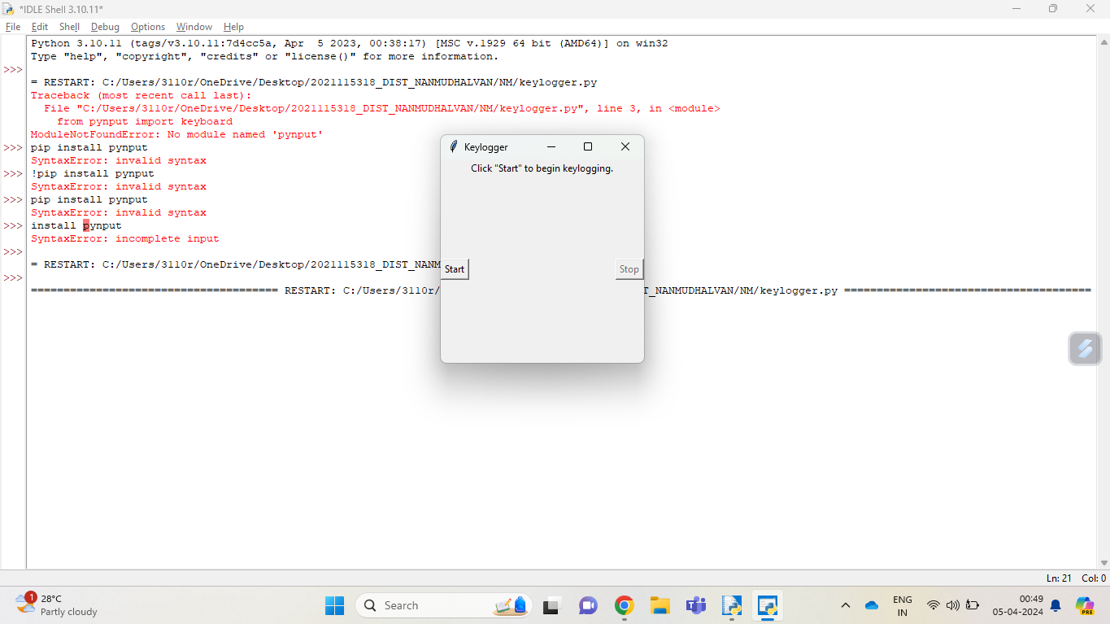
RESULT

Slide 11
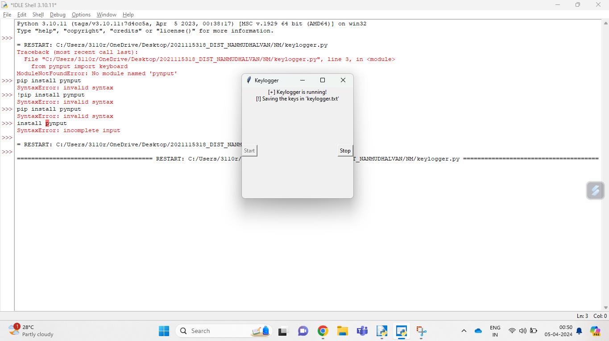
RESULT

Slide 12
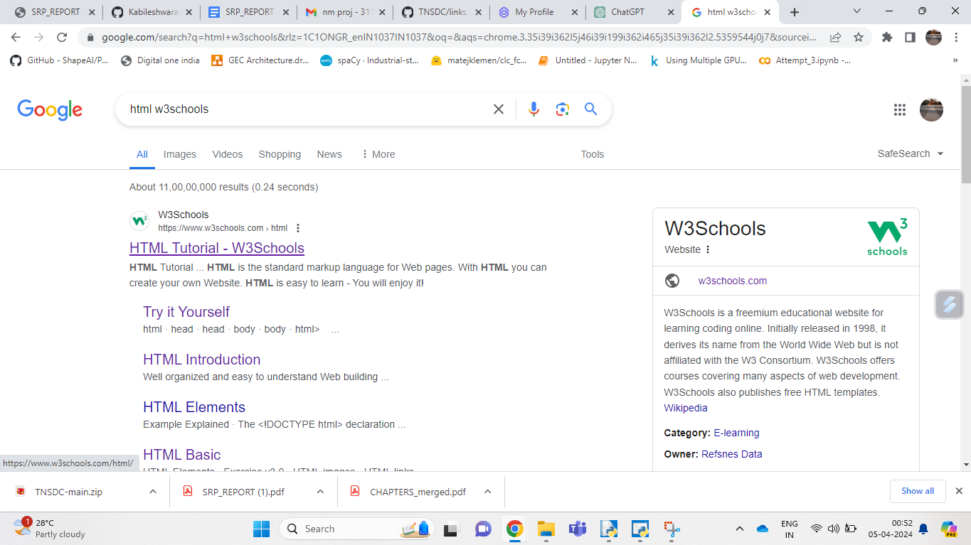
RESULT

Slide 13
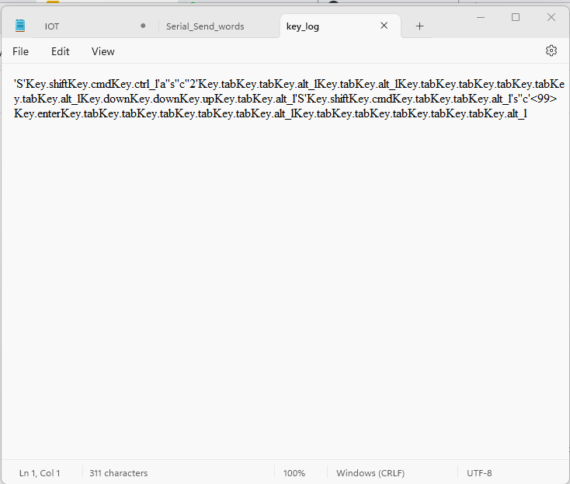
RESULT

Slide 14
CONCLUSION
The provided Python code showcases a fundamental implementation of a keylogger utilizing the pynput library to capture keyboard events and tkinter for constructing a basic GUI interface. This keylogger adeptly records pressed, held, and released keys, storing the data in both text and JSON formats. It furnishes users with the capability to initiate and cease the keylogging process through the GUI, rendering the logger user-friendly and easily controllable.
While the existing implementation effectively achieves its core aim of logging keystrokes, there exist several avenues for refinement and extension to elevate its functionality and user experience.

Slide 15
FUTURE SCOPE
Increased Demand:
Potential for growth in cybersecurity and parental control.
Technological Advancements:
Malware developers may create more sophisticated keyloggers.
Keyloggers might be integrated into hardware for stealth.
Cloud-based logging could pose new privacy challenges.
Legal and Ethical Concerns:
Stricter privacy regulations may limit keylogger use.
Emphasis on transparency and user consent will rise.
Future Outlook:
Balance needed between utility and ethical user protection.
Public awareness about keyloggers is likely to increase.
Regulations around keylogger use may become stricter.

Slide 16
REFERENCES
1. K. C. Yang, "An Improved Keylogging Detection and Prevention System," IEEE Xplore, 2017. [Online].
2. G. Kaspersky, "How to Protect Yourself Against Keyloggers," Kaspersky, 2021.
3. A. Carvey, "Forensic Analysis of Keystroke Dynamics," SANS Institute, 2005. [Online].
4. M. Deshmukh, "Detecting Keylogger Attacks Using Machine Learning Techniques," International Journal of Advanced Research in Computer Science, 2017.
5. C. Silver, "Keylogging and User Privacy," Association for Computing Machinery, 2013.

Slide 17
THANK YOU

