Slide 1
Software Release Planning for Agile Project Management
Ramya Krishnan (rkrishnan1@hawk.iit.edu)
Swetha Radhakrishnan (sradhakrishnan@hawk.iit.edu)
Jane Downer (jdowner@hawk.iit.edu)

Slide 2
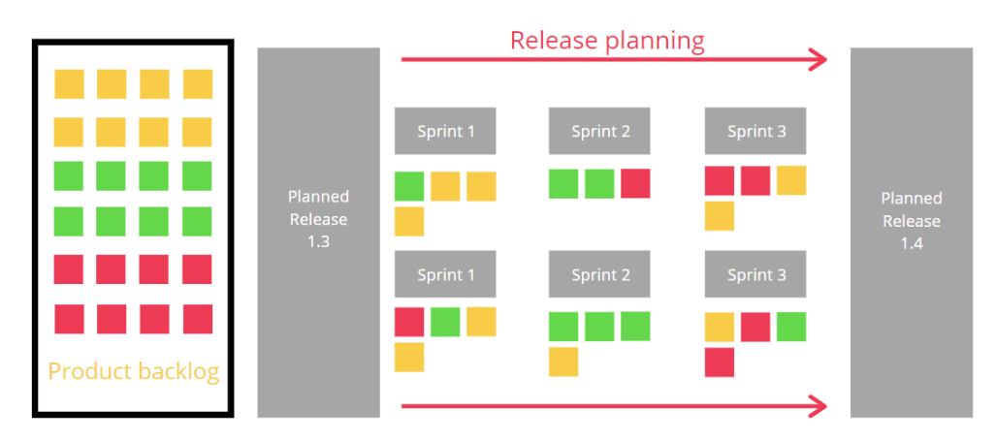
What is Agile Release Planning?
Agile release planning is a product management method where we plan incremental releases of a product.
In Agile release planning, staged releases are break down into several different sprints or iterations.
Depending on the team structure and the size of the project, we can have several sprints running at the same time.

Slide 3
Purpose
Release planning (RP) addresses decisions related to selecting and assigning features to create a sequence of consecutive product releases that satisfies important technical, resource, budget, and risk constraints.
A release plan outlines immediate future releases, but doesn’t try to plan for years in advance.
It is unique from a product roadmap (high-level scope and timeline) because it goes into more detail.
To ensure that a coherent version of the product is created every time.

Slide 4
A good release plan should
Provide maximum business value by offering the best possible blend of features in the right sequence of releases.
Satisfy the most important stakeholders involved.
Be feasible with available resources.
Reflect existing dependencies between features.

Slide 5
Difference between Release Planning and Iteration Planning
Release Planning:
Involves estimating 2–3 months worth of stories.
Basis for planning the next release in terms of prioritizing features and staffing the development team
The estimates are also used for contract negotiations and bidding.
Iteration Planning:
User stories are broken up into development tasks.
Estimates at this level are detailed, but as weekly or biweekly iterations are most common

Slide 6
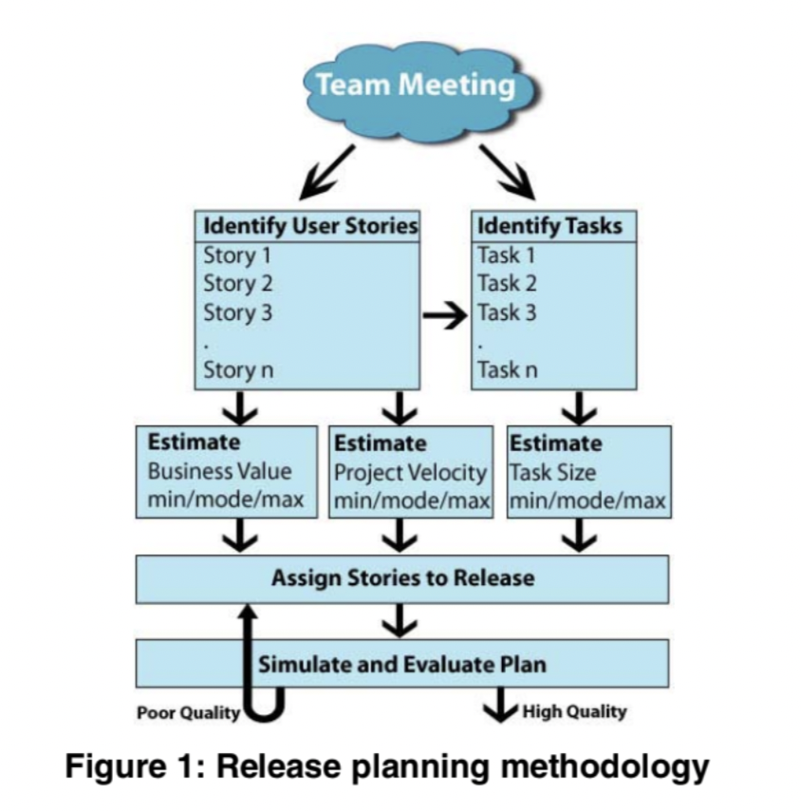
The release planning process includes the following activities
Features are broken down into user stories.
The user stories are identified for the release.
The development team estimates the size of each user story.
The product owner prioritizes the user stories.
The product owner identifies the release features given the available resources.
The product manager and the development team estimate the release date.
The product owner gets the development team commitment on the release date.

Slide 7
The iteration planning process includes the following activities
The product owner and the development team establish an iteration goal.
The team members estimate the work.
The development team chooses the user stories from the product backlog that support the iteration goal.
If the development team finds any of the user stories do not fit in the current iteration, they can remove them from the iteration.
Team members break the user stories into individual tasks and allocate a number of hours to each task.
If a task exceeds the hours available, the development team will discuss with product owner what tasks/user stories are the best to remove.
If the development team finds an extra time available within the iteration, they can include another user story.

Slide 8
Planning Poker
Development teams utilize planning poker, often referred to as "scrum poker" and "pointing poker," as a gamified method to estimate the effort of project management tasks.
Index cards with the values 0.5, 1, 2, 3, 4 and >4 printed on them were distributed to each developer.
Once the user story was explained, developers will individually estimate the effort required and simultaneously reveal the estimated value.
If there is a difference of opinion, developer with highest and lowest estimate will justify their estimate, after a discussion, moderator(Project Manager) will make a decision.

Slide 9
Features that tools provide for release planning:
There are numerous tools available to create release plan for a project. Some of its features are given below,
Create New Release
Edit/Delete User Story
Release Burn-Down Chart
Create New Iteration
Calculate the Iteration Velocity
Iteration Burn-Down Chart

Slide 10
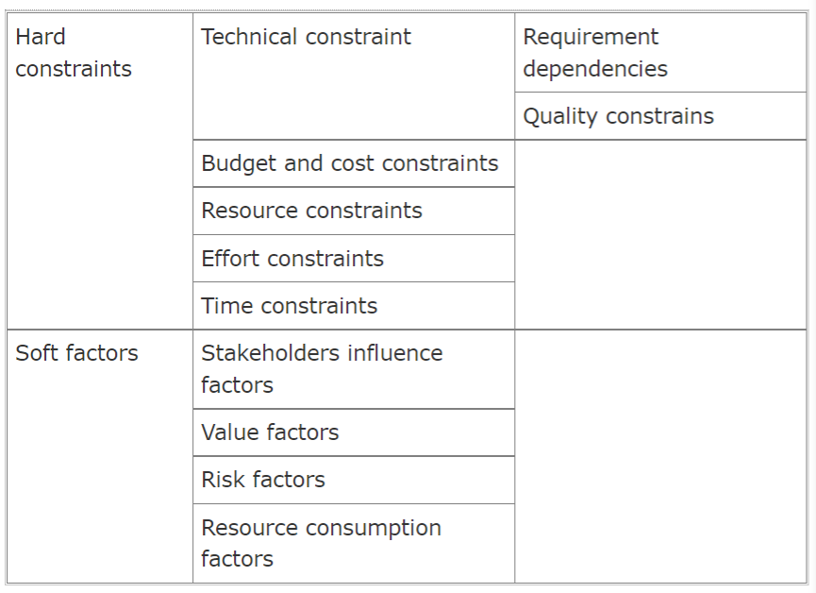
Constraints in Release Planning

Slide 11
Conclusion
Companies are adopting agile practices more frequently, and they require a release strategy that fits inside that framework.
A 2020 McKinsey study finds that businesses that go agile generally:
Increase operational performance by 30% to 50%
Increase employee engagement by 20% to 30%
Improve financial performance between 20% and 30%

Slide 12
References
K. Logue and K. McDaid, "Agile Release Planning: Dealing with Uncertainty in Development Time and Business Value," 15th Annual IEEE International Conference and Workshop on the Engineering of Computer Based Systems (ecbs 2008), 2008, pp. 437-442, doi: 10.1109/ECBS.2008.58.
H. C. Benestad and J. E. Hannay, "A comparison of model-based and judgment-based release planning in incremental software projects," 2011 33rd International Conference on Software Engineering (ICSE), 2011, pp. 766-775, doi: 10.1145/1985793.1985901.
P. Kaur, "Reinforcement Learning Based Approach for Adaptive Release Planning in an Agile Environment," 2010 International Conference on Computational Intelligence and Software Engineering, 2010, pp. 1-4, doi: 10.1109/CISE.2010.5676859.
N. C. Haugen, "An empirical study of using planning poker for user story estimation," AGILE 2006 (AGILE'06), 2006, pp. 9 pp.-34, doi: 10.1109/AGILE.2006.16.
G. Ruhe and M. O. Saliu, "The art and science of software release planning," in IEEE Software, vol. 22, no. 6, pp. 47-53, Nov.-Dec. 2005, doi: 10.1109/MS.2005.164.
S. Alyahya, M. Alqahtani and M. Maddeh, "Evaluation and improvements for agile planning tools," 2016 IEEE 14th International Conference on Software Engineering Research, Management and Applications (SERA), 2016, pp. 217-224, doi: 10.1109/SERA.2016.7516149.

