Slide 1
B. RAMYA B.TECH IT – III YEAR Project title: CNN-based Autoencoder Unleashes Deep Learning Potential

Slide 2
CNN-based Autoencoder
Autoencoders, a class of neural networks, have gained significant attention in the field of deep learning for their ability to learn efficient representations of data. Among various types of autoencoders, Convolutional Neural Network (CNN) based autoencoders have demonstrated remarkable performance in extracting hierarchical features from image data. This paper explores the application of CNN-based autoencoders for feature learning in image data.

Slide 3
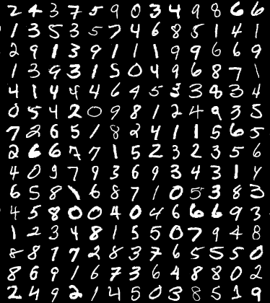
AGENDA
The project introduces a novel approach utilizing Convolutional Neural Network (CNN) based autoencoders for feature learning in image data. By integrating convolutional layers into the traditional autoencoder architecture, the model effectively captures spatial hierarchies and local correlations inherent in images. Through unsupervised learning, the CNN-based autoencoder learns to compress input images into a lower-dimensional latent space and reconstructs them with minimal loss, preserving essential features.

Slide 4
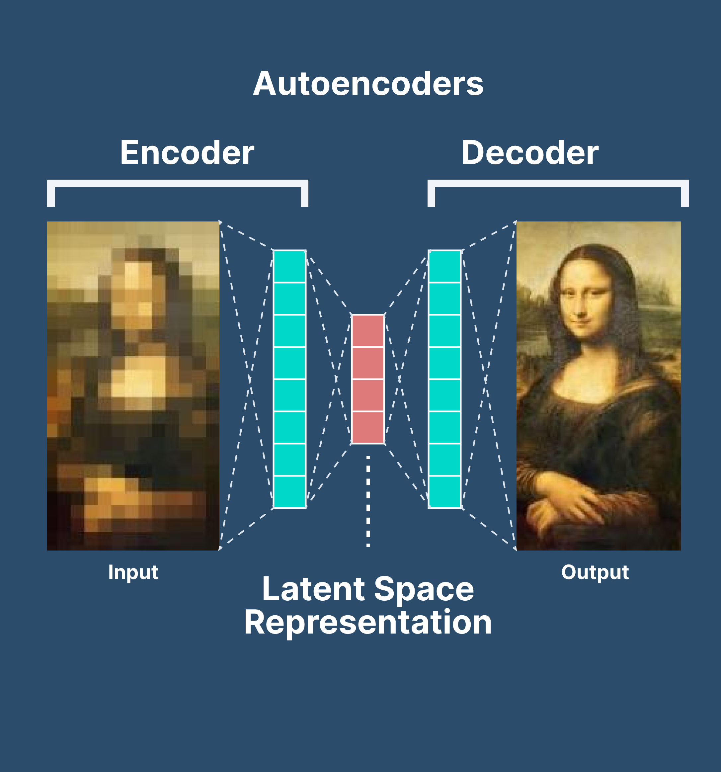
PROJECT STATEMENT
The problem statement revolves around developing a CNN-based autoencoder architecture capable of effectively compressing input images into a lower-dimensional latent space while preserving essential features for accurate reconstruction.
Additionally, the project aims to demonstrate the effectiveness of the learned representations for downstream tasks such as image classification and object detection.

Slide 5
PROJECT OVERVIEW
This project focuses on leveraging Convolutional Neural Network (CNN) based autoencoders for feature learning in image data. The objective is to address the challenge of capturing spatial hierarchies and local correlations inherent in images, which traditional autoencoders may struggle to achieve. By integrating convolutional layers into the autoencoder architecture, the model aims to extract meaningful representations from the input images in an unsupervised man.ner

Slide 6
Deep Learning Researchers
Computer Vision Engineers
END USERS
Software Developers
Data Scientists

Slide 7
SOLUTION:
The project introduces a pioneering solution in deep learning, leveraging
Convolutional Neural Network (CNN) based autoencoders for feature learning in image
data. By integrating convolutional layers into the traditional autoencoder architecture, our
solution adeptly captures spatial hierarchies and local correlations inherent in images.
VALUE PROPORTION:
Our project offers a compelling value proposition by introducing a novel solution in deep
learning, specifically leveraging Convolutional Neural Network (CNN) based autoencoders for feature
learning in image data. This innovative approach addresses the pressing need for more effective
feature extraction methods, particularly in complex image datasets.

Slide 8
THE WOW IN THE SOLUTION
Our project introduces a groundbreaking solution that redefines the landscape of deep learning in image processing. By ingeniously incorporating Convolutional Neural Network (CNN) based autoencoders, we unveil a paradigm-shifting approach to feature learning. This innovative fusion captures the intricate essence of image data, unlocking a treasure trove of spatial intricacies and local correlations. The wow factor lies in our solution's ability to transcend conventional boundaries, seamlessly compressing images into a lower-dimensional space while preserving the essence of their features.

Slide 9

MODELLING
Software like Adobe Photoshop, Adobe Illustrator, or any online tool to create a visual representation of the architecture can be used. This would include layers of convolutional and pooling operations for the encoder and decoder parts of the autoencoder.
Develop visualizations (e.g., scatter plots, heatmaps) showcasing the latent space learned by the autoencoder, illustrating how images are represented in a lower-dimensional space.
If your project involves building an application or interface, you can create wireframes using tools like Balsamiq, Sketch, Adobe XD, or Figma. These wireframes would outline the layout, structure, and functionality of the application, including features related to image analysis or processing.

Slide 10
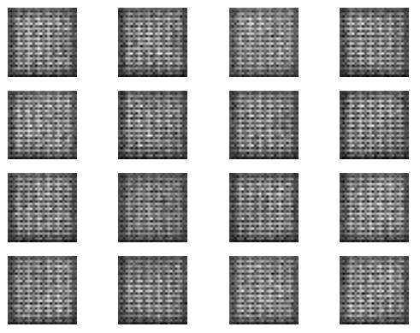
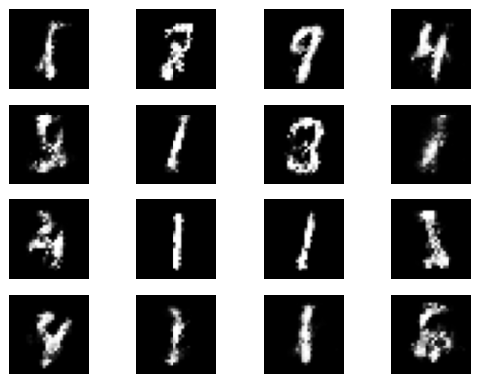
RESULT
After iterative loops

