Slide 1
Alyva-sre
An AI-Native SRE Platform
Onboarding · Alert Rules · Detection & RCA — reasoning is the mechanism, not a feature bolted on top.
Team 1 · SREonCall Hackathon

Slide 2


THE GATE, CHECKED BEFORE ANYTHING ELSE
AI-native, not AI-enabled
SaaS
AI-enabled
AI-native — us
No AI at all.
A deterministic app with a chatbot or summarizer bolted on top.
Delete every LLM call and there is nothing left: no drafted thresholds, no hypothesis, no chat answer.
Checked pass/fail, before the 6-trait score — not folded into it.
Alyva-sre
2

Slide 3



ARCHITECTURE
Three skills, one pipeline
1. Onboarding
2. Alert Rules
3. Detection & RCA
Discovers real services from telemetry. Asks only what it can't derive — never guesses criticality or impact.
Drafts thresholds from real baselines. Backtests, self-tunes, never mutes noise away — only cited adjustments.
Triggers on a real approved-rule breach. Multi-turn tool use, forced structured report, skeptic pass.
Each reads the last one's output — one Project Profile, one rule set, one evidence ledger.
Alyva-sre
3

Slide 4
SCORED ON THESE, NOT VIBES
The 6 traits, with real evidence
Observability
Agency
Every number traces to a live query
3 schedulers confirmed firing unattended
Auditability
Malleability
Evidence ledger on every claim
Follow-ups re-enter the same investigation
Progressive disclosure
Ownership
Headline first, evidence on demand
Real PR opened, edit-then-approve
Alyva-sre
4

Slide 5
WHERE WE'RE AHEAD
Self-learning — real, not aspirational
No agent decides if a pattern is promoted — pure code does. Same four-gate test across all 3 skills:
Generalizable
(2+ matches, not 1)
Material
(consistent, not noise)
Not already captured
(computed fresh)
Minimal footprint
(no new code path)
All 3 other teams scored 0–50 on Self-learning specifically ("no persisted correction loop" / “half still weak”).
This is our clearest relative edge — tested with real prior-edit data, not claimed.
Alyva-sre
5

Slide 6
NOT A DEMO SCENARIO — FOUND LIVE
The agent found a real, recurring bug
Drilling into an actual trace's span data (not just the trace ID) surfaced:
“Error: Product Catalog Fail Feature Flag Enabled”
→ cascading into checkout: “failed to prepare order: failed to get product”
This explained nearly every live incident found across the whole build session —
confirmed independently by an adversarial skeptic pass shown the same raw evidence,
without being told the conclusion first.
Alyva-sre
6

Slide 7
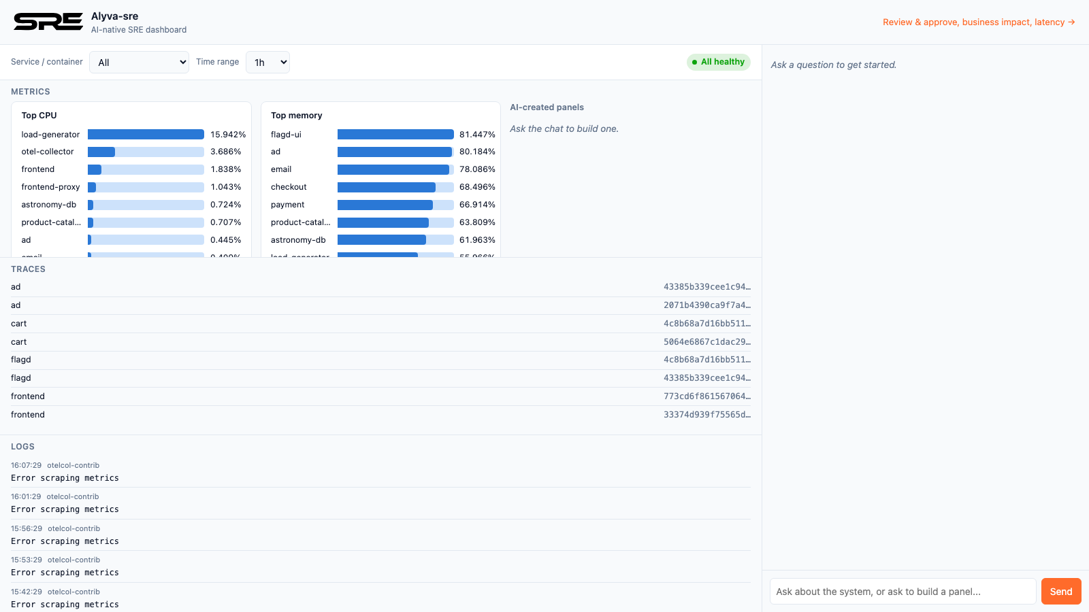
WHAT IT LOOKS LIKE
Live dashboard — metrics, traces, logs, chat
Alyva-sre
7

Slide 8

THE ONE RULE THAT'S NEVER NEGOTIABLE
Self-correction never blinds itself
An agent that “fixes” noise by muting its own alert or disabling its own collector is blinding itself, not fixing anything.
No mute / disable / collector-config tool exists in any skill's registry — anywhere.
Structural, not a prompt asking nicely.
Alyva-sre
8

Slide 9
WHERE THIS STANDS
70.4 · 2nd place
3 skills + dashboard, tested against live data all session
Real bugs found and fixed via testing — not claimed, run and shown
Real PR-opening (draft-then-approve) tested end-to-end
Self-learning + Ownership
Every other team scored weak here.
We have tested code, not a claim.
Alyva-sre
9

Slide 10
Alyva-sre
Thank you.
Questions — or ask it live.

