Slide 1
Integrated Mobile Application for Emergency Medical Assistance: Real-Time Hospital Proximity and Treatment Facility Tracking Using Google Maps API
PIP2001 Capstone Project
VIVA-VOCE
Batch Number: 18
Roll Number | Student Name
20211CSE0370 | RAMYA HANAMANTH SATARADDI
20211CSE0356 | TEJESWINI L
20211CSE0526 | DEEKSHITHA M
Under the Supervision of,
Dr. SenthilKumar S
Professor
School of Computer Science and Engineering
Presidency University
Name of the Program: BTech CSE
Name of the HoD: Dr. Blessed Prince P/Dr. Robin Rohit / Dr. Asif Mohammed H B
Name of the Program Project Coordinator: Mr. Amarnath J L/ Dr Jayanthi K
Name of the School Project Coordinators: Dr. Sampath A K / Dr. Abdul Khadar A / Mr. Md Ziaur Rahman

Slide 2
Introduction
The Integrated Mobile Application for Emergency Medical Assistance aims to enhance emergency response by providing real-time tracking of nearby hospitals and treatment facilities using the Google Maps API. In critical situations, timely access to medical care is vital, and this application will empower users to quickly locate and navigate to the nearest healthcare providers.
Key features include GPS-enabled location tracking, a comprehensive database of medical facilities, educational resources on first aid, and a user-friendly interface. By prioritizing data security and offline access, this app seeks to improve health outcomes and save lives, bridging the gap between individuals in need of urgent care and the healthcare services available to assist them.

Slide 3
Literature Review
Sl. No. | Title of the Paper | Authors | Technology/ Methods used | Results/ Findings | Limitations/ Challenges
1. | Hospital Real-Time Location System (A Practical Approach in Healthcare): A Narrative Review Article | Leila Gholamhosseini, Farahnaz Sadoughi, Aliasghar Safaei (April 2019) | Focuses on HRTLS technologies like RFID, GPS, WLAN, Wi-Fi, and IoT for hospital tracking systems. Emphasizes positioning and cloud computing solutions in healthcare settings. | These systems reduce errors, costs, and improve service speed, enabling tracking of patients, staff, and assets. They enhance patient and staff satisfaction, with accurate data exchange and process control being key benefits. | The study faced limitations due to the lack of Iranian HRTLS literature and the exclusion of non-English and non-Persian sources. Additionally, limited access to full texts of some resources posed challenges.
2. | Domain Specific Search of Nearest Hospital and Healthcare Management System | Ganapathi Shankar, Dr. D. Subba Rao (August-2015) | the A* algorithm for route optimization, and role-based access control for user authentication, along with EHR generation for pre-medical treatment. | EHR enhances patient convenience and safety for chronic conditions, with future improvements targeting distance tracking algorithms and user interface enhancements. | Challenges include data security, privacy concerns, integration with healthcare systems, and ensuring user adoption.

Slide 4
Literature Review
3. | Hospital Finder Application | Rahul A, Satish Babu G, Manoj Kumar S, Nitish K, Mr. Shobit Tembhre (January 2024) | Agile methodology employs iterative development with Scrum and Kanban, focusing on user stories, sprints, daily meetings, and collaboration for flexibility. | The healthcare application improves emergency responses by providing essential information on nearby hospitals and available services, reducing patient shunting significantly. | Real-time data on ICU beds and blood availability is lacking, complicating emergency medical responses.
4. | Implementation of Hospital-Finder | Shivam Bajpai, Tushar Modi, Vatsalya Vinay Sinha, Vidhi Jaiswal (April 2023) | Waterfall model: Requirements, Design, Implementation, Testing, Deployment, & Maintenance. | The application efficiently locates nearby Ayush hospitals and provides essential information, improving emergency responses and patient care accessibility. | The application's effectiveness depends on GPS accuracy and internet access, and it may not reflect real-time hospital service availability.

Slide 5
Literature Review
5. | Hospital Locator and Bed Availability Detector for Emergency Cases | Syed Farzana, Kanakam Sasikalyan, Jasti Manikanta, Kommalapati Manoj, Choppara Prasanth (Dec 2022) | The system utilizes GPS, Google Maps API, PHP, and SQL databases in a client-server architecture to enhance emergency healthcare services. | The application effectively identifies nearest hospitals and available resources, improving emergency response and patient care during crises. | This web-based system requires a strong internet connection to accurately find the nearest hospitals using GPS and Google Maps.
6. | Hospital Finder App | D Tharun, Chandan BM, Shashank Y.C, Dhanush. R (January 2024) | The application utilizes GPS for location tracking, Google Maps API for navigation, and a mobile interface for user interaction. | The app successfully identifies nearest hospitals and available specialists within a five-kilometer radius, enhancing emergency healthcare access. | Dependence on GPS and internet connectivity may hinder performance; limited information on specialist availability can affect user experience.

Slide 6
Literature Review
7. | GPS Based Android Application for Healthcare Dissemination | Ajay Kumar G, Akash Aman, Avinash Kumar, Harshith L (April 2017) | The application utilizes GPS for navigation, J2EE for web services, MySQL for database management, and Android SDK for app development. | Patients can navigate to hospitals offering required services and predict potential diseases based on selected symptoms, enhancing healthcare accessibility. | Accurate hospital service information may be difficult to obtain; predicting diseases relies on user-input symptoms, which could lead to inaccuracies.
8. | Health Care Connect: A Comprehensive Hospital Management System | E. Neelima, Chirudeep, Supriyo Saha, Tarrunee (March 2024) | MERN stack (MongoDB, Express.js, React.js, Node.js) for building a scalable Hospital Management System with modules for patient care, scheduling, and inventory. | The proposed HMS enhances operational efficiency, streamlines administrative processes, and improves patient care through seamless appointment scheduling and electronic health records management. | Potential challenges include data security concerns, integration issues with existing systems, and the need for user training to ensure effective implementation.

Slide 7
Literature Review
9. | Optimizing Hospital-Patient Interactions through Advanced Machine Learning and NLP Methodologies | Ujwal K C, Srividhya Ravichandran (Nov 2023) | DialogFlow, Feedforward Neural Network, Google Maps API, BERT-based NLP, Flask, Keras, QR codes, and AWS Health Scribe. | The system achieved 98.6% accuracy in predicting departments and improved doctor-patient interactions with 75% accuracy in summarization. | Current systems lack holistic integration and may not redirect requests to other hospitals for specialist appointments efficiently.
10. | Hospital Finder Android Application | Prof Shobha MS, Pooja Shantaprasad Utagi, OK Anagha, Deepa M Shidnekoppa, Arjun Arun Nambiar (January 2024) | Utilizes GPS, Android app development, user authentication, real-time data integration, and a user-friendly interface for efficient hospital searches. | Improved access to healthcare, reduced decision-making stress, enhanced communication between hospitals and patients, and increased awareness of available resources. | Dependence on accurate GPS data, potential technical issues, user data privacy concerns, and limited database updates for hospital information.

Slide 8
Research Gaps Identified
1. Static Hospital Directories: Many applications provide static lists of hospitals and clinics without real-time updates.
Drawbacks:
- Lack of real-time location tracking.
- Inability to assess current traffic conditions or facility availability.
2. Basic Mapping Applications: General mapping apps allow users to find hospitals but lack specific emergency features.
Drawbacks:
- No integration of emergency protocols or first aid information.
- Limited focus on medical facilities, making it hard for users in emergencies.
3. Emergency Call Services: Some applications facilitate emergency calls to services without additional features.
Drawbacks:
- Delayed response due to reliance on call centers.
- Lack of user-driven navigation to nearby facilities.

Slide 9
Research Gaps Identified
4. GPS-Based Location Services: Use GPS to show user location and nearby hospitals.
Drawbacks:
- Often do not include real-time traffic updates.
- Limited context on the types of services provided by nearby facilities.
5. First Aid Apps: Focus on providing first aid instructions without location features.
Drawbacks:
- Do not assist in locating medical facilities.
- Users may need additional tools for navigation during emergencies.

Slide 10
Objectives
Emergency Navigation: Provide users with real-time directions to the nearest hospital with the most suitable facilities, considering traffic conditions.
Provide real-time hospital proximity based on location.
Display available medical facilities and specialized treatment options.
Ensure access to critical resources like medicines and blood.
Minimize decision-making delays during medical emergencies.
Incorporate User Feedback on the app's functionality and usability, allowing for ongoing improvements.

Slide 11
Proposed Methodology
1. Requirement Gathering and Analysis: Identify key features such as real-time location tracking, hospital proximity, facility information, and user-friendly design.
- Analyze user needs and emergency response requirements.
2. Technology Stack : Google Maps API for real-time location tracking and proximity-based search for medical facilities. - Implement MongoDB for storing facility information and user data securely.
3. Application Design: Design a user-friendly interface using Figma.
- Focus on simple navigation, easy access to emergency features, and real-time updates.
4. Development: - Front-End: Develop the mobile interface using Android Studio.
- Back-End: Build server-side logic using Java/Kotlin for managing user data, real-time updates, and integration with APIs.
- Google Maps API Integration: Implement Google Maps API to display real-time location, nearby hospitals, and navigation routes.

Slide 12
Proposed Methodology
5. Database Integration: - Create a database of hospitals and healthcare facilities with detailed information on services, contact details, and proximity.
- Implement secure data handling practices for user privacy.
6. Testing: - Perform Unit Testing to validate each function individually.
- User Acceptance Testing to ensure the app meets user expectations.
- Test the app’s performance, usability, and reliability under various emergency scenarios.
7. Deployment and Maintenance: - Deploy the application on Google Play Store
- Set up a feedback loop for continuous improvements and bug fixes.
8. User Feedback and Updates: - Collect user feedback to enhance features and improve user experience.
- Regularly update the hospital database and refine the app based on feedback and changing needs.

Slide 13
System Design and Implementation
1.Input Design
Input Design serves as the connection between the user and the information system
• What data should be provided as input?
• How should the data be arranged or encoded?
• Providing clear guidance to the operating personnel for input entry.
• Preparing input validation methods and handling errors when they occur.
2.Output Design
• Organized Development: Outputs should be planned systematically to meet user requirements while ensuring the system is easy to use.
• Information Presentation: Selecting effective methods for presenting the data.
• Formats and Reports: Creating documents, reports, or formats containing the generated information

Slide 14
System Design and Implementation
3. Implementation
The implementation phase involves translating the planned modules and features into a fully functional system.
- Admin Module
1.Donor management
2.User Requests
3.Doctor and Blood Bank Management
4.Reports and insights
- Doctor module
1.Registration and Login
2.Availability Management
3.Communication

Slide 15
System Design and Implementation
- Blood bank module
1.Registration and Login
2.Profile Management
3.Inventory Updates
4.Collaboration
- User Module
1.Registration and Login
2.Search and Request
3.Access to Doctors and Blood Banks
4.Notifications and Alerts
- Specialist Doctors module
1.Registration and Login
2.First -aid Contributions
3.Suggestions and Monetary
4.Collaboration

Slide 16
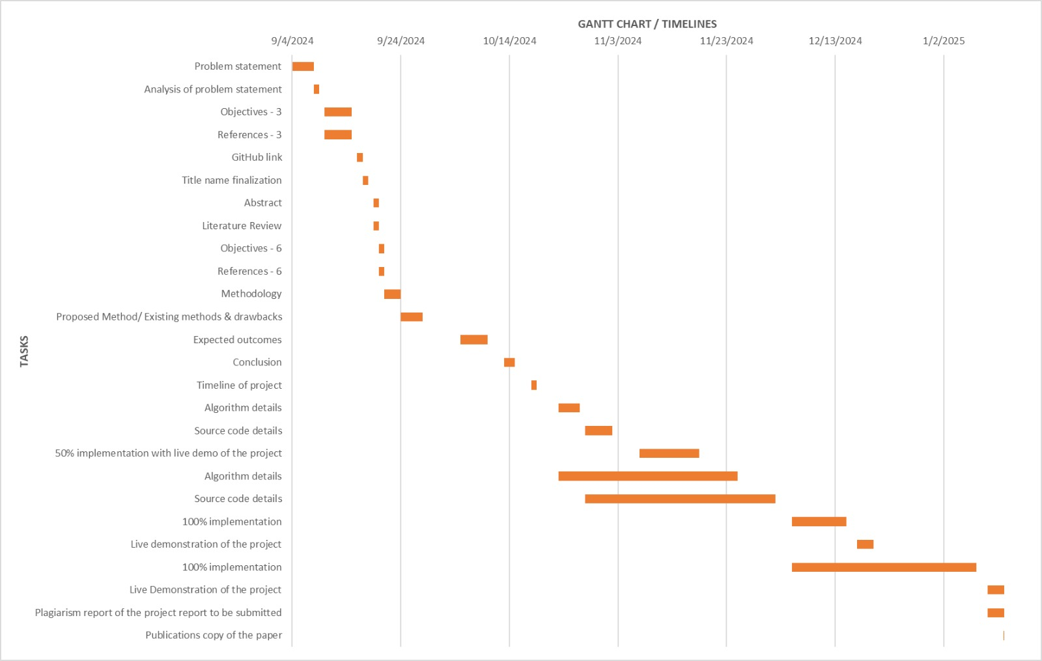
Timeline of Project

Slide 17
Outcomes
1. Faster Emergency Response.
2. Accurate Hospital Information
3. Efficient Navigation
4. User-Friendly Interface
5. Improved Communication with Hospitals
6. Enhanced Healthcare Access
7. Scalability

Slide 18
Conclusion
The Integrated Mobile Application for Emergency Medical Assistance provides a critical solution for improving access to healthcare in emergencies. By leveraging real-time tracking with the Google Maps API and integrating a comprehensive database of medical facilities, the app ensures users can swiftly locate and navigate to the nearest healthcare providers. Its user-friendly design, combined with secure data handling and offline capabilities, makes it an essential tool for both users and emergency responders.
Through this project, we address the existing gaps in emergency healthcare accessibility, offering a more efficient, reliable, and informative approach to saving lives. The continuous improvement of the app, based on user feedback and evolving healthcare needs, will ensure its long-term relevance and impact on enhancing emergency medical assistance.

Slide 19
Github Link
The Github link provided should have public access permission.
Github Link
https://github.com/Ramyahs007/HospitalFinder-PSCS211-ID18.git

Slide 20
References
Leila Gholamhosseini, Farahnaz Sadoughi, Aliasghar Safaei, “Hospital Real-Time Location System (A Practical Approach in Healthcare): A Narrative Review Article”, Iran J Public Health, Vol. 48, No.4, Apr 2019, pp.593-602.
Ganapathi Shankar, Dr. D. Subba Rao, “Domain Specific Search of Nearest Hospital and Healthcare Management System”, International Journal of Advanced Technology and Innovation Research, ISSN 2348–2370 Vol.07,Issue.10, August-2015, Pages:1726-1729.
Rahul A, Satish Babu G, Manoj Kumar S, Nitish K, Mr. Shobit Tembhre, “Hospital Finder Application”, International Journal of Research Publication and Reviews, Vol 5, no 1, pp 1621-1624 January 2024.
Shivam Bajpai, Tushar Modi, Vatsalya Vinay Sinha, Vidhi Jaiswal, “Implementation of Hospital-Finder”, International Journal of Research Publication and Reviews, Vol 4, no 4, pp 3344-3346, April 2023.
Syed Farzana, Kanakam Sasikalyan, Jasti Manikanta, Kommalapati Manoj, Choppara Prasanth, “Hospital Locator and Bed Availability Detector for Emergency Cases”, International Research Journal of Engineering and Technology, Volume: 09, Issue: 12, Dec 2022.

Slide 21
References
D Tharun, Chandan BM, Shashank Y.C, Dhanush. R, “Hospital Finder App”, International Journal of Research Publication and Reviews, Vol 5, no 1, pp 1904-1910, January 2024.
Ajay Kumar G, Akash Aman, Avinash Kumar, Harshith L,” GPS Based Android Application for Healthcare Dissemination ”, International Research Journal of Engineering and Technology, e-ISSN: 2395 -0056, p-ISSN: 2395-0072, Volume: 04, Issue: 04, Apr -2017.
E. Neelima, Chirudeep, Supriyo Saha, Tarrunee, “Health Care Connect: A Comprehensive Hospital Management System”, International Research Journal of Engineering and Technology, e-ISSN: 2395-005, Volume: 11, Issue: 03, Mar 2024
Ujwal K C, Srividhya Ravichandran,” Optimizing Hospital-Patient Interactions through Advanced Machine Learning and NLP Methodologies”, International Research Journal of Engineering and Technology, e-ISSN: 2395-0056, Volume: 10, Issue: 11, Nov 2023.
Prof Shobha MS, Pooja Shantaprasad Utagi, OK Anagha, Deepa M Shidnekoppa, Arjun Arun Nambiar, “Hospital Finder Android Application”, International Research Journal of Modernization in Engineering Technology and Science, e-ISSN: 2582-5208, Volume:06, Issue:01, January-2024.

Slide 22
Pseudocode
package com.example.hospitalfinder.presentationLayer.common;import androidx.appcompat.app.AppCompatActivity;import androidx.cardview.widget.CardView;import android.annotation.SuppressLint;import android.content.Intent;import android.os.Bundle;import com.example.hospitalfinder.R;import com.example.hospitalfinder.presentationLayer.admin.AdminMainActivity;import com.example.hospitalfinder.presentationLayer.bloodBank.BloodMainActivity;import com.example.hospitalfinder.presentationLayer.doctor.DoctorMainActivity;import com.example.hospitalfinder.presentationLayer.specialDoctor.SpecialisedMainActivity;import com.example.hospitalfinder.presentationLayer.user.UserMainActivity;public class MainActivity extends AppCompatActivity { @SuppressLint("MissingInflatedId") @Override protected void onCreate(Bundle savedInstanceState) { super.onCreate(savedInstanceState); setContentView(R.layout.activity_main); CardView imageView=findViewById(R.id.logo); imageView.setAlpha(0f); String name=getSharedPreferences("user",MODE_PRIVATE).getString("type","");
imageView.animate().setDuration(500).alpha(1f) .withStartAction(()->{ overridePendingTransition(androidx.appcompat.R.anim.abc_fade_in,androidx.appcompat.R.anim.abc_fade_out);

Slide 23
Pseudocode
}).withEndAction(()->{ finish();
switch (name){ case"admin":
startActivity(new Intent(MainActivity.this, AdminMainActivity.class));
break; case "User":
startActivity(new Intent(MainActivity.this, UserMainActivity.class));
break; case "Doctor":
startActivity(new Intent(MainActivity.this, DoctorMainActivity.class));
break; case "Specialised Doctor":
startActivity(new Intent(MainActivity.this, SpecialisedMainActivity.class));
break; case "Blood Bank":
startActivity(new Intent(MainActivity.this, BloodMainActivity.class));
break; case "":
startActivity(new Intent(MainActivity.this, LoginActivity.class));
break;
} }); }}

Slide 24
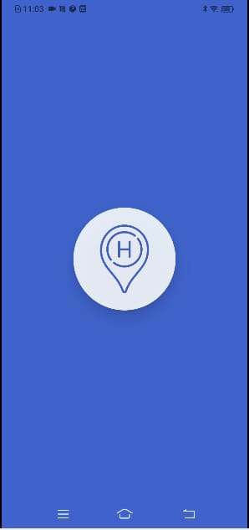
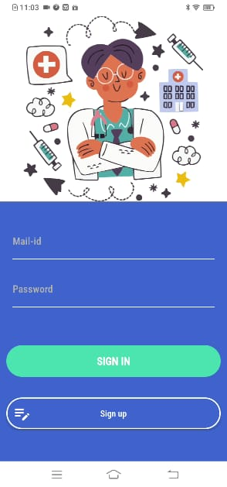
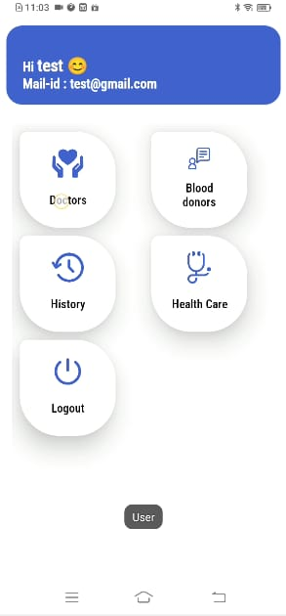
Screenshots

Slide 25
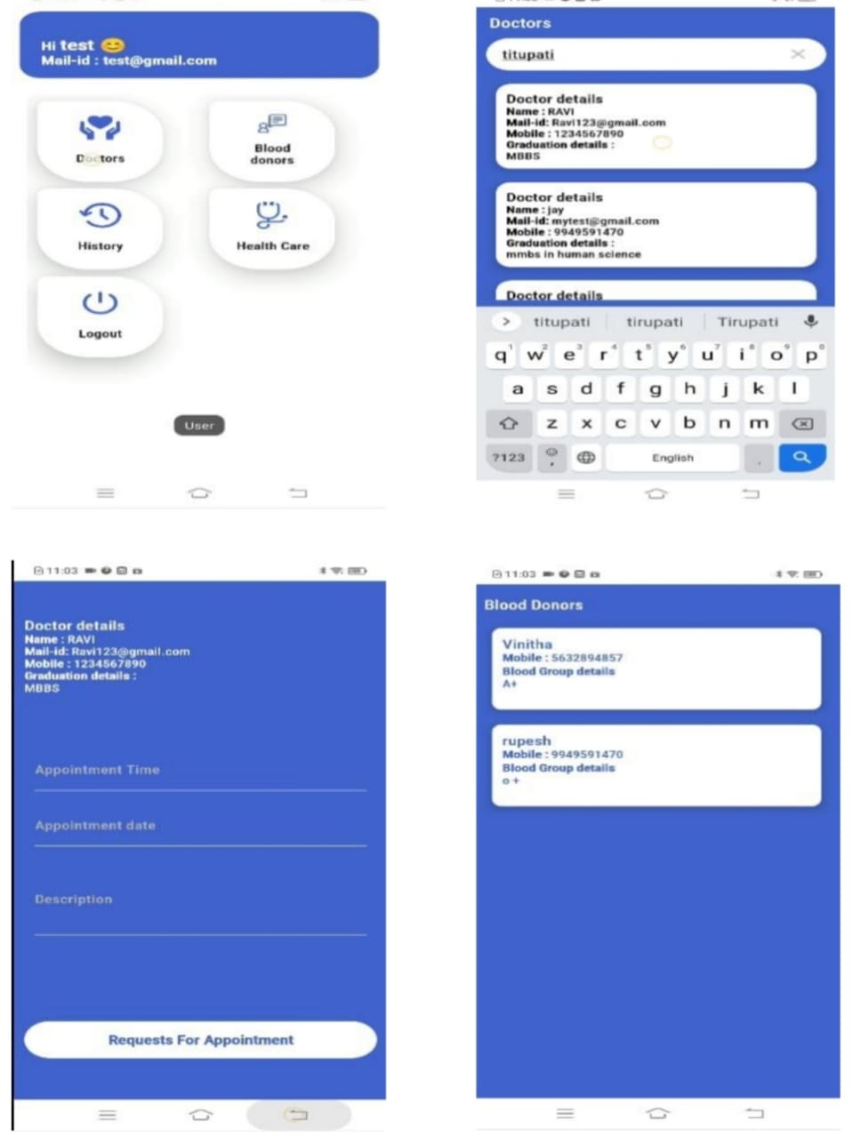
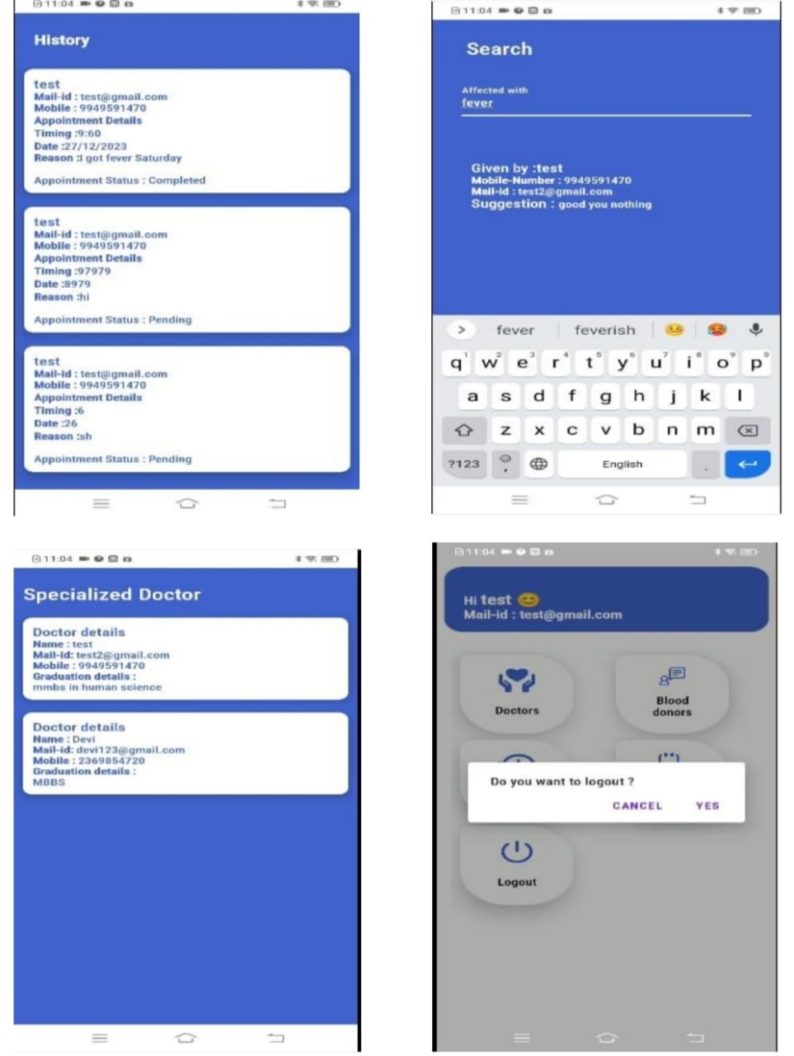
Screenshots

Slide 26
Publication Details
Title: "Integrated Mobile Application for Emergency Medical Assistance: Real-Time Hospital Proximity and Treatment Facility Tracking Using Google Maps Api"
Authors: Dr. SenthilKumar S, Ramya Hanamanth Sataraddi, Tejeswini L, Deekshitha M
Author ID: 24120022
ISSN Number: 2412-0022
Published In: Prime Publication Hub
Publication Date: January 2025
Access Link: https://drive.google.com/file/d/1dNfolSzbPicM6BYSoD9XJc6RiMCGZ5fi/view?usp=drive_link

Slide 27
Publication Details
Abstract - The proposed system offers a unified platform designed to simplify blood donation processes, foster interactions between medical professionals, and enhance user engagement. Administrators can effectively manage the database by adding new blood donors, reviewing user blood requests, and accessing details of registered doctors and blood banks. Dedicated features enable doctors and blood banks to register, log in, and manage their profiles, with doctors having the additional capability to update their availability. Users benefit from a user-friendly interface that facilitates registration, login, viewing lists of doctors and blood banks, requesting blood donors through the admin, and accessing real-time information on donor availability. A unique module for Specialist Doctors (SDoctors) allows for registration, login, sharing first aid resources, and tracking suggestion analytics. This integrated system improves communication among all stakeholders in the healthcare network, enabling efficient blood donation management and encouraging collaborative knowledge exchange among medical professionals.
KEYWORDS: Comprehensive Digital Platform, Seamless Connectivity, Real-time Updates, Enhanced User Interaction, Admin Database Oversight, Trustworthy Vetting, Optimizing Healthcare Services.

Slide 28
Thank You

