Slide 1
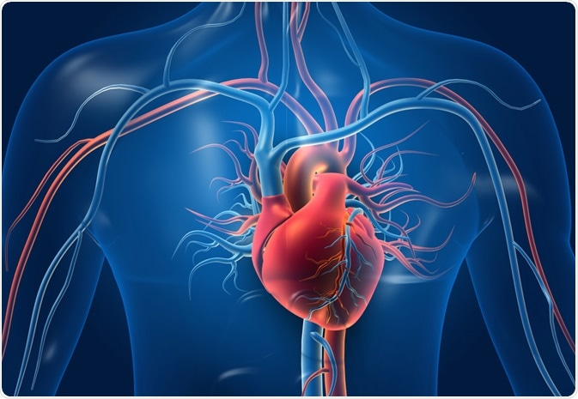
Heart Failure Prediction
Team:

Slide 2
Goal

Slide 3

Process

Slide 4
Findings

Slide 5
Next Steps

