Slide 1
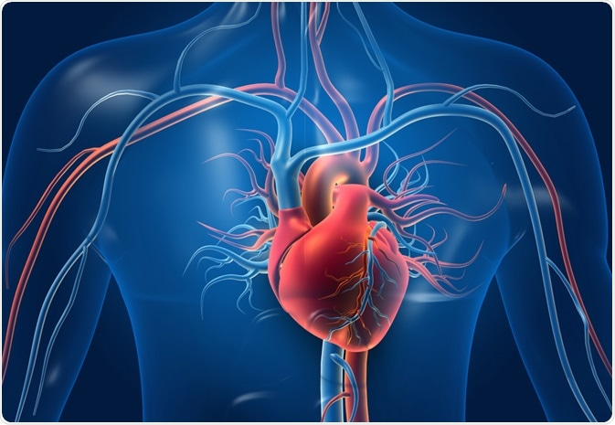
Heart Failure Prediction
Team:

Slide 2
Goal
To determine the most important features in heart failure/heart disease. Utilize machine learning and data visualization tools for better understanding.

Slide 3

Process
Teamwork
Decide on the models of Supervised and Unsupervised ML:
Logistic Regression
KNN, Random Forest
Clustering
Draw conclusion on basis of these models.
Data cleaning, analysis and visualization.

Slide 4
Findings
Male are more prone to get heart disease
55% of the patients have the heart disease in the dataset
Correlation: we found the highly correlated variables to hear diseases were:
Scores :
Possibility of clustering
We know that MaxHR is a good indicator that damage to one's heart has occurred due to heart disease. Using machine model I found that we can predict Heart disease at a 65% rate and this is confirmed when combined with Cholesterol and Resting features increased the prediction to 68%.

Slide 5
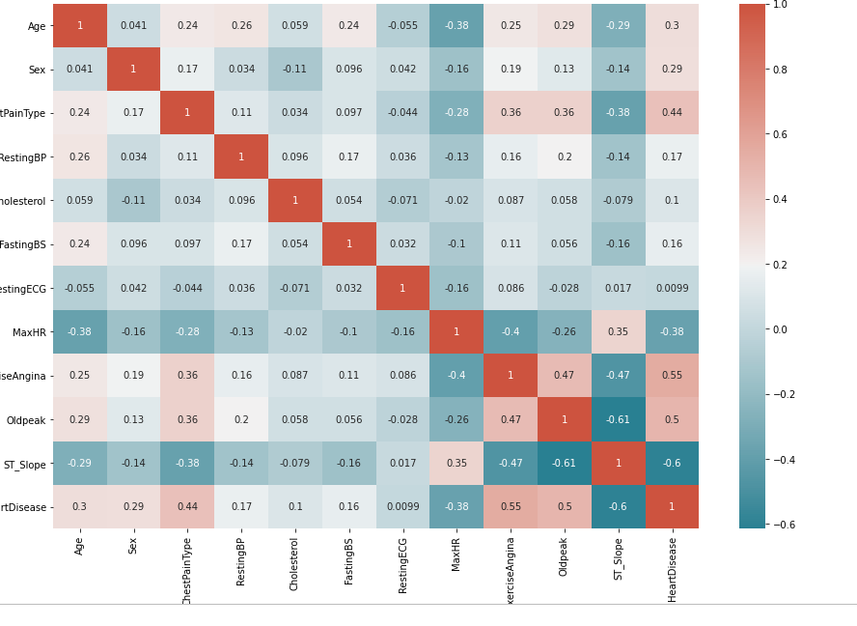
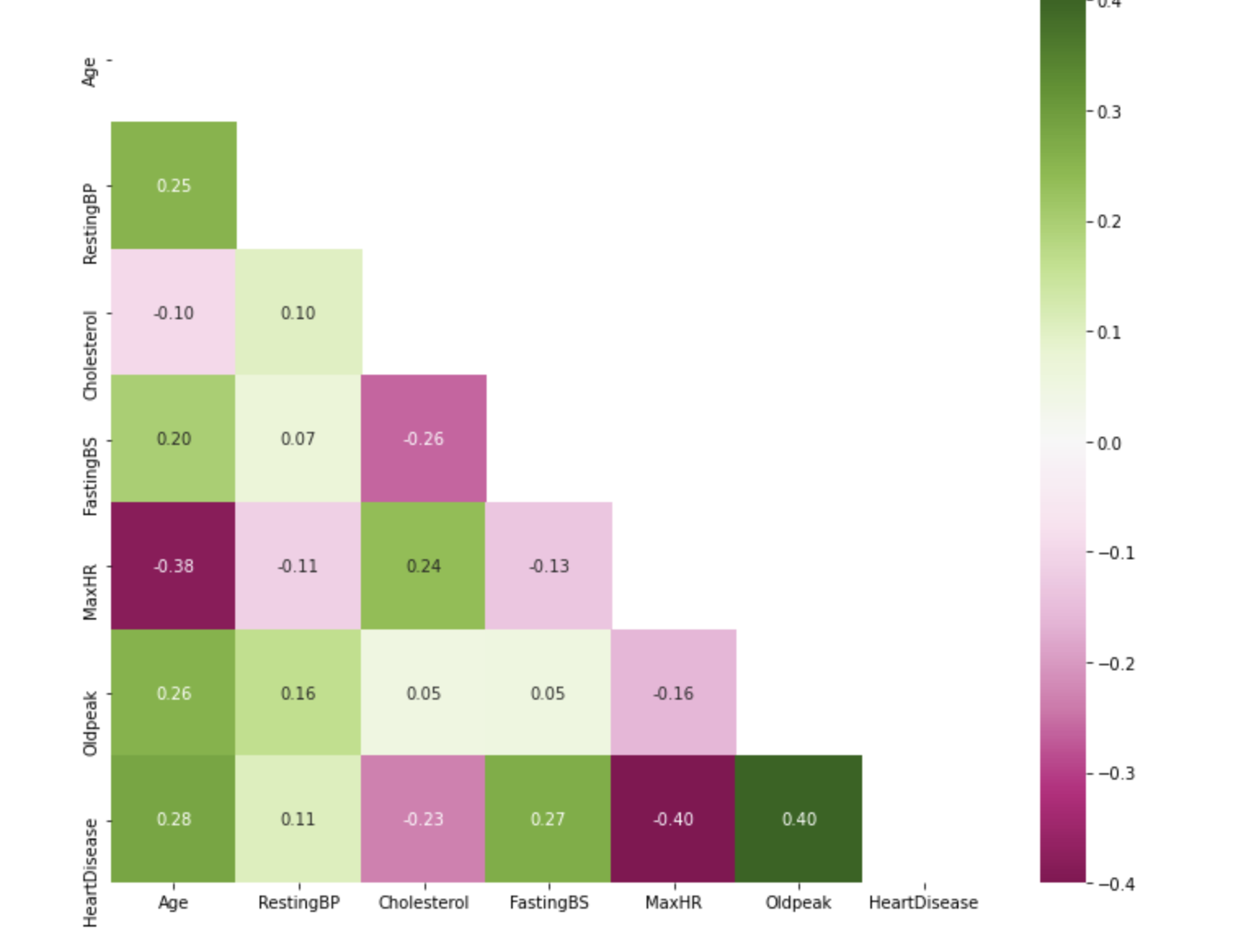
Findings

Slide 6
Findings

Slide 7
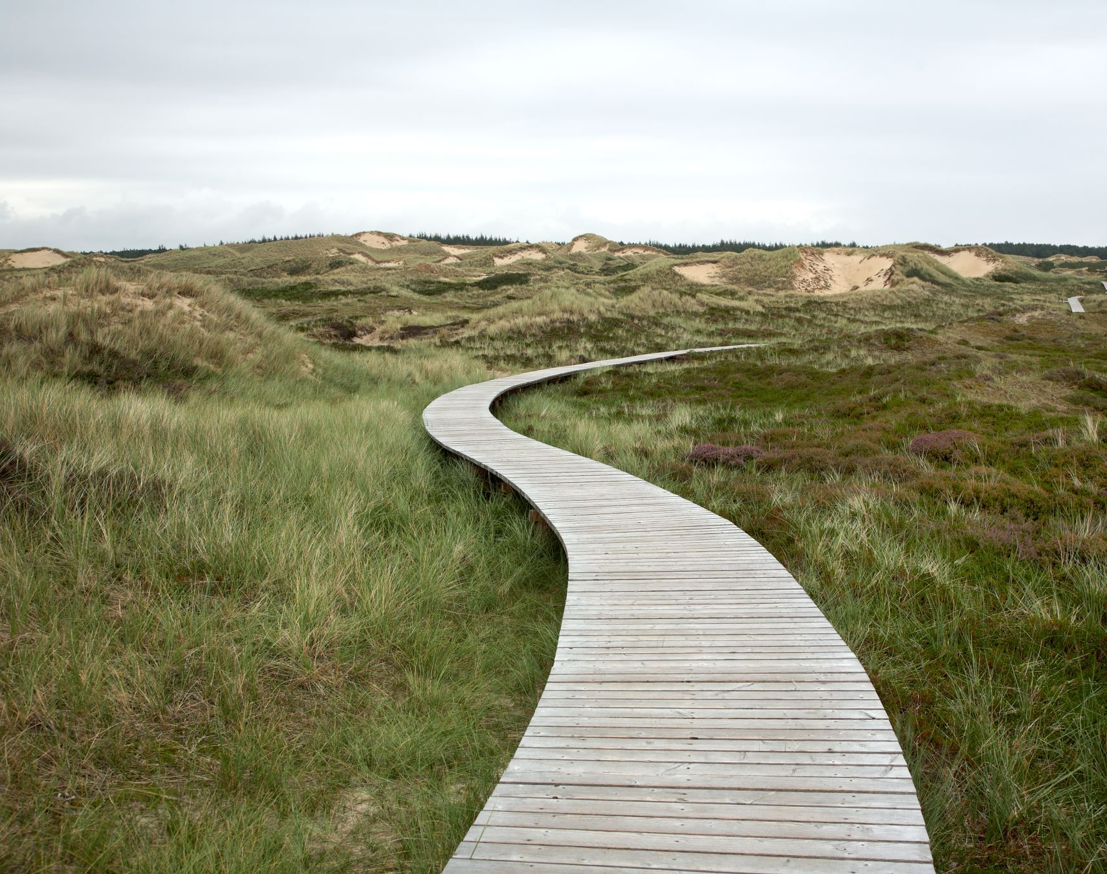
Next Steps
Look into separating into different dataset based on gender to possibly remove bias.
Explore other ML models.
Re-do the clustering by removing the outliers.

