Slide 1
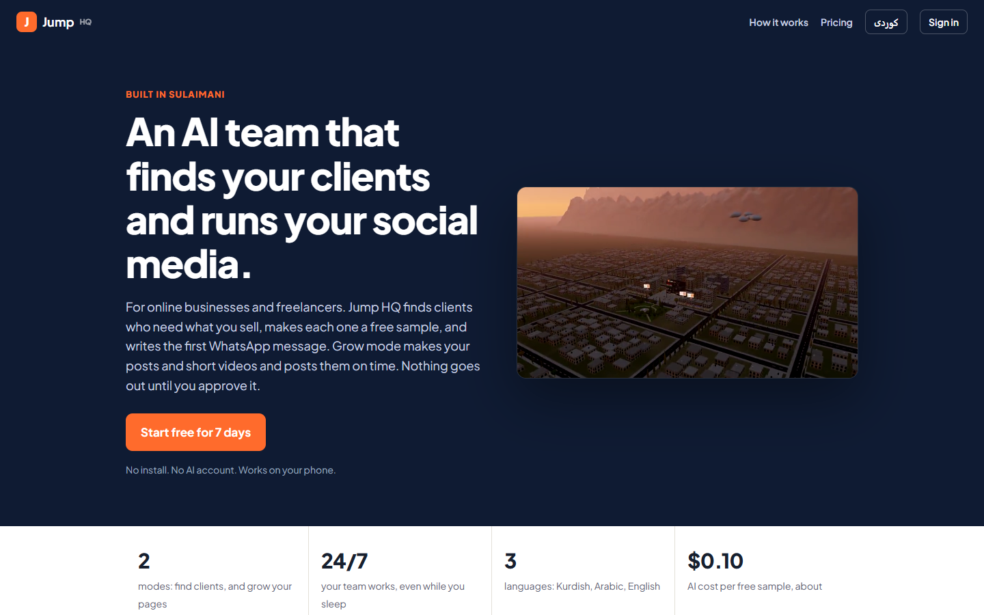
J
Jump HQ
BUILT IN SULAIMANI
An AI team that finds your clients and runs your social media
For Sulaimani’s online businesses and freelancers. Works 24/7 in Kurdish, Arabic and English. You approve everything from your phone.
Our public website: sign up, free week, your team starts in seconds
Ramyar · Jump | SmartSuli AI Hackathon 2026
Notes:
Hi, I’m Ramyar. This is Jump HQ: an AI team that finds your clients and runs your social media, built here in Sulaimani. Keep it under 20 seconds and go straight to the problem.

Slide 2


For online sellers, the work is easy, growing is hard
Ad makers, designers, marketers, developers and Instagram / TikTok shops already earn online
Freelancers and agencies
Online shops and brands
Every new client means hours of searching, checking the business, making a sample and writing a good message in Sorani. Upwork, Fiverr and Stripe payouts don’t work from Iraq, so most give up after a few tries.
Sales follow posting. Posting every day on four apps is a full-time job that most small sellers can’t pay someone for.
The problem: online sellers lose most of their time finding clients and keeping their pages alive, instead of doing the work they’re good at.
Notes:
In Sulaimani, a lot of people already make money online: video ad makers, designers, marketers, Instagram shops. Their problem isn’t the work, it’s growth. Freelancers spend hours finding each client, and Upwork and Fiverr don’t work from Iraq. Online shops live on posting, and posting every day on four apps is a full-time job.

Slide 3
We are customer number one
“
From Sulaimani, I make AI video ads for a US brand and get paid every month. Making the ads was never the hard part. Finding the next client and keeping posts going was.
1
client won pays for a year of Pro
We don’t sell to shops that have never sold online. Our customers already earn online, so one client won pays for a year of Jump HQ.
24/7
your team works, even while you sleep
Notes:
We don’t sell to shops that never sold online. Our customers already earn. I’m one of them: I make AI video ads for a US brand from Sulaimani. The hard part was always finding the next client.

Slide 4


Two modes, one AI team, you only approve
A 2-minute setup chat tells Jump HQ what you sell. Every agent adapts: search, scoring, sample, message and price.
Mode 1
Mode 2
Find clients
Grow your pages
Finds people and businesses who need what you sell
Proves they’re real and scores who will pay
Makes each one a free sample of your work
Writes the WhatsApp message in Sorani
Plans your posts from what works in your niche
Makes picture posts and short vertical videos
Kurdish and Arabic fully right-to-left
Posts on time to Facebook and Telegram
The AI Judge
Checks every sample, message and post before it can leave: rules in code, then an independent AI review against verified facts.
approve · revise · hold
Notes:
Jump HQ has two modes and one team. Mode one finds clients. Mode two runs your own pages. Between the team and the world sits the AI Judge, and the owner only approves.

Slide 5







Mode 1: Find clients, step by step
Each step is its own AI agent. A Team lead turns plain orders into work for the right agent.
1
2
3
4
5
6
Scout
Investigator
Analyst
Builder
Writer
Closer
Buying signals in 3 languages: people asking for your service, brands paying for weak ads, quiet shop pages
Proves they’re real: followers, recent posts, public contact. Facts marked verified or assumed
Scores need, budget and reach 0–100. Only the best go on
Free sample of your work: ad concept, store page, report, app prototype, game, website or proposal
Short, honest WhatsApp message in natural Sorani with one link: the sample
When they reply, drafts the answer until they say yes
You: open the sample, read the Judge’s verdict, tap Approve, and WhatsApp opens with the message ready.
Notes:
Tell Jump HQ what you sell in a 2-minute chat. The Scout looks for buying signals: people asking for your service, brands already paying for ads, shops whose pages went quiet. The team proves they’re real, scores who will pay, makes a free sample of your work, and writes the message in Sorani.

Slide 6
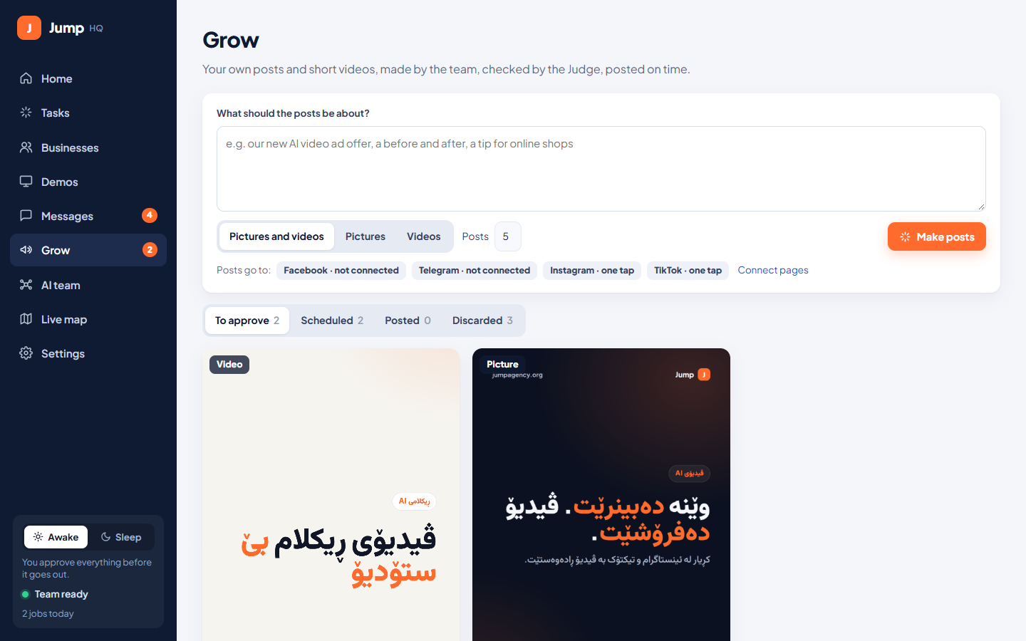
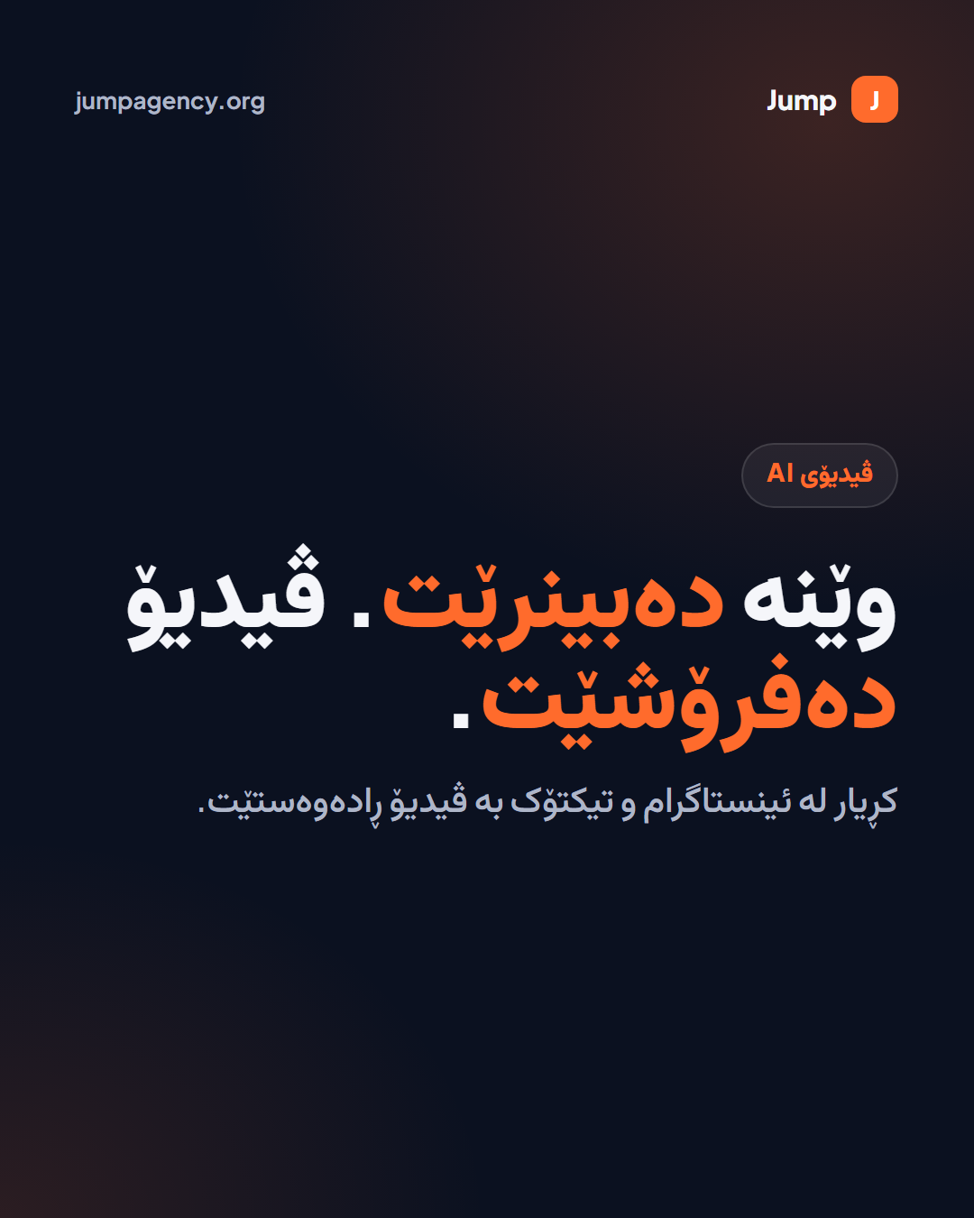
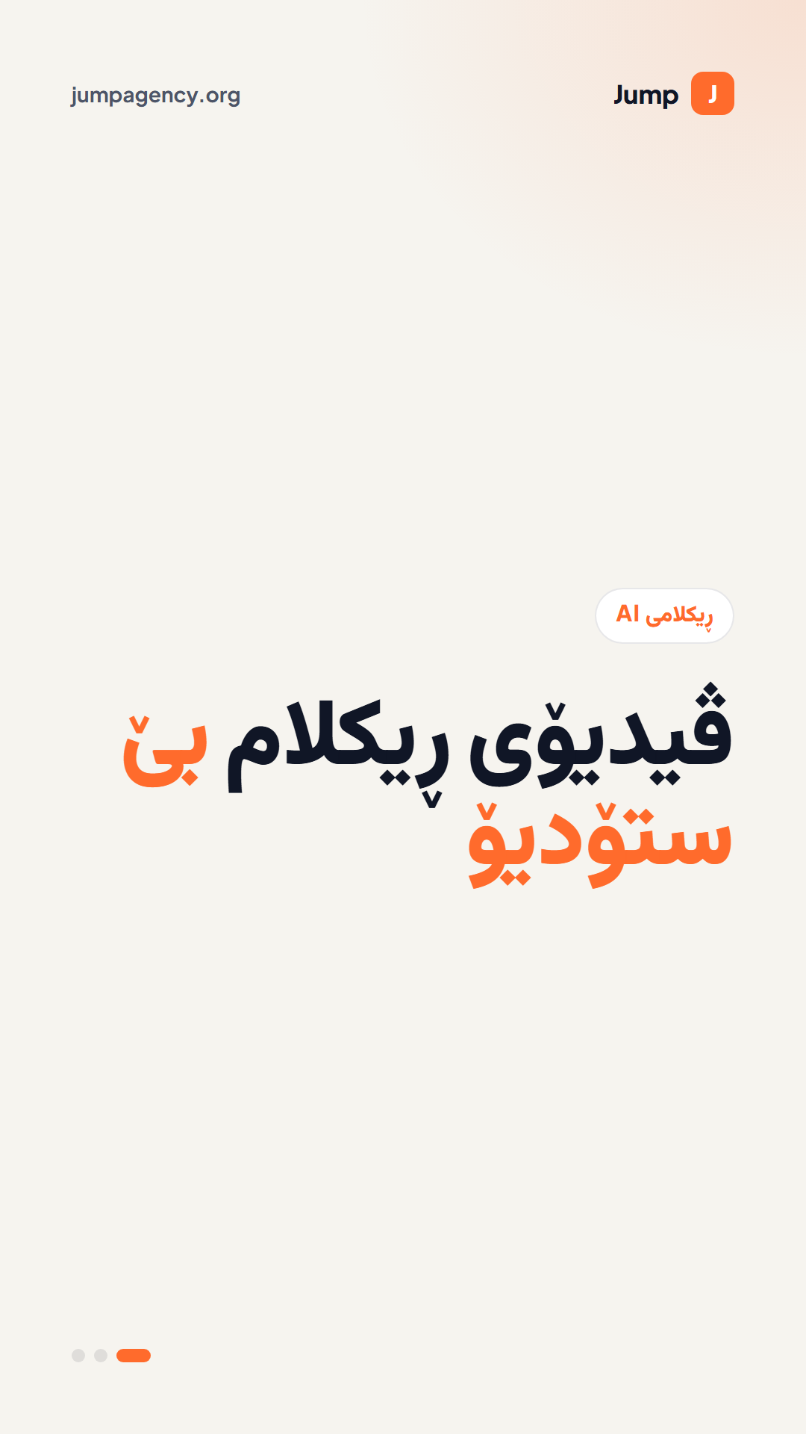
Mode 2: Grow, your social media manager
Picture post 1080×1350
10-second video 1080×1920
The Content creator plans posts from what you sell and what works in your niche now
Real posts made by Jump HQ, in Kurdish, with your brand
The Judge blocks invented prices, results or reviews
Auto-posts to Facebook Page and Telegram; Instagram and TikTok in one tap
Approve, edit the caption, pick the time, or Post now, also from the phone app
Notes:
For your own pages, the Content creator plans your posts, makes pictures and short videos in Kurdish, and posts them on time to Facebook and Telegram. Instagram and TikTok take one tap. These two are real posts the system made.

Slide 7
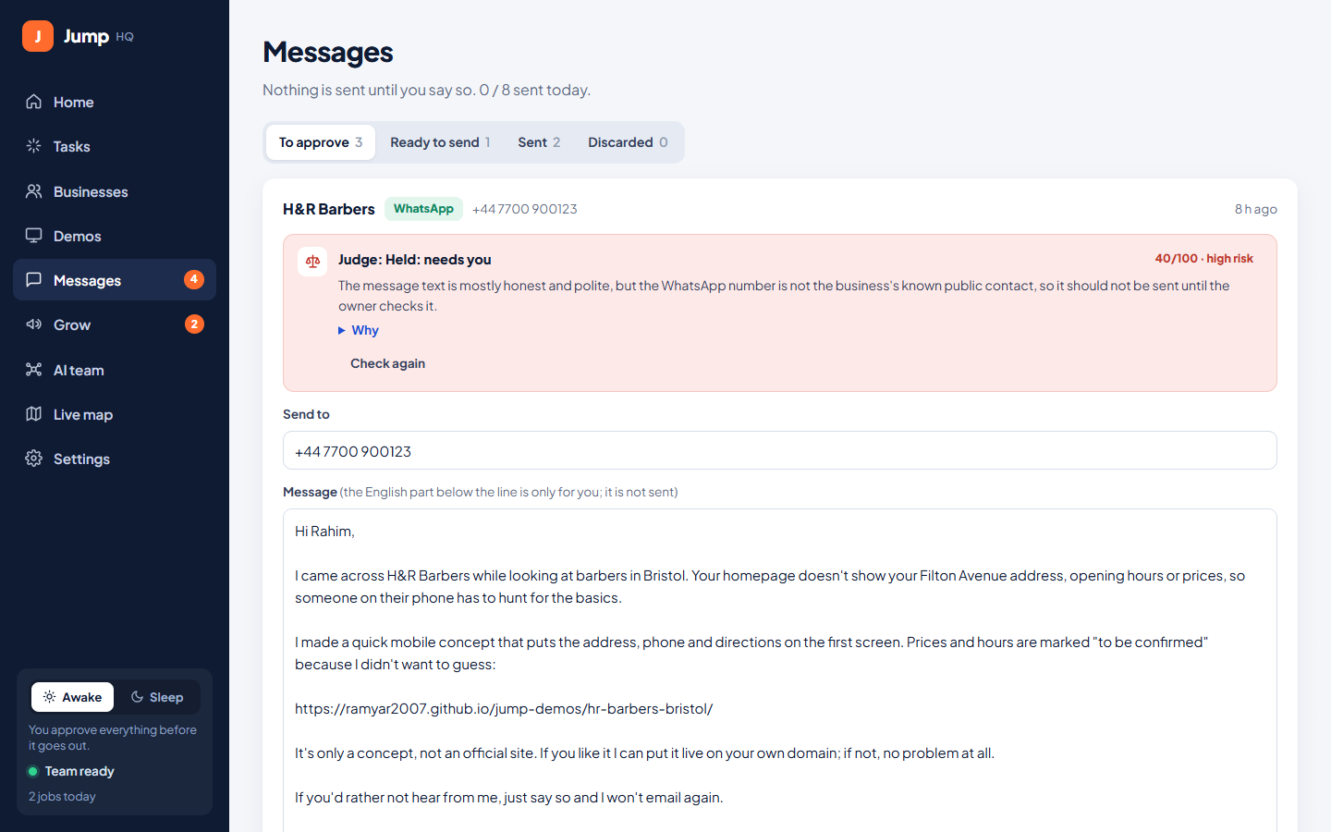



The AI Judge and Sleep mode: it keeps working at night
Awake
You approve everything. The Judge gives a second opinion with a score and reasons.
Sleep
Press Sleep or schedule 23:00–08:00. The Judge passes safe work (score ≥ 80, low risk); anything risky waits.
Morning report
“While you slept”: searches, samples, posts and messages, also sent to Telegram.
A real catch: the Judge held this message because the phone number wasn’t the business’s own
Notes:
Rules in code catch a wrong number, a missing link or spam. Then an AI review checks for invented facts, pressure or a wrong tone. In testing it rewrote a message that praised a feature nothing supported, and it held this one because the number wasn’t the business’s own. Press Sleep and the team keeps working; safe items go out, risky ones wait for the morning.

Slide 8
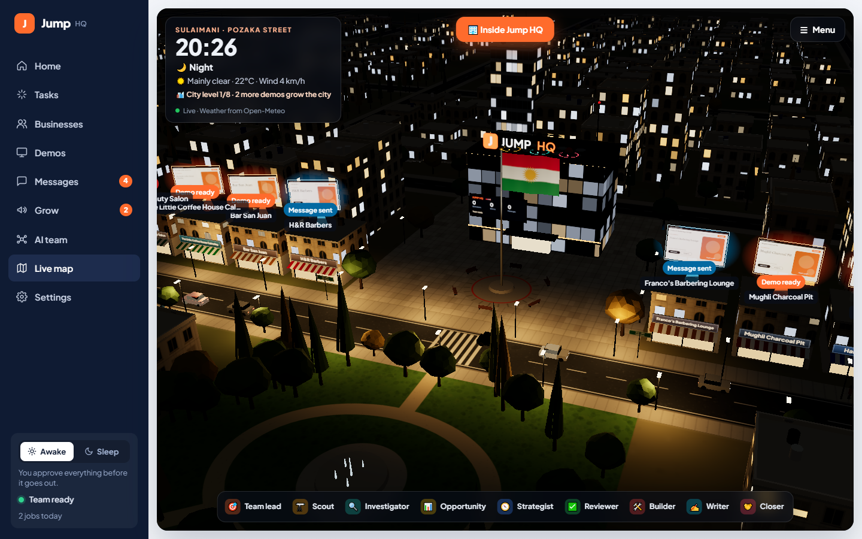


Watch your team work, approve from your phone
Live map
3D Pozaka Street with the real time and live weather. The city grows as you win work.
Phone app
Pair by QR. Awake/Sleep, approve samples, messages and posts, open WhatsApp in one tap.
3 languages
Everything in Kurdish Sorani, Arabic and English, right-to-left done properly.
Notes:
The live map shows the team at work on Pozaka Street with the real time and weather. Everything also works from the Android app: pair by QR and approve from anywhere.

Slide 9
AI does the work, the human only decides
Two independent AI checks keep it honest: the Analyst before building, the Judge before anything goes out
Finding buying signals
Checking facts
Scoring clients
Making the sample
Planning and designing posts
Writing in Sorani
Answering replies
Judging safety
Built during the 2 hackathon days
Grow mode + Content creator
AI Judge + Sleep mode
Setup for any business
Phone app (Android)
Kurdish / Arabic / English
Jump HQ Cloud: sign-up, plans, owner view
Notes:
AI does every step; the human only decides. Honest note: the search-to-sample pipeline was started on October 6. Everything in the dark box was built here, October 8 and 9.

Slide 10
A monthly subscription, profitable from the first customer
No install, no AI account: the agents run on our key, and plan limits cap each customer’s cost.
Free trial
Pro
Agency
$0
$20
$60
for 7 days
a month · ≈26,000 IQD
a month · ≈78,000 IQD
Try both modes
One freelancer or shop · 25 team jobs a day
Agencies and teams · 80 team jobs a day
Pay with FIB, card or bank transfer (works from Iraq)
~$5
~70%
$0.11
what a Pro user costs us a month
margin on Pro
AI cost per free sample
Month 1: 15 Pro users. Month 3: 50 Pro + 10 Agency. Projections, not results.
Notes:
It’s a subscription. Sign up and your team is working in seconds. Pro is 20 dollars a month, Agency is 60. Our customers already earn online, so one client pays for a year. The cheap model does most of the work, and plan limits keep every customer profitable. A Pro user costs us about 4 to 6 dollars a month.

Slide 11





Live demo (phone in hand)
1
2
3
4
5
Clients found today
Open a free sample
Approve
Grow
Switch to Sleep
each with the buying signal it showed
see the Judge’s verdict and score
WhatsApp opens with the Sorani message ready
this week’s posts and a short video, tap Post now
the team keeps working on its own
About 50 seconds. If the internet is slow, use Rehearsal mode on the Live map (no AI credits).
Notes:
Demo order: Home with clients found today, open a free sample and the Judge verdict, tap Approve so WhatsApp opens, show Grow posts and tap Post now, then switch to Sleep. Keep it to 50 seconds.

Slide 12
A team that never sleeps, for every online seller in Sulaimani
Finds your clients. Runs your social media. In Kurdish. You just approve.
Free week · Pro $20 · Agency $60
github.com/Ramyar2007/jump-hq · jumpagency.org
Thank you · سوپاس
Notes:
Built at this hackathon: the Judge, Sleep mode, Grow mode, the phone app, setup for any business, Kurdish and Arabic. Jump HQ gives every online seller in Sulaimani a team that never sleeps. Thank you.

Slide 13
Backup: likely judge questions
Is it spam?
What if the AI invents facts?
Nothing goes out without you or the Judge. Daily cap, clear opt-out, only the business’s own public contact.
The Analyst and the Judge check against verified facts. Samples say “concept”. Posts with invented prices or results are held.
Instagram and TikTok?
Why not just ChatGPT?
Facebook Pages and Telegram post automatically via official APIs. Instagram / TikTok: one tap now, automatic after app review.
It’s a whole pipeline: find, verify, score, sample, write, judge, post, on its own at night, in Kurdish.
Privacy?
How do you make money?
Public business information only, never private people. Each customer has a private Jump HQ.
Customers pay monthly, we pay the AI. Plan limits cap cost; the owner view shows cost vs revenue per customer.
Notes:
Only for Q&A, not part of the 3 minutes.

