Slide 1
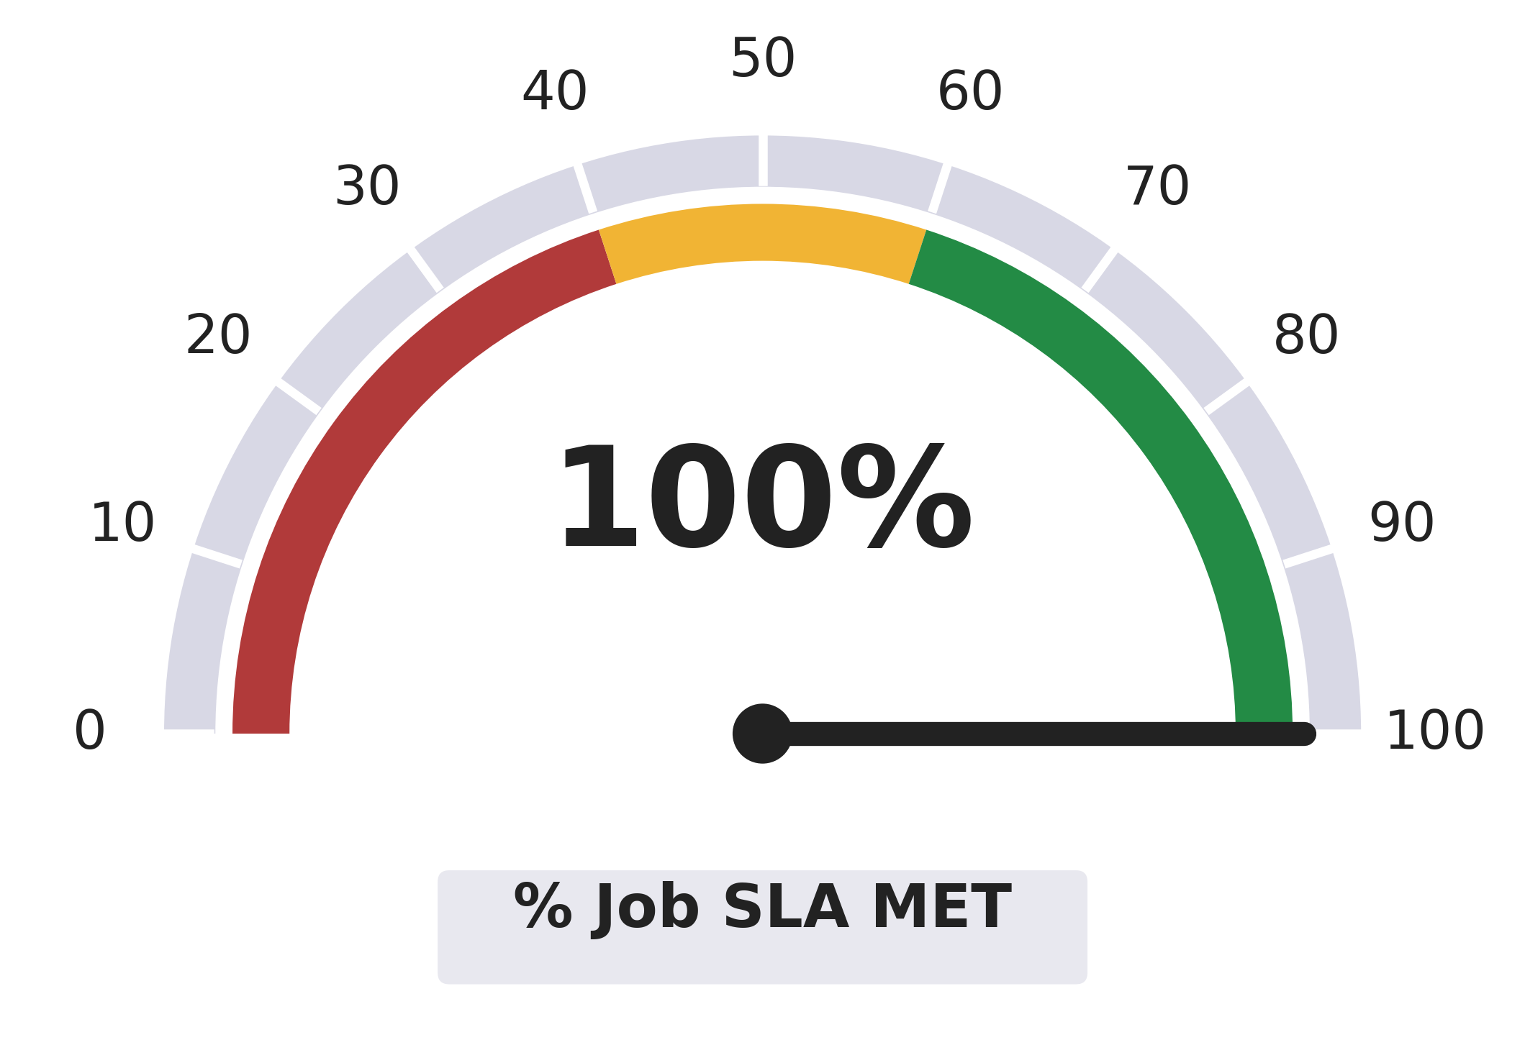

Operational Support
20
No.Of Batch
Cycles
33
No. Of Incidents
<5
MTTR* (in mins)
1
Recuuring Issues
1
Recurring Issues
Resolved
*MTTR–Mean Time To Resolve

