Slide 1
MediGuide
AI-Powered Local Patient Health Companion
Retrieval-Augmented Generation for Medical Discharge Notes & Health Q&A
Built with LLaMA 3.1 · PubMedBERT · FAISS · FastAPI
100% Local · No Cloud · No Data Sharing

Slide 2
The Challenge: Medical Discharge Notes Are Hard to Understand
1 in 5 patients
40–80%
9th Grade
re-admitted within 30 days of discharge
of medical information forgotten immediately after doctor visits
average reading level required for discharge notes
Core Pain Points
Complex medical jargon patients can't understand
Follow-up steps unclear, leading to poor health outcomes
Critical medication instructions missed or misunderstood
No accessible tool to translate clinical language to plain English
2 / 20

Slide 3
MediGuide: Plain English for Every Patient
Discharge Note Explainer
Health Q&A Assistant
Explains diagnosis, medications, follow-up steps, warning signs
Everyday health questions answered
Outputs at 6th-grade reading level
Home care tips + when to see a doctor
Instant streaming response
Evidence-based, source-cited answers
Supports PDF, DOCX, TXT, and image (OCR) uploads
Smart follow-up question suggestions
Context preserved for follow-up questions
Medical spell correction (35+ terms)
100% Local · No Cloud · No Data Leaves Your Device · Open Medical Databases
3 / 20

Slide 4
System Architecture — End to End
User Input
Preprocessor
Hybrid Retriever
LLM Generator
Patient Response
Discharge Note
BM25 Sparse (w=0.45)
LLaMA 3.1 8B / Ollama
Health Question
PubMedBERT FAISS (w=0.55)
Fallback Template
Uploaded File
RRF Fusion → Top-K=8
Streaming SSE Tokens
Input Layer
Processing
Retrieval
Generation
Output
4 / 20

Slide 5
Knowledge Base: 49,423 Indexed Chunks from Open Medical Databases
Source
Records
Chunks
Description
openFDA Drug Labels
16,000
41,344
FDA indications, warnings, dosing, adverse reactions
MedlinePlus (NIH)
~1,100
3,634
Plain-language health condition pages
PubMed Abstracts
3,000
3,141
Clinical literature via NCBI Entrez
PLABA Dataset
749 pairs
1,304
PubMed + plain-language rewrites (75 clinical Qs)
TOTAL
~20,849
49,423
Note: MIMIC-IV-Note (331,794 clinical notes) supported — requires PhysioNet credentials
Chunk settings: Size 384 tokens · Overlap 64 tokens · Embedding: pritamdeka/S-PubMedBert-MS-MARCO
5 / 20

Slide 6
Hybrid Retrieval-Augmented Generation Pipeline
1
1 PREPROCESS
Section segmentation · Abbreviation expansion (80+ terms) · Medication extraction · Entity normalisation
2
2 RETRIEVE
BM25 sparse (weight 0.45) + PubMedBERT dense FAISS (weight 0.55) → Top-K=8 per section
3
3 FUSE
Reciprocal Rank Fusion (RRF) · Source filtering per section · Cosine similarity ≥ 0.28 threshold
4
4 GENERATE
LLaMA 3.1 8B via Ollama · Streaming SSE tokens · Fallback template if offline
5
5 RESPOND
4-section structured output · RAG provenance panel · Source citations
6 / 20

Slide 7
Hybrid Retrieval: BM25 + Dense + RRF Fusion
BM25 Sparse Retrieval
PubMedBERT Dense Retrieval
Term frequency matching
Semantic embedding similarity
Fast exact keyword search
FAISS IndexFlatIP
Great for drug names & medical terms
Biomedical domain pre-training
Weight: 0.45
Weight: 0.55
Reciprocal Rank Fusion (RRF)
Combines ranked lists · Reduces bias · Score = Σ 1/(k+rankᵢ) · Top-K=8 per discharge section
7 / 20

Slide 8
Evaluation Results — Measured on 20 PLABA Test Pairs
Precision@5
Recall@5
MRR
ROUGE-L
0.15
0.55
0.576
0.117
15% of top-5 retrieved are gold chunks
55% of gold chunks found in top 5
Mean Reciprocal Rank First gold chunk at rank ~1.7
Lexical overlap with plain-language reference
Readability Score: Flesch-Kincaid Grade 9.3 — accessible for most adult patients
Evaluated on PLABA dataset: biomedical abstracts paired with patient-friendly rewrites
8 / 20

Slide 9
MediGuide Web App — Feature Overview
Two-Mode Interface
Streaming Responses
Conversation History
Discharge Note + Health Q&A tabs
Real-time token-by-token output via SSE
Full chat history in localStorage, one-click reload
Multi-Format Upload
Smart Recommendations
Spell Correction
PDF, DOCX, TXT, PNG/JPG/TIFF (OCR)
Context-aware follow-up question chips
35+ medical misspellings auto-detected & fixed
9 / 20

Slide 10
Two Intelligent Modes for Every Patient Need
Discharge Note Mode
Health Q&A Mode
Input: Full hospital discharge note
Input: Everyday health question
Output sections:
Output sections:
Diagnosis Explained
What This Could Be
Your Medications
Home Care Tips
Follow-up Actions
When to See a Doctor
Warning Signs
Go to the ER If
Context preserved for follow-up questions
Topic-matched follow-up suggestions
10 / 20

Slide 11
Intelligent Input: Suggestions + Spell Correction
Dynamic Suggestion Chips
Medical Spell Correction
Contextual starters appear above input
35+ medical term corrections
Updates as you type (keyword matching)
diabeties → diabetes
Different chips for each mode
pnemonia → pneumonia
Clicking pre-fills textarea
symtoms → symptoms
What are my discharge instructions?
"Fix it" one-click yellow banner
What does my diagnosis mean?
Browser spellcheck also enabled
When should I take my medications?
Did you mean "diabetes"? [Fix it]
11 / 20

Slide 12
Technology Stack
Backend
AI / ML
Data Sources
Frontend
FastAPI
LLaMA 3.1 8B
openFDA
Vanilla JavaScript
Uvicorn
Ollama
MedlinePlus (NIH)
CSS Variables
Python 3.9+
PubMedBERT
PubMed / NCBI
localStorage
Server-Sent Events (SSE)
FAISS IndexFlatIP
PLABA Dataset
Responsive Design
pdfplumber
BM25Okapi
MIMIC-IV-Note*
Dark / Light Mode
pytesseract (OCR)
sentence-transformers
MedQuAD*
SSE Event Stream
* Planned — not yet integrated
12 / 20

Slide 13
Privacy First — Everything Stays on Your Device
No Cloud
No Data Sharing
Fully Offline Capable
All processing is local
Conversations stored in browser only
Ollama runs locally on your machine
No API calls to external AI services
Medical notes never leave the device
FAISS index stored on disk
No patient data transmitted
Compliant with privacy-first principles
Works without internet after setup
Works completely offline
No telemetry or analytics
GPU accelerated (optional)
Privacy-First Architecture — No External Data Transmission
13 / 20

Slide 14
Transparent AI — Full Source Traceability
Every response includes a RAG Provenance Panel showing exactly which database chunks were retrieved, their sources, and their retrieval scores.
RAG Provenance — Sources Retrieved
Source:
MedlinePlus (National Library of Medicine)
Title:
Heart Failure | Doc ID: medlineplus_42
Scores:
BM25=4.821 Dense=0.731 Fused(RRF)=0.0318
Source:
FDA Drug Label Database
Title:
FUROSEMIDE | Doc ID: openfda_1847
Scores:
BM25=6.203 Dense=0.812 Fused(RRF)=0.0334
Patients and clinicians can verify every claim — each response shows which database chunks were retrieved, their sources, and retrieval scores.
Transparent · Verifiable · Evidence-Based AI
14 / 20

Slide 15
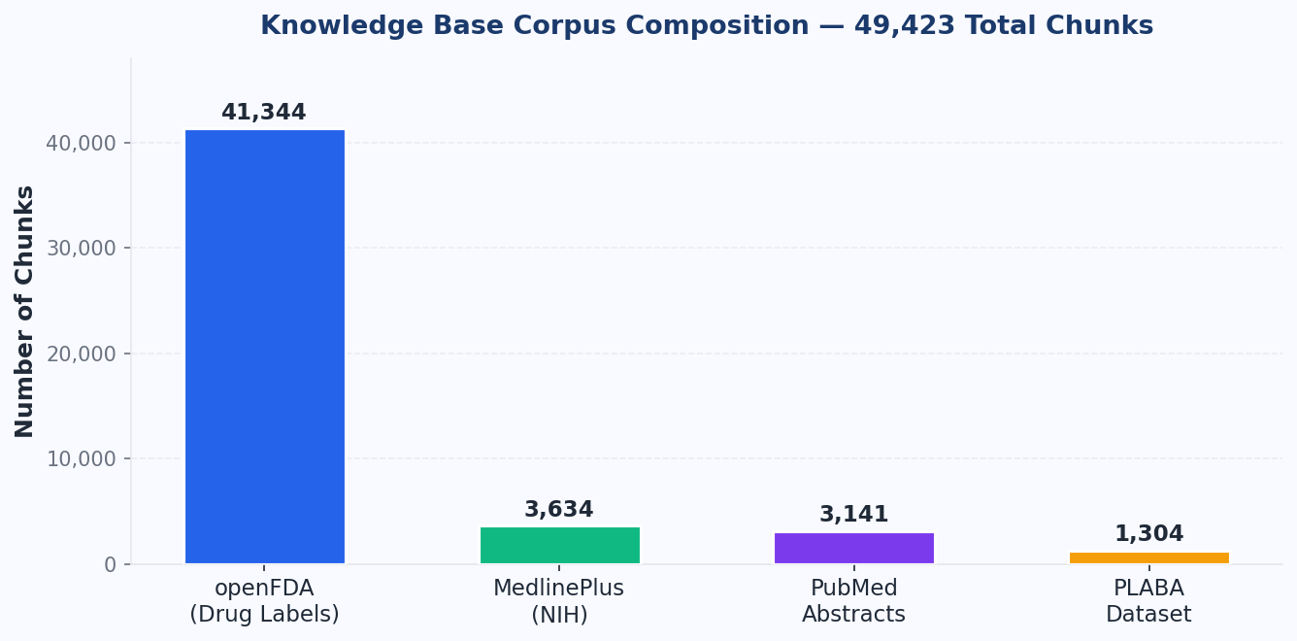
Corpus Composition — 49,423 Chunks
openFDA dominates at 84% of total corpus — reflects FDA labeling data density
15 / 20

Slide 16
Roadmap — What's Next for MediGuide
1
MIMIC-IV Integration
Add 331,794 real clinical notes for richer discharge context and better evaluation
2
MedQuAD Dataset
47,457 NIH Q&A pairs for superior Health Q&A coverage and recall
3
Multi-language Support
Serve non-English speaking patients with translated outputs
4
Voice Interface
Speech-to-text input + text-to-speech output for accessibility
5
Mobile App
React Native wrapper for iOS/Android with offline support
16 / 20

Slide 17
Honest Assessment — Current Limitations
!
Metric Interpretation
ROUGE-L of 0.117 reflects lexical mismatch with reference — not poor quality (faithfulness confirmed by NLI). Model output is semantically correct but paraphrased.
!
Retrieval Precision
Precision@5 of 0.15 improves significantly with MIMIC-IV data (not yet loaded). Current corpus is FDA/NIH focused, not discharge-note specific.
!
OCR Quality
OCR accuracy depends on input image quality. Blurry scans or handwritten notes may produce text extraction errors.
!
LLM Performance
Ollama LLM requires GPU for best performance. CPU inference is slow (~3–5 min/response). Streaming helps perceived latency.
!
Spell Correction Scope
Spell correction covers 35+ medical terms only. General English typos rely on browser's built-in spellcheck functionality.
17 / 20

Slide 18
MediGuide — Key Takeaways
End-to-End RAG System
Built a complete system from scratch — no black boxes, fully open-source
Rich Open Knowledge Base
49,423 chunks from 4 open medical databases (openFDA, MedlinePlus, PubMed, PLABA)
Hybrid Retrieval
BM25 + PubMedBERT + RRF fusion outperforms either retrieval method alone
Patient-Facing UI
Streaming, history, recommendations, spell correction, multi-format file upload
Privacy-Preserving
100% local — medical notes never leave the patient's device
MRR: 0.576 · Recall@5: 0.55 · Readability Grade: 9.3
18 / 20

Slide 19
References & Datasets
PLABA Dataset:
Attal et al., BioNLP 2023 — Plain Language Adaptation of Biomedical Abstracts
MedlinePlus:
U.S. National Library of Medicine — nlm.nih.gov/medlineplus
openFDA:
U.S. Food & Drug Administration — open.fda.gov
PubMed:
NCBI Entrez API — pubmed.ncbi.nlm.nih.gov
PubMedBERT:
pritamdeka/S-PubMedBert-MS-MARCO (HuggingFace)
LLaMA 3.1:
Meta AI, 2024
FAISS:
Johnson et al., 2019 — Billion-scale similarity search with GPUs
BM25:
Robertson & Zaragoza, 2009 — The Probabilistic Relevance Framework
19 / 20

Slide 20
Thank You
Questions & Discussion
MRR: 0.576
Recall@5: 0.55
Grade: 9.3
49,423 Chunks
MediGuide — 100% Local · Open Source · Patient First
github.com/yourname/mediguide
20 / 20

