Slide 1
Performance Improvement Program
Delivery Partner Benefit & Quality Framework
Strategy Case Study | Business Analyst Portfolio
Prepared by Ganga Ramya Sri
Performance Improvement Program | Ganga Ramya Sri | 1

Slide 2
1. Business Problem
Translate operational needs into a simple, measurable program.
36,313
Partner-day records
3,553
Partner quality records
₹0.90
Maximum CPT
• Increase delivery-partner availability without creating excessive incentive cost.
• Prioritize supply on Sunday and Monday, followed by Friday and Saturday.
• Encourage consistent availability throughout the week rather than weekend-only participation.
• Identify low-performing partners and provide structured retraining before stronger corrective action.
Performance Improvement Program | Ganga Ramya Sri | 2

Slide 3
2. Solution Architecture
A two-part framework: incentivize availability, then protect service quality.
PART 1 | SUPPLY
• Supply-hour points
• + demand multipliers
• + consistency bonus
• + CPT control
PART 2 | QUALITY
• 100-point scorecard
• + thresholds
• + partner buckets
• + progressive retraining
Performance Improvement Program | Ganga Ramya Sri | 3

Slide 4
3. Proposed Benefit Program
Keep the rule simple enough for partners to understand immediately.
Daily Supply Hours | Base Points
< 4 hours | 0
4–< 8 hours | 4
8–< 12 hours | 8
12+ hours | 12
Day | Multiplier
Sunday | 1.50×
Monday | 1.50×
Friday | 1.25×
Saturday | 1.25×
Tue–Thu | 1.00×
10 points
Weekly consistency bonus for 5+ active days
Performance Improvement Program | Ganga Ramya Sri | 4

Slide 5
4. How the Incentive Works
One transparent calculation with a fixed point value.
₹0.50
Value per point
12
Maximum base points/day
1.50×
Peak-day multiplier
• Daily Points = Base Points × Day Multiplier
• Example: 9 hours on Sunday → 8 × 1.5 = 12 points = ₹6.
• Example: 13 hours on Monday → 12 × 1.5 = 18 points = ₹9.
• Partners active on 5+ days in a week receive an additional 10 points.
• Design intent: reward incremental availability without making the program difficult to explain.
Performance Improvement Program | Ganga Ramya Sri | 5

Slide 6
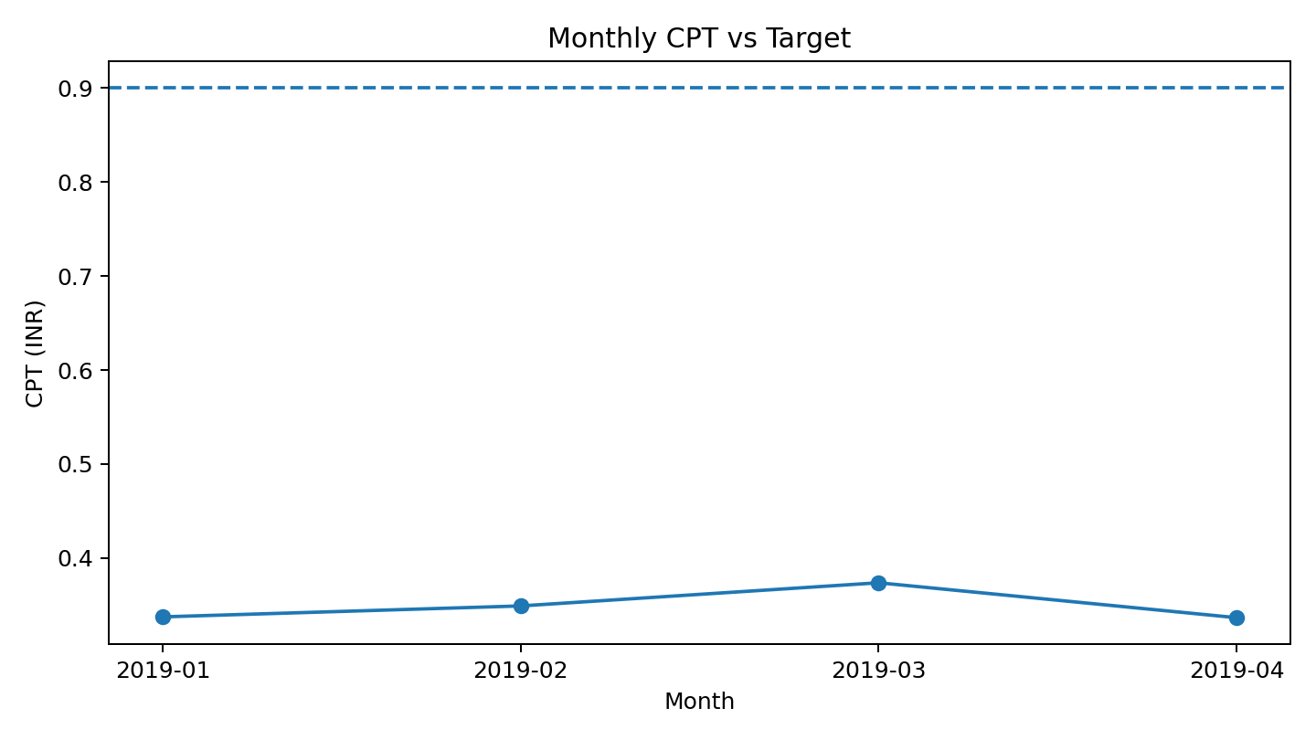
5. Budget & CPT Validation
The model remains below the required ₹0.90 CPT ceiling.
Month | Tasks | Incentive Cost | CPT
2019-01 | 86,825 | ₹29,304 | ₹0.338
2019-02 | 103,865 | ₹36,263 | ₹0.349
2019-03 | 112,178 | ₹41,928 | ₹0.374
2019-04 | 119,677 | ₹40,290 | ₹0.337
₹0.350
Overall CPT
₹0.374
Max monthly CPT
Performance Improvement Program | Ganga Ramya Sri | 6

Slide 7
6. Partner Quality Scorecard
Balance productivity, reliability, efficiency and customer experience.
Metric | Weight | Threshold
Acceptance Rate | 15 | ≥ 90%
Cancellation Rate | 15 | ≤ 2%
Tasks Not Delivered | 15 | ≤ 1%
Partner Cancellation | 10 | ≤ 1%
Task Time | 15 | ≤ 45 min
Interaction Rate | 10 | ≤ 40%
Contact Rate | 5 | ≤ 15%
Rating | 15 | ≥ 4.7
100
Total quality score
• High weights are assigned to reliability and customer-facing outcomes.
• Thresholds create an explainable screening mechanism.
• Partners are evaluated across multiple dimensions rather than a single KPI.
Performance Improvement Program | Ganga Ramya Sri | 7

Slide 8
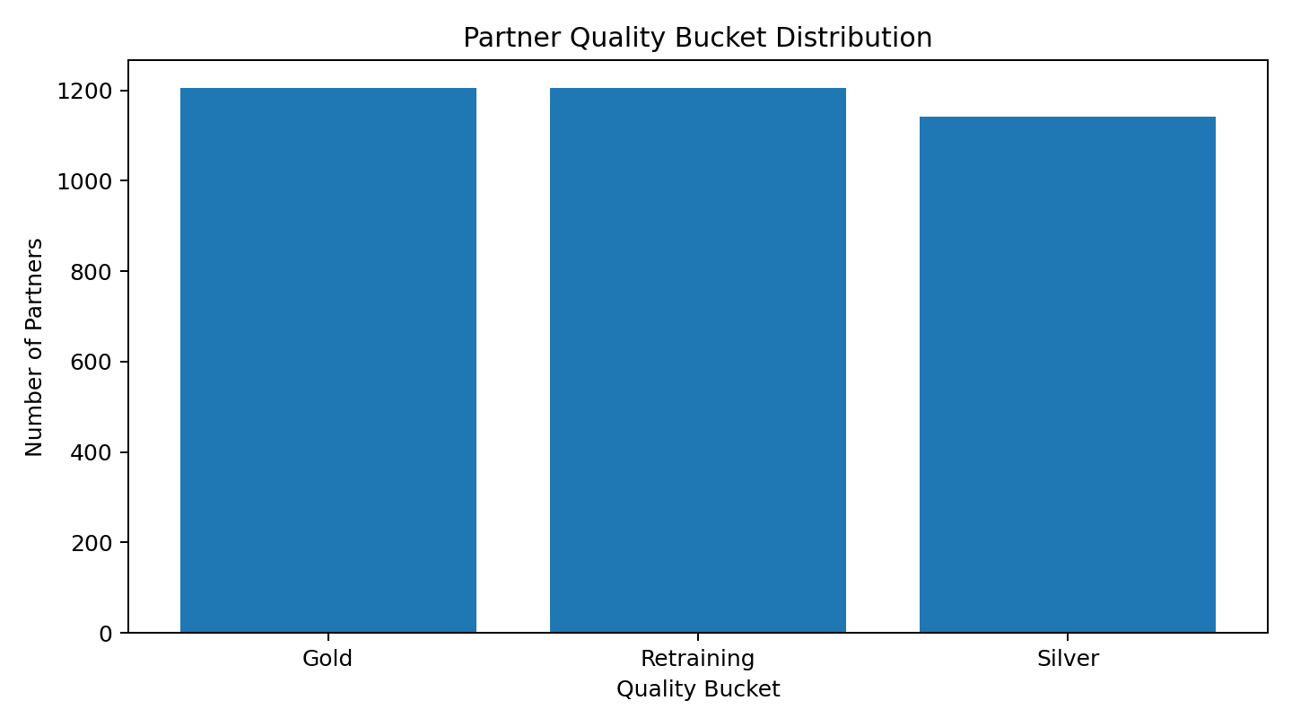
7. Partner Segmentation & Retraining
Turn the score into clear operational actions.
≥85
Gold
70–84
Silver
<70
Retraining
• First event → root-cause analysis + targeted refresher training + 1-week monitoring.
• Second event → one-to-one coaching + 2-week improvement plan.
• Third event → formal PIP + manager review.
• Repeated failure → operational/contract review according to company policy.
Performance Improvement Program | Ganga Ramya Sri | 8

Slide 9
8. Risks, Controls & Governance
Monitor the program continuously rather than treating it as a one-time launch.
Risk | Control
Weekend-only optimization | Weekly consistency bonus
Incentive overspend | Monthly CPT monitoring
Gaming of supply hours | Validate hours against operational activity
Low-quality partners earning rewards | Quality eligibility / scorecard
Unfair retraining decisions | Transparent metric-level scoring
• Weekly: supply coverage, quality and retraining candidates.
• Monthly: CPT, incentive ROI and partner behavior.
• Quarterly: recalibrate point values and thresholds based on observed outcomes.
Performance Improvement Program | Ganga Ramya Sri | 9

Slide 10
9. Final Recommendation
• Implement the simple supply-hour points program with demand-based multipliers.
• Use the weekly consistency bonus to create balanced availability across the week.
• Track CPT monthly and keep the incentive model below the ₹0.90 ceiling.
• Deploy the 100-point quality scorecard to protect customer experience.
• Use progressive retraining so partners have a structured path to improvement.
SUPPLY + COST + QUALITY + CUSTOMER EXPERIENCE
Performance Improvement Program | Ganga Ramya Sri | 10

