Slide 1

A MAJOR PROJECT PRESENTATION
ON
DEPARTMENT OF ELECTRONICS & COMMUNICATION ENGINEERING
SMART INDUSTRIAL HAZARDOUS GAS LEAKAGE DETECTION AND AUTOMATED SAFETY RESPONSE SYSTEM
Presented by:
B .Prasanna [22681A0409]
A .Ramya [22681A0406]
K .Achala [22681A0431]
A .Raghavendra [22681A0407]
Under the esteemed guidance of:
Mr. B. Hanumanthu
(Assistant Professor)

Slide 2
Contents:
Abstract
Existing system
Proposed system
Block Diagram
Components
Working principle
Applications
Advantages
Expected Results
Conclusion
Future scope
References

Slide 3
Abstract:
This project is about creating a smart system that can detect hazardous gas leaks in industrial areas and respond automatically to keep people safe. It uses special sensors to monitor gases like methane, carbon monoxide, and ammonia in real time. If dangerous levels are found, the system quickly activates safety measures such as alarms, ventilation, and emergency shutdowns. It also sends alerts to workers through mobile and web apps so they can take action immediately. This system helps prevent accidents, protects health, protects works and ensures a safer working environment. The system is easy to install, energy-efficient, and can be used in many types of industries.

Slide 4
Existing System:
Here’s a description of the current methods used to solve the problem of industrial harmful gas leakage detection and automated safety response
IoT gas detection
Harmful gas sensors
Automated safety response
Real-time gas monitoring
Smart gas leak detection
Wireless sensor networks
Emergency shutdown systems

Slide 5
Proposed system:
Gas leakage detection
Real-time monitoring
Automated safety response
Wireless communication
Cloud integration
Alert system (SMS/Email/Buzzer)
Emergency shutdown
Environmental monitoring

Slide 6
Block diagram:
NODE MCU
DHT11
BUZZER
GAS SENSOR
LED
FIRE SENSOR

Slide 7
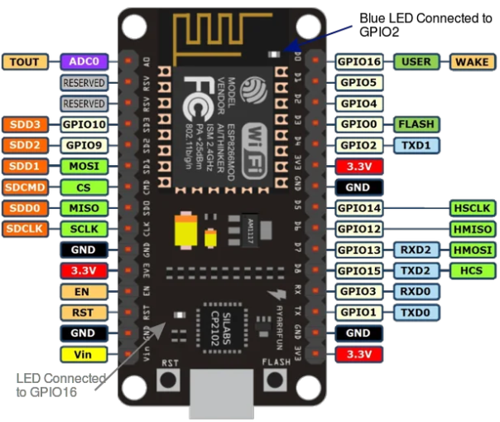

Components:
NODE MCU:
NodeMCU ESP8266 acts as the central controller with built-in Wi-Fi for IoT connectivity.
Connects to gas sensors ( MQ-2) to detect harmful gases like LPG, methane, and CO.
Processes sensor data and compares it to safety thresholds.
Sends real-time alerts to mobile apps for remote monitoring.
Offers a low-cost, scalable, and efficient solution for industrial safety automation.
BUZZER:
It helps warn workers immediately about danger in the area.
The buzzer is controlled by NodeMCU based on gas sensor readings.
It activates automatically when gas levels cross the safety limit.

Slide 8
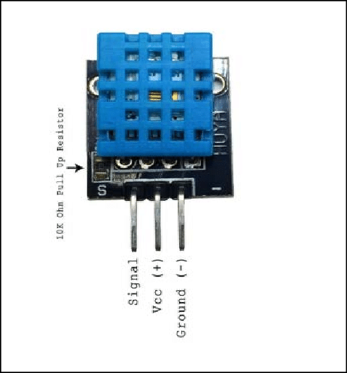

DHT11 SENSOR:
Measures temperature and humidity in the environment.
Helps monitor climatic conditions around gas leakage zones.
It works with NodeMCU to collect climate data along with gas levels.
Helps detect heat buildup or fire-prone conditions near gas leaks.
Supports automated safety actions like turning on fans or alarms.
GAS SENSOR:
A gas sensor can detect harmful gases like LPG, methane, and carbon monoxide.
It sends gas level data to a microcontroller like NodeMCU.
If the gas level is too high, the system turns on alarms or fans.
It works with Wi-Fi to send alerts to mobile apps or cloud platforms.
The system can shut down machines automatically for safety.

Slide 9
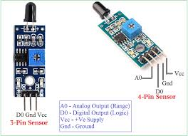
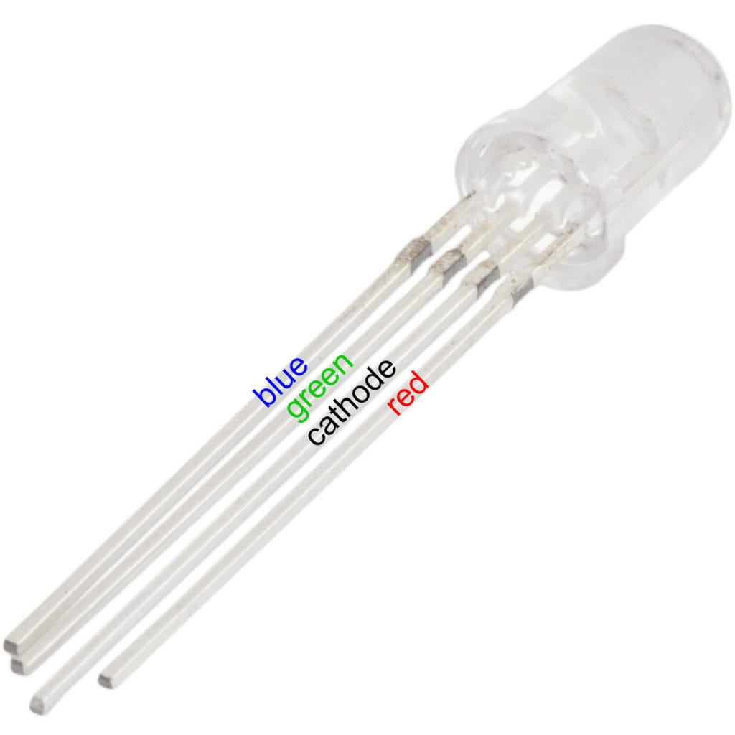
FIRE SENSOR:
A fire sensor detects flames or sudden heat in the environment.
It works with NodeMCU to monitor fire risks along with gas leaks.
If fire is detected, the system activates alarms and safety devices.
Sends instant alerts to mobile apps or cloud platforms via Wi-Fi.
Helps in quick response and remote monitoring during emergencies.
LED(Light Emitting Diode):
LEDs help workers quickly understand danger levels without checking a screen.
The LED is controlled by NodeMCU based on sensor readings.
It works with other safety devices like buzzers and fans for alerts.
LED status can match alerts sent to mobile apps or cloud platforms.

Slide 10
Working principle:
Gas Sensors
Threshold Detection
Real-Time Alerts
Automated Shutdown
Cloud Monitoring
WirelessTransmission
Emergency protocols

Slide 11
Applications:
Automated Safety System
Real-time Monitoring
Data Transmission
Alert Notification
Environmental Safety
Industrial Automation
Temperature and Humidity Monitoring
Wireless Communication

Slide 12
Advantages:
Early gas leakage detection
Automatic safety response
Real-time IoT monitoring
Worker and environmental safety
Remote alert system
Low-cost and energy-efficient
Scalable and flexible design
Supports industrial automation

Slide 13
Conclusion:
The Smart Industrial Harmful Gas Leakage Detection and Automated Safety Response System provides an effective and reliable way to ensure industrial safety. It detects harmful gas leaks at an early stage and automatically activates safety measures such as buzzer alarms, LED indicators.This system helps reduce accidents, protect workers, and prevent environmental damage. It demonstrates how automation and IoT can improve industrial safety and efficiency. Overall, it is a cost-effective, smart, and scalable solution for modern industrial environments.

Slide 14
Future Scope:
Mobile app integration
SMS and email alerts
AI-based leak prediction
Multi-sensor network
Battery backup system
Automatic ventilation control
Cloud data analytics
Fire suppression integration

Slide 15
References:
R. C. Gonzalez, R. E. Woods, Digital Image Processing, 4th Edition, Pearson, 2018. (For sensor data visualization concepts if needed)
A. K. Ray, Industrial Safety and Hazard Management, McGraw-Hill, 2017.
S. K. Singh, IoT Based Industrial Automation, International Journal of Advanced Research in Electrical, Electronics and Instrumentation Engineering, 2019.
R. Kumar, Smart Gas Leakage Detection System using IoT, IEEE Conference, 2020.

Slide 16


Slide 17


