Slide 1
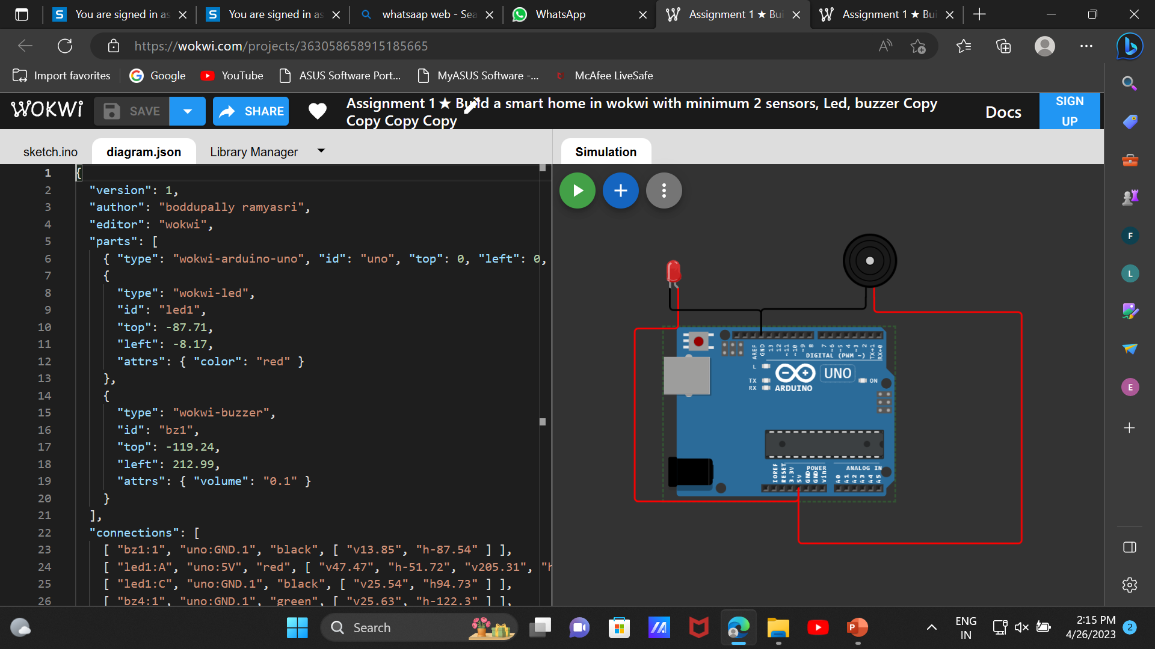
B .Ramyasri 711120106014 Assignment 1
https://wokwi.com/projects/363058658915185665

Slide 2
"version": 1,
"author": "boddupally ramyasri",
"editor": "wokwi",
"parts": [
{ "type": "wokwi-arduino-uno", "id": "uno", "top": 0, "left": 0, "attrs": {} },
{
"type": "wokwi-led",
"id": "led1",
"top": -87.71,
"left": -8.17,
"attrs": { "color": "red" }
},
{
"type": "wokwi-buzzer",
"id": "bz1",
"top": -119.24,
"left": 212.99,
"attrs": { "volume": "0.1" }
}
],
"connections": [
[ "bz1:1", "uno:GND.1", "black", [ "v13.85", "h-87.54" ] ],
[ "led1:A", "uno:5V", "red", [ "v47.47", "h-51.72", "v205.31", "h192.21" ] ],
[ "led1:C", "uno:GND.1", "black", [ "v25.54", "h94.73" ] ],
[ "bz4:1", "uno:GND.1", "green", [ "v25.63", "h-122.3" ] ],
[
"bz4:2",
"uno:5V",
"red",
[ "v11.11", "h242.99", "v186.31", "h-71.92", "v94.52", "h-252.74", "v30.82" ]
],
[ "bz1:2", "uno:5V", "red", [ "v17.68", "h175.49", "v274.56", "h-262.33" ] ]
],
"dependencies": {}
}

