Slide 1
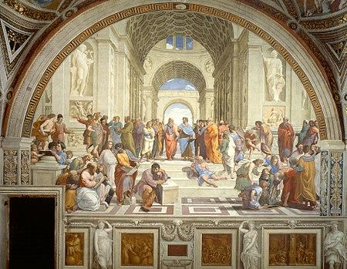
All roads lead to philosophy
By Ramzi Chariag and David Almasi

Slide 2
Project Question
What are the properties of a network of the first hyperlinks in a randomly selected number of Wikipedia pages?
There is a well-known phenomenon on Wikipedia: that, if clicking the first link of a main text of any randomly selected Wikipedia article, one can get to the Wikipedia page of philosophy.
In 2016, this was true for 96% of Wikipedia pages (the rest ended in loops or articles with no links).
The question arises: what are the properties of such an eccentric network of Wikipedia pages?

Slide 3
Data generation Process
Python: data-generating algorithm which randomly selects a Wikipedia article, then keeps clicking on the first non-italicised, non-parenthesized link, repeating the process until it reaches the Wikipedia page of philosophy
Then, sorting the data happened in Matlab and Excel to prepare it for further analysis in Matlab and Gephi
The end product was a node list with labels and node IDs, as well as an edge list with the source-target format.

Slide 4
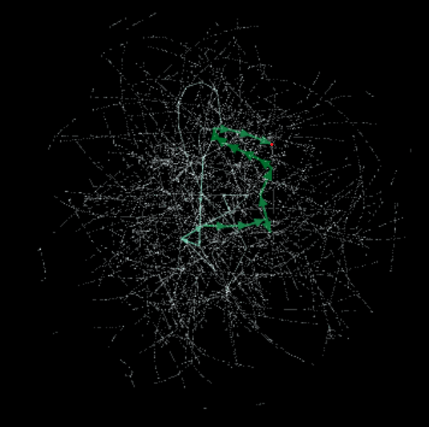
The visualised Network
Layout: Yifan HU proportional, colouring according to the number of degrees.
Red dot: Philosophy. Only incoming links - sink!
Thick lines: a recurring path that most links went through
Small, separated networks at the periphery: loops or paths which led to articles with no links.

Slide 5
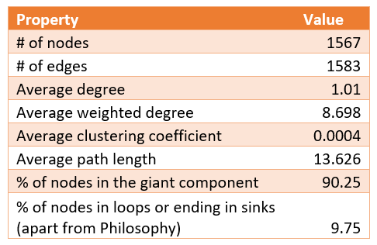
Table on the most important properties

Slide 6
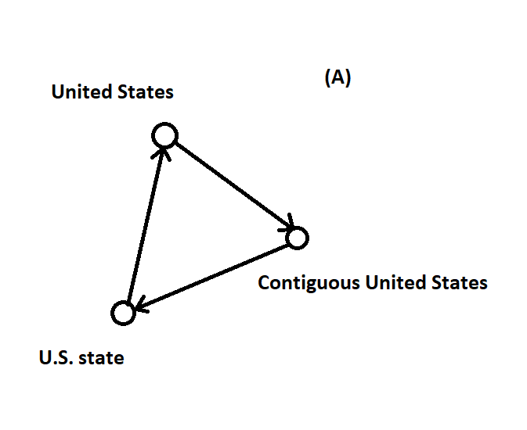
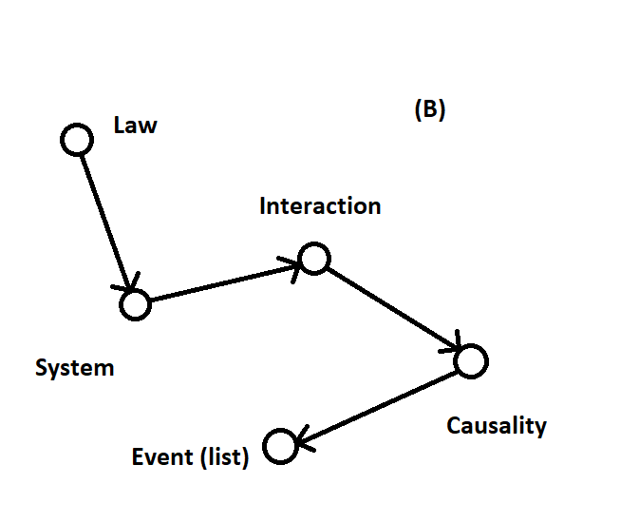
Networks Independent to the Giant Component
As said earlier, 9.25% of nodes form networks apart from the giant component
either are loops (A) or links leading to articles with no further nodes or Wikipedia lists (B)
This is a ratio more than the one suggested with by the respective Wikipedia page (3%). However, this metric is from 2016, and Wikipedia gets almost 600 new articles every day, it might be that the ratio of unconnected networks changes (e.g. the ratio was 5.48% in 2011).
Also, our code did not consider lists either, while the official Wiki statistics might do

Slide 7
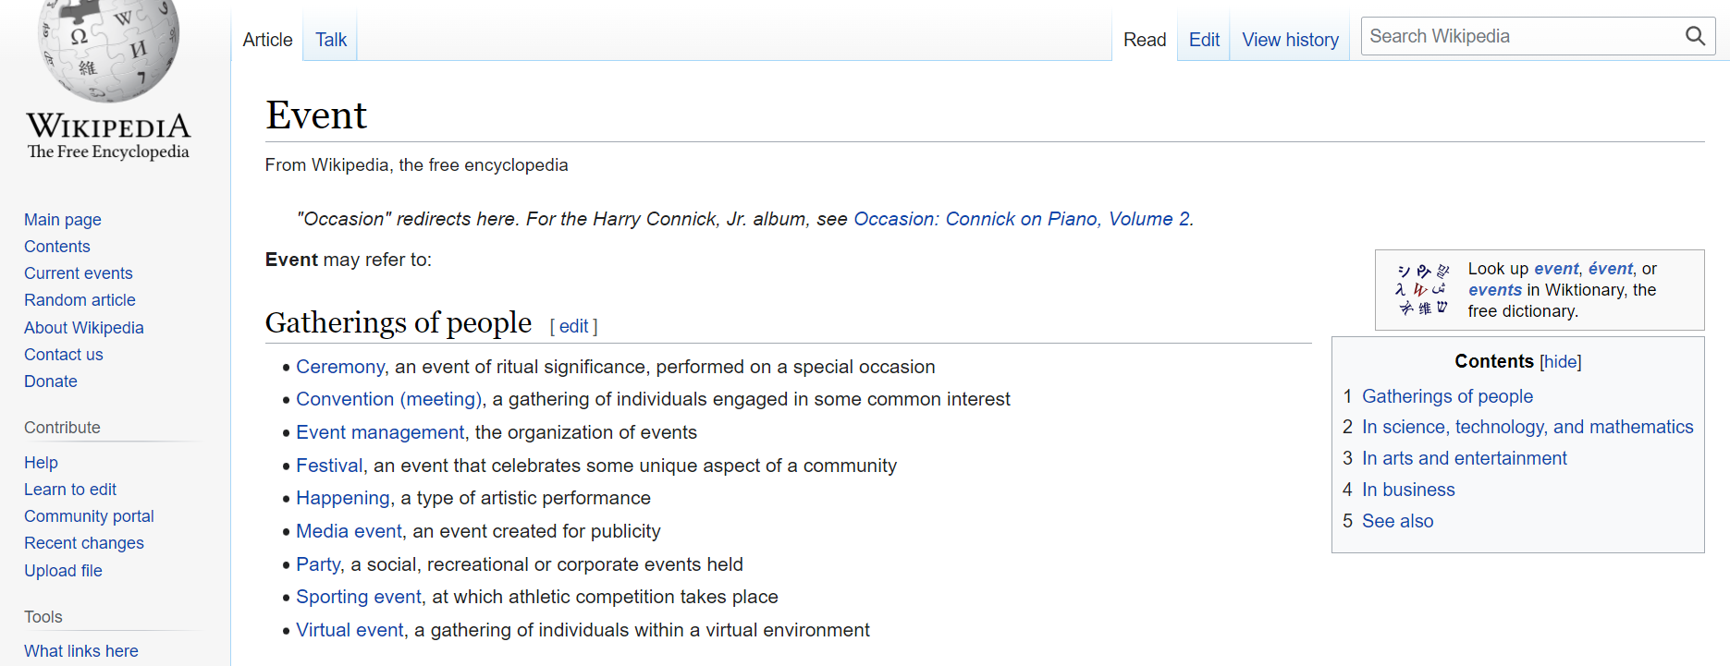

Slide 8
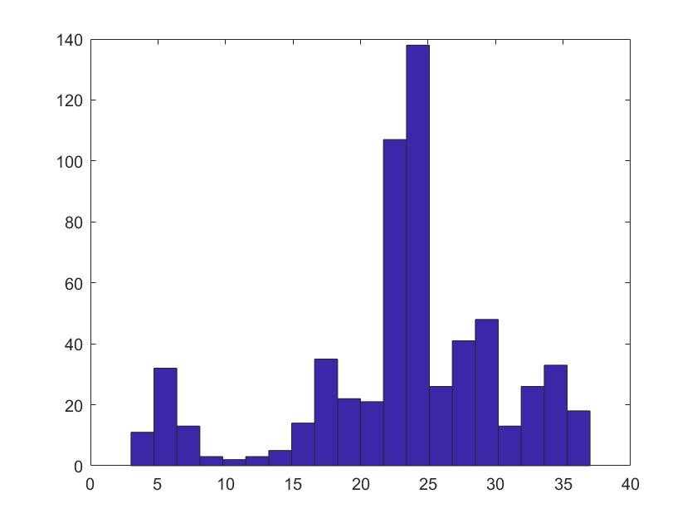
Path distribution
average path is 13.626
surprisingly, very few articles have very long path lengths - this means that
another surprise: there is only five direct links to philosophy, and all other paths channel into philosophy through a well-definable chain of links
This is a bimodal distribution - let us look at this closer!

Slide 9
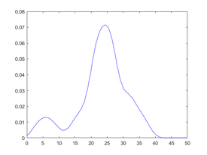
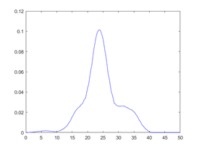
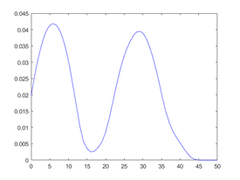
Path Distribution - continued, nonparametric approach
KDE of path length distribution for all paths
KDE of path length distribution for paths leading to philosophy
KDE of path length distribution for paths not leading to philosophy

Slide 10
Loops and degrees
The US and sovereign state lead to loops – in fact, physics is the node with the most degrees

Slide 11
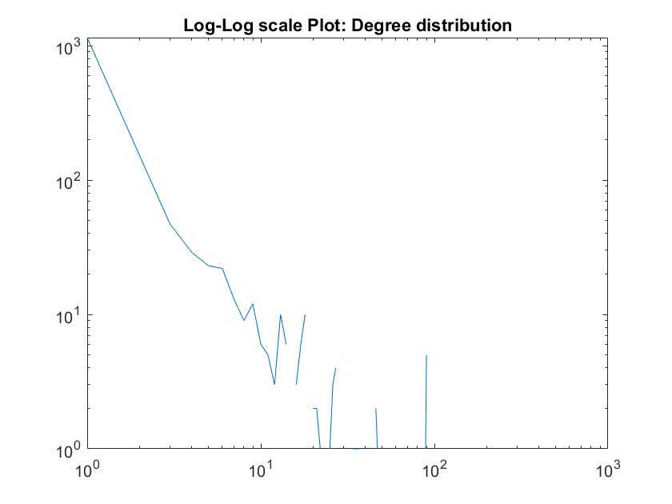
Degree Distribution
Power law section: There are a few large hubs. (exponent is approx. 900)
End is noisy: due to paths that end in loops, and the small sample

Slide 12
Extensions and applicability
This network is more of a tree, to go from one node to another, you would need to go up in hierarchy
Think about it like the public transport of a large city - if you want to get from one suburban area to the other, you will probably have to get through the city center
This is how analysing Wikipedia networks can be useful - networks like this can be useful in providing a structure for analysing directed networks.
Future research:
How do foreign language Wikipedia networks behave?
How does a model which extends into further links (and not only the first one) behaves?

Slide 13
Bibliography
Ibrahim et al. (2016) Connecting every bit of knowledge: the structure of Wikipedia’s first link network. [Online] Available at: https://arxiv.org/pdf/1605.00309.pdf?fbclid=IwAR1SY0tNCF9LoegJNdD7lIohQVuATxprzv46788GjPCc46oqWwtgfTkgebc
Wikipedia (no date) Statistics. [Online] Available at: https://en.wikipedia.org/wiki/Wikipedia:Statistics
Wikipedia (no date) Getting to Philosophy. [Online] Available at: https://en.wikipedia.org/wiki/Wikipedia:Getting_to_Philosophy

