Slide 1

ACADEMIC USABILITY & INTERFACE AUDIT
Sadat Academy for Management Sciences (SAMS)
Homepage Usability Evaluation & Interactive Figma Redesign
Analyzing cognitive load, affordance failures, and heuristic violations to create a modern, task-centered digital experience.
Course: Human-Computer Interaction & UI/UX Design • Target: http://sams.edu.eg/en/ • Deliverable: Figma Prototype & HCI Analysis

Slide 2
HUMAN-COMPUTER INTERACTION (HCI) CASE STUDY
Target Audience & Core User Personas
🎓 Prospective Students
High school graduates & postgraduate applicants seeking degree catalogs, requirements, tuition fees, and admission deadlines.
• Priority 1: Find major study plans
• Priority 2: Clear 'Apply Now' pathway
• Pain Point: Buried admission links
📚 Current Enrolled Students
Over 15,000 students enrolled across Cairo, Alexandria, Tanta, Mansoura, Minia, and Port Said campuses.
• Priority 1: Check semester exam grades
• Priority 2: Class schedules & academic advising
• Pain Point: Student portal hidden midway
🏢 Executive & Faculty
Corporate professionals, researchers, and academic faculty seeking training programs and LMS portals.
• Priority 1: Management consulting & diplomas
• Priority 2: Staff LMS & academic journals
• Pain Point: Lack of institutional hierarchy

Slide 3
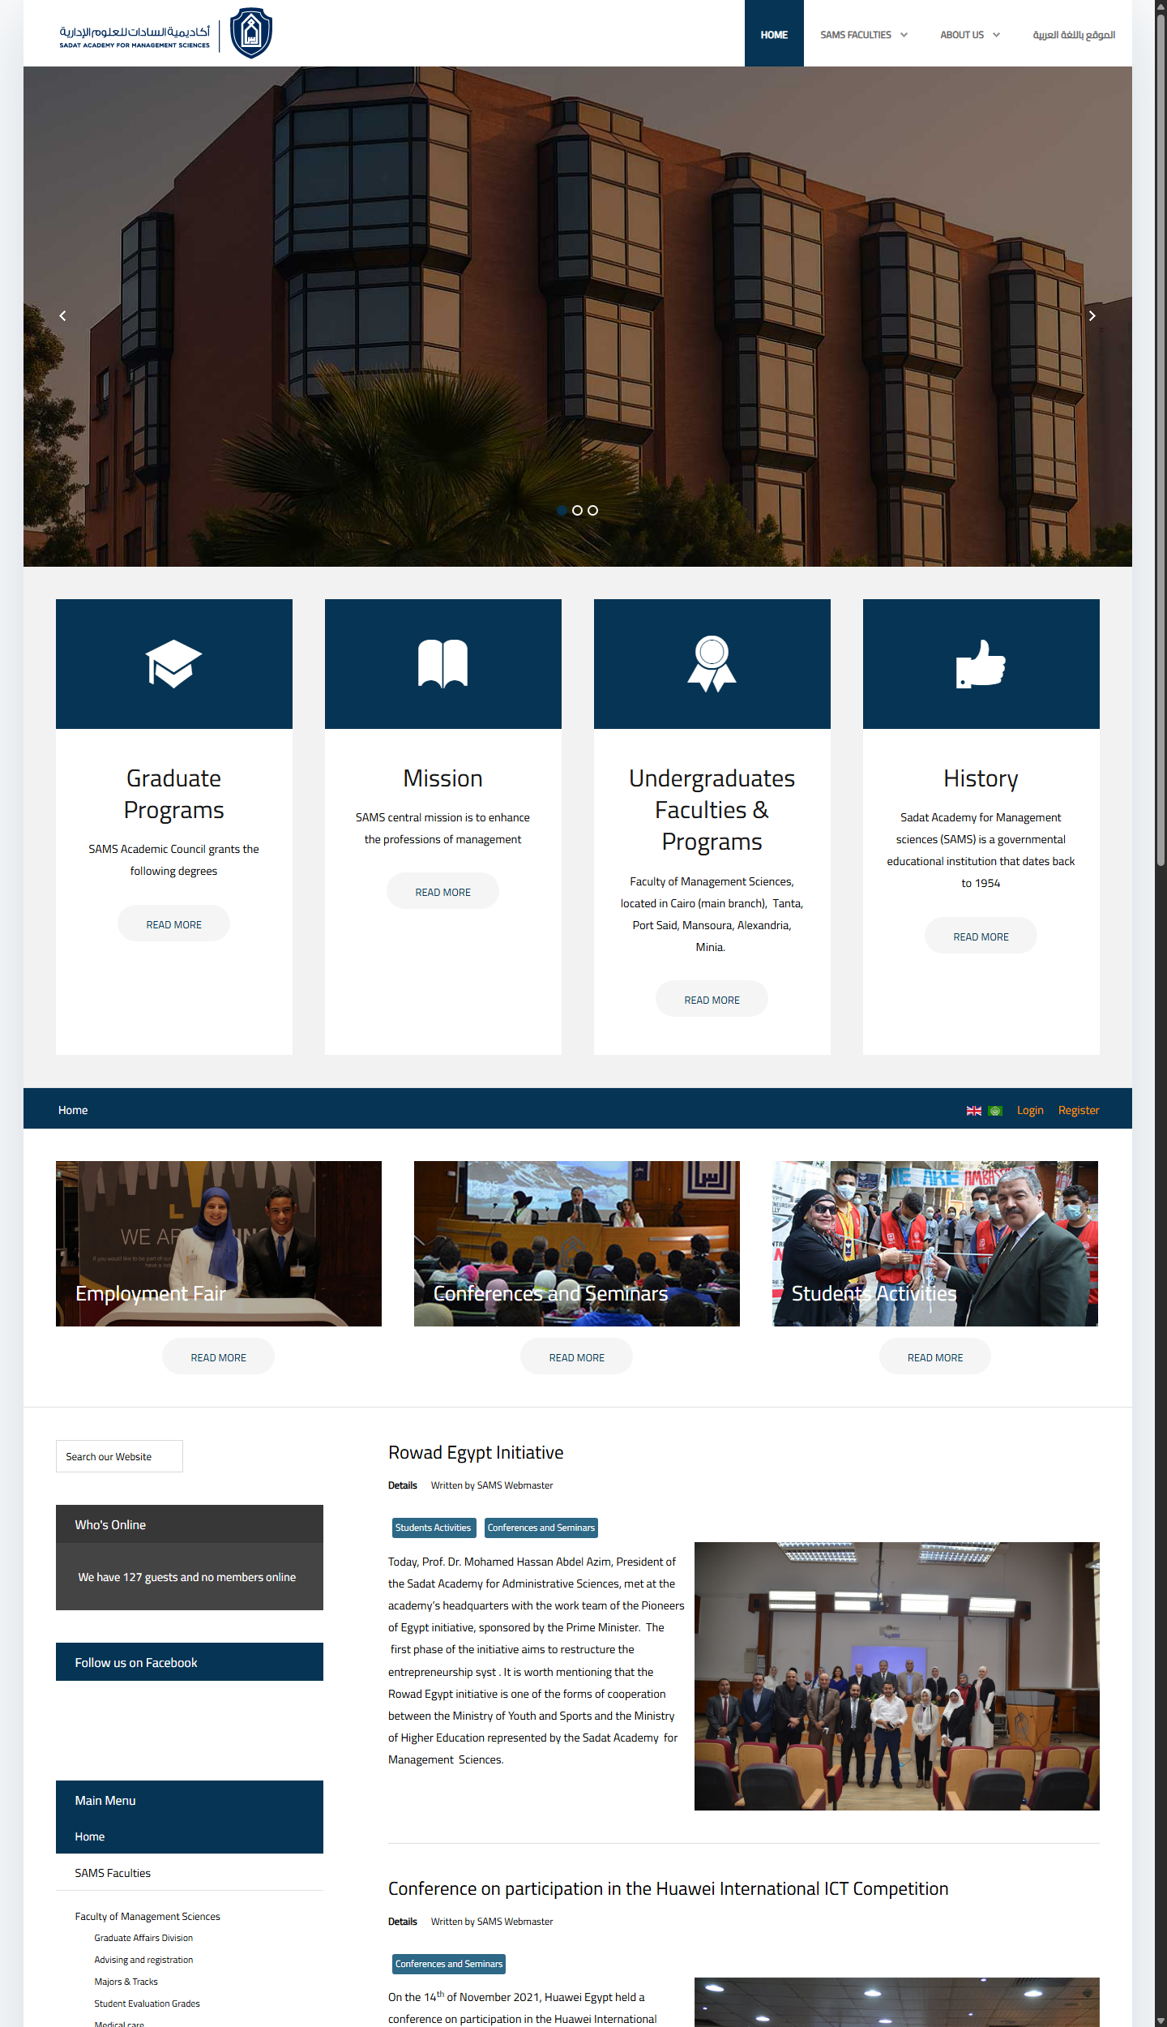
HUMAN-COMPUTER INTERACTION (HCI) CASE STUDY
Original Interface Audit: Identified Flaws
Key Usability Bottlenecks on Current Page
1. Passive Hero Slider
Massive building photo carousel with zero text, zero headline, and no interactive CTAs.
2. Illogical Card Grouping
Academic programs are mixed with static History & Mission, all using identical 'READ MORE' buttons.
3. Misplaced Utility Controls
Student Login, Register, and Language flags are buried in the middle of the page below the fold.
4. Low-Utility Diagnostic Widgets
'Who's Online' counter (127 guests) and duplicated menu clutter the left sidebar.

Slide 4
HUMAN-COMPUTER INTERACTION (HCI) CASE STUDY
HCI Theoretical Grounding of the Usability Flaws
Norman's Affordances & Fitts's Law
The passive hero section provides no signifiers for interaction, leaving users in a wide 'Gulf of Execution'. Fitts's Law ($T = a + b \log_2(2D/W)$) is violated as prime above-the-fold screen space has zero clickable targets.
Gestalt Similarity & Information Scent
Because History, Mission, and Undergraduate Programs share identical visual weight and low-contrast 'READ MORE' pills, the system fails Gestalt similarity and forces users to guess link destinations.
Nielsen #4: Consistency & Standards
Violates Jakob's Law of Internet UX. Users expect authentication and locale toggles in the top-right header. Placing them midway down breaks existing user mental models.
Nielsen #8: Minimalist Design & Cognitive Load
Visitor counters ('Who's Online') and sitemap repetition represent extraneous cognitive load (Sweller), competing with relevant academic announcements for working memory.

Slide 5
HUMAN-COMPUTER INTERACTION (HCI) CASE STUDY
Information Architecture Transformation: Before vs. After
BEFORE: Fragmented Legacy Layout
• Unorganized top nav with nested menus & pseudo-links
• Passive hero photo slider (no CTAs or value proposition)
• 4 identical cards mixing degrees with institutional history
• Mid-page secondary bar with login & UK/Saudi flags
• Left sidebar: 'Who's Online' counter & duplicated menu tree
• Right column: Raw chronological blog feed with dated articles
AFTER: User-Centered Hierarchical Flow
• Tier 1: Top Utility Bar (Student Portal, Staff LMS, Search, عربي)
• Tier 2: Sticky Header (SAMS Official Crest, Nav, 'Apply Now' CTA)
• Tier 3: Actionable Hero (Value proposition headline, Dual CTAs)
• Tier 4: Persona Cards (Prospective, Current, Postgrad, Executive)
• Tier 5: Interactive Faculty Tabs (Progressive disclosure for tracks)
• Tier 6: Curated News & Events Grid (Date badges, real SAMS photos)

Slide 6
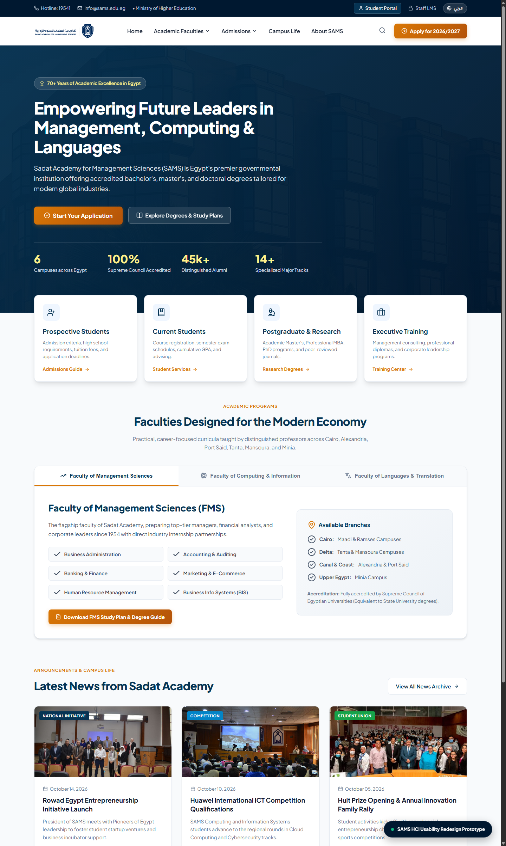
HUMAN-COMPUTER INTERACTION (HCI) CASE STUDY
The Redesigned SAMS Homepage
Key UI/UX Design System Improvements
• Official Institutional Branding: Integrated the authentic SAMS emblem and bilingual crest into header and footer.
• High-Contrast Actionable CTAs: Golden-amber primary button ('Apply for 2026/2027') stands out against the navy palette.
• Cognitive Chunking via Personas: Elevated 4 audience cards that immediately direct users based on their primary intent.
• Progressive Disclosure Tab System: Tabs allow instant switching between Management, Computing, and Languages without reloading.
• Modern Gestalt News Grid: Organized campus announcements with high-resolution imagery, dates, and category pills.

Slide 7
HUMAN-COMPUTER INTERACTION (HCI) CASE STUDY
Figma Interactive Prototype Walkthrough
Interaction 1: Faculty Tab Switching
Clicking between 'Faculty of Management Sciences' and 'Computing & Information' triggers an instant state transition displaying study tracks and lab partnerships using Smart Animate.
Interaction 2: Global Search Modal Overlay
Clicking the 🔍 search icon opens a centered modal with trending search shortcuts (e.g., BIS study plan, Student exam grades), supporting recognition over recall.
Interaction 3: Micro-Interactions & Hover Signifiers
All buttons and persona cards feature subtle elevation shifts (Y: -4px) and shadow transitions to reinforce clickability and affordance feedback.
👉 Live Prototype Verification: Tested locally via index.html and imported into Figma components.

Slide 8
HUMAN-COMPUTER INTERACTION (HCI) CASE STUDY
Usability Evaluation Matrix: Before vs. After
Criterion | Original Homepage (Before) | Redesigned Homepage (After) | HCI Concept Grounding
Primary CTA | Missing. Only passive photo slider. | High-contrast 'Apply Now' CTA button. | Norman's Signifiers & Fitts's Law
Auth & Language | Buried midway down the page. | Consolidated in top-right utility bar. | Jakob's Law & Nielsen Heuristic #4
Architecture | Degrees mixed with static history text. | Persona routing cards + faculty tabs. | Gestalt Proximity & Miller's Law
Button Labels | Generic 'READ MORE' pills. | Descriptive task labels with arrows. | Information Scent & Heuristic #6
Visual Clutter | 'Who's Online' & duplicated menu. | Eliminated. Clean 3-card news grid. | Nielsen Heuristic #8 (Minimalism)
Search Usability | Tiny input in bottom sidebar. | Prominent modal search with auto-suggest. | Error Prevention & Heuristic #7

