Slide 1
EDES 301
Proposal:
One-handed Game Controller
October 4, 2026
Randy Casas Alvarez

Slide 2
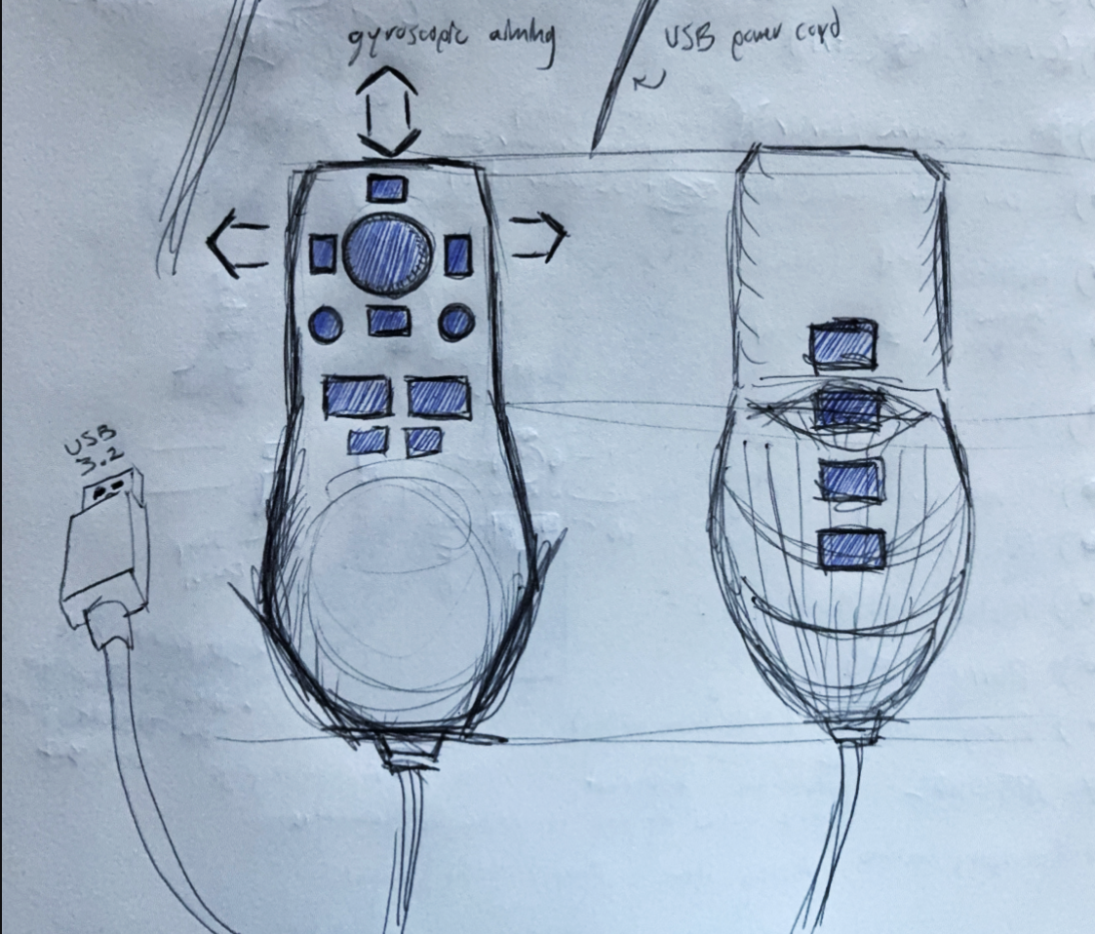
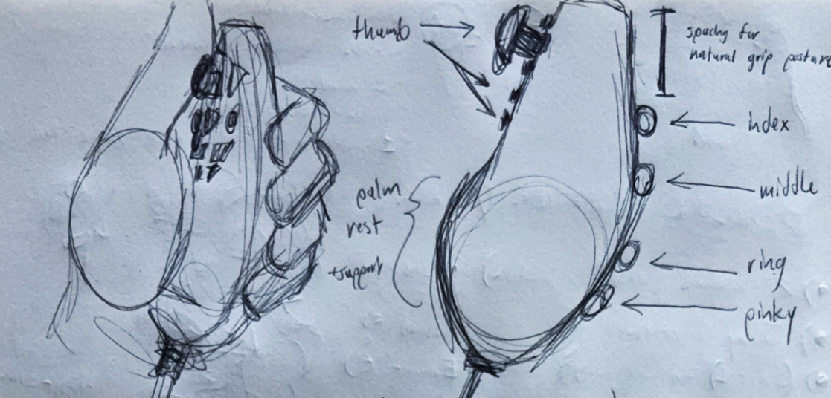
Proposal
One-handed video game controller, supported by Steam Input API, that substitutes conventional yet wrist-straining mouse & keyboard layouts to address accessibility concerns while retaining most, if not all, gameplay capabilities.

Slide 3
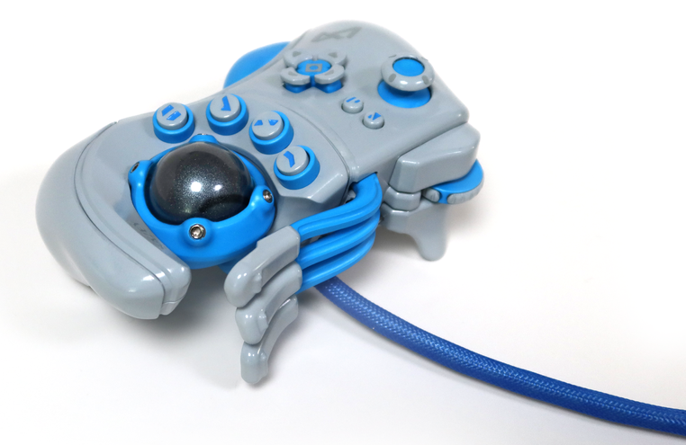
Background Information
Inspired by:
Ultimate FPS - Controller Design & Build - PyottDesign
I Made Steam Controller Joy-Cons (Capacative Touchpad Mod) - Eric Halin
Referencing:
XInput-Python · PyPI - Xinput API interface for Python library
Improvements over existing designs
Traditional Gamepads: two-handed, imprecise controls
Nintendo Wii Remote: lack of support outside of Nintendo platforms, IR sensor for precise aiming controls
Nintendo Joy-con: too few buttons and poor handling
VR controllers: asymmetrical design reinforces hand dominance
Charlie Pyott Design, 2024

Slide 4
System Block Diagram
GPIO
Linux Python
Windows PC
  Label interfaces (I2C, SPI, GPIO, etc.; You do not need to know all of the connections)
  Components (part numbers if possible)
PocketBeagle
Interpreter Software (i.e. Xbox Controller Emulator)
Analog
Analog
I2C
Steam Games
Buttons
Joystick (Potentiometers)
IMU sensor
Need Moderate Level of Detail

Slide 5
Power Block Diagram
Windows PC
USB 3.2 port
PocketBeagle
Label voltages / currents of components
5 V
3.3 - 5 V
IMU
0 - 5 V
Joystick
5 V
Buttons

Slide 6
Components / Budget
Component | EDES301 to Buy? | Cost
WMYCONGCONG Joystick Breakout Module (x2) | Yes | $2.67
DAOKI 4-pin Tactile Buttons (x10) Amazon.com: DAOKI 100Pcs 6x6x5 mm Miniature Micro Momentary Tactile Tact Touch Push Button Switch Quality Switch SPST Miniature/Mini/Micro/Small PCB | Yes | $0.50
AITRIP MPU-6050 IMU (x2) | Yes | $4.20
PocketBeagle Development board | No | —
3D-printed PLA casing | No | —
microUSB to USB Type A adapter | No | —
Total |  | $7.57

Slide 7
Component Selection (Remove slide for submission)
All components must be from either: Amazon, Adafruit, Sparkfun, Digi-Key, or Mouser
Select no more than two (2) components that are not on approved component spreadsheet
  See Canvas 🡪 Files 🡪 assignments 🡪 EDES301_project_01_parts_list.xlsx
  If there is a cheaper part that you would like to use, we can discuss in the project meeting
All components needed for the project should be listed on Slide 5
All components should have links to the website where they can be purchased
  Please trim URLs for links to Amazon
EDES301 will supplement $25 to $35 dollars for components
  Please indicate what components need to be purchased by EDES301
If you have a special request, we can discuss in the project meeting

