Slide 1
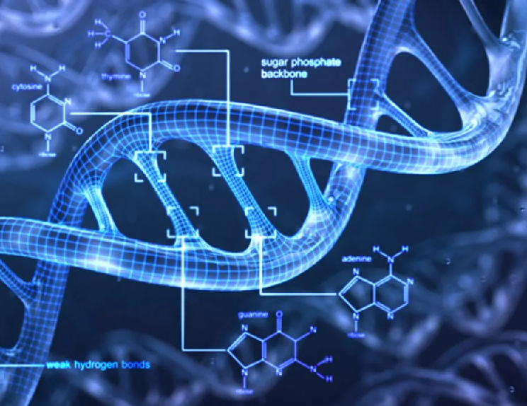
Privacy-Preserving
Aging Analytics
Ran Toledo | Shelly Brezner

Slide 2

Chapters
Introduction
Epigenetic Pacemaker
Linear Homomorphic Encryption
System Overview
Implementation
Evaluation
Conclusions & Discussion
Acknowledgements

Slide 3
Introduction
In recent studies, it has been found that DNA methylation could be an accurate biomarker for aging in humans
Despite analytical tools to model the change of methylation and aging being relatively undeveloped, a recent line of work known as the Epigenetic PaceMaker (EPM) has developed a statistical, likelihood-based approached to model precisely that
However, employing such a model on human subjects raises privacy concerns and if privacy is not ensured it could have a vast range of serious implications
Also, the input for the EPM model relies on sensitive personal data and the model itself could also be confidential, for example; when it is a proprietary asset of a commercial entity
In our work, we have developed a privacy-preserving protocol to securely infer epigenetic aging using chronological ages and DNA methylation arrays. Our solution builds on the EPM method along with privacy-preserving solutions for linear regression

Slide 4
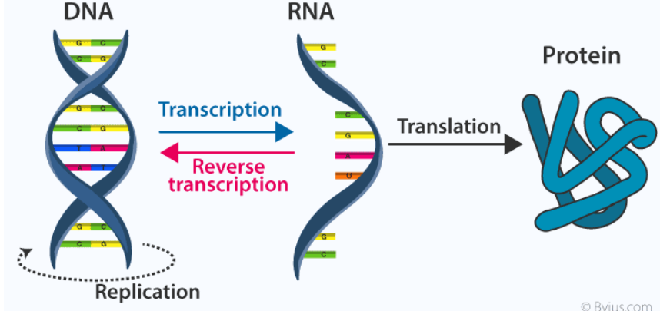
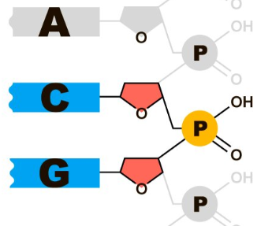
Biological Explanation
DNA is the hereditary material in humans and almost all other organisms
The information in DNA is stored as a code made up of four chemical bases: adenine (A), guanine (G), cytosine (C), and thymine (T)
CpG sites are regions of DNA where a C base is followed by a G base. CpG islands are regions of the genome that contain many CpG repeats
CpG islands are often present around promoter sequences, which are DNA sequences that define where to start transcription of DNA to RNA
CpG Sites

Slide 5
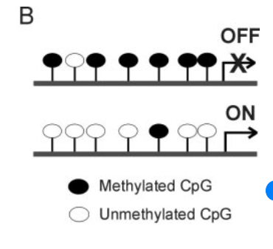
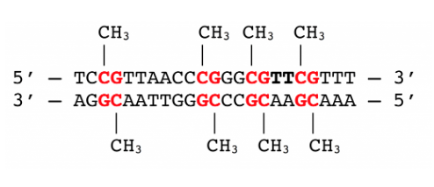
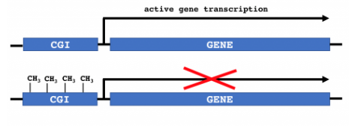
Biological Explanation
Methylation is the process by which methyl (CH3) groups are added to the DNA molecule
When a CpG site is methylated within the promoter region of a gene, its transcription is inhibited, resulting in a loss of gene expression
DNA methylation has proven to be a remarkably accurate biomarker for human age, allowing the prediction of chronological age to within a couple of years
Therefore, DNA Methylation levels can be used to accurately estimate the age of tissues and cell types, forming an accurate epigenetic clock.

Slide 6

MC Model
First description of a robust epigenetic clock that worked across different tissues was presented by Steve Horvath and consisted of 353 CpG sites whose weighted sums yield and estimate of chronological age to within a couple of years
The Horvath epigenetic clock model uses a linear combination of the methylation status of several hundred sites to predict the age of an individual
The time linearity of the Horvath clock makes it the “epigenetic parallel” of the classical evolutionary version of the molecular clock (MC)

Slide 7
Universal PaceMaker (UPM)
Mechanisms from molecular evolution have been adopted to the process of methylation
Specifically, the Universal PaceMaker (UPM) allows for rate variability as opposed to the constancy imposed by the molecular clock
In the UPM approach, we assume that all sites are changing linearly with an adjusted time, which is a non-linear function of the chronological time
UPM framework models epigenetic aging better than the molecular clock- an observation strengthened by analysis of the algorithm’s classification of substantially larger inputs of individuals and methylation sites
UPM allows sites to accelerate and decelerate jointly, accounting for nonlinear trends in aging

Slide 8
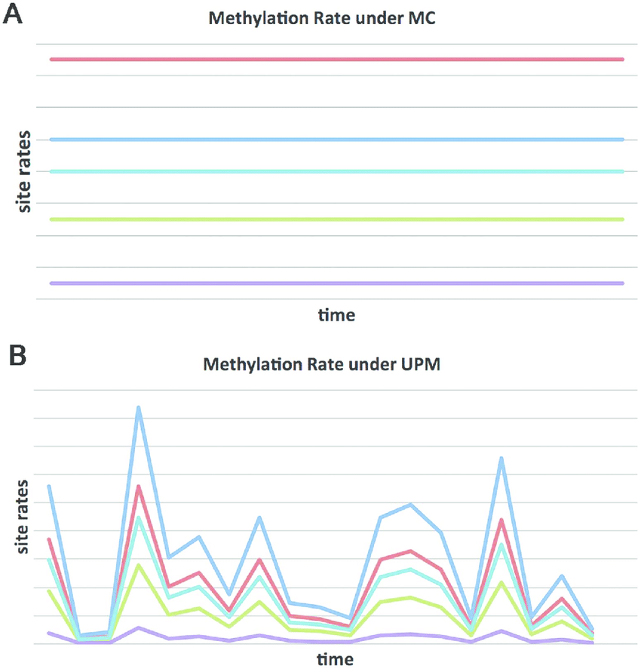

MC Model vs. UPM Model
In the MC model, site methylation rates are constant over time
Whereas under the UPM model; site methylation rates varies over time however the change proportion remains the same between any two sites $i, i$

Slide 9
Epigenetic PaceMaker
The Epigenetic PaceMaker system developed by S. Snir uses the universal pacemaker (UPM) of genome evolution to allow for rate variability as opposed to the constancy imposed by the MC concept
EPM replaces genes with CpG sites and interpret UPM rate increases as accelerated aging, thus the UPM framework becomes an appealing paradigm to study age related changes in DNA methylation

Slide 10
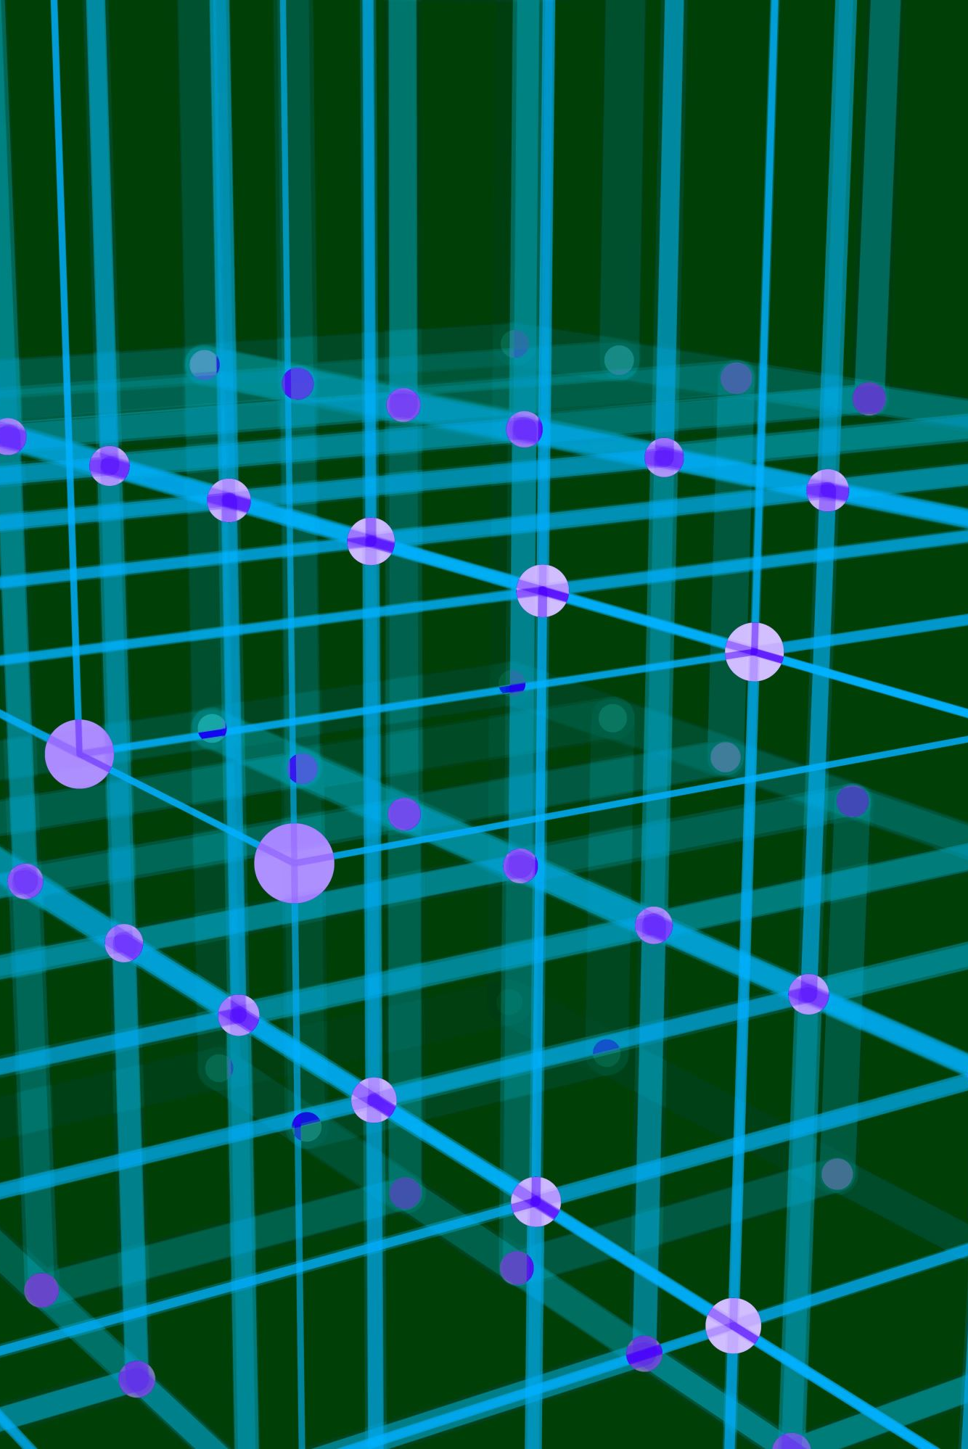

MC Model Framework
Model has $m$ individuals and $n$ methylation sites
$t_{j}$ = time period representing individual $j$’s age
$s_{i}$ = methylation site that undergoes changes
$r_{i}$ = change rate of methylation site $i$
$s_{i}^{0}$ = initial methylation level of site $i$
matrix $\hat{S}$ = holding the observed methylation level at site $s_{i}$ of individual j.
$s_{i,j}$ measures the methylation level at site $s_{i}$, in individual $j$ at time $t_{j}$
Under the molecular clock model (rate is constant over time), we expect: $s_{i,j}=s_{i}^{0}+r_{i}t_{j}$

Slide 11
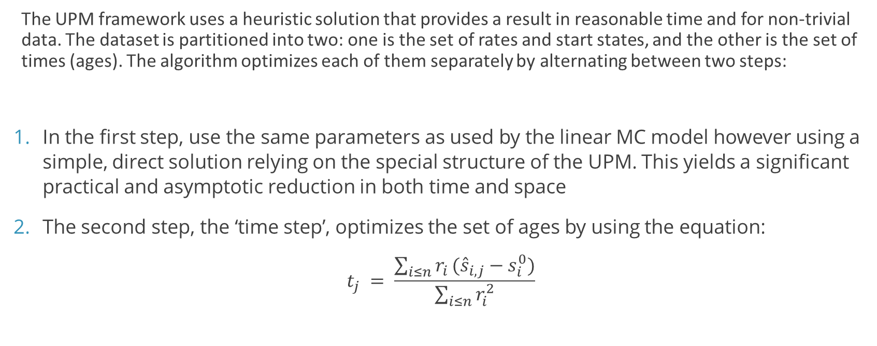
UPM Framework
The UPM framework uses a heuristic solution that provides a result in reasonable time and for non-trivial data. The dataset is partitioned into two: one is the set of rates and start states, and the other is the set of times (ages). The algorithm optimizes each of them separately by alternating between two steps:
In the first step, use the same parameters as used by the linear MC model however using a simple, direct solution relying on the special structure of the UPM. This yields a significant practical and asymptotic reduction in both time and space
The second step, the ‘time step’, optimizes the set of ages by using the equation:
$$t_{j} = \frac{\sum_{i≤n}{r_{i}}({\hat{s}}_{i,j}−s_{i}^{0})}{\sum_{i≤n}{r_{i}^{2}}}$$

Slide 12
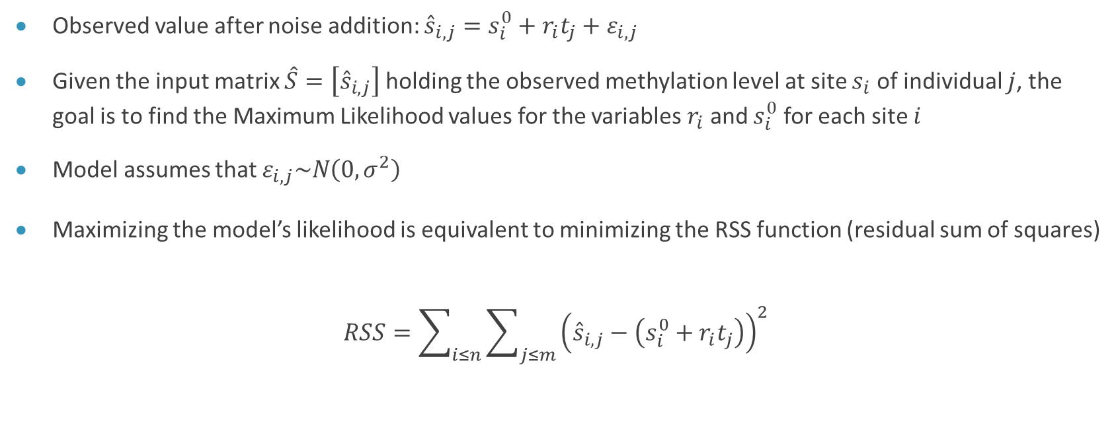
EPM System Overview
Observed value after noise addition: ${\hat{s}}_{i,j}=s_{i}^{0}+r_{i}t_{j}+ε_{i,j}$
Given the input matrix $\hat{S}=\left[{\hat{s}}_{i,j}\right]$ holding the observed methylation level at site $s_{i}$ of individual $j$, the goal is to find the Maximum Likelihood values for the variables $r_{i}$ and $s_{i}^{0}$ for each site $i$
Model assumes that $ε_{i,j}\sim N\left(0,σ^{2}\right)$
Maximizing the model’s likelihood is equivalent to minimizing the RSS function (residual sum of squares)
$$RSS=\sum_{i≤n}{\sum_{j≤m}{{\left({\hat{s}}_{i,j}−\left(s_{i}^{0}+r_{i}t_{j}\right)\right)}^{2}}}$$

Slide 13
Complete CEM-UPM Algorithm
Find the second set ($t_{j}$) by the equation using parameters calculated in Stage 1
Find the second set (𝑡_𝑗) by the equation using parameters calculated in Stage 1
Calculate RSS0 using the variable and variants from previous iteration.
Calculate RSS1 using the variable and variants from current iteration.
If ($RSS1 – RSS0 > δ$AND $m < n$) => return to stage 1 and perform another iteration. ($m$ represents the number of iterations).
If (𝑅𝑆𝑆1 – 𝑅𝑆𝑆0 > 𝛿 AND 𝑚 < 𝑛) => return to stage 1 and perform another iteration. (𝑚 represents the number of iterations).
Input : $t_{j} , \hat{S}\text{, }\text{δ}$ $\text{(}\text{the} \text{minimal} \text{improvement}\text{)}$, $n$(maximum number of iterations)
Input : 𝑡_𝑗 , 𝑆 ̂", δ" "(the minimal improvement)", 𝑛 (maximum number of iterations)
Perform the site step ($s_{i}^{0} and r_{i}$) If this is the first iteration: $t_{j}$ is provided by the user (the chronological age). If not : use the values of $t_{j}$ calculated in the previous iteration.
Perform the site step (𝑠_𝑖^0 𝑎𝑛𝑑 𝑟_𝑖) If this is the first iteration: 𝑡_𝑗 is provided by the user (the chronological age). If not : use the values of 𝑡_𝑗 calculated in the previous iteration.

Slide 14
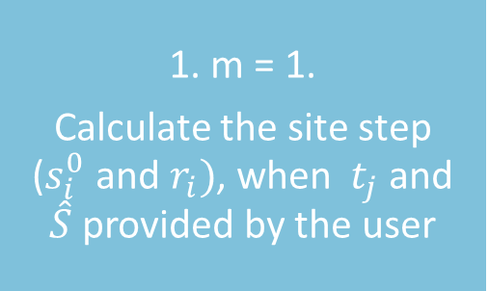
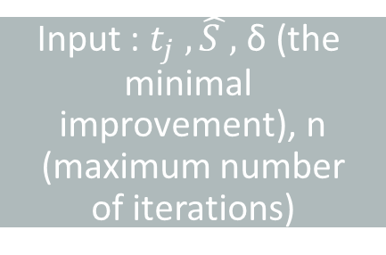
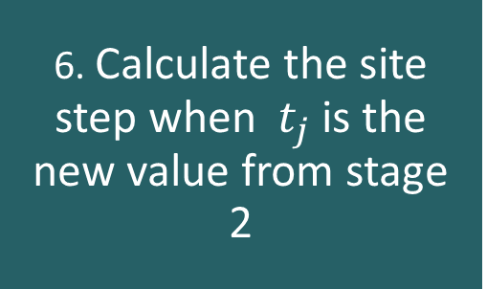
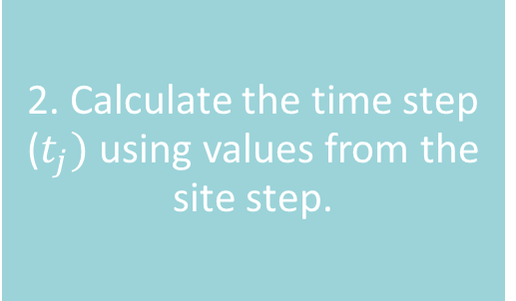
1. m = 1.
Calculate the site step ($s_{i}^{0}$ and $r_{i})$, when $t_{j}$and $\hat{S}$ provided by the user
2. Calculate the time step ($t_{j})$ using values from the site step.
Input : $t_{j} , \hat{S }\text{, }\text{δ}\text{ (}\text{the} \text{minimal} \text{improvement}\text{)}$, n (maximum number of iterations)
4. Calculate RSS1 using the variable and variants from current iteration.
5. If RSS0 – RSS1 > δ AND m < n :
Go to stage 6
Else, complete.
3. Calculate RSS0 using the variable and variants from previous iteration
6. Calculate the site step when $t_{j}$is the new value from stage 2

Slide 15
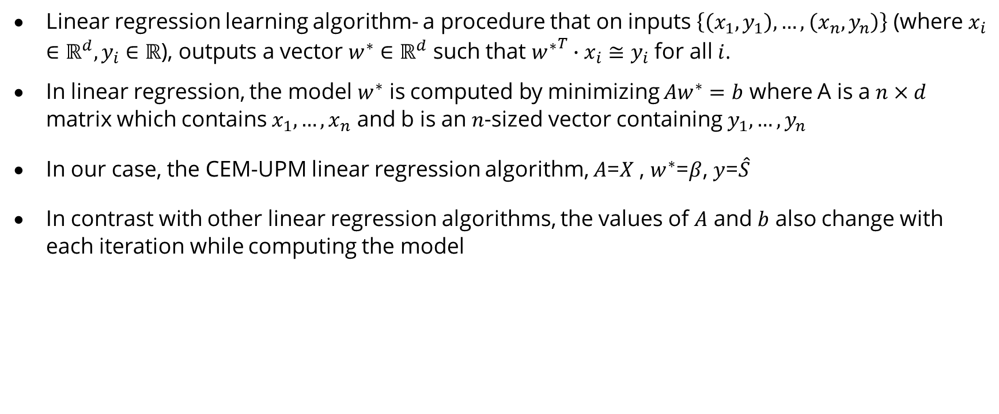
Linear Regression
Linear regression learning algorithm- a procedure that on inputs $\left\{\left(x_{1},y_{1}\right), …,\left(x_{n},y_{n}\right)\right\}$ (where $x_{i}∈ℝ^{d}, y_{i}∈ℝ$), outputs a vector $w^{∗}∈ℝ^{d}$ such that ${w^{∗}}^{T}∙x_{i}≅y_{i}$ for all $i$.
In linear regression, the model $w^{∗}$ is computed by minimizing $Aw^{∗}=b$ where A is a $n×d$ matrix which contains $x_{1},…,x_{n}$ and b is an $n$-sized vector containing $y_{1},…,y_{n}$
In our case, the CEM-UPM linear regression algorithm, $A$=$X$ , $w^{∗}$=$β$, $y$=$\hat{S}$
In contrast with other linear regression algorithms, the values of $A$ and $b$ also change with each iteration while computing the model

Slide 16
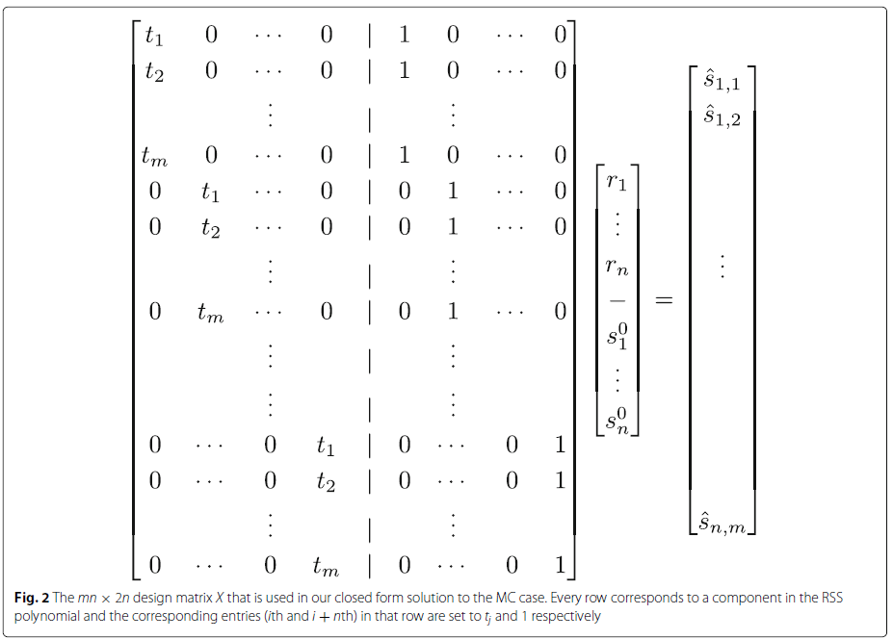
Linear Regression (CEM-UPM)

Slide 17
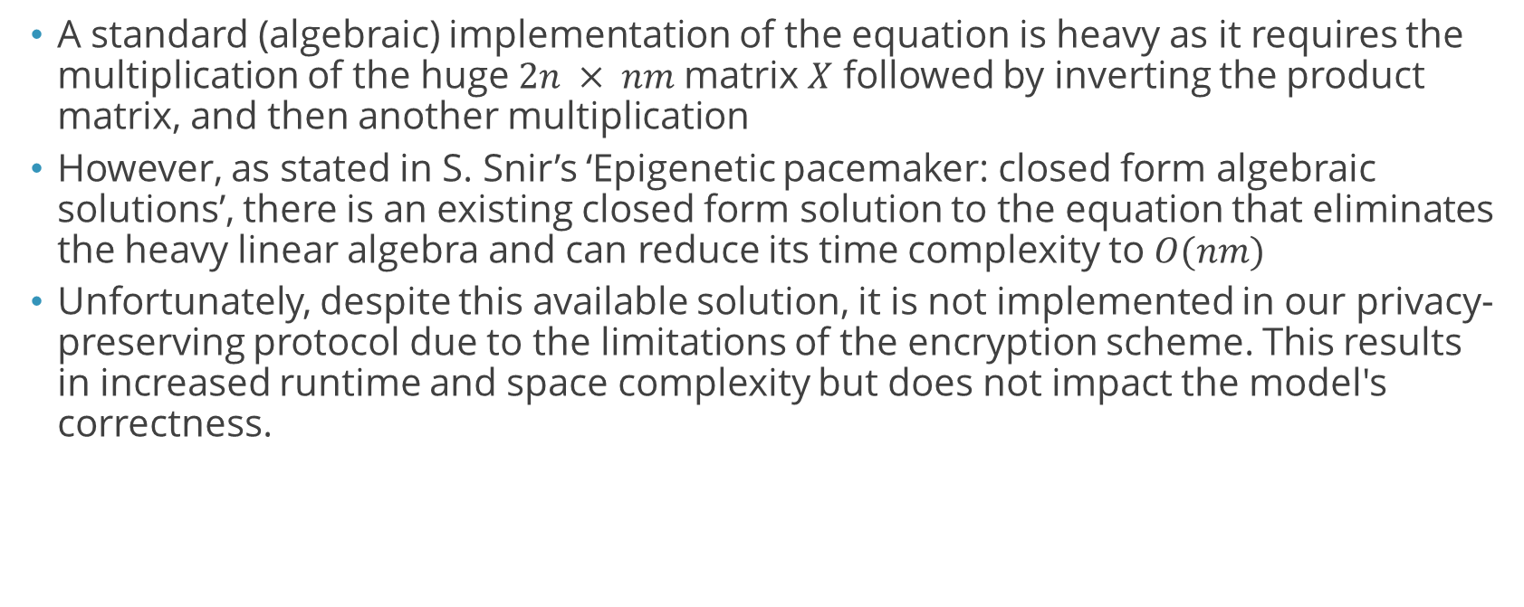
Algorithm Complexity Reduction
A standard (algebraic) implementation of the equation is heavy as it requires the multiplication of the huge $2n × nm$matrix $X$ followed by inverting the product matrix, and then another multiplication
However, as stated in S. Snir’s ‘Epigenetic pacemaker: closed form algebraic solutions’, there is an existing closed form solution to the equation that eliminates the heavy linear algebra and can reduce its time complexity to $O(nm)$
Unfortunately, despite this available solution, it is not implemented in our privacy-preserving protocol due to the limitations of the encryption scheme. This results in increased runtime and space complexity but does not impact the model's correctness.

Slide 18
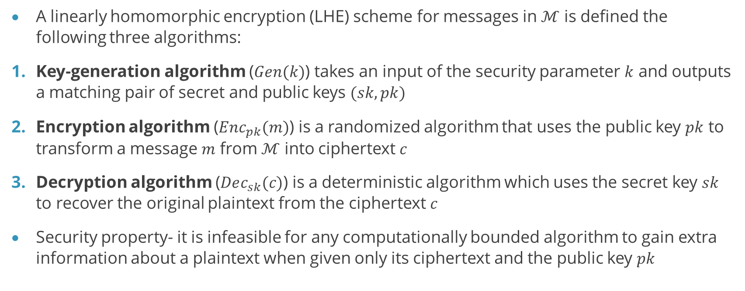
Linearly-Homomorphic Encryption (LHE)
A linearly homomorphic encryption (LHE) scheme for messages in $ℳ$ is defined the following three algorithms:
Key-generation algorithm ($Gen(k)$) takes an input of the security parameter $k$ and outputs a matching pair of secret and public keys $(sk,pk)$
Encryption algorithm ($Enc_{pk}(m)$) is a randomized algorithm that uses the public key $pk$ to transform a message $m$ from $ℳ$ into ciphertext $c$
Decryption algorithm ($Dec_{sk}(c)$) is a deterministic algorithm which uses the secret key $sk$ to recover the original plaintext from the ciphertext $c$
Security property- it is infeasible for any computationally bounded algorithm to gain extra information about a plaintext when given only its ciphertext and the public key $pk$

Slide 19
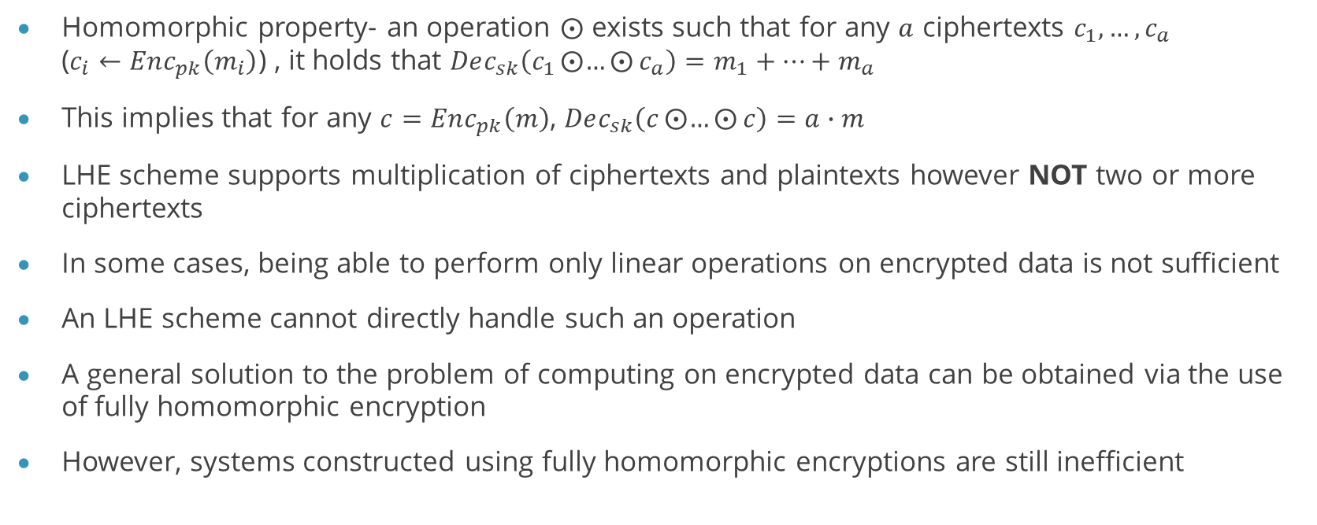
Linearly-Homomorphic Encryption (LHE)
Homomorphic property- an operation $⨀$ exists such that for any $a$ ciphertexts $c_{1},…,c_{a}$ (­$c_{i}←Enc_{pk}\left(m_{i}\right)$) , it holds that $Dec_{sk}\left(c_{1}⨀{…}⨀{c_{a}}\right)=m_{1}+…+m_{a}$
This implies that for any $c=Enc_{pk}\left(m\right)$, $Dec_{sk}\left(c⨀{…}⨀{c}\right)=a∙m$
LHE scheme supports multiplication of ciphertexts and plaintexts however NOT two or more ciphertexts
In some cases, being able to perform only linear operations on encrypted data is not sufficient
An LHE scheme cannot directly handle such an operation
A general solution to the problem of computing on encrypted data can be obtained via the use of fully homomorphic encryption
However, systems constructed using fully homomorphic encryptions are still inefficient

Slide 20

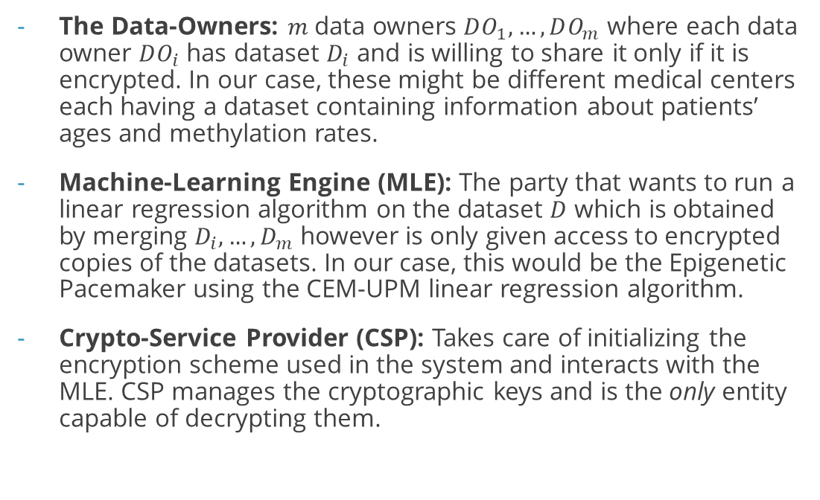
System Overview
The Data-Owners: $m$ data owners $DO_{1},…,DO_{m}$ where each data owner $DO_{i}$ has dataset $D_{i}$ and is willing to share it only if it is encrypted. In our case, these might be different medical centers each having a dataset containing information about patients’ ages and methylation rates.
Machine-Learning Engine (MLE): The party that wants to run a linear regression algorithm on the dataset $D$ which is obtained by merging $D_{i},…,D_{m}$ however is only given access to encrypted copies of the datasets. In our case, this would be the Epigenetic Pacemaker using the CEM-UPM linear regression algorithm.
Crypto-Service Provider (CSP): Takes care of initializing the encryption scheme used in the system and interacts with the MLE. CSP manages the cryptographic keys and is the only entity capable of decrypting them.

Slide 21
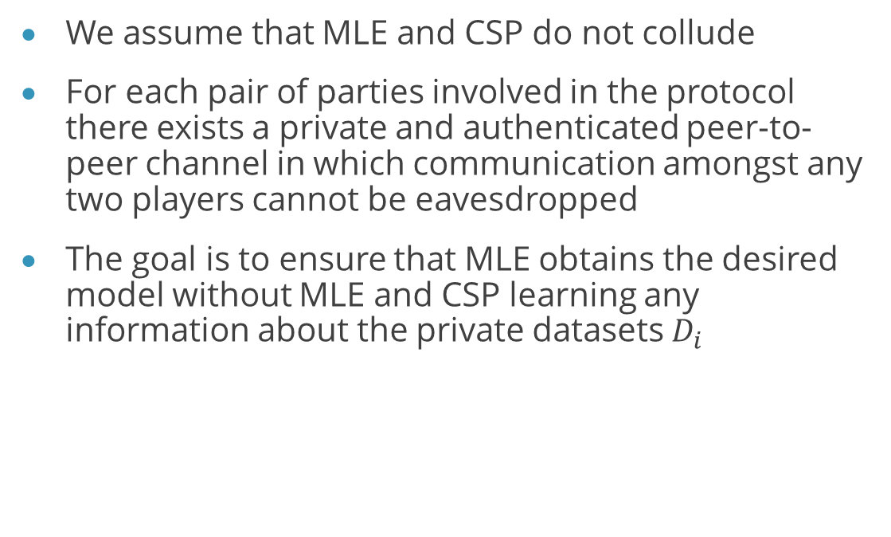
System Overview
We assume that MLE and CSP do not collude
For each pair of parties involved in the protocol there exists a private and authenticated peer-to-peer channel in which communication amongst any two players cannot be eavesdropped
The goal is to ensure that MLE obtains the desired model without MLE and CSP learning any information about the private datasets $D_{i}$

Slide 22
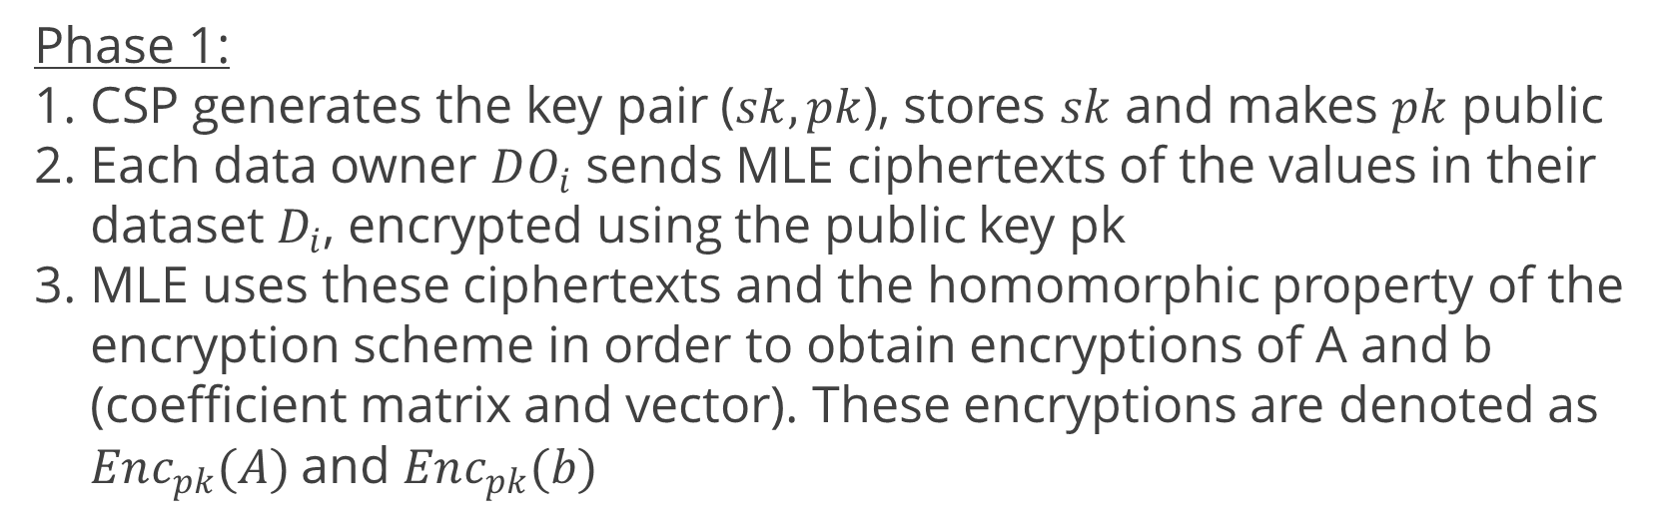
Linear Regression with only LHE Protocol Description
Phase 1:
CSP generates the key pair ($sk, pk$), stores $sk$ and makes $pk$ public
Each data owner $DO_{i}$ sends MLE ciphertexts of the values in their dataset $D_{i}$, encrypted using the public key pk
MLE uses these ciphertexts and the homomorphic property of the encryption scheme in order to obtain encryptions of A and b (coefficient matrix and vector). These encryptions are denoted as $Enc_{pk}(A)$and $Enc_{pk}(b)$

Slide 23
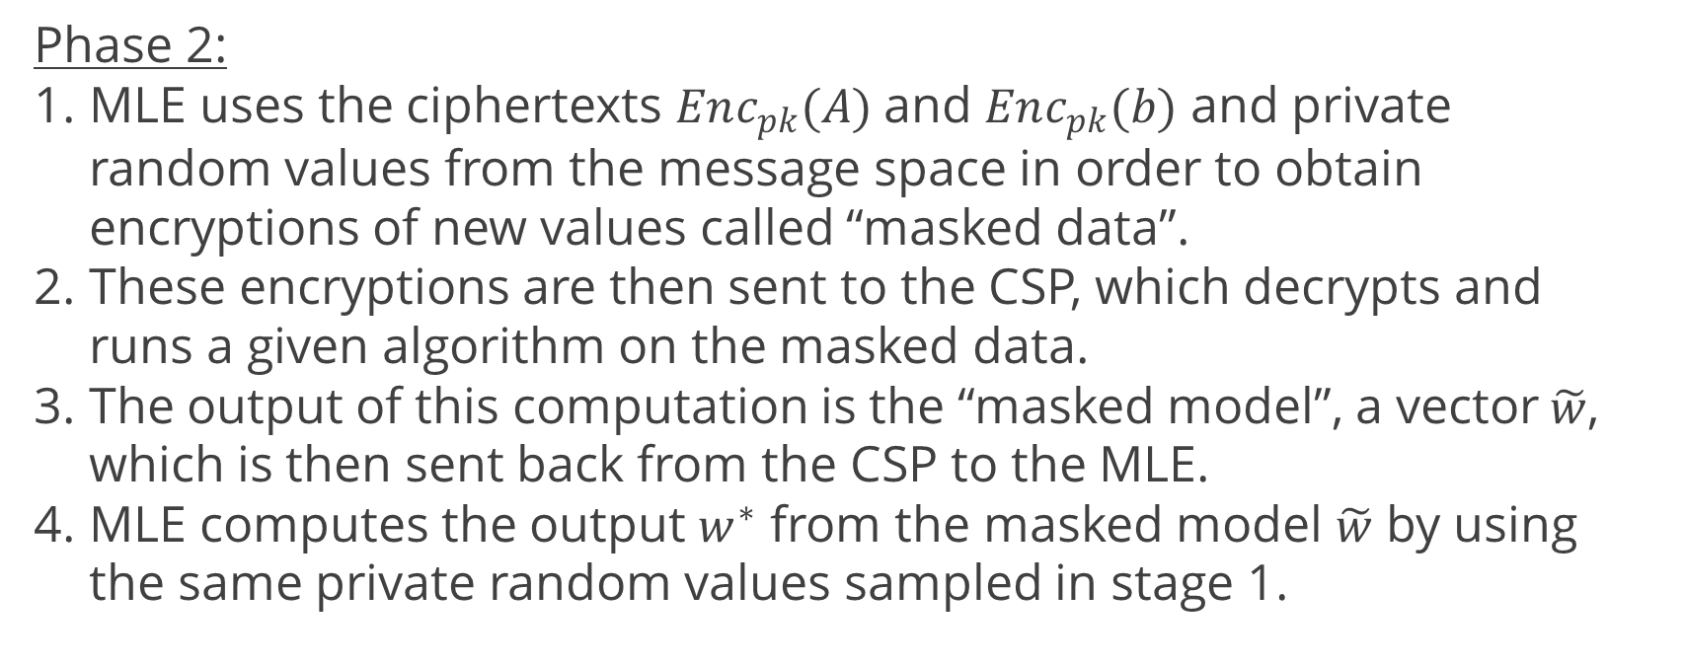
Linear Regression with only LHE Protocol Description
Phase 2:
MLE uses the ciphertexts $Enc_{pk}(A)$and $Enc_{pk}(b)$ and private random values from the message space in order to obtain encryptions of new values called “masked data”.
These encryptions are then sent to the CSP, which decrypts and runs a given algorithm on the masked data.
The output of this computation is the “masked model”, a vector$\tilde{w}$, which is then sent back from the CSP to the MLE.
MLE computes the output $w^{∗}$ from the masked model $\tilde{w}$ by using the same private random values sampled in stage 1.

Slide 24

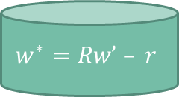
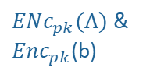

encrypts the data with the given pk
Merges datasets
$ENc_{pk}(A)$ & $Enc_{pk}$(b)
CSP
pk
generates key pair (sk, pk)
sample a random invertible matrix R ⋲ GL(d,M) and random vector r ⋲ M.
encrypts the data with the given pk
$ENc_{pk}(A)$ & $Enc_{pk}$(b)
pk
Data owner
pk
encrypts the data with the given pk
$ENc_{pk}(A)$ & $Enc_{pk}$(b)
compute C’ = Enc (AR), d’ = Enc (b + Ar).
decrypts C’ (A) and d’ (b), and calculate w’.
C’ & d’
MLE
$$w^{∗}=Rw’ – r$$
w’

Slide 25
Linear Regression with only LHE Protocol Description
We say the system is correct if the model computed by the MLE is equal to the model computed by the learning algorithm in the clear using the unencrypted dataset
We say the system is private if the distribution of the masked data sent by MLE to the CSP is independent of the distribution of the local inputs.

Slide 26
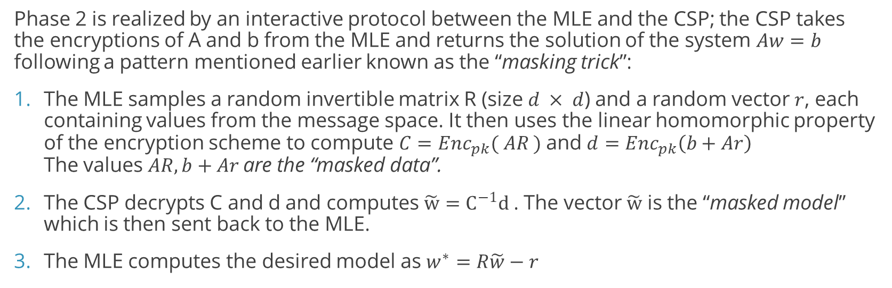
The “masking trick”
Phase 2 is realized by an interactive protocol between the MLE and the CSP; the CSP takes the encryptions of A and b from the MLE and returns the solution of the system $Aw=b$ following a pattern mentioned earlier known as the “masking trick”:
The MLE samples a random invertible matrix R (size $d × d$) and a random vector $r$, each containing values from the message space. It then uses the linear homomorphic property of the encryption scheme to compute $C=Enc_{pk}( AR )$and $d=Enc_{pk}\left(b+Ar\right)$ The values $AR, b+Ar$are the “masked data”.
The CSP decrypts C and d and computes $\tilde{w}=C^{−1}d$ . The vector $\tilde{w}$ is the “masked model” which is then sent back to the MLE.
The MLE computes the desired model as $w^{∗}=R\tilde{w}−r$

Slide 27
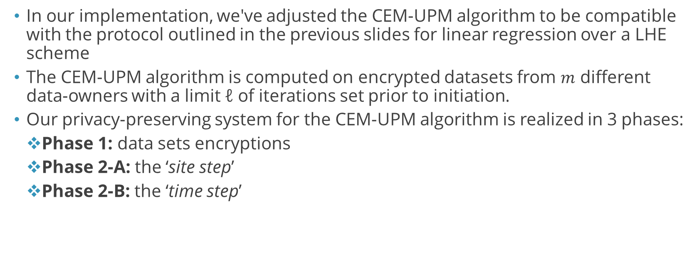
Implementation
In our implementation, we've adjusted the CEM-UPM algorithm to be compatible with the protocol outlined in the previous slides for linear regression over a LHE scheme
The CEM-UPM algorithm is computed on encrypted datasets from $m$ different data-owners with a limit ℓ of iterations set prior to initiation.
Our privacy-preserving system for the CEM-UPM algorithm is realized in 3 phases:
Phase 1: data sets encryptions
Phase 2-A: the ‘site step’
Phase 2-B: the ‘time step’

Slide 28

Implementation – Phase 1
This phase is almost entirely identical to the LHE linear regression protocol described in the previous slides.
CSP generates the key pair ($sk, pk$) using the Paillier cryptosystem, stores $sk$ and makes $pk$ public.
Each data owner encrypts their dataset using $pk$ and sends it to the MLE

Slide 29
Implementation – Phase 1
It is important to note that the protocol assumes that Pearson correlation was computed by the data-owners on their respective datasets prior to the encryption process and that all datasets contain data about the same agreed upon methylation sites (however which sites those are is ultimately unknown and irrelevant to the MLE)
This assumption is critical in reducing runtime complexity and is also necessary due to the nature of the underlying linearly homomorphic encryption scheme
Another assumption mentioned earlier is that all datasets provided by the data owners are shaped alike, allowing the MLE to merge the data in negligible time

Slide 30
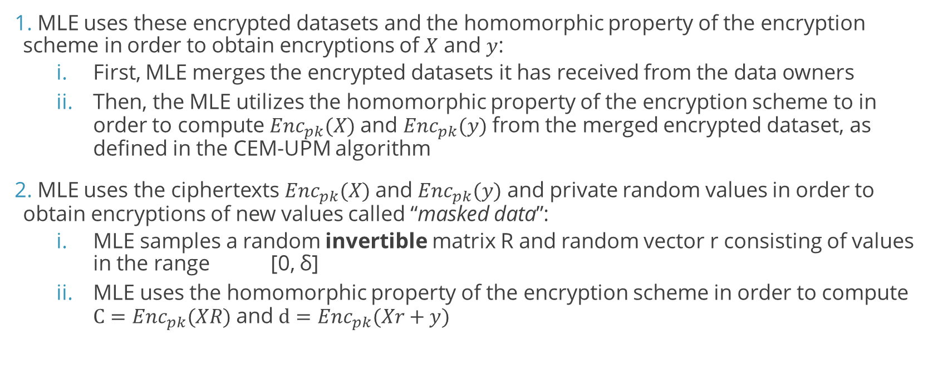
Implementation – Phase 2-A
MLE uses these encrypted datasets and the homomorphic property of the encryption scheme in order to obtain encryptions of $X$ and $y$:
First, MLE merges the encrypted datasets it has received from the data owners
Then, the MLE utilizes the homomorphic property of the encryption scheme to in order to compute $Enc_{pk}(X)$and $Enc_{pk}(y)$ from the merged encrypted dataset, as defined in the CEM-UPM algorithm
MLE uses the ciphertexts $Enc_{pk}(X)$and $Enc_{pk}(y)$ and private random values in order to obtain encryptions of new values called “masked data”:
MLE samples a random invertible matrix R and random vector r consisting of values in the range [0, δ]
MLE uses the homomorphic property of the encryption scheme in order to compute $C=Enc_{pk}(XR)$and $d=Enc_{pk}(Xr+y)$

Slide 31
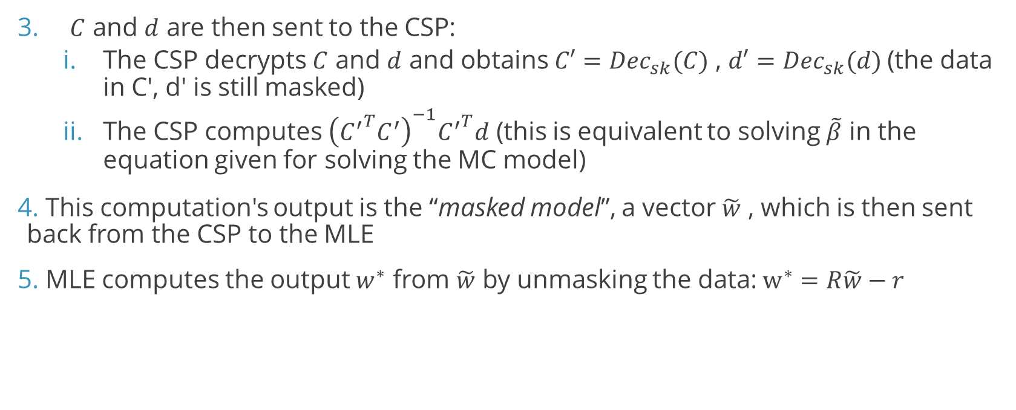
Implementation – Phase 2-A
$C$ and $d$ are then sent to the CSP:
The CSP decrypts $C$ and $d$ and obtains $C′=Dec_{sk}(C)$ , $d′=Dec_{sk}(d)$(the data in C', d' is still masked)
The CSP computes ${\left({C^{′}}^{T}C^{′}\right)}^{−1}{C^{′}}^{T}d$ (this is equivalent to solving $\tilde{β}$ in the equation given for solving the MC model)
This computation's output is the “masked model”, a vector $\tilde{w}$ , which is then sent back from the CSP to the MLE
MLE computes the output $w^{∗}$ from $\tilde{w}$ by unmasking the data:$w^{∗}=R\tilde{w}−r$

Slide 32
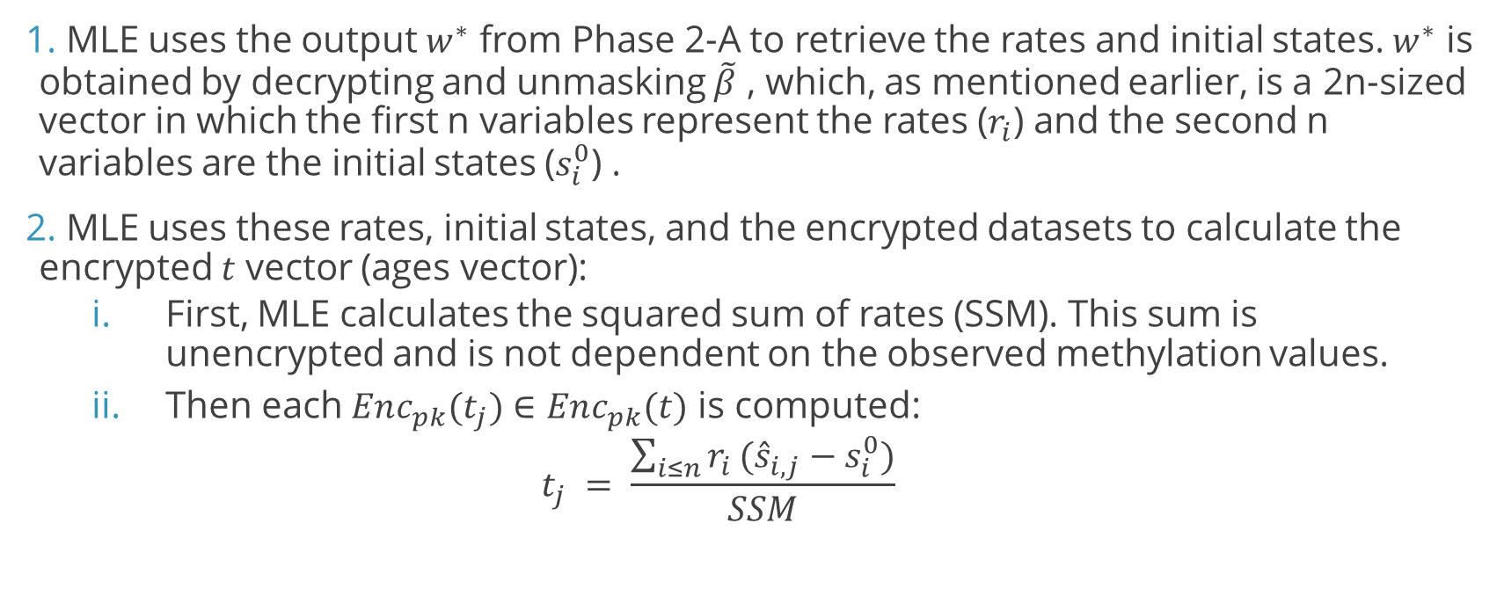
Implementation – Phase 2-B
MLE uses the output $w^{∗}$ from Phase 2-A to retrieve the rates and initial states. $w^{∗}$ is obtained by decrypting and unmasking $\tilde{β}$ , which, as mentioned earlier, is a 2n-sized vector in which the first n variables represent the rates ($r_{i}$) and the second n variables are the initial states ($s_{i}^{0}$) .
MLE uses these rates, initial states, and the encrypted datasets to calculate the encrypted $t$ vector (ages vector):
First, MLE calculates the squared sum of rates (SSM). This sum is unencrypted and is not dependent on the observed methylation values.
Then each $Enc_{pk}(t_{j})∈Enc_{pk}(t)$ is computed:
$$t_{j} = \frac{\sum_{i≤n}{r_{i}}({\hat{s}}_{i,j}−s_{i}^{0})}{SSM}$$

Slide 33

Implementation – Phase 2-B
MLE uses the ciphertexts $Enc_{pk}(t)$and private random values in order to obtain encryptions of new values called "masked data":
MLE samples a random invertible matrix R consisting of values in the range [0 , δ]
MLE uses the homomorphic property of the encryption scheme in order to compute $Enc_{pk}(Rt)$

Slide 34
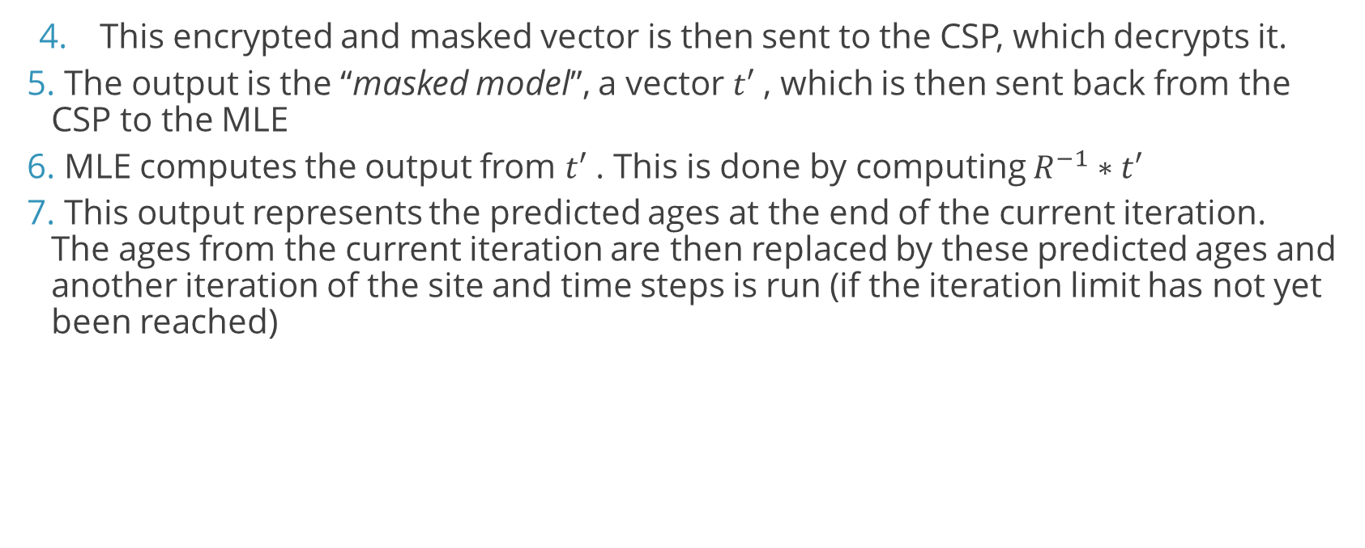
Implementation – Phase 2-B
This encrypted and masked vector is then sent to the CSP, which decrypts it.
The output is the “masked model”, a vector $t′$ , which is then sent back from the CSP to the MLE
MLE computes the output from $t′$ . This is done by computing $R^{−1}∗t′$
This output represents the predicted ages at the end of the current iteration. The ages from the current iteration are then replaced by these predicted ages and another iteration of the site and time steps is run (if the iteration limit has not yet been reached)

Slide 35
Implementation – Notes
In our privacy-preserving solution for the EPM system, the RSS is not calculated at the end of each iteration and instead a fixed number of iterations is set at the beginning of the protocol
This is due to the algorithm fixating on the solution relatively quickly (within a few iterations) and the limitations of the underlying LHE scheme
After the first iteration, the predicted ages are revealed to the MLE, concealing them would require a more complex protocol not described in the paper we based our implementation on

Slide 36
Implementation – Notes
Complexity of the CEM-UPM algorithm used in our cryptographic implementation is not the reduced complexity, due to the limitations of the LHE scheme
It is assumed that the Pearson correlation used in the EPM was applied to the dataset prior to its encryption, each data owner encrypted and sent only its most correlated methylation sites (>90%)

Slide 37
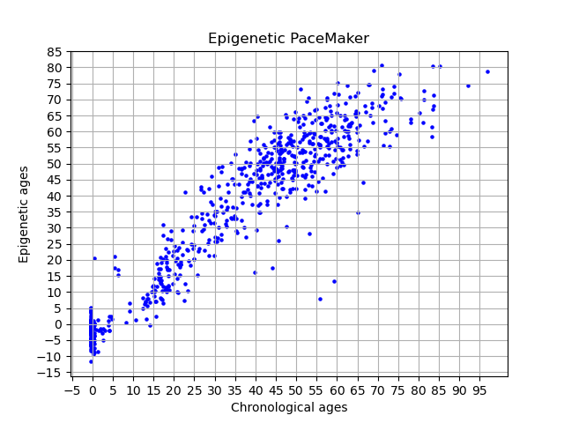
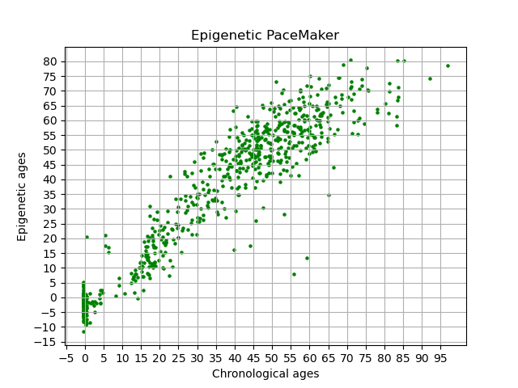
System Evaluation
Result of running our privacy-preserving protocol ON AN ENCRYPTED DATASET
Result of running the CEM-UPM algorithm on the same Unencrypted dataset

Slide 38
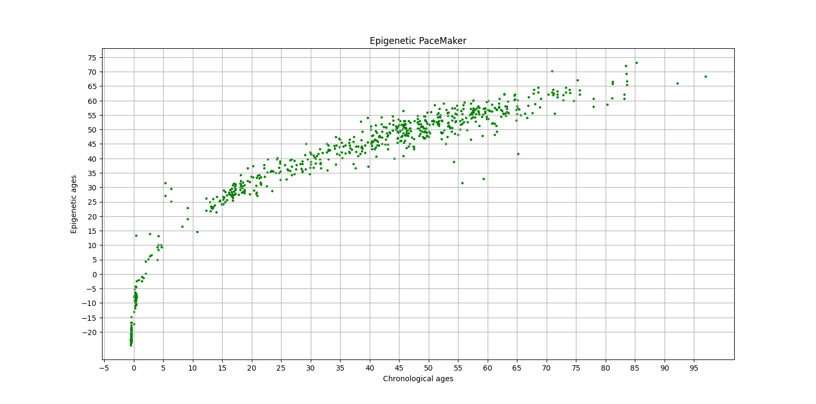
System Evaluation
CEM-UPM algorithm on an unencrypted dataset containing 1000 methylation sites, 675 individuals

Slide 39
Conclusions
Utilizing a linearly homomorphic encryption scheme, we've developed a privacy-preserving protocol for the Epigenetic Pacemaker which provides an accurate, encrypted solution to the privacy concerns raised by running the CEM-UPM algorithm on plaintext datasets
We've shown that our solution provides accurate results with minimal errors and completes its runtime within a relatively reasonable time frame in comparison with running the naive approach to solving the UPM problem on unencrypted data.

Slide 40
Discussions
For future research, several upgrades to the protocol can be implemented in order to strengthen the system’s security
For example, concealing the age values from the Machine Learning engine at the end of each time step. The MLE is not exposed to the unencrypted ages in the datasets and therefore these predicted epigenetic ages are relatively meaningless, however revealing them at the end of each iteration prior to the end of the protocol could still be considered a breach of privacy.
The MLE is also exposed to the unencrypted rates and initial states at the end of the site step in each iteration, instead of only knowing them once the protocol has concluded. Re-encrypting their values after each site step would require a more complex encryption scheme or involving third-party interaction with the CSP and MLE.

Slide 41
Discussions
Another option for future research would be to implement the closed form solution to the MC model in our privacy-preserving protocol (in the site step phase).
Being able to implement this solution instead of the naive approach that we've used due to the limitations of the underlying encryption scheme would substantially decrease the protocol's runtime and allow for it to be run on encrypted datasets consisting of greater scales of methylation sites and individuals.

Slide 42
Acknowledgements
Credit to Dr. Adi Akavia, privacy-preserving machine learning lab lecturer, for the project proposal
Meir Goldenberg, for his support and guidance throughout the process of creating this project
Collin P. Farrel, EPM Tutorial - Epigenetic PaceMaker [epigeneticpacemaker.readthedocs.io/]

