Slide 1
Chương 03 GIỚI THIỆU FEATURE ENGINEERING
TS. Nguyễn Tấn Trần Minh Khang
ThS. Trần Minh Tùng
ThS. Võ Duy Nguyên

Slide 2
Concept
Concept

Slide 3
Concept
Concept
What we intend to learn
Concept description
Model that results from learning the concept based on data.

Slide 4
ĐƠN VỊ THÔNG TIN
Units of information

Slide 5
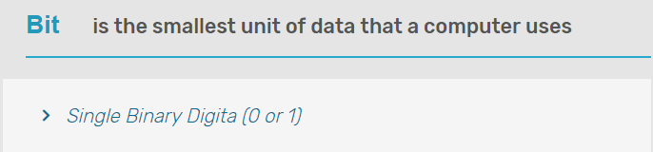
Đơn vị thông tin
Bit
Byte
Kilobyte
Megabyte
Gigabyte
Terabyte
Petabyte
Exabyte
Zettabyte
Yottabyte

Slide 6
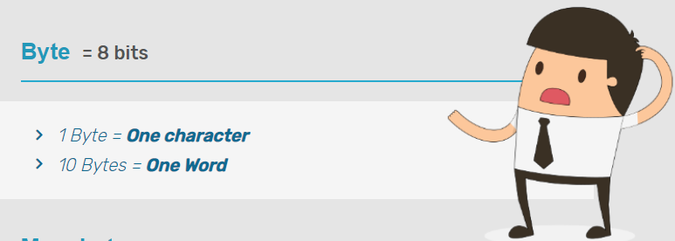
Đơn vị thông tin
Bit
Byte
Kilobyte
Megabyte
Gigabyte
Terabyte
Petabyte
Exabyte
Zettabyte
Yottabyte

Slide 7
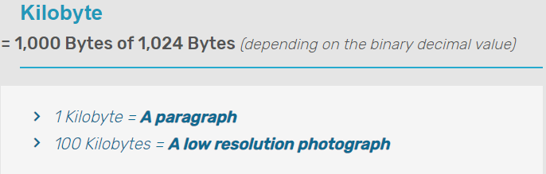
Đơn vị thông tin
Bit
Byte
Kilobyte
Megabyte
Gigabyte
Terabyte
Petabyte
Exabyte
Zettabyte
Yottabyte

Slide 8
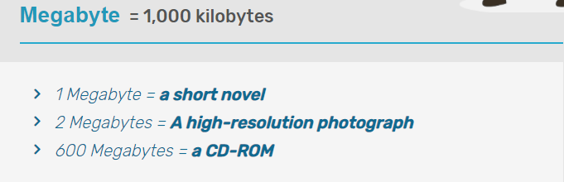
Đơn vị thông tin
Bit
Byte
Kilobyte
Megabyte
Gigabyte
Terabyte
Petabyte
Exabyte
Zettabyte
Yottabyte

Slide 9
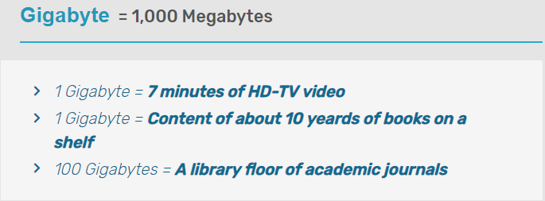
Đơn vị thông tin
Bit
Byte
Kilobyte
Megabyte
Gigabyte
Terabyte
Petabyte
Exabyte
Zettabyte
Yottabyte

Slide 10
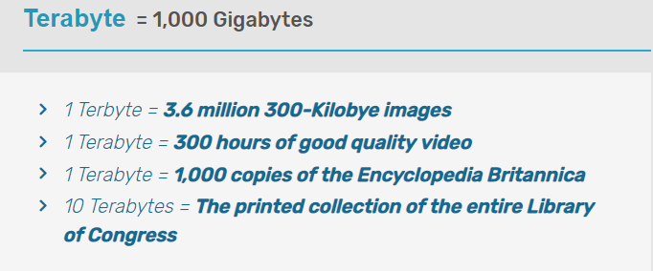
Đơn vị thông tin
Bit
Byte
Kilobyte
Megabyte
Gigabyte
Terabyte
Petabyte
Exabyte
Zettabyte
Yottabyte

Slide 11
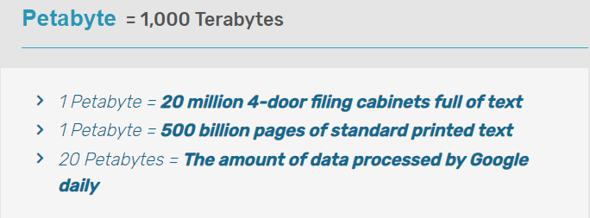
Đơn vị thông tin
Bit
Byte
Kilobyte
Megabyte
Gigabyte
Terabyte
Petabyte
Exabyte
Zettabyte
Yottabyte

Slide 12
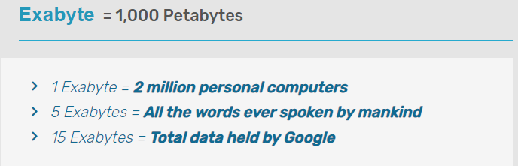
Đơn vị thông tin
Bit
Byte
Kilobyte
Megabyte
Gigabyte
Terabyte
Petabyte
Exabyte
Zettabyte
Yottabyte

Slide 13
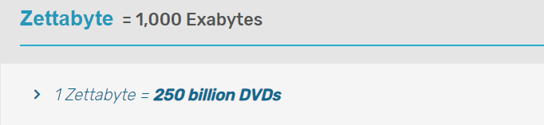
Đơn vị thông tin
Bit
Byte
Kilobyte
Megabyte
Gigabyte
Terabyte
Petabyte
Exabyte
Zettabyte
Yottabyte

Slide 14
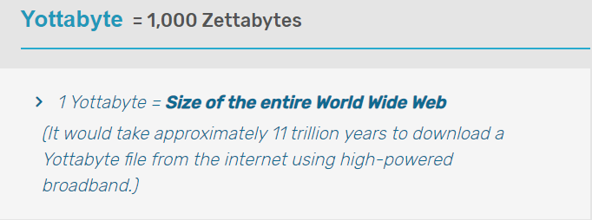
Đơn vị thông tin
Bit
Byte
Kilobyte
Megabyte
Gigabyte
Terabyte
Petabyte
Exabyte
Zettabyte
Yottabyte

Slide 15
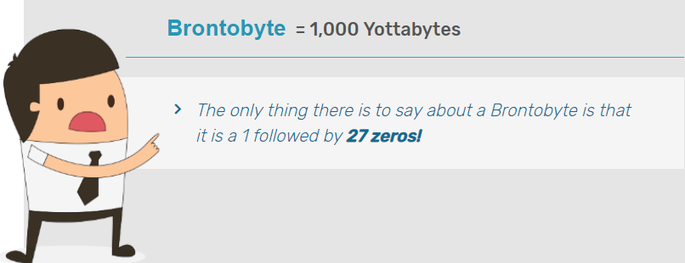
Đơn vị thông tin
Bit
Byte
Kilobyte
Megabyte
Gigabyte
Terabyte
Petabyte
Exabyte
Zettabyte
Yottabyte
Brontobyte

Slide 16
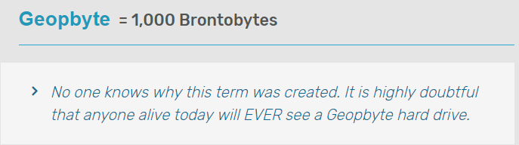
Đơn vị thông tin
Bit
Byte
Kilobyte
Megabyte
Gigabyte
Terabyte
Petabyte
Exabyte
Zettabyte
Yottabyte
Geopbyte

Slide 17
Đơn vị thông tin
B | Byte | 1
KB | Kilobyte | 1,024
MB | Megabyte | 1,048,576
GB | Gigabyte | 1,073,741,824
TB | Tetrabyte | 1,099,511,627,776
PB | Petabyte | 1,125,899,906,842,624
EB | Exabyte | 1,152,921,504,606,846,976
ZB | Zettabyte | 1,180,591,620,717,411,303,424
YB | Yottabyte | 1,208,925,819,614,629,174,706,176
BB | Brontobyte
GPB | Geopbyte

Slide 18
CÁC loại DỮ LIỆU
Data types

Slide 19
Data types
Texts – Văn bản.
Numbers – Số.
Clickstreams – dữ liệu đường dẫn.
Graphs
Tables – Bảng, Quan hệ.
Images – Ảnh.
Transactions – Giao dịch.
Videos – Phim.

Slide 20


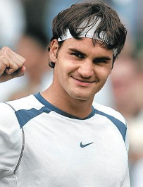



Dữ liệu
Data
Data
→ “politics”
→ “apple”
→ “sports”
→ “tomato”
→ “business”
→ “cow”

Slide 21
Dữ liệu
Data everywhere!
Google: processes 24 peta bytes of data per day.
Facebook: 10 million photos uploaded every hour.
Youtube: 1 hour of video uploaded every second.
Twitter: 400 million tweets per day.
Astronomy: Satellite data is in hundreds of PB.
. . . .
“By 2020 the digital universe will reach 44 zettabytes...”

Slide 22
Dữ liệu
Dữ liệu cơ bản trong máy học giống như một bảng gồm nhiều hàng và cột.
Những dữ liệu khác như hình ảnh, video, văn bản là những dữ liệu không có cấu trúc sẽ không được xét đến.
Ví dụ.
Diện tích | Số phòng ngủ | Giá ngôi nhà
2104 | 3 | 399900
1600 | 3 | 329900
2400 | 3 | 369000
1416 | 2 | 232000
… | … | …

Slide 23
Dữ liệu
Diện tích | Số phòng ngủ | Giá ngôi nhà
2104 | 3 | 399900
1600 | 3 | 329900
2400 | 3 | 369000
1416 | 2 | 232000
3000 | 4 | 539900
1985 | 4 | 299900
1534 | 3 | 314900
1427 | 3 | 198999
1380 | 3 | 212000
1494 | 3 | 242500
1940 | 4 | 239999
2000 | 3 | 347000

Slide 24
THỂ HIỆN - INSTANCE
Instance

Slide 25
Thể hiện - Instance
Thể hiện/Dữ kiện (instance): Là một hàng trong bảng dữ liệu.
Trong ví dụ trên 12 thể hiện/dữ kiện, mỗi thể hiện gồm thông tin của một căn hộ (diện tích, số phòng ngủ, và giá tiền).
Diện tích | Số phòng ngủ | Giá ngôi nhà
2104 | 3 | 399900
1600 | 3 | 329900
2400 | 3 | 369000
1416 | 2 | 232000
… | … | …

Slide 26
NHÃN DỮ LIỆU – LABEL
Label

Slide 27
Nhãn dữ liệu – Label
Label:
A category for data
Labels are the final output.
A label is the thing we're predicting
A prediction from a classification algorithm
After obtaining a labeled dataset, machine learning models can be applied to the data so that new unlabeled data can be presented to the model and a likely label can be guessed or predicted for that piece of unlabeled data.

Slide 28
TẬP DỮ LIỆU – DATASET
Dataset

Slide 29
Tập dữ liệu – Dataset
Tập dữ liệu (dataset): một tập hợp các thể hiện/dữ kiện là một tập dữ liệu.
Tập dữ liệu huấn luyện (training dataset): là một tập dữ liệu dùng để huấn luyện mô hình của thuật toán Máy học. Nói một cách khác, thuật toán Máy học sẽ học từ tập dữ liệu này.
Tập dữ liệu kiểm chứng (cross validation dataset): Dùng để kiểm chứng mô hình khi huấn luyện.
Tập dữ liệu kiểm tra (testing dataset): là một tập dữ liệu dùng để đánh giá mô hình của thuật toán Máy học.

Slide 30
Tập dữ liệu – Dataset
3 independent datasets
Tập huấn luyện – Training set: learn the model.
Tập kiểm chứng – Validation set
used to evaluate parameter optimization, feature selection, compare models.
tune the parameters using validation set.
Tập kiểm thử – Tập kiểm tra – Test set: used to evaluate the final accuracy of the optimized model.
Training set
Validation set
Test set

Slide 31
Tập dữ liệu – Dataset
Tập dữ liệu kiểm tra không được dùng để huấn luyện mô hình (The test set must not be used in any way to create the model!).
The larger the training set, the better the classifier!
The larger the test set, the better the accuracy estimate!
Training set
Validation set
Test set

Slide 32
ĐẶC TRƯNG
Feature

Slide 33
Đặc trưng – Feature
Đặc trưng (feature): là một cột trong bảng dữ liệu.
Một số đặc trưng là dữ liệu quan sát được và một số là đặc trưng cần được dự đoán.
Trong ví dụ trên 2 cột đầu (diện tích và số phòng ngủ) là đặc trưng quan sát, cột cuối cùng là đặc trưng cần dự đoán (giá căn hộ).
Diện tích | Số phòng ngủ | Giá ngôi nhà
2104 | 3 | 399900
1600 | 3 | 329900
2400 | 3 | 369000
1416 | 2 | 232000
… | … | …

Slide 34
Đặc trưng – Feature
A feature is an input variable.
A simple machine learning project might use a single feature.
A simple machine learning project might use a single feature, while a more sophisticated machine learning project could use millions of features, specified as: x = x₁, x₂, x₃, …,x_{n}.
Feature types
Numeric
Nominal

Slide 35
Đặc trưng – Feature
Feature Normalization
Algorithms such as SVMs or neural networks have numerical problems if features are very different ranges
Typically, min-max normalization to the [0, 1] interval.
[-1, 1] interval also common, e.g., in Multi-Layer Perceptrons.
Other possibilities: z-score normalization.

Slide 36
K – FOLD
K-fold Cross-Validation

Slide 37
K-fold Cross-Validation
Repeated Stratified K-fold Cross-Validation
Idea
Randomly separate the entire set into a number of stratified k equal-size folds (partitions)
Train using k-1 folds, test using the remaining fold
Repeat training and testing (step 2) k times, alternating each fold in the test set
Repeat steps 1 to 3 a number of times (reshuffle and restratify data) Typically, 10 to 20 times.
Average the results.

Slide 38
K-fold Cross-Validation
Repeated Stratified K-fold Cross-Validation
Recommended k
High k: lower bias, higher variance
Low k: higher bias, lower variance
Typically, k = 10, 10-fold cross validation
Mostly, empirical result.
Good bias-variance trade-off.

Slide 39
COMMONLY USED DATASETS FOR ML
Commonly used datasets for ML

Slide 40
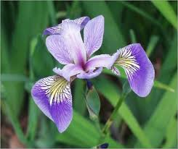
UCI Dataset: Iris
Source
R.A. Fisher, 1936
Goal
Predict the types of iris in Hawaii
Dataset specs
150 instances, 3 classes
4 attributes (features)
sepal length
sepal width
petal length
petal width

Slide 41
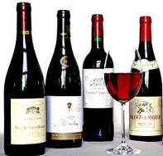
UCI Dataset: Wine
Source
Institute of Pharmaceutical and Food Analysis and Technologies, Via Brigata Salerno, 16147 Genoa, Italy.
Goal
Using 13 chemical constituents to determine the origin of wines
Dataset specs
178 instances, 3 classes, 13 attributes

Slide 42
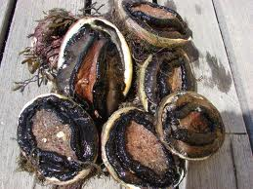
UCI Dataset: Abalone
Source
Dept. of Primary Industry and FIsheries, Tasmania, Australia
Goal
Predict the age of abalone (鮑魚)
Dataset specs
4177 instances, 29 classes
8 attributes (features): sex, length, diameter, height, whole weight, shucked weight, viscera weight, shell weight
1 output: rings (+1.5 gives the age in years)

Slide 43
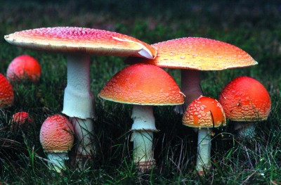
UCI Dataset: Mushroom Classification
Source
Mushroom records drawn from The Audubon Society Field Guide to North American Mushrooms (1981).
Goal
To determine a mushroom is poisonous or edible.
Dataset specs
8124 instances, 2 classes, 22 attributes.

Slide 44
UCI Dataset: Liver Disorder
Source
BUPA Medical Research Ltd.
Goal
Use variables from blood tests and alcohol consumption to see if liver disorder exists
Dataset specs
345 instances, 2 classes, 6 attributes (the first five are results from blood tests, the last one is alcohol consumption per day).

Slide 45
UCI Dataset: Credit Screening
Source
Chiharu Sano, csano@bonnie.ICS.UCI.EDU.
Goal
Determine people who are granted credit.
Dataset specs
125 instances, 2 classes, 15 attributes.

Slide 46
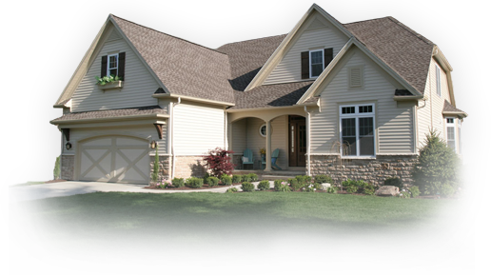
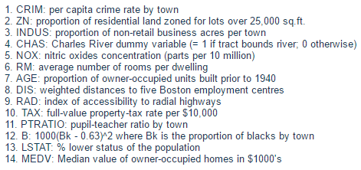
UCI Dataset: House Price Prediction
Source
CMU StatLib Library
Goal
Predict house price near Boston
Dataset specs
506 instances, 13 attributes

Slide 47
MNIST Digit Dataset (1/2)
Source
NIST's Special Database 3 (collected among Census Bureau employees) and Special Database 1 (collected among high-school students).
Goal
Recognize isolated hand-written digits of 0-9.
Dataset specs
70000 instances
60000 for training (30000 from SD-3 and 30000 from SD-1) of about 250 writers
10000 for test (5000 from SD-3 and 5000 from SD-1)
Normalized to 28x28 gray-scale image, centered by gravity.

Slide 48
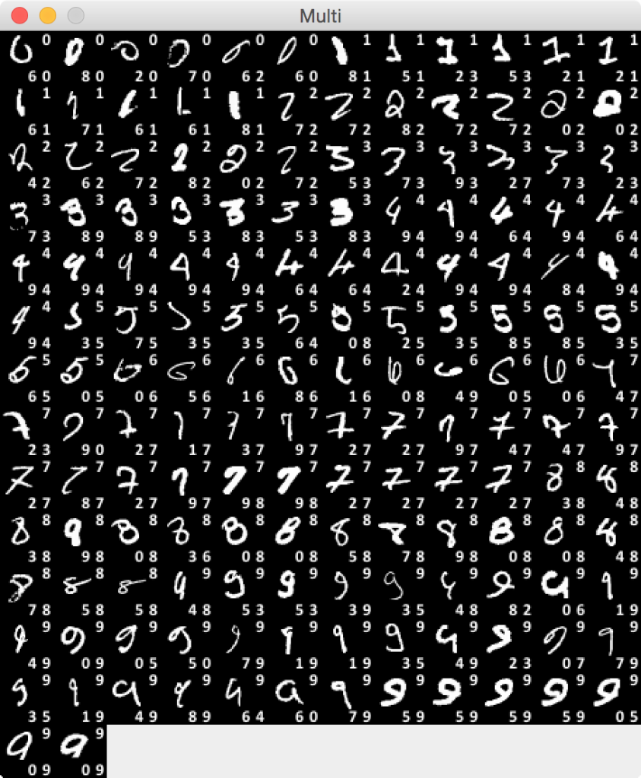
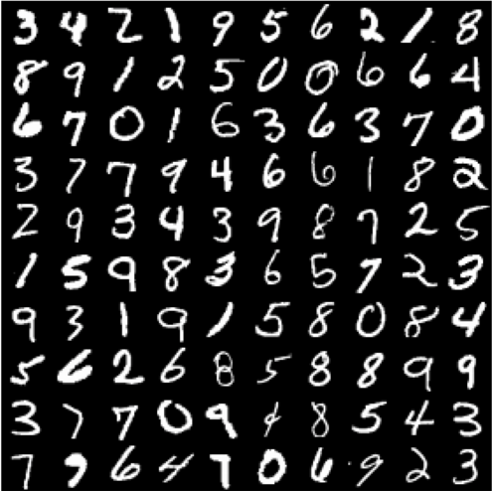
MNIST Digit Dataset (1/2)
Links
Data source
Wikipedia
Examples

Slide 49
MNIST dataset

Slide 50
MNIST dataset
MNIST (Mixed National Institute of Standards and Technology) database is dataset for handwritten digits, distributed by Yann Lecun’s THE MNIST DATABASE of handwritten digits website.
The MNIST database was constructed from NIST's Special Database 3 (SD-3) and Special Database 1 (SD-1) which contain binary images of handwritten digits.

Slide 51
MNIST dataset
Dataset specs
70000 instances
60000 for training (30000 from SD-3 and 30000 from SD-1) of about 250 writers
10000 for test (5000 from SD-3, 5000 from SD-1)
Normalized to 28x28 gray-scale image, centered by gravity.

Slide 52
MNIST dataset
The dataset consists of pair, “handwritten digit image” and “label”.Digit ranges from 0 to 9, meaning 10 patterns in total.
handwritten digit image: This is gray scale image with size 28 x 28 pixel.
label : This is actual digit number this handwritten digit image represents. It is either 0 to 9.

Slide 53
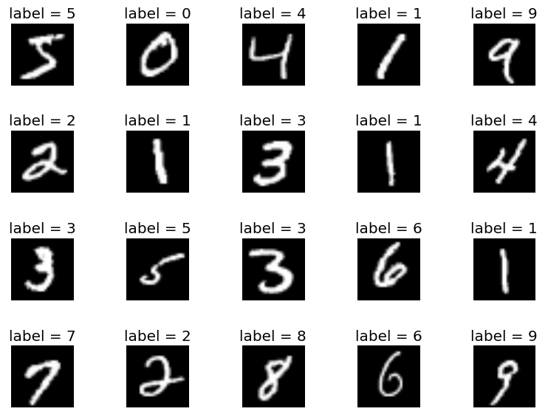
MNIST dataset

Slide 54
Tensorflow
TensorFlow is a Python library

Slide 55

TensorFlow in python
TensorFlow is a Python library for high-performance numerical calculations that allows users to create sophisticated deep learning and machine learning applications.
Released as open source software in 2015, TensorFlow has seen tremendous growth and popularity in the data science community.

Slide 56
Downloading the Mnist Data

Slide 57
Environment Setup
Install Anaconda.
After installing Anaconda or Miniconda, create a new conda environment containing TensorFlow and activate it.
Install matplotlib library in a new conda environment.
Install IDE jupyter notebook in tensorflow environment.

Slide 58
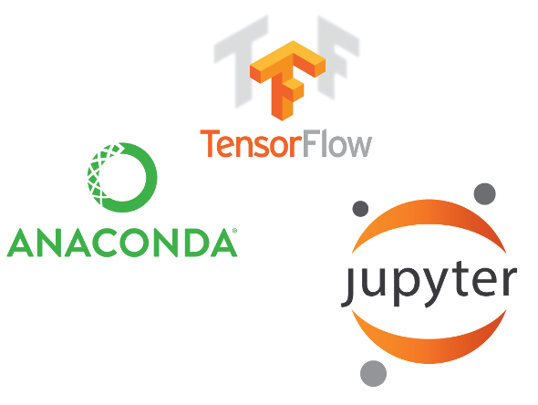
Environment Setup

Slide 59
Install tensorflow environment
Environment Setup

Slide 60
Install environment
After installing Anaconda or Miniconda, create a new conda environment containing TensorFlow, activate it.
conda create -n tensorflow_env tensorflow
conda activate tensorflow_env
Or for the GPU version
conda create -n tensorflow_gpuenv tensorflow-gpu
conda activate tensorflow_gpuenv
Deactivate environment
conda deactivate

Slide 61
Install matplotlib library
To install this package with conda run one of the following:
conda install -c conda-forge matplotlib
conda install -c conda-forge/label/rc matplotlib

Slide 62
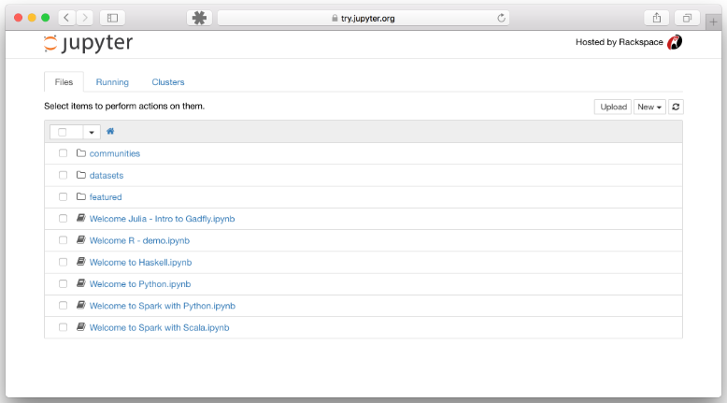
IDE jupyter notebook
Start the notebook server from the command line.
You should see the notebook open in your browser.

Slide 63
Downloading the Mnist Data in python

Slide 64
Using TensorFlow library
import tensorflow as tf
import matplotlib.pyplot as plt
mnist = tf.keras.datasets.mnist
(x_train,y_train),(x_test,y_test) = mnist.load_data()
%matplotlib inline
image_index = 19
print(y_train[image_index])
plt.imshow(x_train[image_index], cmap='Greys')

Slide 65
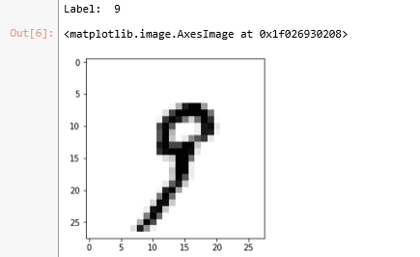
Using TensorFlow library

Slide 66
Handwritten digit identification

Slide 67
Python library
Scikit-learn is a free machine learning library for Python. It features various algorithms like support vector machine, random forests, and k-neighbours, and it also supports Python numerical and scientific libraries like NumPy and SciPy.

Slide 68
MNIST in Keras
Dataset of 60,000 28x28 grayscale images of the 10 digits, along with a test set of 10,000 images.
from keras.datasets import mnist
(x_train,y_train),(x_test,y_test) = mnist.load_data()

Slide 69
MNIST in Keras
Returns:
2 tuples:
x_train, x_test: uint8 array of grayscale image data with shape (num_samples, 28, 28).
y_train, y_test: uint8 array of digit labels (integers in range 0-9) with shape (num_samples).
Arguments:
path: if you do not have the index file locally (at '~/.keras/datasets/' + path), it will be downloaded to this location.

Slide 70
KNeighborsClassifier
class sklearn.neighbors.KNeighborsClassifier( n_neighbors=5, weights = 'uniform', algorithm = 'auto', leaf_size = 30, p = 2, metric = 'minkowski', metric_params = None, n_jobs = None, **kwargs)

Slide 71
Parameters
n_neighbors : int, optional (default = 5)
Number of neighbors to use by default for kneighbors queries.
algorithm : {'auto', 'ball_tree', 'kd_tree', 'brute’}
Algorithm used to compute the nearest neighbors:
'ball_tree' will use BallTree
'kd_tree' will use KDTree
'brute' will use a brute-force search.
'auto' will attempt to decide the most appropriate algorithm based on the values passed to fit method.

Slide 72
Parameters
weights : str or callable, optional (default = 'uniform')
weight function used in prediction. Possible values:
'uniform' : uniform weights. All points in each neighborhood are weighted equally.
'distance' : weight points by the inverse of their distance. in this case, closer neighbors of a query point will have a greater influence than neighbors which are further away.
[callable] : a user-defined function which accepts an array of distances, and returns an array of the same shape containing the weights.

Slide 73
Parameters
leaf_size : int, optional (default = 30)
Leaf size passed to BallTree or KDTree. This can affect the speed of the construction and query, as well as the memory required to store the tree. The optimal value depends on the nature of the problem.

Slide 74
Parameters
p : integer, optional (default = 2)
Power parameter for the Minkowski metric. When p = 1, this is equivalent to using manhattan_distance (l1), and euclidean_distance (l2) for p = 2. For arbitrary p, minkowski_distance (l_p) is used.

Slide 75
Parameters
metric : string or callable, default 'minkowski'
The distance metric to use for the tree. The default metric is minkowski, and with p = 2 is equivalent to the standard Euclidean metric. See the documentation of the DistanceMetric class for a list of available metrics.

Slide 76
Parameters
metric_params : dict, optional (default = None)
Additional keyword arguments for the metric function.
n_jobs : int or None, optional (default=None)
The number of parallel jobs to run for neighbors search. None means 1 unless in a joblib.parallel_backend context. -1 means using all processors. See Glossary for more details. Doesn’t affect fit method.

Slide 77
Import library
from matplotlib import pyplot as plt
from sklearn import datasets, metrics
from sklearn.neighbors import KNeighborsClassifier
from keras.datasets import mnist
#Using TensorFlow backend.

Slide 78
Dataset
# load dataset Scikit-learn
digits = datasets.load_digits()
data_with_labels = list(zip( digits.images,digits.target))
print(digits.images.shape)
# load dataset Keras
(img_train, val_train),(img_test, val_test) = mnist.load_data()
print(img_train.shape)
print(img_test.shape)

Slide 79
(matrixs) to vectors
# convert images (matrixs) to vectors
n = len(img_train)
data = img_train.reshape(n, -1)
print(data.shape)

Slide 80

KNN classifier
# create KNN classifier
k = 1
knn = KNeighborsClassifier (metric='minkowski’, p=2, n_neighbors=k)
knn.fit(data, val_train)

Slide 81
(matrixs) to vectors
# convert test images (matrixs) to vectors
n = len(img_test)
test_data = img_test.reshape(n, -1)
# predict data (1000)
predicted = knn.predict(test_data)
print(len(predicted))

Slide 82

Accuracy average
# calculate accuracy average
num_correct=0
for i in range(0,len(val_test)):
if val_test[i] == predicted[i]:
num_correct +=1
print("Accuracy:\n%s" % str(float(num_correct / float(len(val_test)))))

