Slide 1
HANDWRITTEN DIGIT IDENTIFICATION
TS. Nguyễn Tấn Trần Minh Khang
ThS. Trần Minh Tùng
ThS. Võ Duy Nguyên

Slide 2
Handwritten digit identification

Slide 3
Python library
Scikit-learn is a free machine learning library for Python. It features various algorithms like support vector machine, random forests, and k-neighbours, and it also supports Python numerical and scientific libraries like NumPy and SciPy.

Slide 4
MNIST in Keras
Dataset of 60,000 28x28 grayscale images of the 10 digits, along with a test set of 10,000 images.
from keras.datasets import mnist
(x_train,y_train),(x_test,y_test) = mnist.load_data()

Slide 5
MNIST in Keras
Returns:
2 tuples:
x_train, x_test: uint8 array of grayscale image data with shape (num_samples, 28, 28).
y_train, y_test: uint8 array of digit labels (integers in range 0-9) with shape (num_samples).
Arguments:
path: if you do not have the index file locally (at '~/.keras/datasets/' + path), it will be downloaded to this location.

Slide 6
KNeighborsClassifier
class sklearn.neighbors.KNeighborsClassifier( n_neighbors=5, weights = 'uniform', algorithm = 'auto', leaf_size = 30, p = 2, metric = 'minkowski', metric_params = None, n_jobs = None, **kwargs)

Slide 7
Parameters
n_neighbors : int, optional (default = 5)
Number of neighbors to use by default for kneighbors queries.
algorithm : {'auto', 'ball_tree', 'kd_tree', 'brute’}
Algorithm used to compute the nearest neighbors:
'ball_tree' will use BallTree
'kd_tree' will use KDTree
'brute' will use a brute-force search.
'auto' will attempt to decide the most appropriate algorithm based on the values passed to fit method.

Slide 8
Parameters
weights : str or callable, optional (default = 'uniform')
weight function used in prediction. Possible values:
'uniform' : uniform weights. All points in each neighborhood are weighted equally.
'distance' : weight points by the inverse of their distance. in this case, closer neighbors of a query point will have a greater influence than neighbors which are further away.
[callable] : a user-defined function which accepts an array of distances, and returns an array of the same shape containing the weights.

Slide 9
Parameters
leaf_size : int, optional (default = 30)
Leaf size passed to BallTree or KDTree. This can affect the speed of the construction and query, as well as the memory required to store the tree. The optimal value depends on the nature of the problem.

Slide 10
Parameters
p : integer, optional (default = 2)
Power parameter for the Minkowski metric. When p = 1, this is equivalent to using manhattan_distance (l1), and euclidean_distance (l2) for p = 2. For arbitrary p, minkowski_distance (l_p) is used.

Slide 11
Parameters
metric : string or callable, default 'minkowski'
The distance metric to use for the tree. The default metric is minkowski, and with p = 2 is equivalent to the standard Euclidean metric. See the documentation of the DistanceMetric class for a list of available metrics.

Slide 12
Parameters
metric_params : dict, optional (default = None)
Additional keyword arguments for the metric function.
n_jobs : int or None, optional (default=None)
The number of parallel jobs to run for neighbors search. None means 1 unless in a joblib.parallel_backend context. -1 means using all processors. See Glossary for more details. Doesn’t affect fit method.

Slide 13
Import library
from matplotlib import pyplot as plt
from sklearn import datasets, metrics
from sklearn.neighbors import KNeighborsClassifier
from keras.datasets import mnist
#Using TensorFlow backend.

Slide 14
Dataset
# load dataset Scikit-learn
digits = datasets.load_digits()
data_with_labels = list(zip( digits.images,digits.target))
print(digits.images.shape)
# load dataset Keras
(img_train, val_train),(img_test, val_test) = mnist.load_data()
print(img_train.shape)
print(img_test.shape)

Slide 15
Review dataset
fig=plt.figure(figsize=(16, 16))
columns = 5
rows = 5
for i in range(1, columns*rows +1):
img = img_train[i]
fig.add_subplot(rows, columns, i)
plt.imshow(img, cmap = plt.cm.gray_r)
plt.show()

Slide 16
Data visualiztion
plt.figure(figsize=(13,7))
plt.hist( x=val_train, bins=19 ,color='c')
plt.xlabel('Digits')
plt.ylabel('Frequency')
plt.title('Distribution of Label\'s')

Slide 17
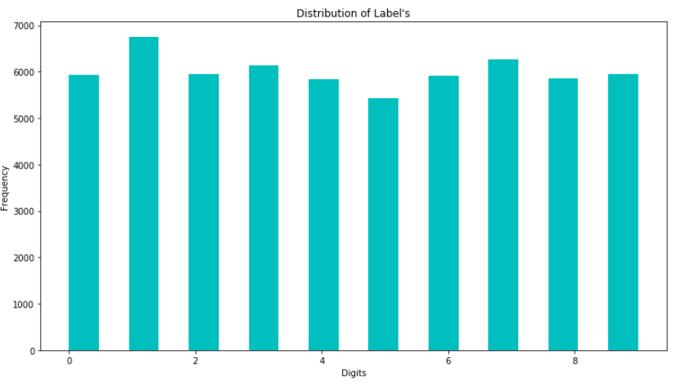
Data visualiztion

Slide 18
(matrixs) to vectors
# convert images (matrixs) to vectors
n = len(img_train)
data = img_train.reshape(n, -1)
print(data.shape)

Slide 19

KNN classifier
# create KNN classifier
k = 1
knn = KNeighborsClassifier (metric='minkowski’, p=2, n_neighbors=k)
knn.fit(data, val_train)

Slide 20
(matrixs) to vectors
# convert test images (matrixs) to vectors
n = len(img_test)
test_data = img_test.reshape(n, -1)
# predict data (1000)
predicted = knn.predict(test_data)
print(len(predicted))

Slide 21

Accuracy average
# calculate accuracy average
num_correct=0
for i in range(0,len(val_test)):
if val_test[i] == predicted[i]:
num_correct +=1
print("Accuracy:\n%s" % str(float(num_correct / float(len(val_test)))))

Slide 22
KNN with Cosine similarity
MNIST dataset

Slide 23
Cosine similarity
# declare and asign values for variables
max_k = 29
dist_algo = 'cosine'
index_name = []
train_time = []
predict_time = []
accuracy = []
headers = ['train-time','predict-time','accuracy']

Slide 24
Cosine similarity
# train model with KNN
for k in range(1, max_k+1, 2):
print('Training ' + str(k) + '-NN with ' + dist_algo + ' distance algorithm')
index_name.append(str(k) + '-NN’)
…

Slide 25
Cosine similarity
…
# create KNN classifier
start = time.time()
knn = KNeighborsClassifier (metric ='cosine', p=2, n_neighbors=k)
knn.fit(data, val_train)
end = time.time()
print("Training time:%s seconds"% str(end - start))
train_time.append(round(end-start,2))

Slide 26
Cosine similarity
…
# save model using joblib
filename = str(k) + '-NN ‘ + dist_algo + '.sav'
joblib.dump(knn, filename)
print("%s saved\n" %filename)
print('Train complete!')

Slide 27
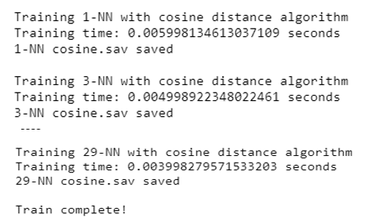
Cosine similarity

Slide 28
Cosine similarity
# convert test images (matrixs) to vectors
n = len(img_test)
test_data = img_test.reshape(n, -1)

Slide 29
Cosine similarity
for k in range(1, max_k+1, 2):
# load model
filename = str(k) + '-NN ‘ + dist_algo + '.sav'
loaded_model = joblib.load(filename)
…

Slide 30
Cosine similarity
…
# predict data
start = time.time()
predicted = loaded_model.predict(test_data)
end = time.time()
print('Predicting ' + str(k) + '-NN')
print(len(predicted))
print("Predict time: %s seconds" % str(end - start))
predict_time.append(round(end-start,2))

Slide 31
Cosine similarity
# calculate accuracy average
num_correct=0
for i in range(0,len(val_test)):
if val_test[i] == predicted[i]:
num_correct +=1
print("Accuracy:\n%s"%str(float(num_correct/ float(len(val_test)))))
accuracy.append(float(num_correct/ float(len(val_test))))
print('Predict complete')

Slide 32
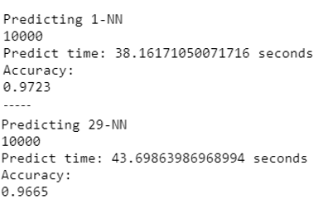
Cosine similarity

Slide 33
Cosine similarity
# save result
list_of_result = list(zip(train_time, predict_time, accuracy))
df = pd.DataFrame(list_of_result, columns=headers, index=index_name)
print(df)
df.to_csv('result_cosine.csv', sep=',')

Slide 34
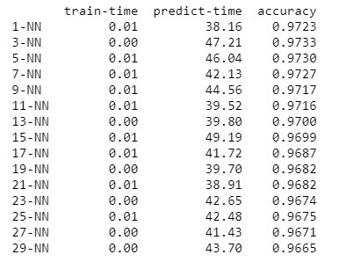
Cosine similarity

