Slide 1
HANDWRITTEN DIGIT IDENTIFICATION
TS. Nguyễn Tấn Trần Minh Khang
ThS. Trần Minh Tùng
ThS. Võ Duy Nguyên

Slide 2
DataSet Characteristics

Slide 3
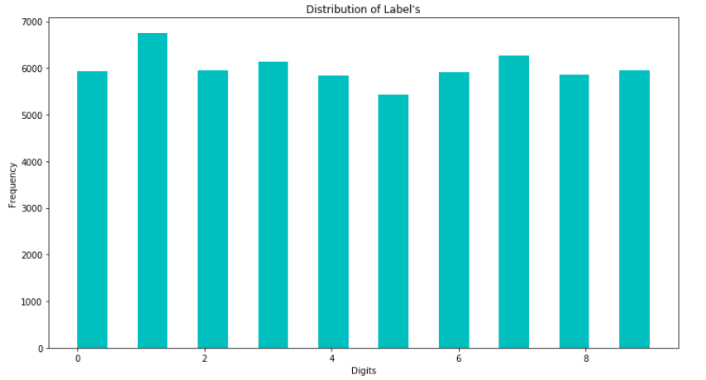
MNIST in Keras
Dataset of 60,000 28x28 grayscale images of the 10 digits, along with a test set of 10,000 images.

Slide 4
MNIST in Keras
Returns:
2 tuples:
x_train, x_test: uint8 array of grayscale image data with shape (num_samples, 28, 28).
y_train, y_test: uint8 array of digit labels (integers in range 0-9) with shape (num_samples).
Arguments:
path: if you do not have the index file locally (at '~/.keras/datasets/' + path), it will be downloaded to this location.

Slide 5
Python library
Scikit-learn is a free machine learning library for Python. It features various algorithms like support vector machine, random forests, and k-neighbours, and it also supports Python numerical and scientific libraries like NumPy and SciPy.

Slide 6
KNeighborsClassifier
class sklearn.neighbors.KNeighborsClassifier( n_neighbors=5, weights = 'uniform', algorithm = 'auto', leaf_size = 30, p = 2, metric = 'minkowski', metric_params = None, n_jobs = None, **kwargs)

Slide 7
Parameters
n_neighbors : int, optional (default = 5)
Number of neighbors to use by default for kneighbors queries.
algorithm : {'auto', 'ball_tree', 'kd_tree', 'brute’}
Algorithm used to compute the nearest neighbors:
'ball_tree' will use BallTree
'kd_tree' will use KDTree
'brute' will use a brute-force search.
'auto' will attempt to decide the most appropriate algorithm based on the values passed to fit method.

Slide 8
Parameters
weights : str or callable, optional (default = 'uniform')
weight function used in prediction. Possible values:
'uniform' : uniform weights. All points in each neighborhood are weighted equally.
'distance' : weight points by the inverse of their distance. in this case, closer neighbors of a query point will have a greater influence than neighbors which are further away.
[callable] : a user-defined function which accepts an array of distances, and returns an array of the same shape containing the weights.

Slide 9
Parameters
leaf_size : int, optional (default = 30)
Leaf size passed to BallTree or KDTree. This can affect the speed of the construction and query, as well as the memory required to store the tree. The optimal value depends on the nature of the problem.

Slide 10
Parameters
p : integer, optional (default = 2)
Power parameter for the Minkowski metric. When p = 1, this is equivalent to using manhattan_distance (l1), and euclidean_distance (l2) for p = 2. For arbitrary p, minkowski_distance (l_p) is used.

Slide 11
Parameters
metric : string or callable, default 'minkowski'
The distance metric to use for the tree. The default metric is minkowski, and with p = 2 is equivalent to the standard Euclidean metric. See the documentation of the DistanceMetric class for a list of available metrics.

Slide 12
Parameters
metric_params : dict, optional (default = None)
Additional keyword arguments for the metric function.
n_jobs : int or None, optional (default=None)
The number of parallel jobs to run for neighbors search. None means 1 unless in a joblib.parallel_backend context. -1 means using all processors. See Glossary for more details. Doesn’t affect fit method.

Slide 13
Supervised Model
KNeighborsClassifier - KNN

Slide 14
Model
Use k-Nearest Neighborsclassifier
The algorithm search for the nearest point in the training set.
Then it assigns the label of the training point to the new data point. It can be a mean of N closest neighbors, but for now, it’s just one.
Use Cosine similarity distance
The accuracy is 97%, pretty good!

Slide 15
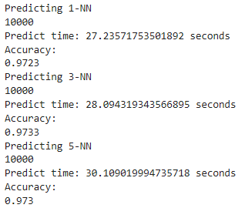
Example

Slide 16
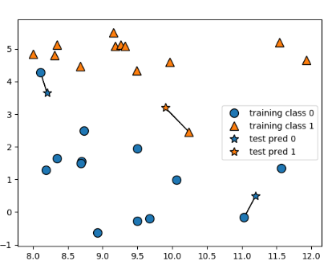
Classification
k-NN takes the closest point from the training set and assigns its class to a new predicting point.
k-NN can be used both for classification and for regression tasks.

Slide 17
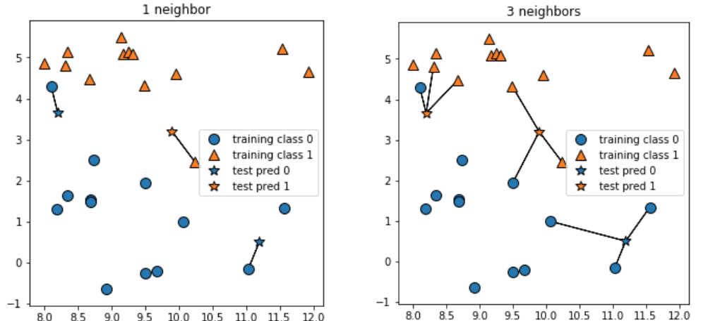
Classification
Smoother boundary corresponds to a simpler model.

Slide 18
Cosine Similarity
Distance in KNN

Slide 19
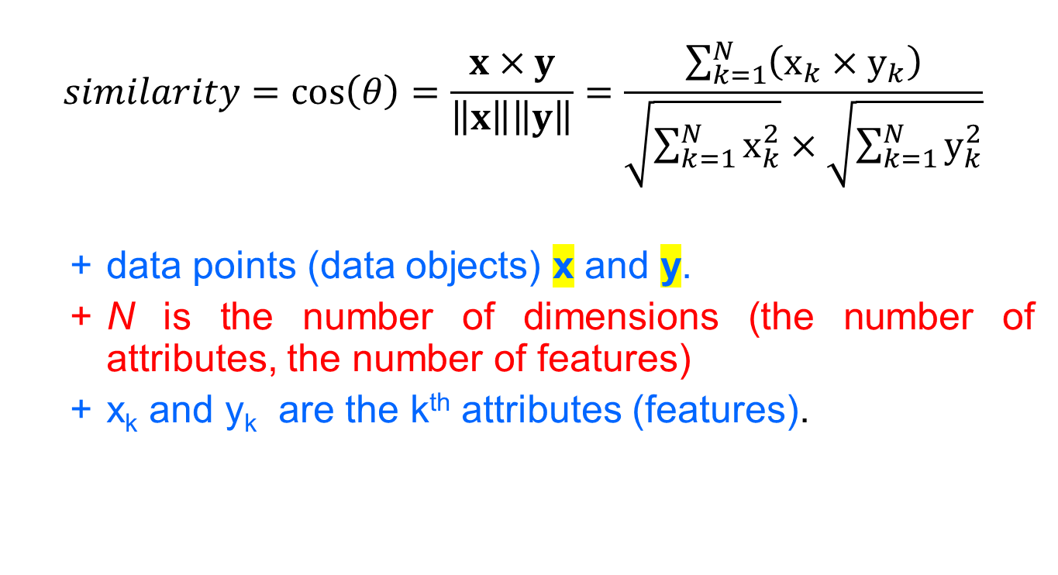
Cosine similarity
$$similarity=\cos\left(θ\right)=\frac{x×y}{\left\|x\right\|\left\|y\right\|}=\frac{\sum_{k=1}^{N}{\left(x_{k}×y_{k}\right)}}{\sqrt{\sum_{k=1}^{N}{x_{k}^{2}}}×\sqrt{\sum_{k=1}^{N}{y_{k}^{2}}}}$$
data points (data objects) x and y.
N is the number of dimensions (the number of attributes, the number of features)
x_{k} and y_{k} are the k^{th} attributes (features).

Slide 20
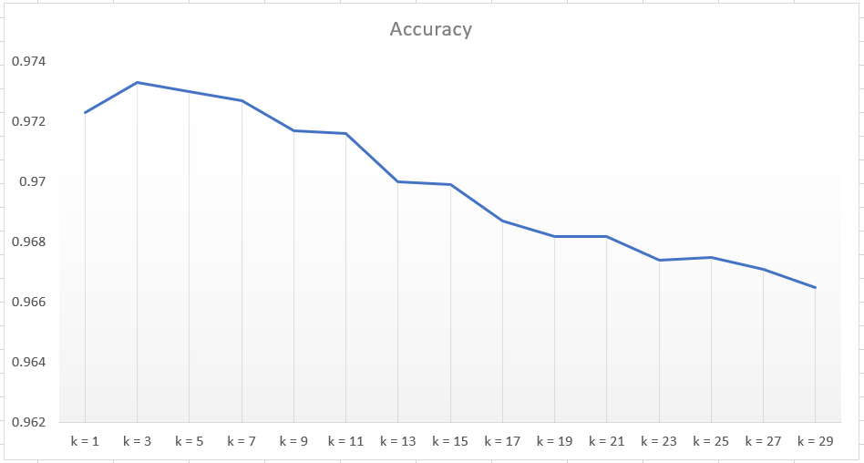
Accuracy

Slide 21
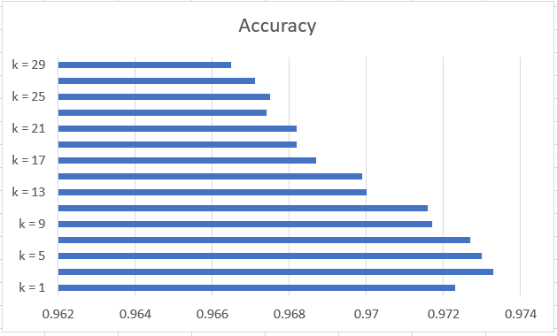
Accuracy

Slide 22
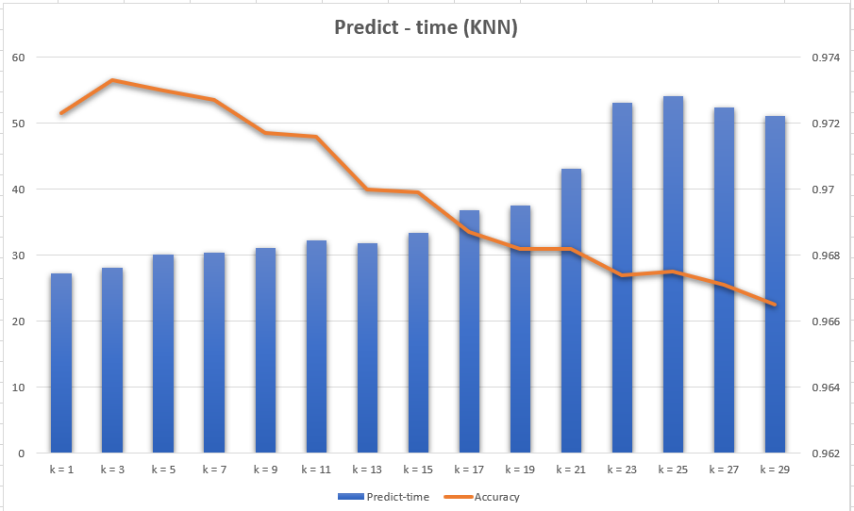
Predict

Slide 23
Conclusion
The accuracy is 97%, pretty good! ( k = 1, k = 3, k = 5)
In practice using a small number like 3 or 5 often works well.
Cosine distance is used, which works well too.
Model is very easy to understand and it gives a reasonable performance without much adjustments for small training sets. On a large training set model can be slow.
KNN doesn’t perform well on datasets with many features (>100 or 0).

Slide 24
Conclusion
There are two important parameters to the k-NN classifier - the number of neighbors and how it measures the distance between points.

