Slide 1
Compiler Optimization Playground
Visualizing How Compilers Make Code More Efficient
BCSE307P — Compiler Design Lab | Fall Semester 2026–2027
• An Interactive Intermediate Representation & Multi-Pass Optimization Platform
• Built with React, TypeScript, and Vite for Education & Evaluation

Slide 2
Project Team Details
BCSE307P — Fall Semester 2026–2027
• Student Name 1: [STUDENT_NAME_PLACEHOLDER]
• Registration Number 1: [REG_NUMBER_PLACEHOLDER]
• Student Name 2: [TEAM_MEMBER_2_PLACEHOLDER]
• Registration Number 2: [REG_NUMBER_2_PLACEHOLDER]
• Department: Computer Science and Engineering
• School of Computer Science and Engineering (SCOPE)

Slide 3
Faculty & Course Coordination
BCSE307P — Compiler Design Lab
• Faculty Guide / Reviewer: [FACULTY_NAME_PLACEHOLDER]
• Designation: Faculty of Computer Science & Engineering
• School: School of Computer Science and Engineering (SCOPE)
• Review Milestone: Final Laboratory Project Evaluation

Slide 4
Project Abstract
Core Focus & Pedagogical Innovation
• Undergraduate compiler education frequently struggles to bridge theoretical AST and data-flow algorithms with practical compiler backend transformations.
• Industrial tools (GCC, LLVM) act as opaque black boxes emitting thousands of lines of machine assembly with dense architecture metadata.
• We developed the Compiler Optimization Playground: a client-side web application translating C-like source into Three-Address Code (TAC).
• Visualizes Control Flow Graphs (CFG) and Directed Acyclic Graphs (DAG), and executes 5 real optimization passes: Constant Folding, CSE, DCE, Strength Reduction, and LICM.
• Provides side-by-side TAC diffs, step-by-step transformation traces, and verifiable instruction-count reduction metrics.

Slide 5
Introduction & Motivation
Demystifying Compiler Optimizations
• Intermediate Representations (IR) decouple high-level programming syntax from target machine architectures.
• Understanding optimizations is vital for building performant software and mastering compiler engineering.
• Existing educational tools concentrate primarily on regex/lexing and context-free parsing, leaving backend optimization neglected.
• Our solution provides a transparent, zero-install, browser-based environment where students observe actual IR rewrites and graph reconfigurations in real time.

Slide 6
Literature Review: 10 Verified Studies (2021–2026)
Peer-Reviewed Foundations across ACM & IEEE Venues
• 1. VisOpt (Koitz-Hristov et al., ACM SIGCSE TS 2025) — Visualization of compiler optimizations.
• 2. Teaching Compilation Pipeline (Lilis & Savidis, IEEE TLT 2023) — Interactive web compilation.
• 3. Verified LICM & CSE (Boulmé & Six, CoRR 2021) — Modular verified optimization decomposition.
• 4. IR for Embeddings (Liu et al., IEEE/ACM ICSE 2022) — Intermediate code for neural pass search.
• 5. FAIR: Flow-Type IR Pre-Training (Dong et al., IEEE/ACM ICSE 2024) — Graph IR pre-training.
• 6. Compiler Event Profiling (Traini & Cortellessa, ACM TOPLAS 2023) — Optimization tracking.
• 7. egg: Equality Saturation (Willsey et al., ACM POPL 2021) — E-graphs for algebraic simplification.
• 8. Graph IR Representations (Brauckmann et al., IEEE TC 2021) — CFGs & dependency graphs.
• 9. MLIR Infrastructure (Prabhu & Adve, IEEE Micro 2022) — Multi-level IR for loop transformations.
• 10. Interactive Compiler Tools (El-Ghandour & Padua, IEEE TE 2023) — Visual compiler pedagogy.

Slide 7
Summary of the Literature & Research Gap
Synthesizing Findings & Defining the Unaddressed Gap
• Common Research Trends: Adoption of graph-based IRs (CFGs/DAGs) and empirical proof that interactive visual feedback improves student mastery by 20–25%.
• Strengths of Existing Systems: Extreme runtime performance in LLVM/MLIR; mathematical verification proofs in CompCert.
• Critical Pedagogical Gap: Industrial compilers are too complex for classroom exploration; existing tools require heavy desktop installations and lack selective, pass-by-pass toggling.
• Our Contribution: A clean, 100% client-side web playground featuring TAC, CFG, DAG, and 5 independent optimization passes with full transformation auditability.

Slide 8
Project Objectives
Measurable Goals Aligned with Implementation
• Primary Objective: Implement a functional, browser-based compiler playground that converts C-like syntax into TAC, visualizes CFG/DAG, and executes 5 verified optimization passes.
• Specific Objective 1: Build a robust Lexer, Recursive-Descent Parser, and TAC generator supporting variables, arithmetic precedence, if/else, while, for, and print/return.
• Specific Objective 2: Formulate basic block leader partitioning, interactive CFGs with branch edge classification, and local expression DAGs.
• Specific Objective 3: Implement Constant Folding, CSE, DCE, Strength Reduction, and LICM with live diffs and quantitative metrics.

Slide 9
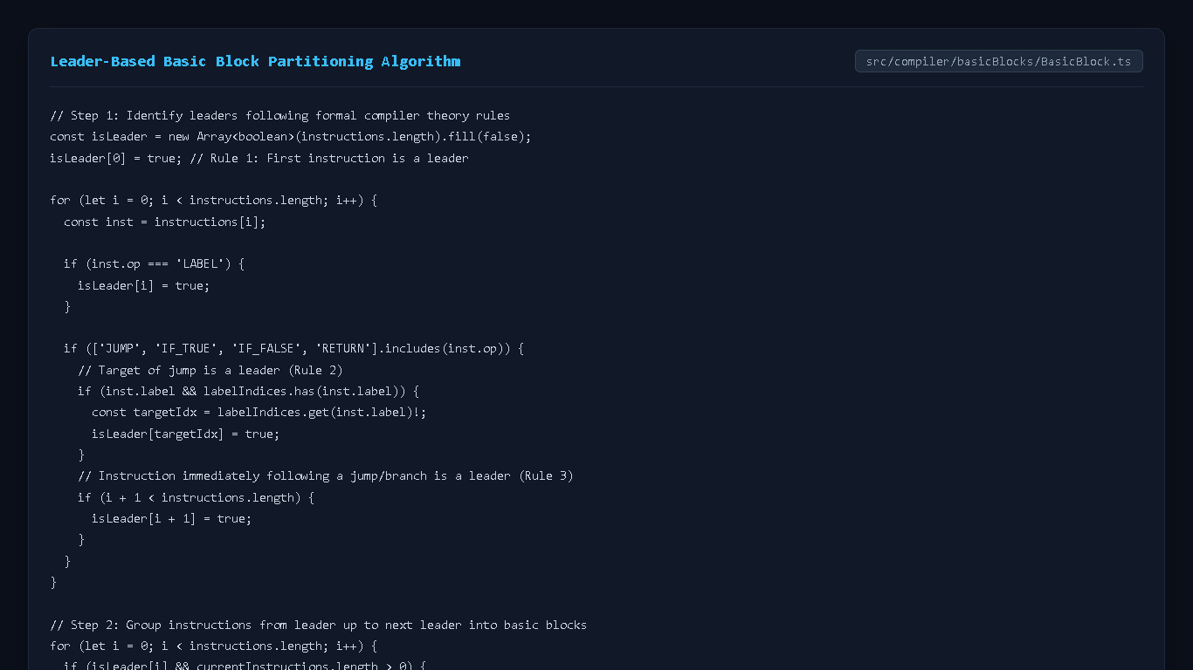
Code Implementation: TAC & Basic Blocks
Leader-Based Partitioning Algorithm (src/compiler/basicBlocks/BasicBlock.ts)
• Rule 1: The first instruction in the TAC sequence is designated as a leader (isLeader[0] = true).
• Rule 2: Any target of a jump or conditional branch is a leader.
• Rule 3: Any instruction immediately following a jump or return statement is a leader.

Slide 10
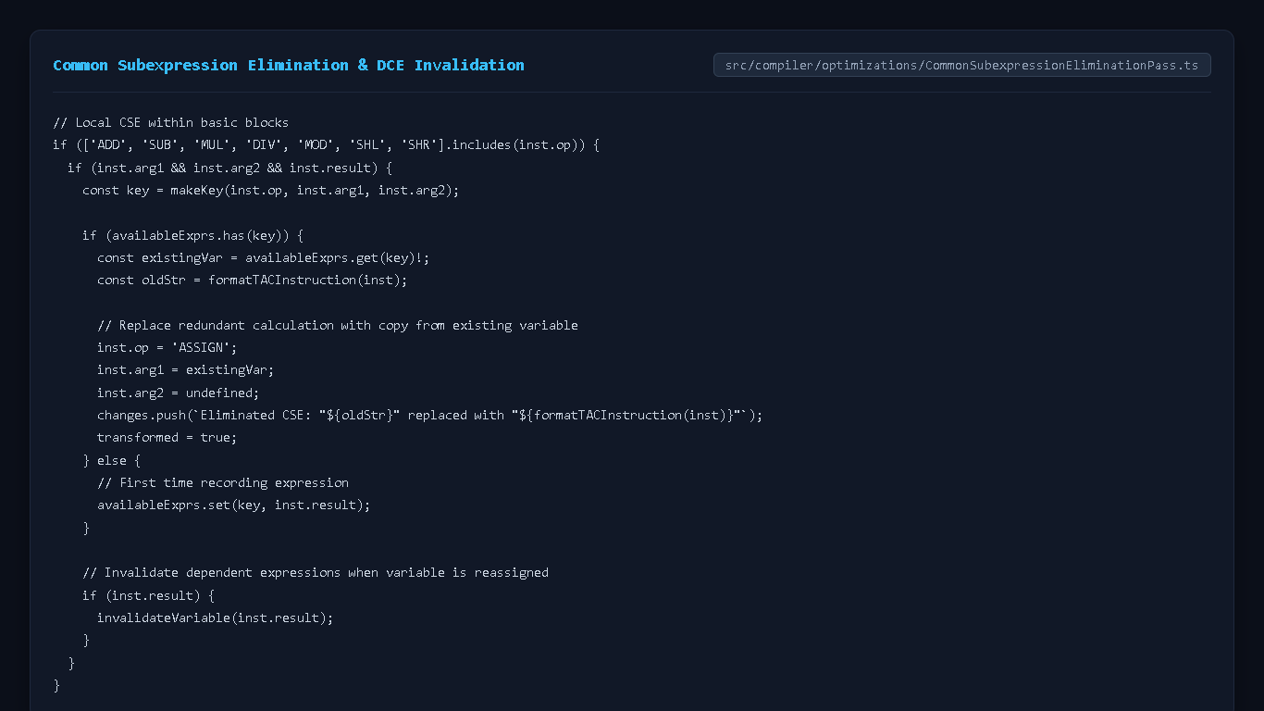
Code Implementation: Optimization Passes
Common Subexpression Elimination & DCE (src/compiler/optimizations/)
• CSE: Tracks available expressions within basic blocks using normalized commutative keys.
• Invalidation: Operands modified by subsequent assignments immediately invalidate dependent expressions in the available pool.
• DCE: Performs backward iterative liveness analysis to eliminate dead writes while preserving side effects.

Slide 11
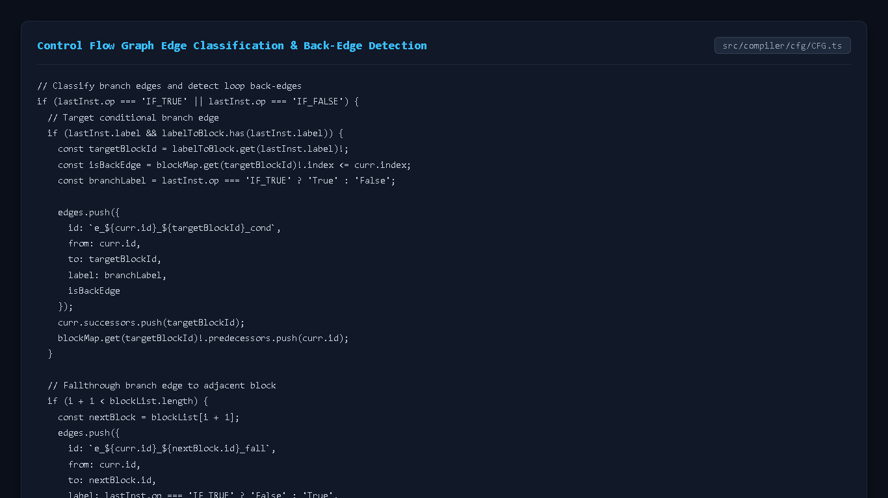
Code Implementation: CFG & DAG Builders
Control Flow & Expression Dependencies (src/compiler/cfg/ & dag/)
• CFG Builder: Maps block leaders and jump targets into directed edges labeled as True, False, Fallthrough, or BackEdge.
• Loop Detection: Back-edges explicitly identify loop bodies for Loop-Invariant Code Motion.
• DAG Builder: Models operand leaves and operator nodes, attaching variable names to show subexpression sharing.

Slide 12
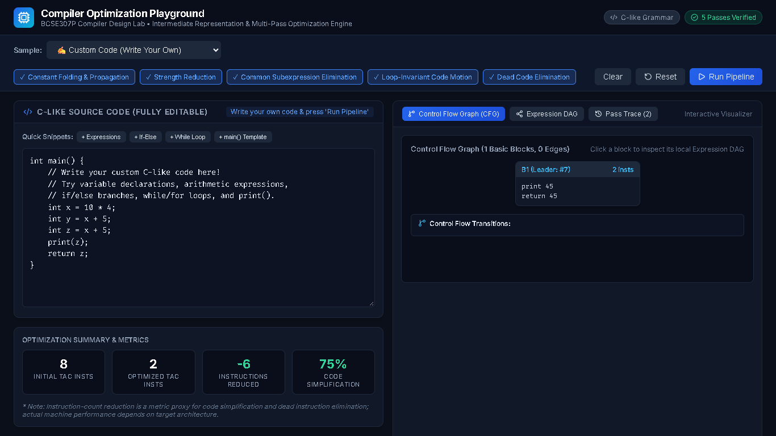
Application Output: Before-and-After TAC Optimization
Side-by-Side Comparison & Metric Tracking
• Demonstration: Constant Folding and Dead Code Elimination on arithmetic program.
• Initial TAC: 6 instructions -> Optimized TAC: 2 instructions (-66.67% simplification).
• Side-by-side panels highlight modified lines in blue and eliminated instructions.

Slide 13
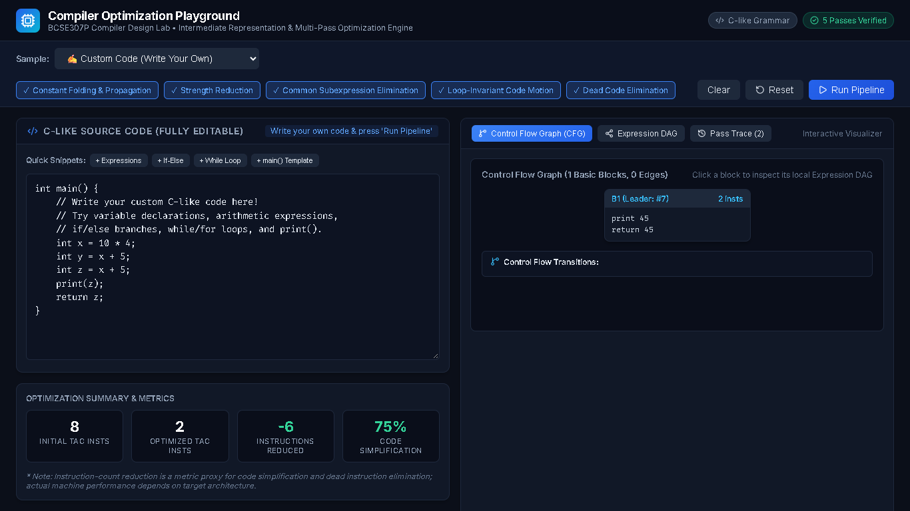
Application Output: CFG & Expression DAG Visualizations
Topological Control Flow & Subexpression Sharing
• Renders basic block cards with leaders and internal TAC instructions.
• Interactive edge transition badges indicate True/False conditional paths and loop back-edges.
• Expression DAG shows operator node reuse for identical computations within basic blocks.

Slide 14
Conclusion & Future Scope
Validation Summary & Architectural Roadmap
• Achievements: 100% functional, browser-native compiler engine verified by 15 passing Vitest automated tests and 0 build errors.
• Educational Value: Provides students with an immediate visual laboratory to explore how compilers analyze and optimize imperative programs.
• Future Scope 1: Static Single Assignment (SSA) form generation with explicit phi-node placement.
• Future Scope 2: Graph-coloring register allocation visualization (Chaitin-Briggs algorithm).

Slide 15
Academic References
Complete Verified Citations (2021–2026)
• Koitz-Hristov et al., VisOpt, ACM SIGCSE TS 2025. DOI: 10.1145/3641554.3701869
• Lilis & Savidis, Teaching Compilation Pipeline, IEEE TLT 2023. DOI: 10.1109/TLT.2023.3248981
• Boulme & Six, Formally Verified LICM and CSE, CoRR 2021. DOI: 10.48550/arXiv.2105.08635
• Liu et al., Compiler IR for Neural Program Embeddings, IEEE/ACM ICSE 2022. DOI: 10.1145/3510003.3510214
• Dong et al., FAIR: Pre-Training on Compiler IR, IEEE/ACM ICSE 2024. DOI: 10.1145/3597503.3639148
• Traini & Cortellessa, Compiler-Level Event Profiling, ACM TOPLAS 2023. DOI: 10.1145/3587459
• Willsey et al., egg: Fast Equality Saturation, ACM POPL 2021. DOI: 10.1145/3434304
• Brauckmann et al., Compiler Graph Representations, IEEE TC 2021. DOI: 10.1109/TC.2021.3129598
• Prabhu & Adve, MLIR Infrastructure, IEEE Micro 2022. DOI: 10.1109/MM.2022.3175440
• El-Ghandour & Padua, Interactive Compiler Tools, IEEE TE 2023. DOI: 10.1109/TE.2022.3217822

