Slide 1
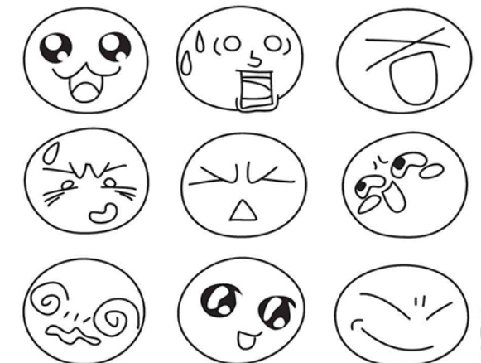





Emotion Detection
Group 3
Jinxiao Du
Tram Duong
Ziyun Liu
Ran Lu
Kexin(Collen) Su

Slide 2
Contents
1. Gradient Boosting Machine(GBM) -- Based Model
2. CNN
3. KNN
4. Random Forest
5. Support Vector Machine(SVM) – Advanced Model

Slide 3
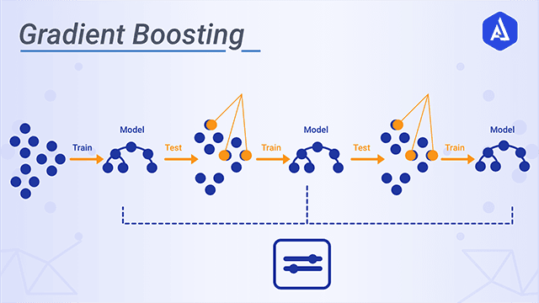
Baseline Model: GBM
Test Accuracy: 44.4 %
Limitations:
1. Long Time to Train Model
2. Easy to Overfit

Slide 4
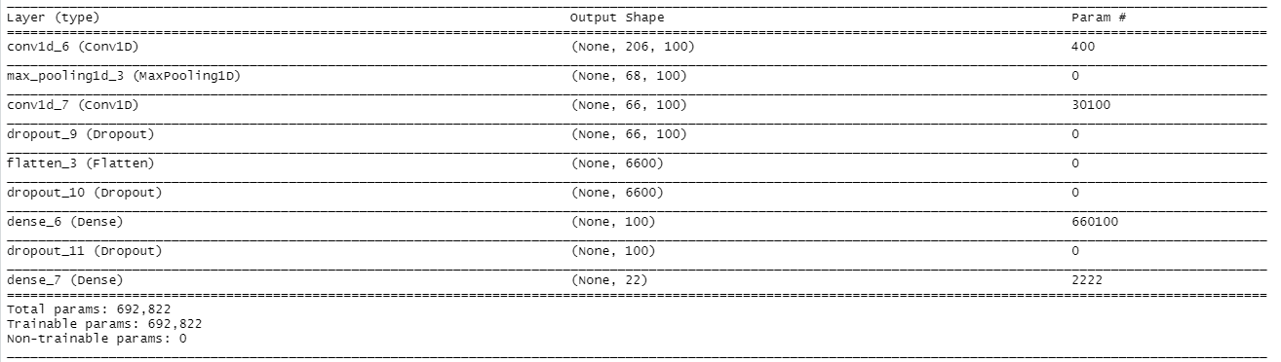
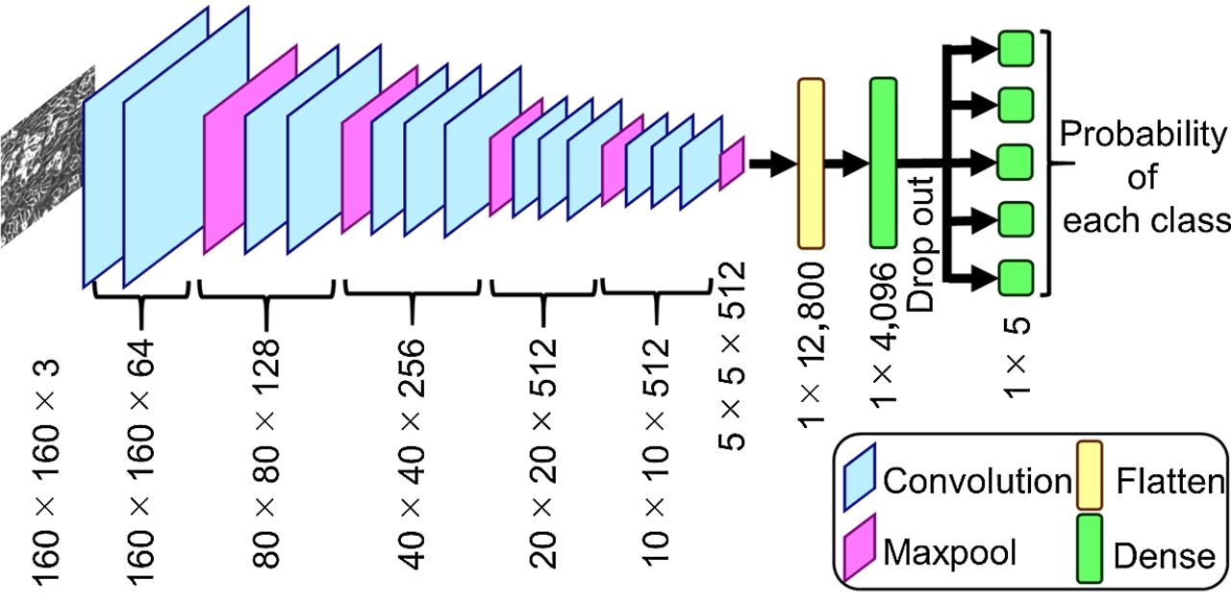
Convolutional Neural Network(CNN)
Test Accuracy: 46.6 %
Limitations:
1. Easy to Overfit

Slide 5
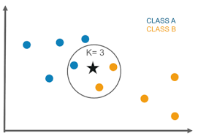
K Nearest Neighbor(KNN)
Test Accuracy: 38.8%
Limitations:
1. Need to tune hyperparameter k
2. Computation cost is high when dealing with large data

Slide 6
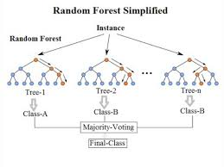
Random Forest
Test Accuracy: 43.3%
Limitations:
1. Need to choose the number of trees
2. Slow to predict

Slide 7
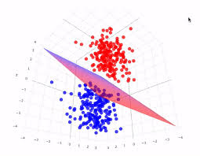
Advanced Model: SVM
Test Accuracy: 52.8%
Advantages:
1. More effective in high dimensional spaces
2. Relatively memory efficient
Comparison:
1. SVM has higher test accuracy compared with others,
2. As advanced model, SVM is significantly
more accurate than baseline model
3. SVM has better time consuming

