Slide 1

Google Merchandise
A Dive into
By:
Ran Tun

Slide 2

Questions to Answer:
What pages on my website are most successful?
What percentage of my traffic comes from mobile and/or tablets?
How do our new users interact with our website?
How do visitors find my site?
What do our users look like?
How does out website perform?

Slide 3
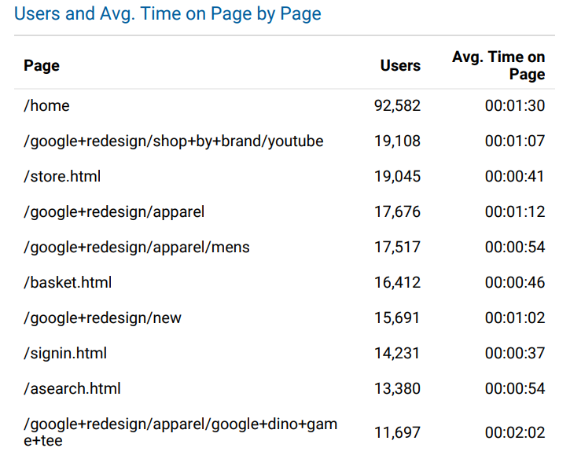
What pages on my website are most successful?
Indicating which pages generate the most traffic the business can see how to better operate the home page.
The home page has the most traffic as expected.
Traffic drops
Many users visit the store
Using this data, we can see preliminary information regarding our customers

Slide 4
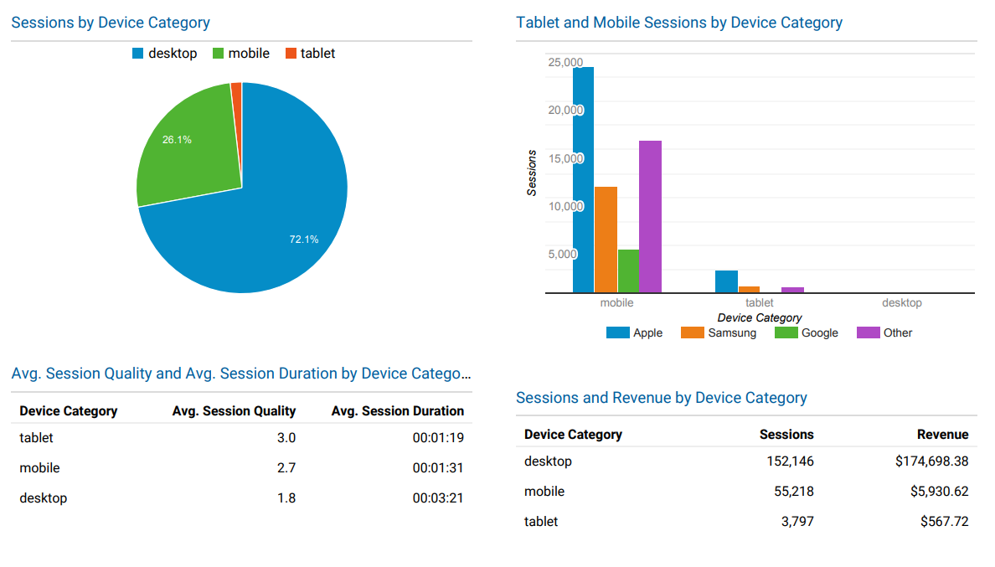
What percentage of my traffic comes from mobile and/or tablets?
Provides insight of potential usefulness of multidevice marketing.
Around 26.15% of sessions occur from mobile devices and about 1.79% of sessions come from tables.
Tablet and Mobile sessions have a better quality compared to desktop sessions.
Session Quality: Estimate of a user’s proximity to conversion.
The higher the better
Apple Devices made up the most of both tablet and mobile sessions.
Desktop sessions had about $1.15 of revenue per session
Mobile - $0.11 revenue per session
Tablet - $0.15 revenue per session

Slide 5
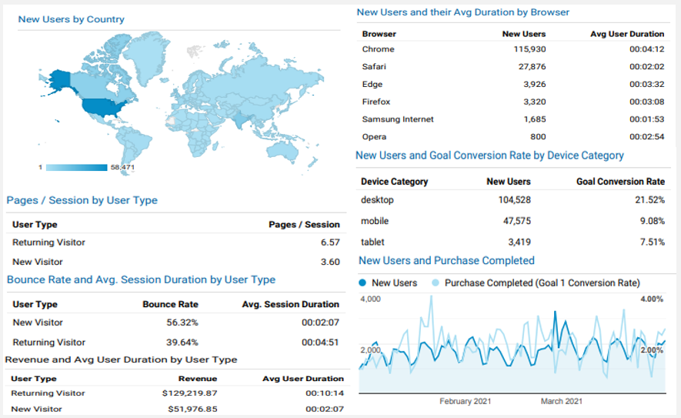
How do our new users interact with our website?
Seeing how new users interact with our website is important when capturing market share.
We see new users have an “okay” bounce rate, but spend little time during their sessions
New users provided $51,976.85 in revenue during Q1.
Majority of users use chrome, and a large majority of new users used a desktop.
A healthy amount used other devices
This data provides, additional preliminary information regarding our customers

Slide 6
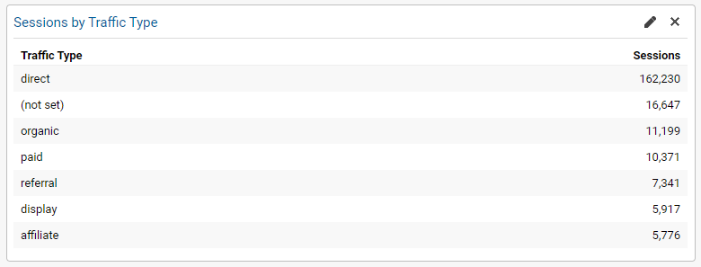
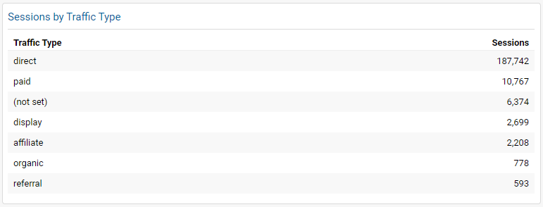
How do visitors find my site?
Finding which stream of traffic enables more visitors to reach the site is crucial to the growth and success of a business.
When comparing Q4 of 2020 to Q1 of 2021 we can see that direct traffic increased, however overall traffic decreased.
Paid traffic stayed about the same.
Strategies can stem from traffic data. When paired with revenue strategies can be planned and implemented.
For example, in Q4 of 2020 the website generated $87,379.84 of revenue while in Q1 of 2021 the site generated $181,196.72. Even though traffic to the site decreased there was more than double the revenue.
2020 Q4
2021 Q1

Slide 7
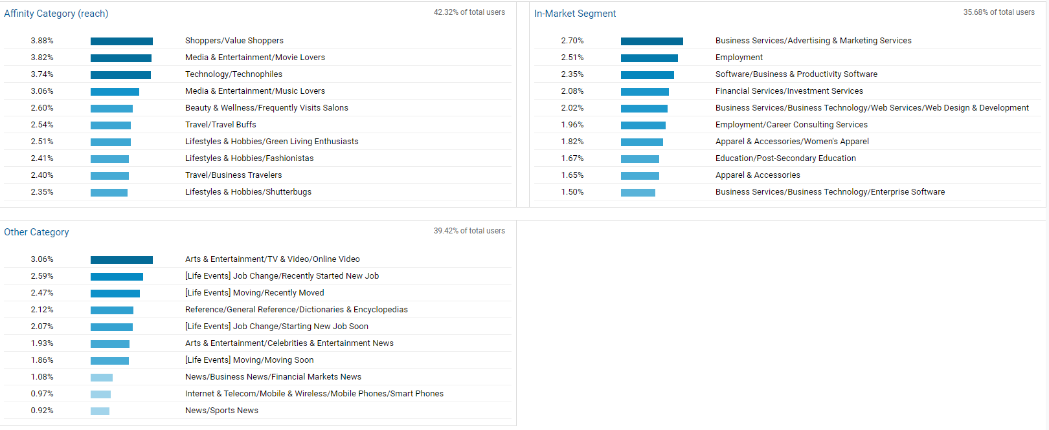
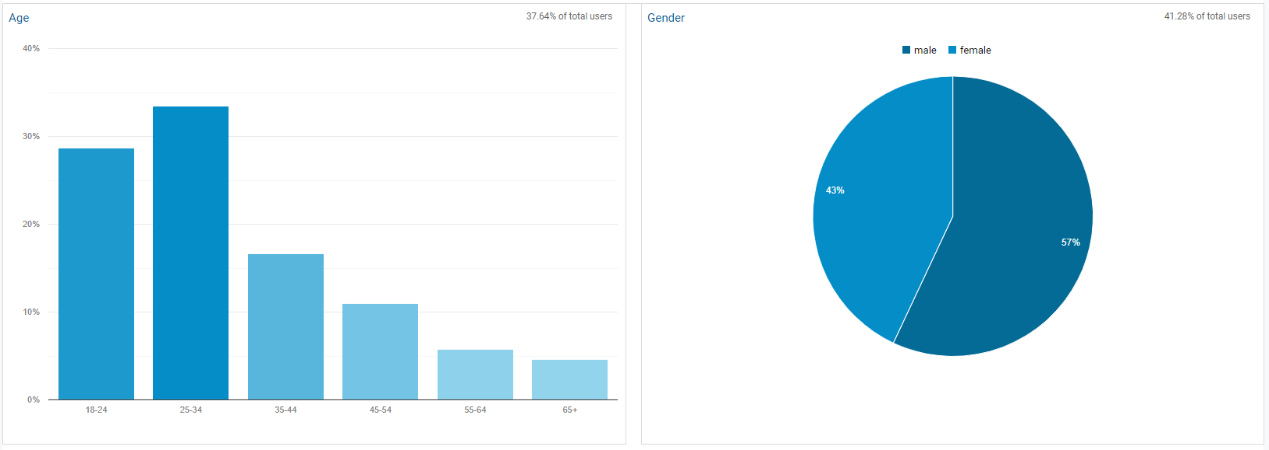
What do our users look like?

Slide 8
What do our users look like?
Looking at our user demographic and interests we will be better able to capture a larger market share.
Based on the previous data our typical user was male (based on pages visited), used chrome (based on browser data), and most likely within the United States (based on all visual maps).
When analyzing our data most users identified as female around 57%.
The age group was largely between 25-34 years old with 18-24 years old following closely behind.
42.32% of users are in the affinity category
Affinity - Categories that are used to reach potential customers to make them aware of your brand or product. Typically, these users are higher in the purchase funnel, near the beginning of the process.
The most popular affinity was Shoppers/Value Shoppers
Spinning a wheel for a discount will most likely capture these kinds of users
35.68% of users are In-Market Segment
In-Market - Users in these segments are more likely to be ready to purchase products in from a specific category.
Most popular being Business Services/Advertising & Marketing Services
39.42% of users are in the Other Category
Those in the other category have a more specific tastes than those offered in the affinity or in-market segment.
Most popular in this segment is Arts & Entertainment/TV & Video/ Online Video

Slide 9
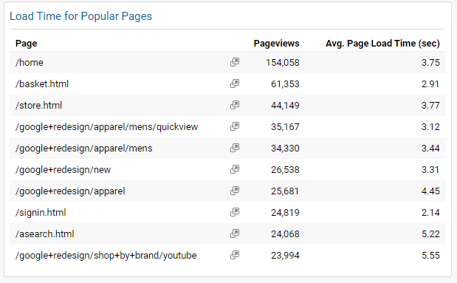
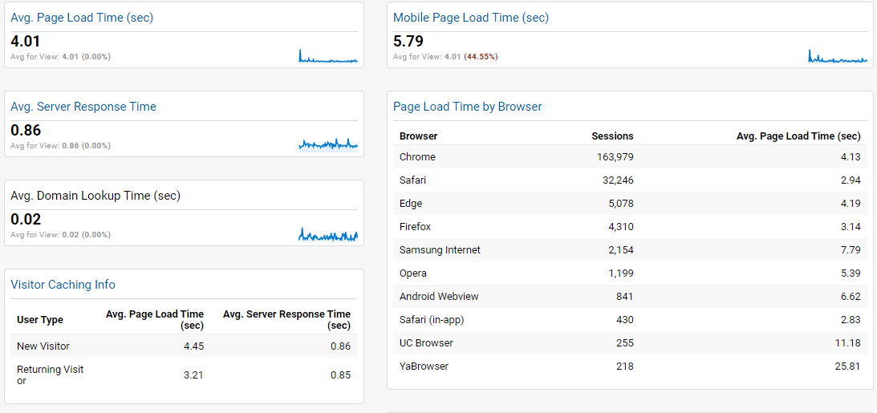
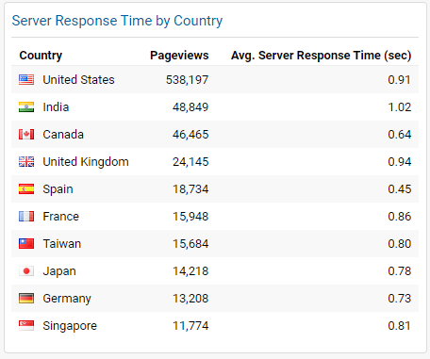
How does out website perform?
Keeping an eye on our websites system performance is key. Not everyone enjoys a long wait time
During Q1 server response time was less than a second, except in India where it was 1.02 seconds.
Loading time on the other hand was much longer, but still bearable.
Depending on the browser the store loaded in either no time, or what is considered an eternity in todays standards.

Slide 10


Additional Questions?
10th most popular link in Q1

