Slide 1


Woodhaven, NY
Ran Tun
Notes:
Good Afternoon my name is Ran and I will be presenting the opportunities that lie within Woodhaven, NY.

Slide 2
Types of Analytics
Descriptive Analytics
01
Predictive analytics
02
Prescriptive analytics
03
Notes:
I will briefly discuss the following in order to explain how the models were created.
Descriptive, then Predictive, followed by Prescriptive. The order or steps should also follow this 1,2,3 design.

Slide 3
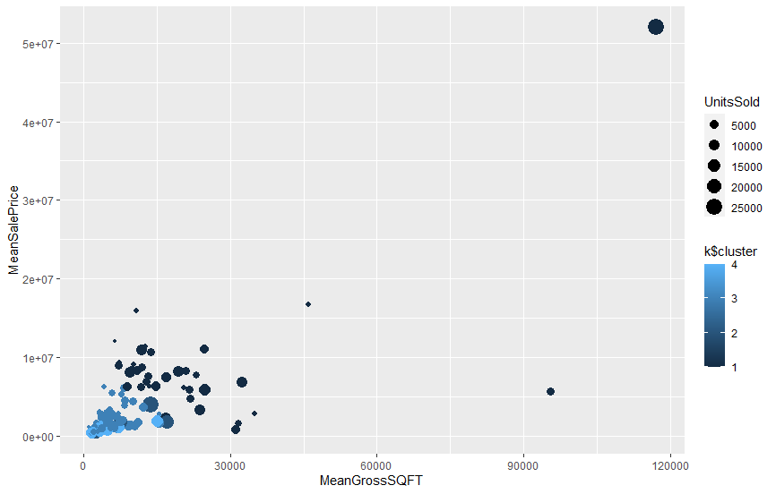
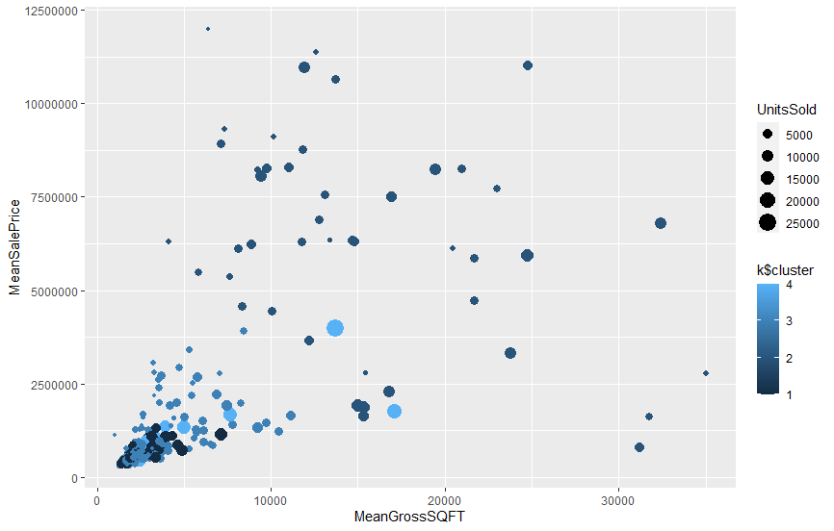
Types of Analytics - Descriptive
Used to describe how the data looks
Mean
Percentiles
Frequency
Central Tendency
Cleans data
Identifies outliers
Contains Outliers
Removed Outliers
Notes:
Data is first processed using descriptive analytics. This offers insight about how the data will look and provides preliminary information that can lead to decisions. This field also cleans the data. Removing outliers and invalid data points.
Take these two charts for example. It is a chart of the mean sale price and mean gross square footage in every neighborhood. One is basically illegible and the other shows a decent spread of data that can provide early decisions. If one finds that the neighborhood falls in a low sale price but high square footage it may not be the best investment opportunity.

Slide 4
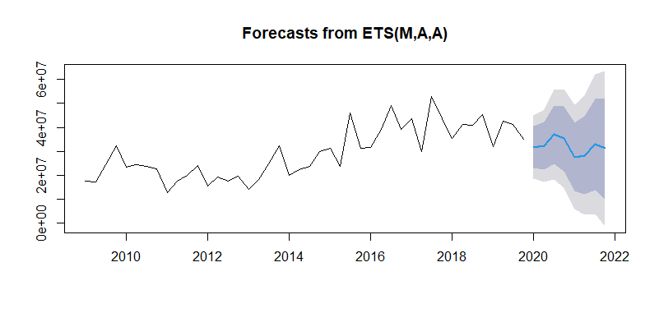
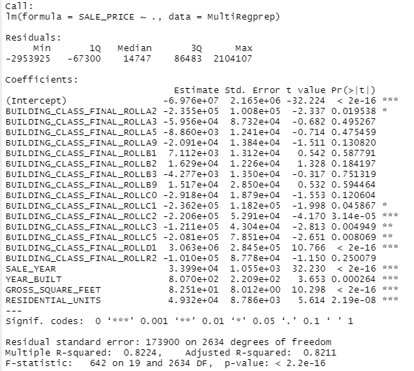
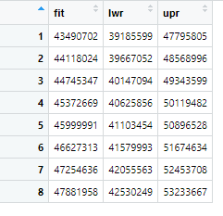

Types of Analytics - Predictive
Graphical Representation
Used to describe how the data may look in the future
Time Series
Regression Models
Variable Testing
Useful insight of given interval
Strength is displayed with $R^{2}$
Mathematical Representation
Numerical Representation
(Quarters)
Notes:
Then there is predictive analytics. The predictive step provides a deep look at potential rather than what was. Types of predictive analytics include time series, regressions, and variable testing. Variable testing is arguably the most important step within this process. A model’s R^2 represents its ability to explain the data. The stronger the R^2 the stronger the model is. Testing variables can provide potential to create stronger models. In the case of Woodhaven building class, sale year, year built, gross square footage and residential units all provided the best possible r^2.

Slide 5
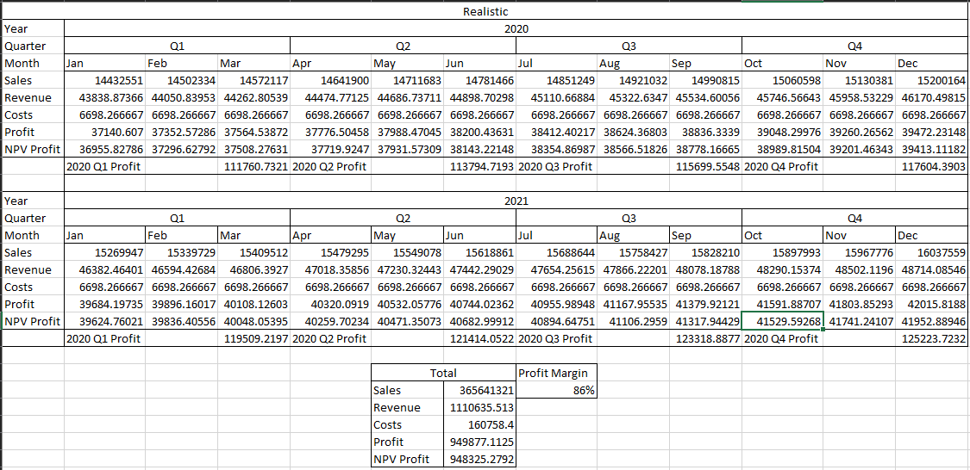
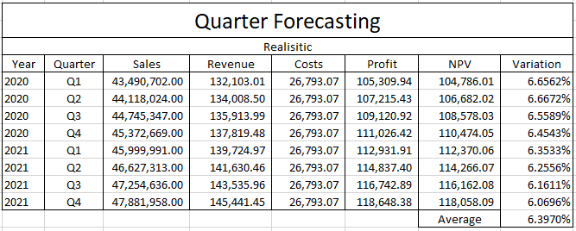
Types of Analytics - Prescriptive
Used to describe how a goal should be met
Optimization
Planning
Investment Opportunities
Define Constraints
Provide Useful Data
Create Quick Analysis Between Alternatives
Optimistic Optimization
(Monthly)
Optimistic Optimization
(Quarterly)
Notes:
Prescriptive analytics is the final step in model building. It is the first time the data that has been transformed, processed, and predicted can be used. Much like a doctor would prescribe their patients with the most effective medicine, prescriptive analytics can aid in optimizing an organizations operation. In this case given a few distinct variables, our model found the best way to proceed in Woodhaven was have one salesperson with a decrease of .5% commission. The employee is given an annual $65,000 salary and the location cannot cost more than $15,000 per month. In this model monthly data was used rather than quarterly data, it was neater, and more accurate. In fact the quarterly model had a pessimistic variation of 10%. A huge margin to be in. Anything more than 5% is honestly drastic.
This optimization step can also display different opportunities. For example, Whitestone NY has a higher pessimistic outlook than Woodhaven’s optimistic outlook. There are also internal remodeling potentials. The organization can look on how to restructure. They could reduce pay but increase commissions therefore increasing sales and maintaining cost efficiency.

Slide 6
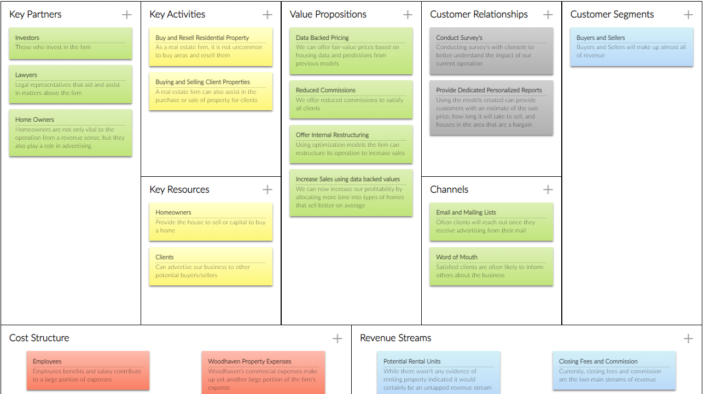
Notes:
Here is a canvas business model for the firm in Woodhaven. It outlines practiced revenue sources as well as a potential source. Cost structures comprised of employees and property expenses and value.

Slide 7
Managing Life Cycle
Manage the Necessary Data
Update every month with new data
Model Development
Use relevant data to improve historical data
Model Validation
See how relevant this data is using histograms and other statistical measures
Confusion Matrix, use the model to see how well the information was predicted
Model Deployment
Score new models created based on relevance and accuracy
Model Monitoring
Test models monthly
Model Improvement
Run the scoring tests and see which new items improve or worsen the model
Model Retirement
If needed update models, but keep an old version

Slide 8
Value of the Model
External and internal values of the organization
Can create more accurate sale prices for clientele as well as more accurate predictions for future housing values
Adds insight in target areas such as sale increases and cost reduction
Adds insight of restructuring possibilities
Efficacy in the creation of external value
Given the nature of the model it can create custom reports for each client or interested party
Efficiency of enterprises to create more internal value through automation
Increases work capacity of one employee
Find potential in potential revenue streams

Slide 9

Recommendation
Proceed in the operation of a Woodhaven firm
The area still provides revenue
Is a bargain area for those in the city
Good growth even under a pessimistic outlook
While there have been better investment opportunities, it would not necessarily put Woodhaven out as an opportunity
Things to consider
Are there better investment opportunities?
Is the area able to withhold its value?
Will there be a demand for rentals?

