Slide 1
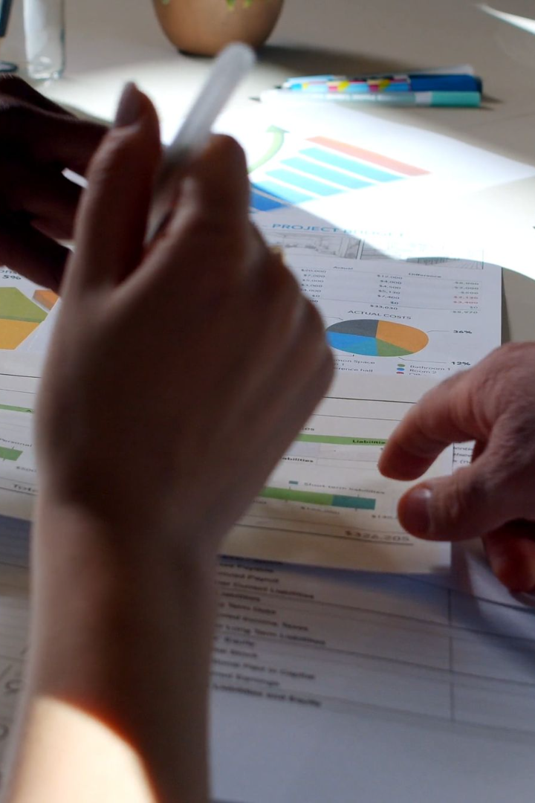

Project: Personal Finance Tracker
The Personal Finance Tracker is an application that helps users track their expenses and income to better manage their personal finances. It provides valuable insights and summaries to improve budgeting and make informed decisions.
Done By: Rana AlHababi

Slide 2

Introduction: Purpose and Benefits
1
Take Control of Finances
2
Gain Insights & Summaries
Empower individuals to understand their spending habits and improve financial management.
Analyze financial data to identify trends, areas of improvement, and make informed decisions.

Slide 3
Features of the Personal Finance Tracker
Expense Tracking
Income Tracking
Data Analysis
Effortlessly record and categorize expenses to keep track of where your money is going.
Monitor and categorize income sources to understand your financial inflows.
Get a clear picture of your finances with visualizations, charts, and summaries.

Slide 4
Budgeting and Informed Decisions
1
Track Spending Patterns
Identify areas where you can reduce expenses and save more effectively.
Set Financial Goals
2
Establish realistic targets and track your progress towards achieving them.
3
Informed Financial Decisions
Make educated choices based on insights from your financial data.

Slide 5
Conclusion: Summary
1
Become Financially Empowered
2
Get Started Today
Take control of your finances and achieve your financial goals with the Personal Finance Tracker.
Download the app now and embark on your journey towards financial freedom.

