Slide 1


Slide 2



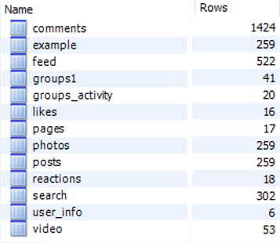


Tables

Slide 3
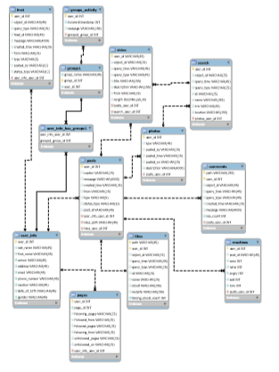

EER Diagram

Slide 4
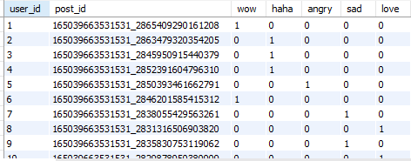
Instance of Database

Slide 5
Tools and Files used
MySQL Workbench
Face pager
Microsoft Excel
CSV Files
JSON Files

Slide 6
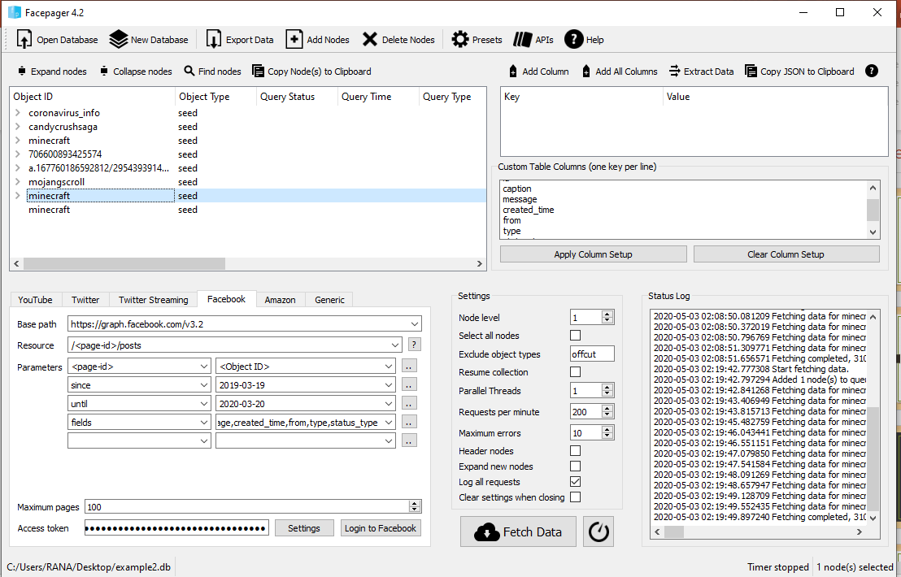
Method to populate Tables
Step 1: Create an account in Facebook
Step 2: Generate a token to access the facebook data from the facepager tool.

Slide 7
Method to populate Tables
Step 3: create a node and enter the object id in node field.
Step 4: To find the object id, search the details of the page in Facebook search box.
Step 5: Select the type of data from resource tab and fetch data

Slide 8
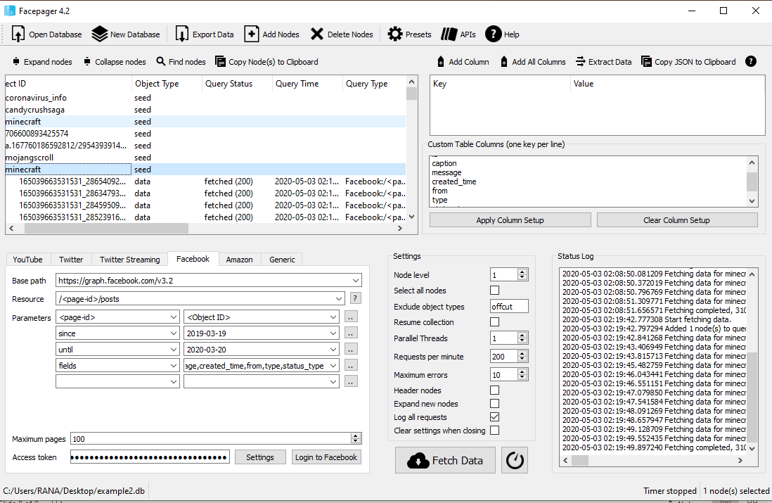
Method to populate Tables
Step 6: Export the data into csv file
Step 7: Use Microsoft excel to transform the raw data into some meaningful order.

Slide 9
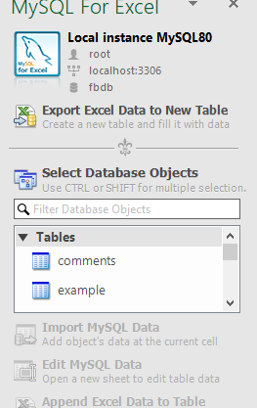
Method to populate Tables
Step 8: After transformation use MySQL connection to export data to MySQL workbench.

Slide 10
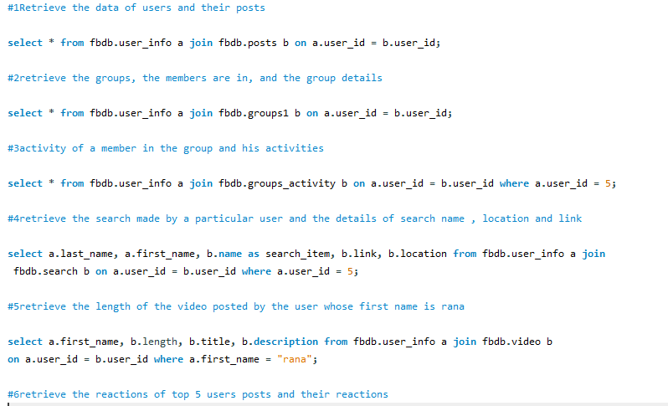
Queries

Slide 11
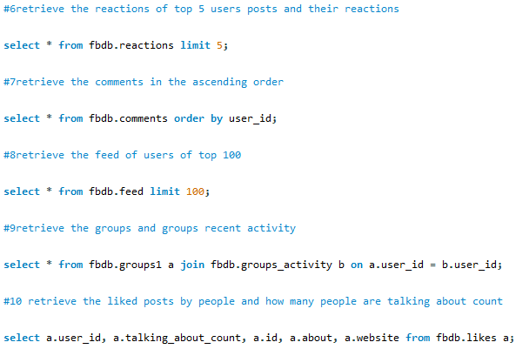
Queries

Slide 12

Thank you

