Slide 1




User car sales

Slide 2
The Team
Omar Mostafa Abdelhady Mohamed –Data Cleaning
Menna Allah Shehata Mahmoud Shehata–Dashboard
Mostafa Ahmed Ebraheem Ragab–Data Modeling
Rana Waleed Hosny Hassanein–Debloyment

Slide 3
problem statement
The pricing of used cars is challenging because it depends on many factors such as vehicle age, mileage, manufacturer, fuel type, and engine specifications. Manual pricing is often subjective and inaccurate, which can lead to unfair prices for both buyers and sellers. This project uses machine learning to analyze these factors and predict a fair estimated market price, providing users with a fast, consistent, and data-driven pricing solution through an interactive web application.

Slide 4
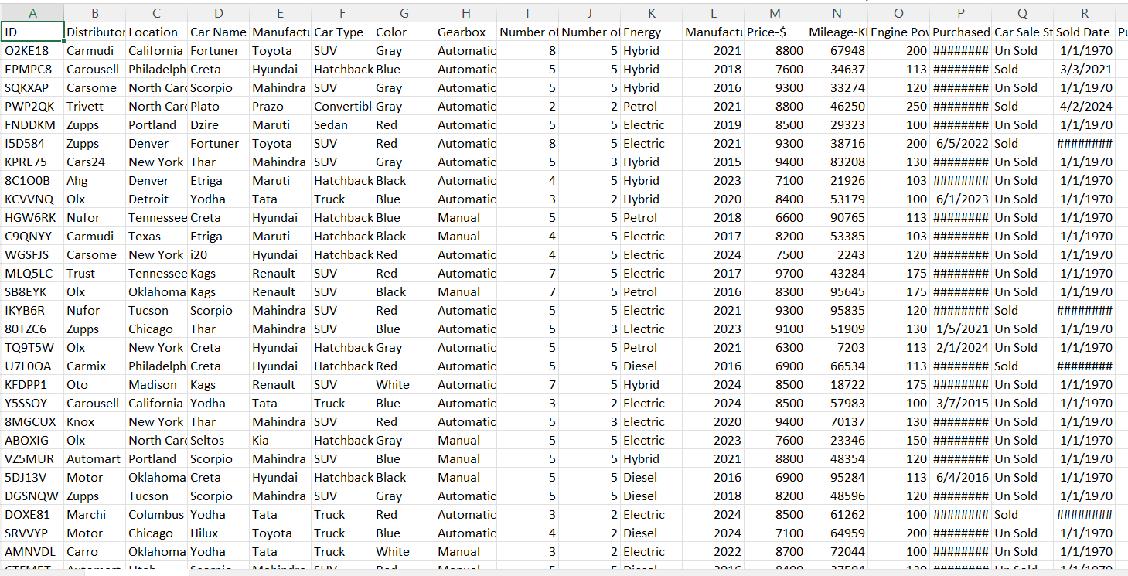
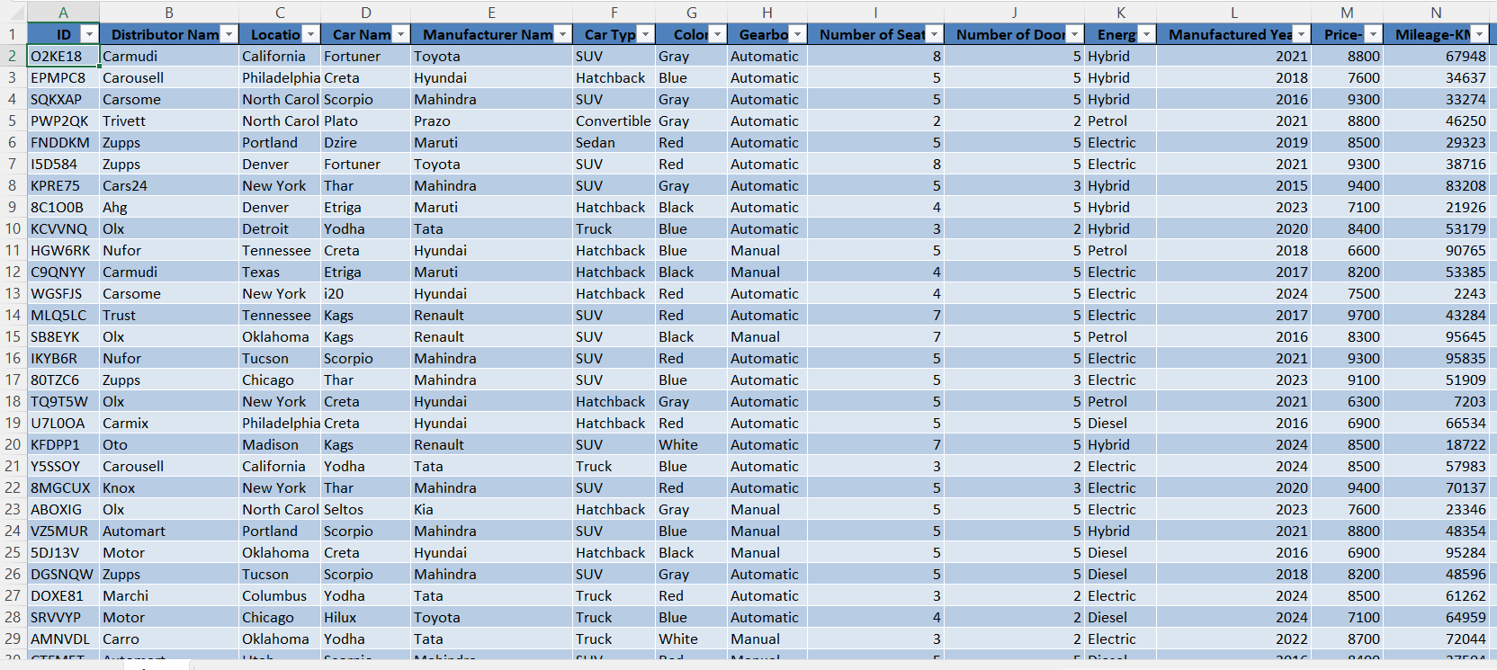
Data
cleaning

Slide 5
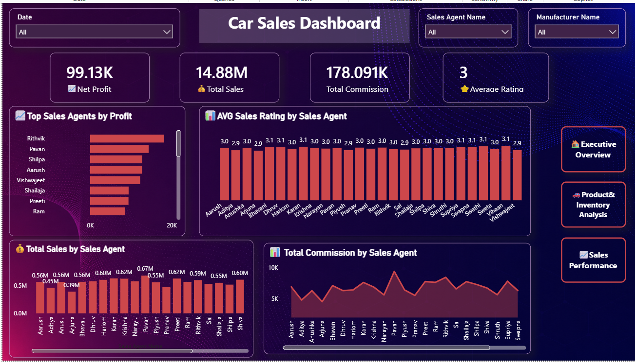
dashboard

Slide 6
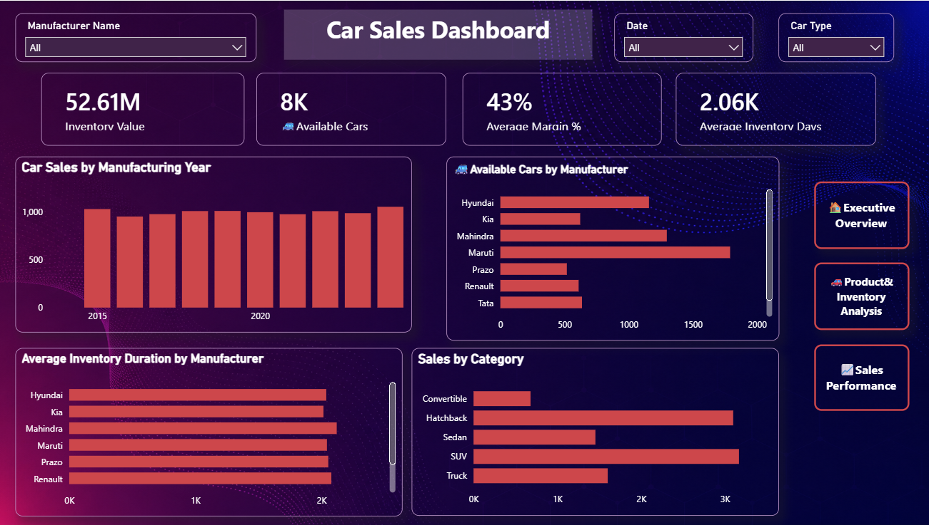
dashboard

Slide 7
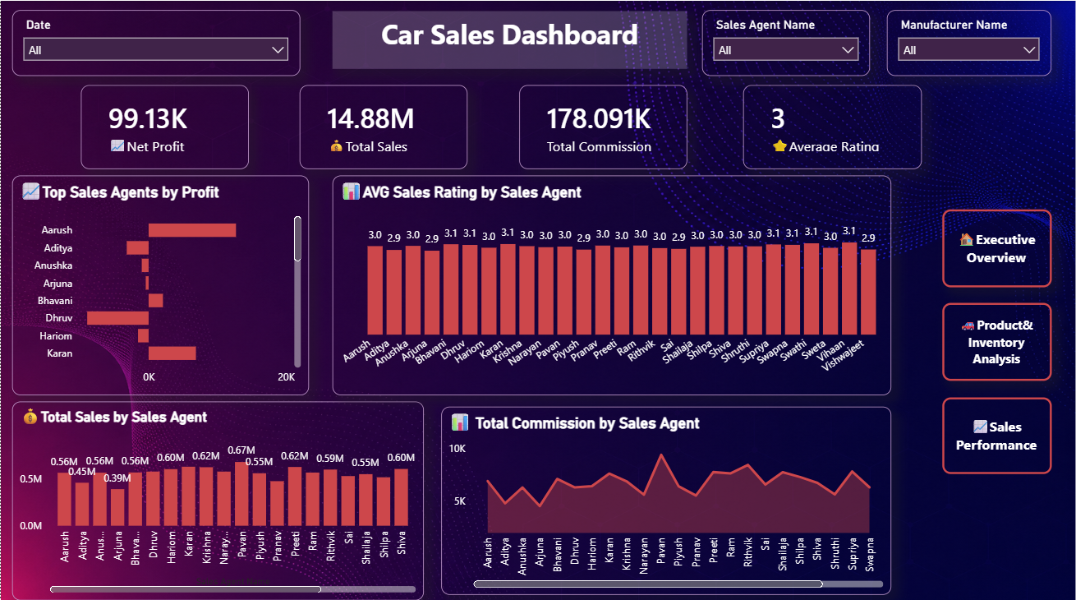
dashboard

Slide 8
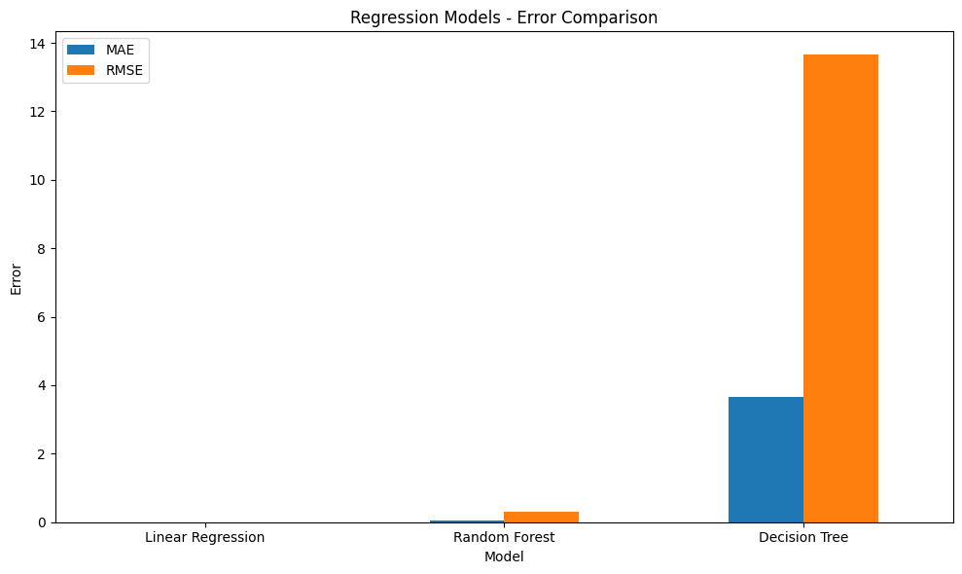
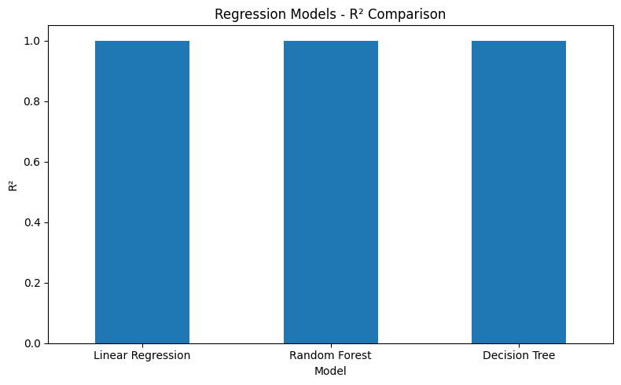
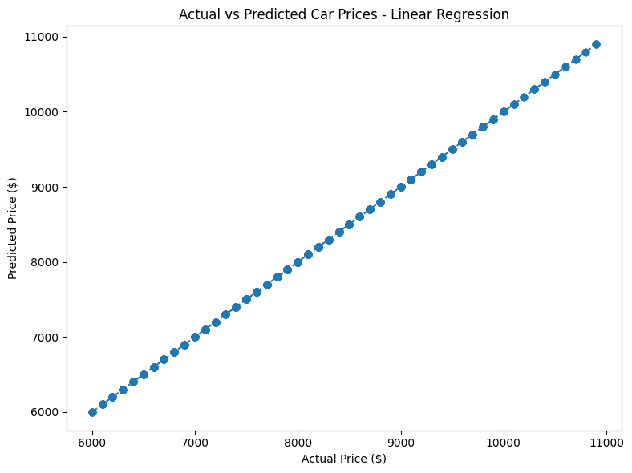
Machine learning

Slide 9
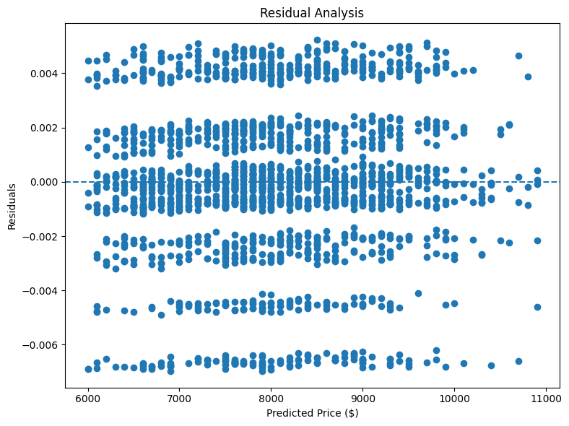
Machine learning

Slide 10
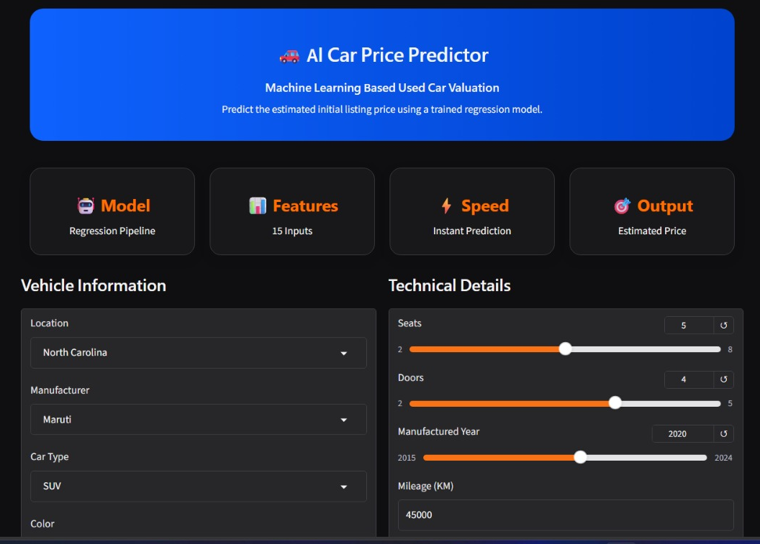
Deployment using gradio

Slide 11
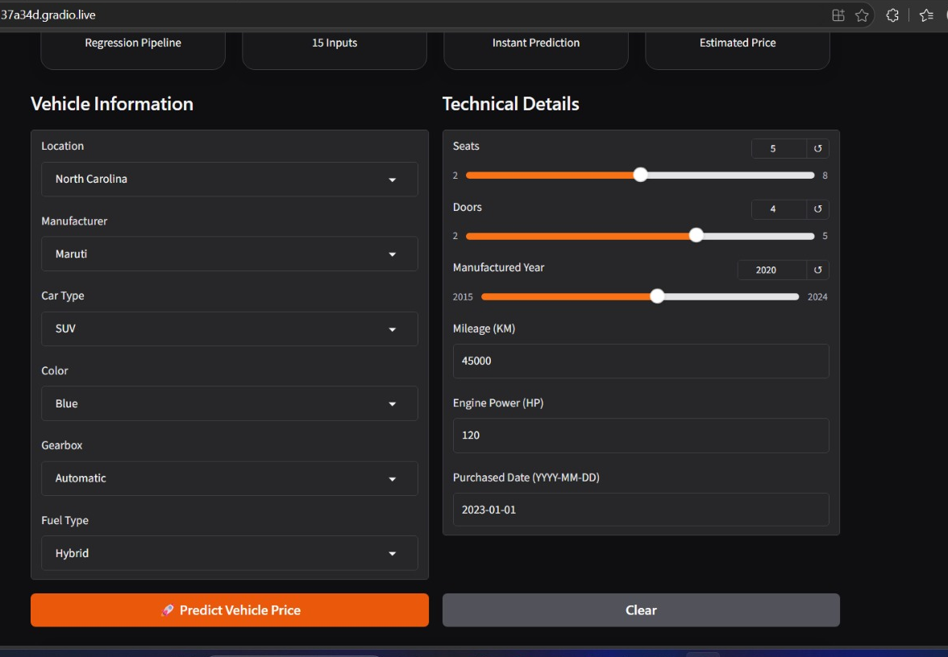
Deployment using gradio

Slide 12
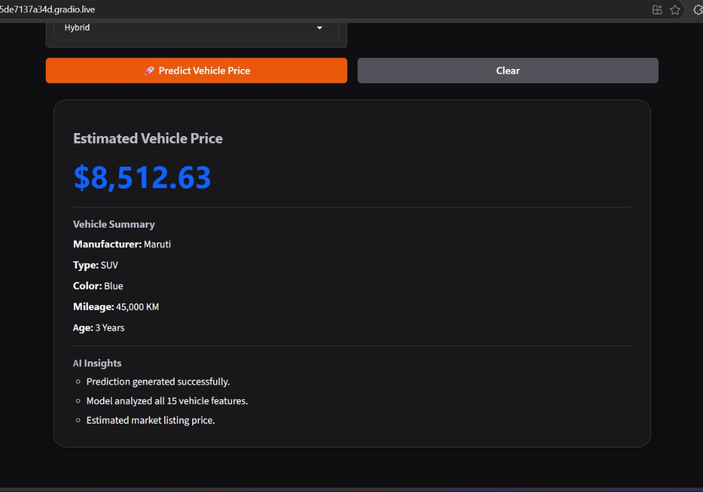
Deployment using gradio

Slide 13
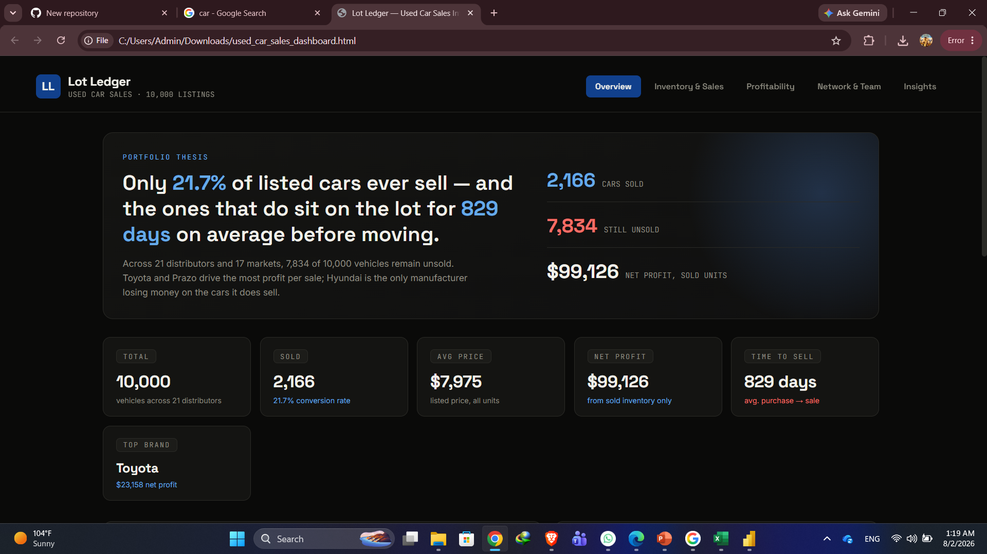
Bonus dashboard with html

Slide 14
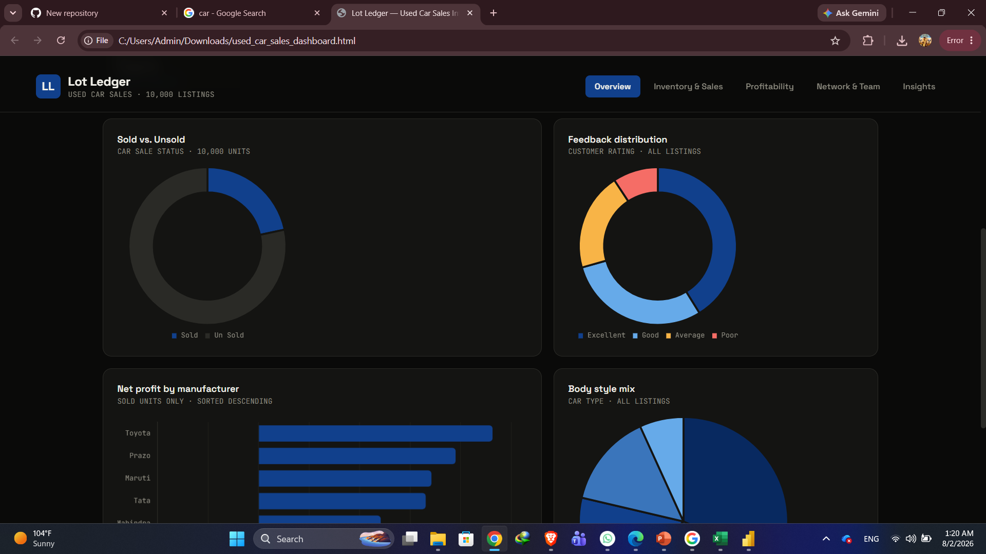
Bonus dashboard with html

Slide 15
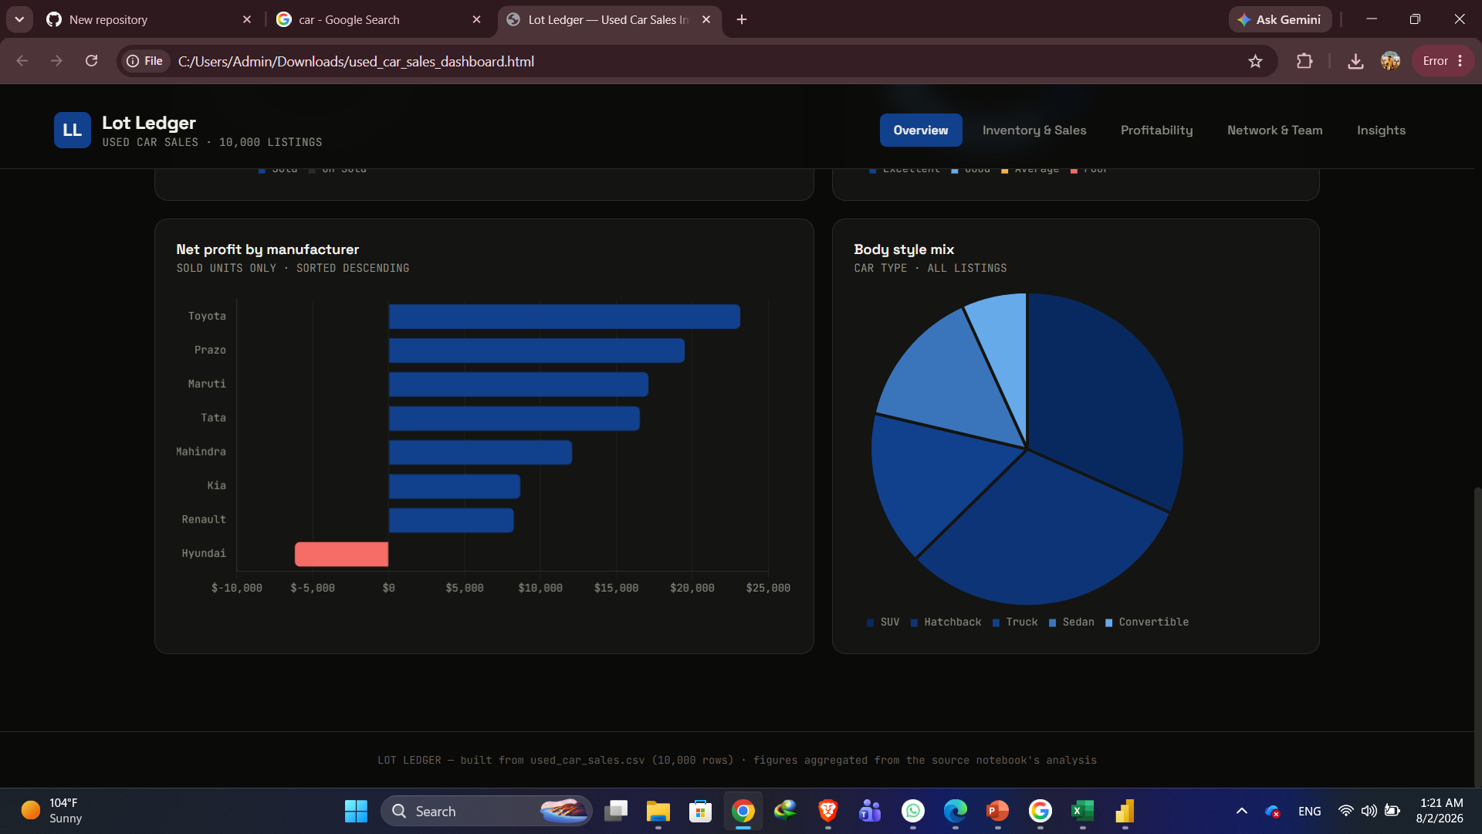
Bonus dashboard with html

Slide 16
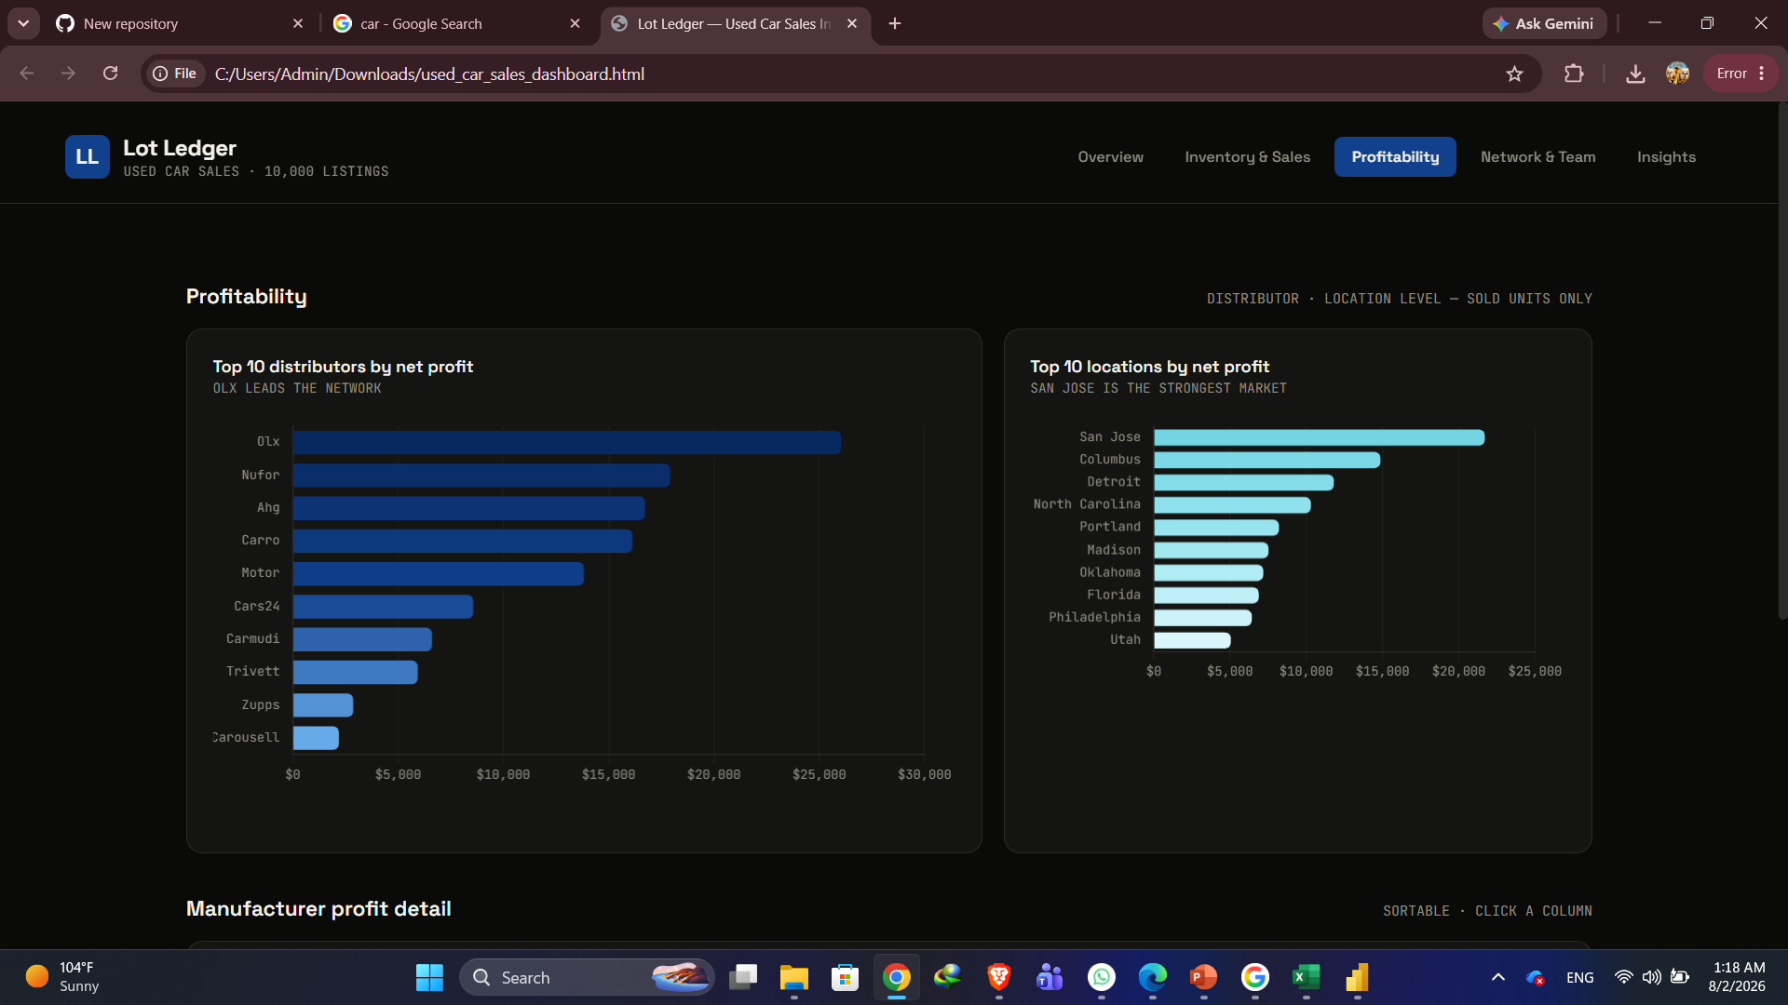
Bonus dashboard with html

Slide 17
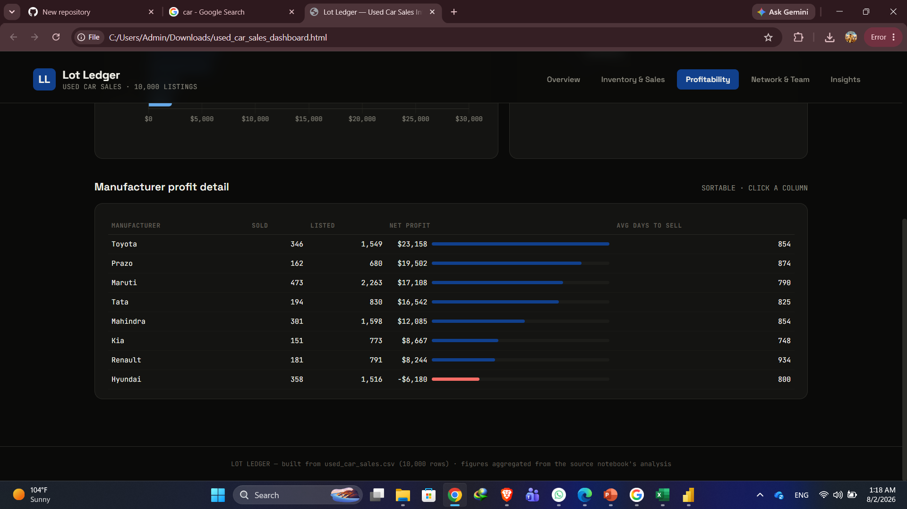
Bonus dashboard with html

