Slide 1
NORTHWIND Project#1 Presentation

Slide 2
Introduction:
Group-A
Syed Ali Rehan
Muhammad Ahmed
Rana Sheraz Shafi
Muhammad Umair Arif

Slide 3
About: NorthWind Sample Dataset
Wholesale Distribution Company (B2B) working since 04-07-1996.
Providing to 93 Businesses over 21 countries with wide array of products under 8 different categories. From Beverages to Seafood.

Slide 4
EDA: Exploratory Data Analysis
Categories --→8
Customers --→93
Employees --→9
Orderdetails --→2155?
Orders --→830
Products --→77 Discontinued --→8
Regions --→4
Shippers --→3
Suppliers --→29
Territories --→53

Slide 5
Business Metrics Analyzed In This PROJECT:
Product Performance Ranking
Customer Segmentation based on RFM Analysis
Churn and Retention Rate Calculation
Critical Inventory Status
Employee’s Performance
Shipper’s Performance

Slide 6

Product Performance Ranking:
BUSINESS METRIC: Top Selling Products (That brings the max revenue)
Importance:
Revenue Generation.
Strategic Decision Making.
Inventory Management.
Marketing and Promotions.
WHY UNIQUE CUSTOMERS: We aim to identify unique customers
for high-sales products to strategically retain and engage them
through effective marketing and decision-making.

Slide 7
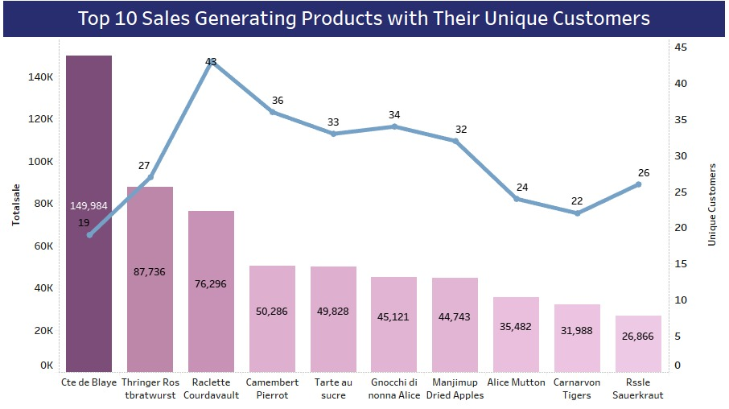

Slide 8
Top 5 Products Sales Comparison Metrics:
Price
Average order value
Total Units sold
Amount of orders

Slide 9
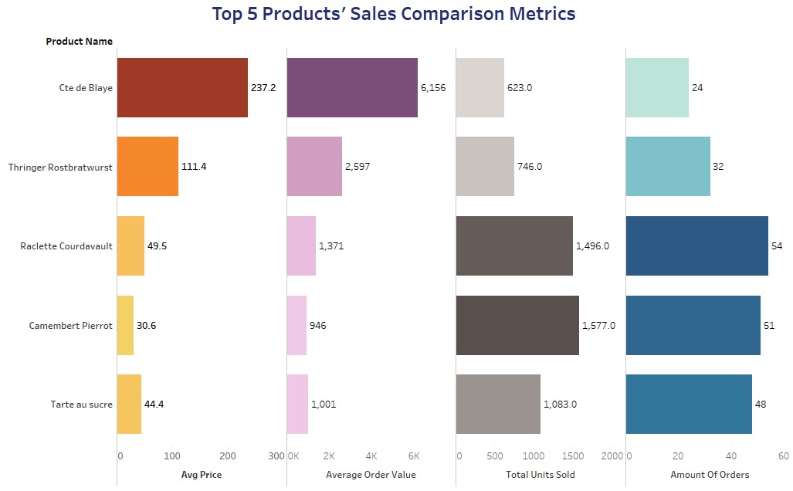

Slide 10
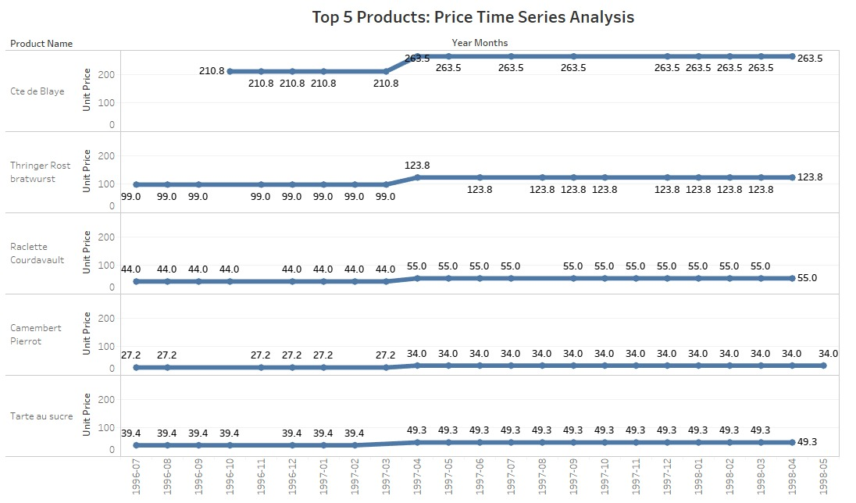

Slide 11
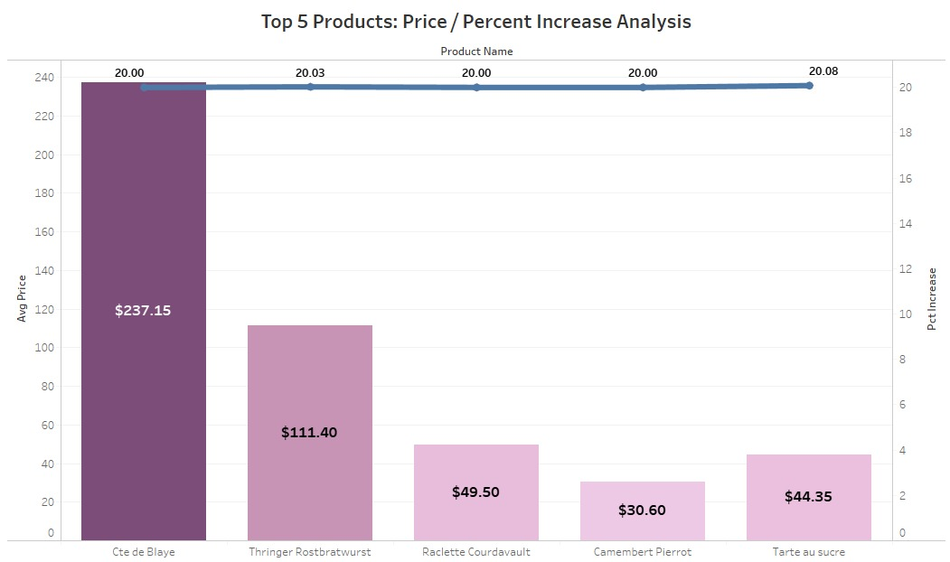

Slide 12
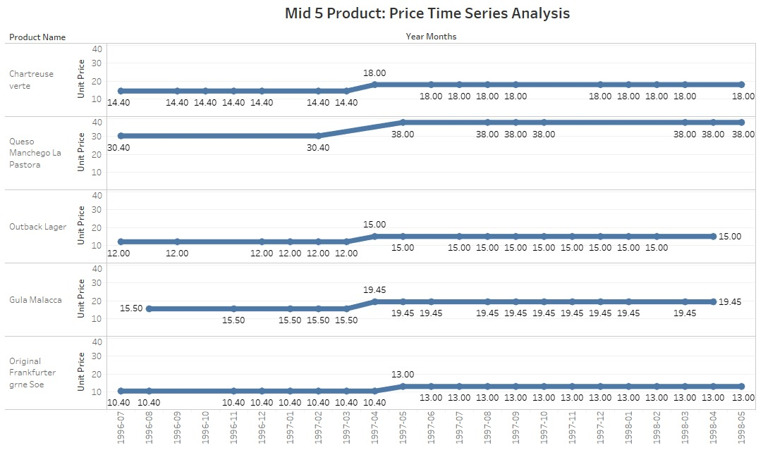

Slide 13
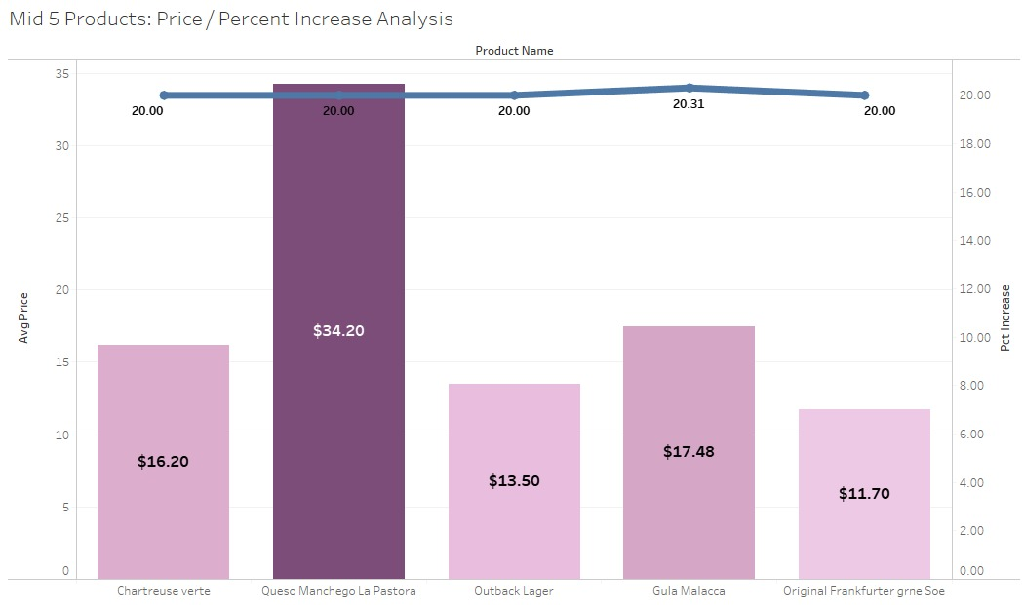

Slide 14
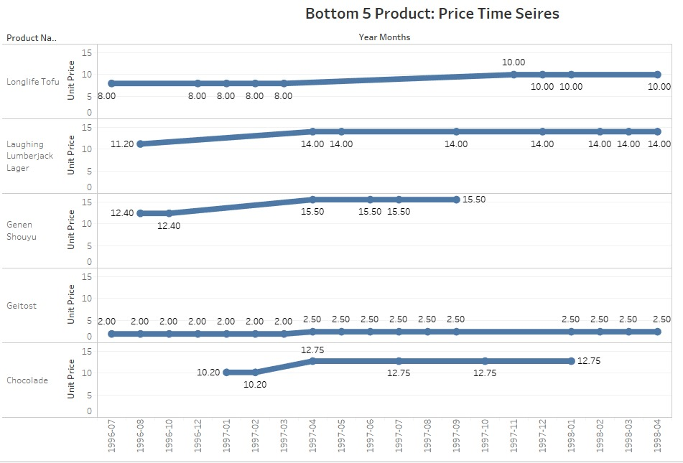

Slide 15
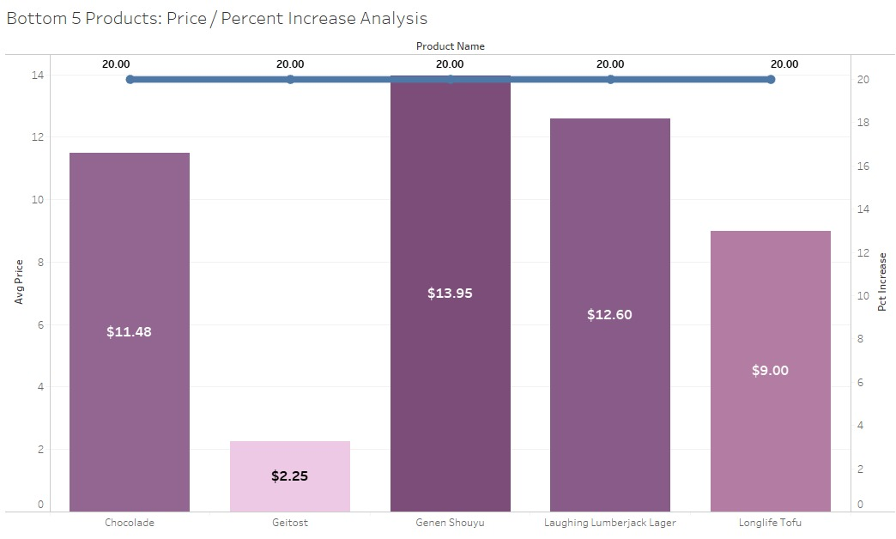

Slide 16
Proposed Solutions and Expected Outcomes
Since highest sales generating products have less unique customers as compared to others.
So we must Focus on retaining such customers.
For that we should do Customer Segmentation.

Slide 17

RFM Customer Segmentation:
Definition: RFM customer segmentation is a method of categorizing customers based on three key factors:
Recency (how recently a customer made a purchase) last
Frequency (how often a customer makes purchases)
Monetary (how much money a customer has spent).

Slide 18
S.no | Customer Segments | Segment Descriptions | R | F | M
1. | Champions | High-Value, Active Customers | 5 | 5 | 5
2. | Loyal Customers | Consistent, Valuable Buyers | 2-3 | 3-4 | 4-5
3. | Best Spenders | High-Value, Infrequent Shoppers | 3 | 2-3 | 5
4. | Potential Loyalists | Promising, Engagement Opportunity | 2-3 | 2-3 | 3
5. | Need Attention | Declining, Active Customers | 2 | 2 | 3
6. | About to Sleep | Inactive, Possible Revival | 1 | 1-2 | 1-4
7. | At Risk | Churning, Engagement Needed | 1 | 1-2 | 1-3
8. | Lost Customers | Inactive, Hard to Reclaim | 1 | 1 | 1

Slide 19
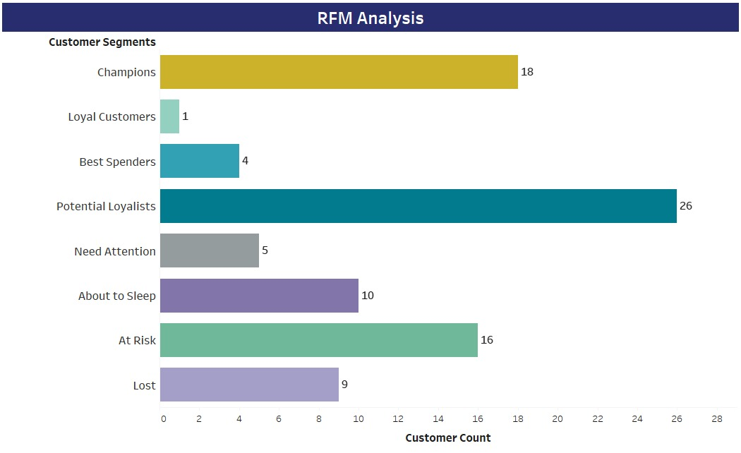

Slide 20
RFM Average by Segments:
RFM averages by segments refer to the calculated average values of Recency, Frequency, and Monetary metrics within each customer segment created through RFM segmentation.
It provides insights into the typical behavior of customers in each segment.

Slide 21
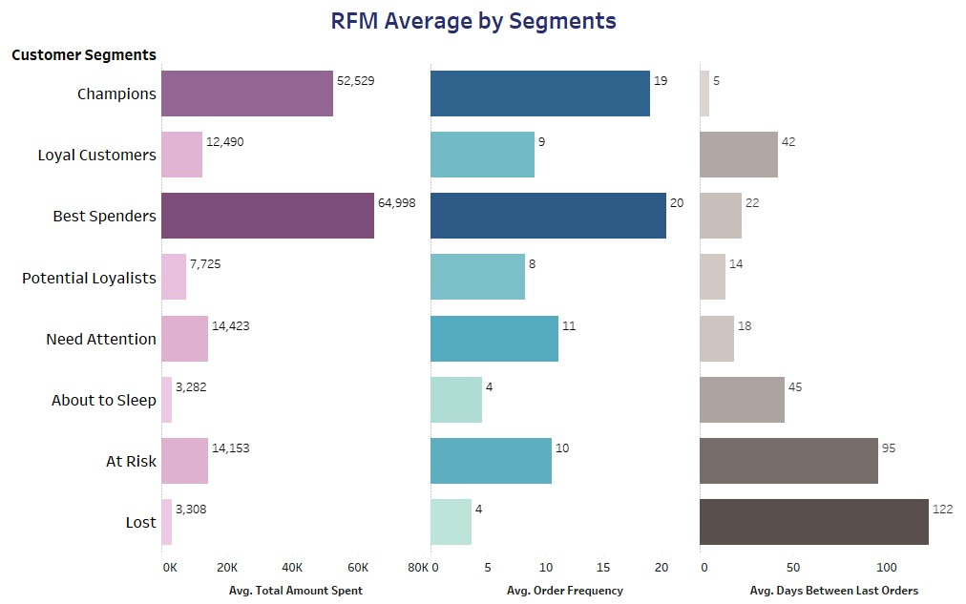

Slide 22
Proposed Solutions and Expected Outcomes
This segmentation helps in identifying and targeting customers with similar buying behaviors.
Improving these metrics can boost revenue, as satisfied customers tend to spend more and remain loyal.

Slide 23
Churn, Retention Analysis:
Churn rate is the percentage of customers who have stopped using a product or service over a given period.
retention rate is the percentage of customers who continue to use it.
CHURN RATE
CUSTOMERS LOST
TOTAL
CUSTOMERS

Slide 24
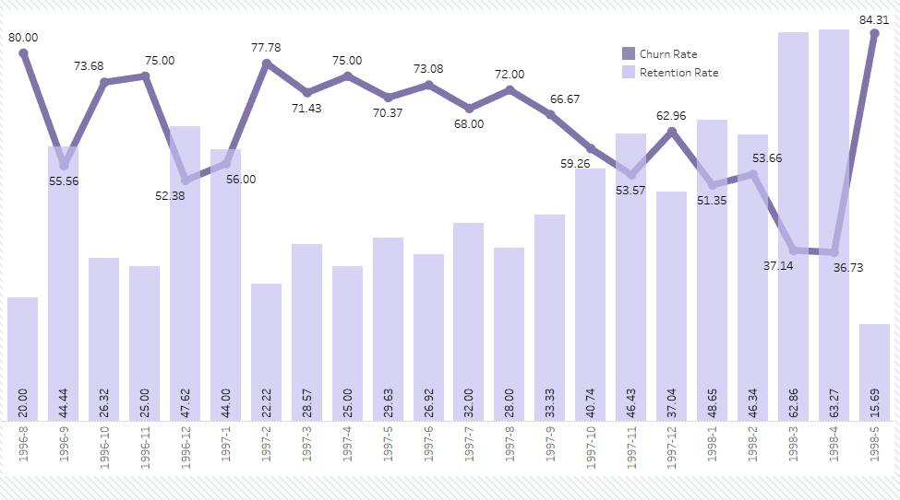

Slide 25
Proposed Solutions and Expected Outcomes
Provide excellent customer service and address issues promptly.
Lower churn reduces the need for acquiring new customers and, consequently, decreases CAC, leading to cost savings and improved profitability.

Slide 26

Critical Inventory Status:
Critical inventory status involves monitoring and managing inventory levels of products.
This includes tracking the number of :
Units in stock.
Average units sold.
Reorder levels.
to ensure product availability and prevent stockouts.

Slide 27
Categorization Basis:
Units In Stocks < Monthly Average Sales = CRITICAL
Products with Reorder Level = 0 : Must be assigned with Reorder Levels based on their monthly average sales
Products that have inventory Over Stocked must be optimized
Products that have balanced inventory as compared to their average sales No need to optimize
Products that have Units in stocks almost near to there Monthly Average have Potential of being Out of Stock

Slide 28
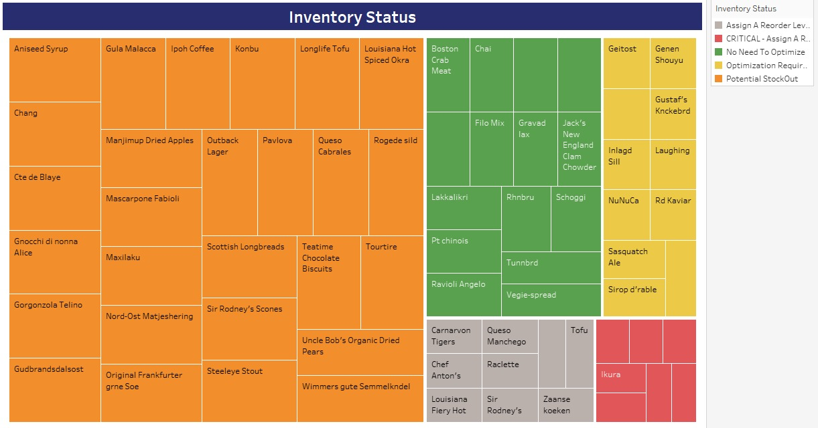

Slide 29
Proposed Solutions and Expected Outcomes:
We can Improve inventory management by employing demand forecasting and real-time tracking of our products.
That will reduce costs, minimizes overstocking, and ensures product availability, leading to improved customer satisfaction and profitability.

Slide 30

Employee Performance:
Employee performance metrics helps in ranking employees.
It offers data-driven insights for informed decision-making and improvement.
It fosters accountability, enhance engagement, and drive business success.

Slide 31
Ranking Measures:
Monthly Average Sales
Monthly Average Orders
Number of Customers served.

Slide 32
Monthly Average Sales: MAS
MAS = Total Sales / Number of Months
MAS
TOTAL SALES
EMPLOYEE TENURE

Slide 33
Monthly Average Order (MAO):
MAO = Total Orders / Number of Months measures
MAO
TOTAL ORDERS
EMPLOYEE TENURE

Slide 34

No. Of Customers Served by Employee
Number Of Customers: Customers served by employee is a metric that quantifies the number of customers or clients served or assisted by individual employees.

Slide 35
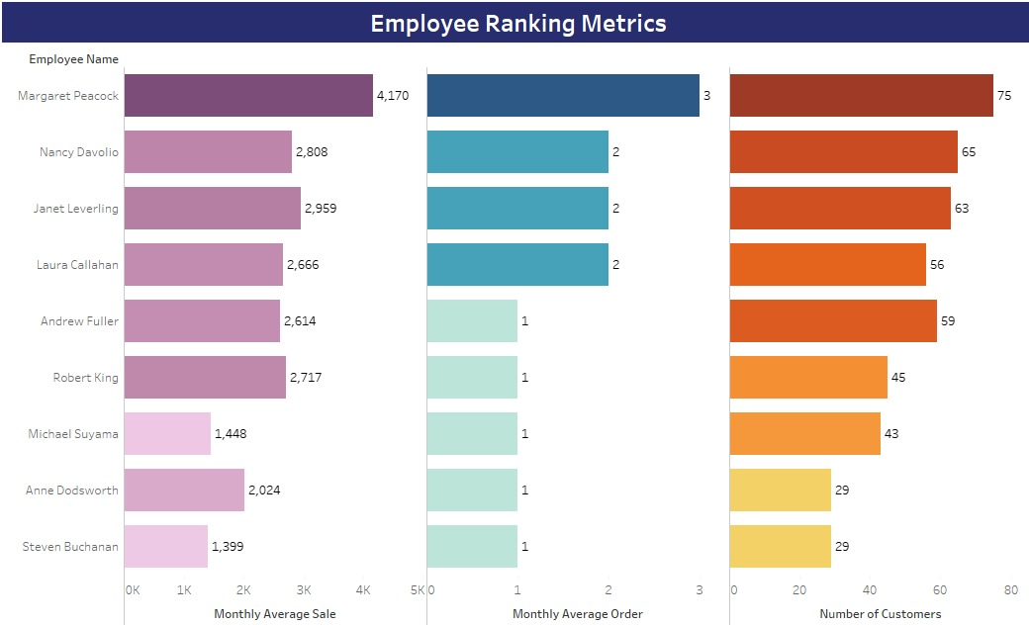

Slide 36
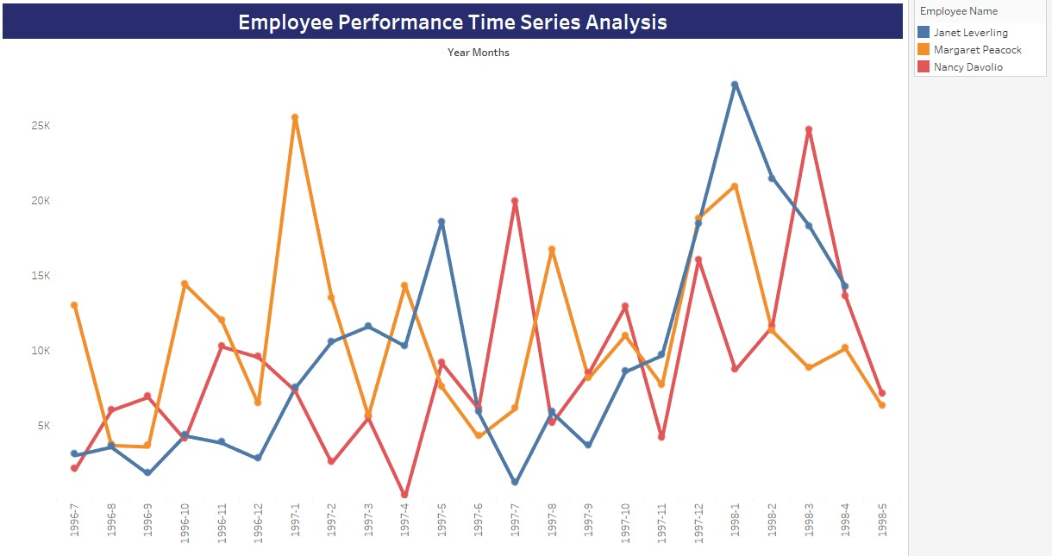

Slide 37
Proposed Solutions and Expected Outcomes:
Motivate and enhance employee performance by implementing performance-based incentives, setting clear goals, and fostering a collaborative work culture.
High-performing employees can significantly boost company revenue, and incentivizing them further encourages consistent excellence and drives profitability.

Slide 38

Shipping Performance:
On-Time Delivery Rate measures the percentage of shipments that are delivered according to their scheduled delivery date.
Average Freight Cost how much each shipment company charges on average.

Slide 39
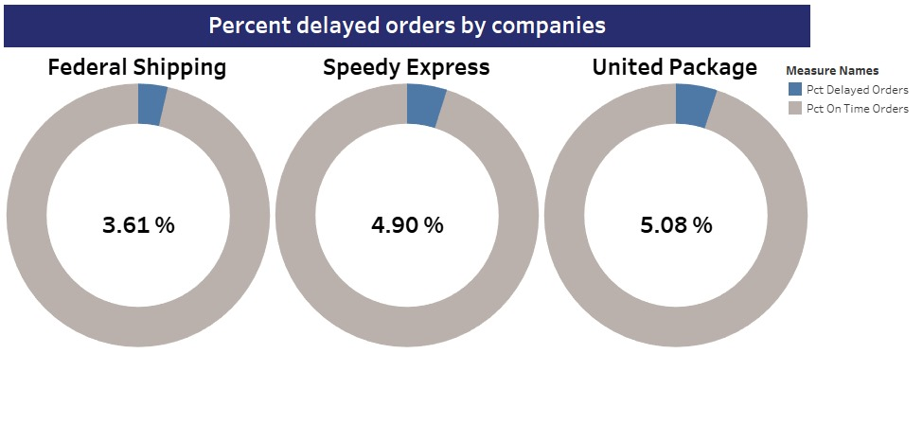

Slide 40
Proposed Solutions and Expected Outcomes
Suggestion:
Enhance route optimization,
Real-time tracking
Efficient warehouse operations to minimize delays.
Improving on-time delivery rate boosts customer satisfaction, loyalty, and trust, leading to increased repeat business and positive word-of-mouth.

Slide 41
Thank You

