Slide 1









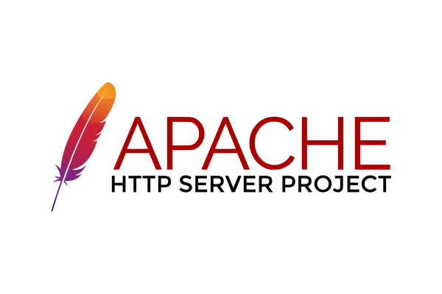
PROJECT
OVERVIEW
push
key components:
  User Management using Bash scripts
  Service Automation
  Notifications sent upon pipeline execution.
  Services: Apache, Grafana, Jenkins, Gogs, Mail Transfer Agent, Ansible, Docker.
send
Trigger
build
playbook

Slide 2
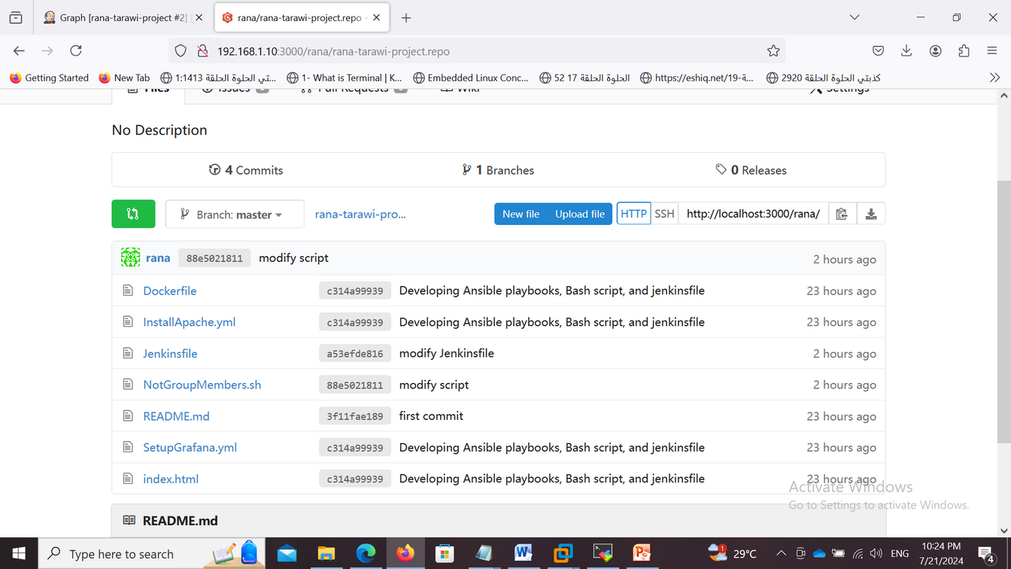
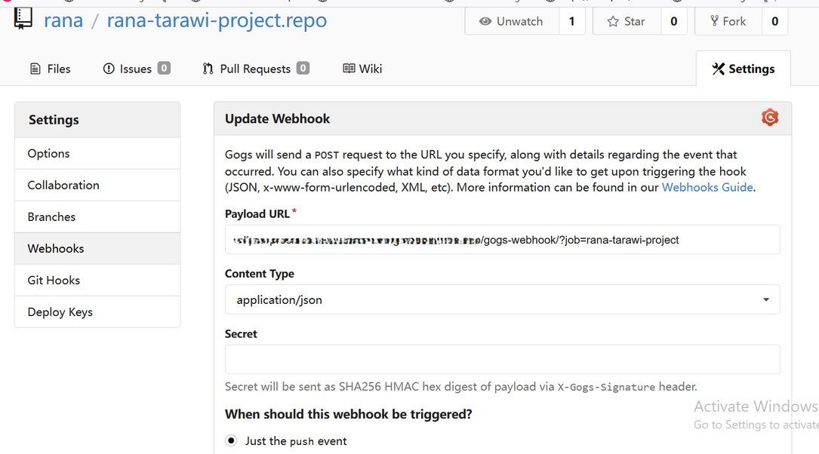
GOGS
SERVER
  Deploy Gogs on a VM to manage Git repositories.
  Create Repo and access token
Set Up Webhook in Gogs:
  Provide Jenkins URL and specify the trigger event

Slide 3
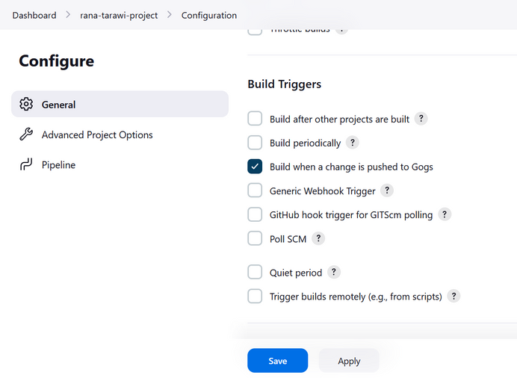
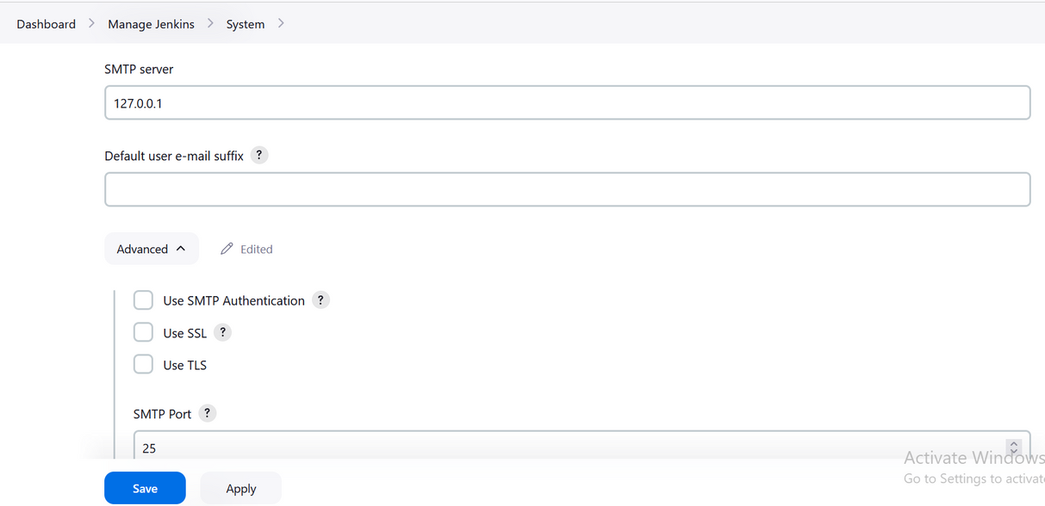
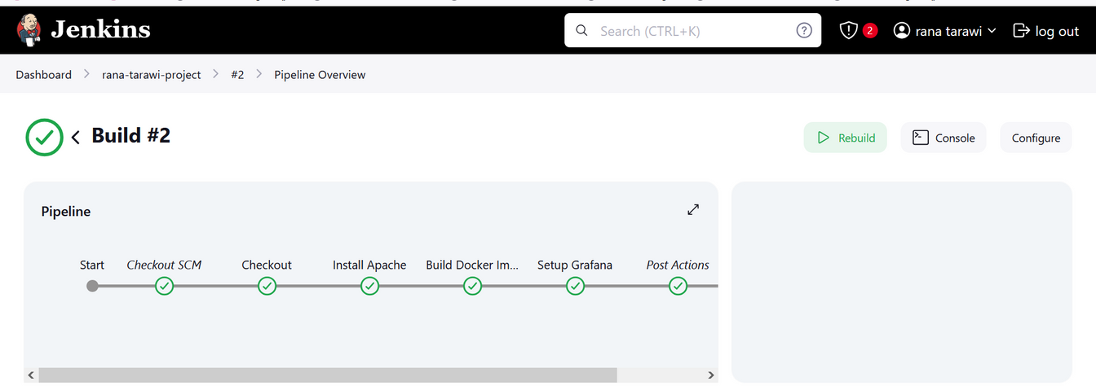
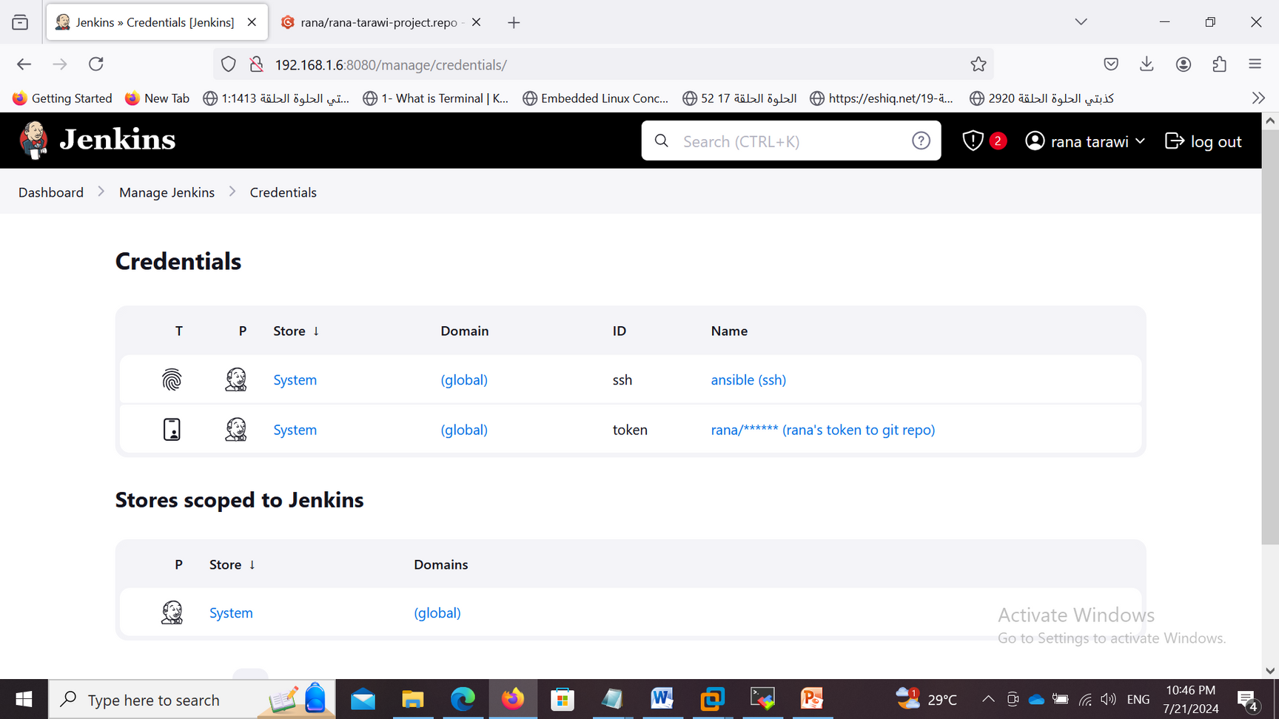
JENKINS
PIPELINE
  defines the stages of your Jenkins pipeline
  configure Build Triggers section
  configure in the E-mail Notification section
  ADD necessary credentials

Slide 4

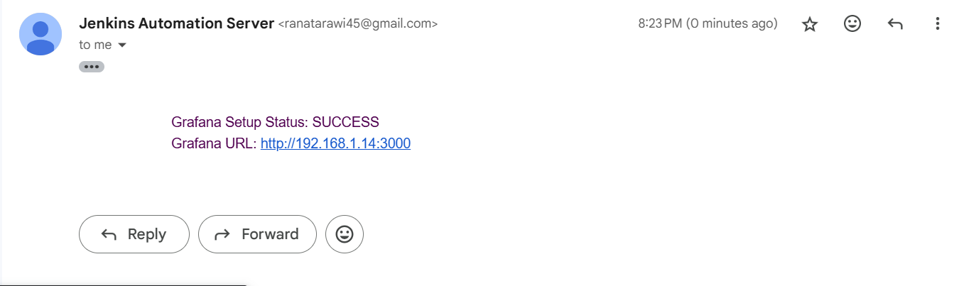
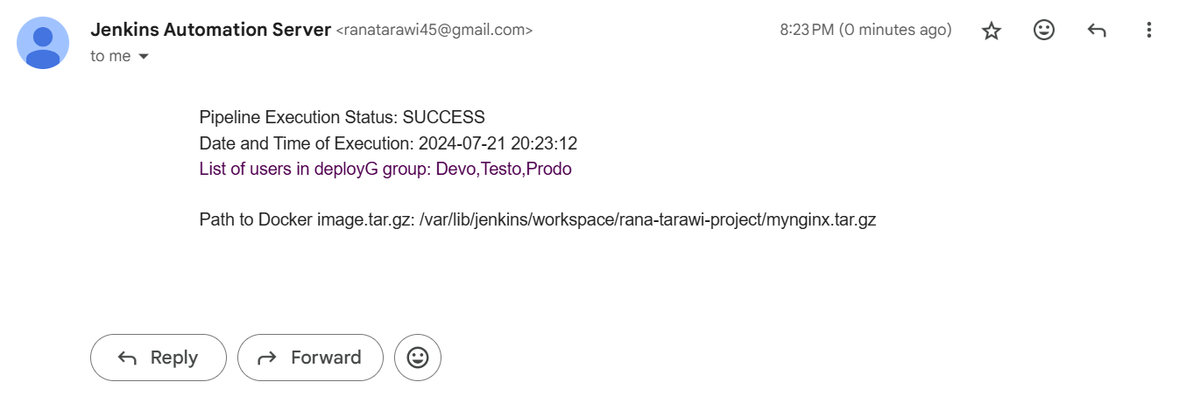
EMAIL
NOTIFICATIONS
  Install Postfix and S-nail
  Set Up Gmail Authentication
  Configure Postfix to use Gmail’s SMTP server for sending emails.
  Configure Jenkins to use local MTA

Slide 5
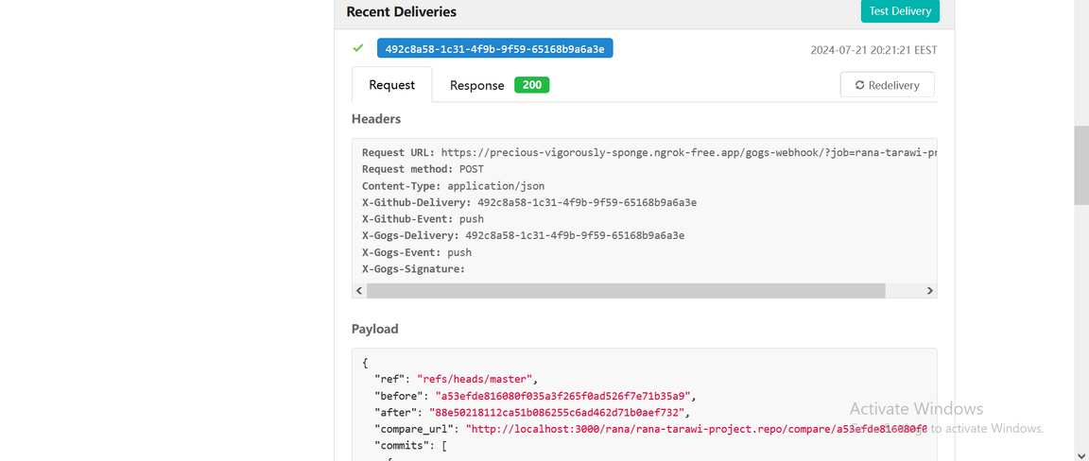
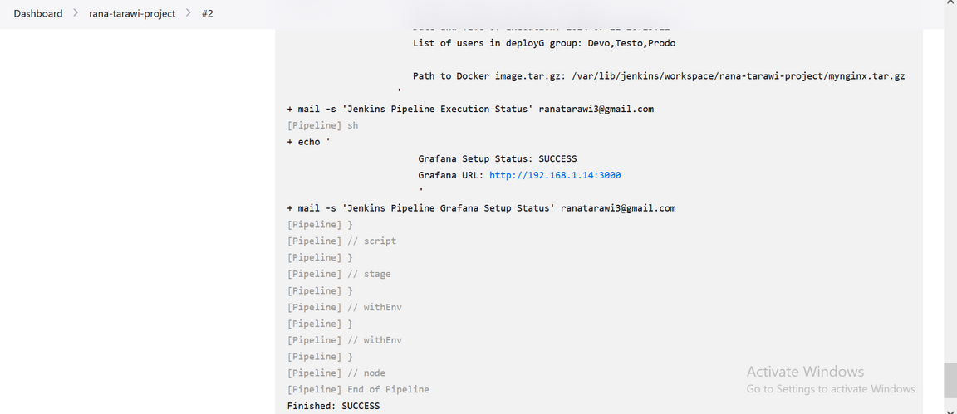
TRIGGER
PIPELINE

Slide 6
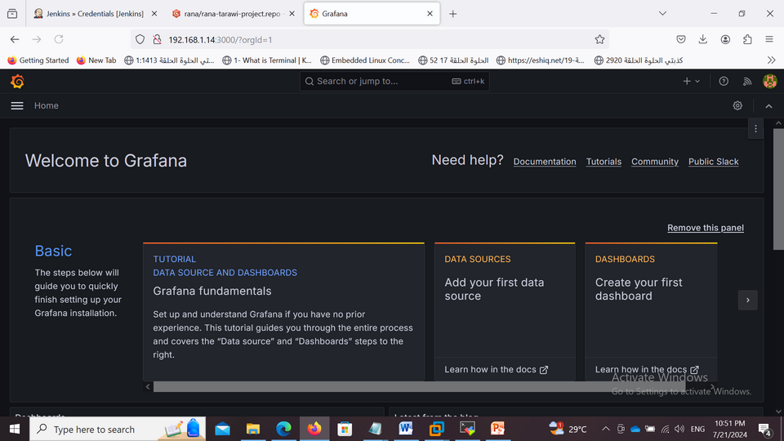
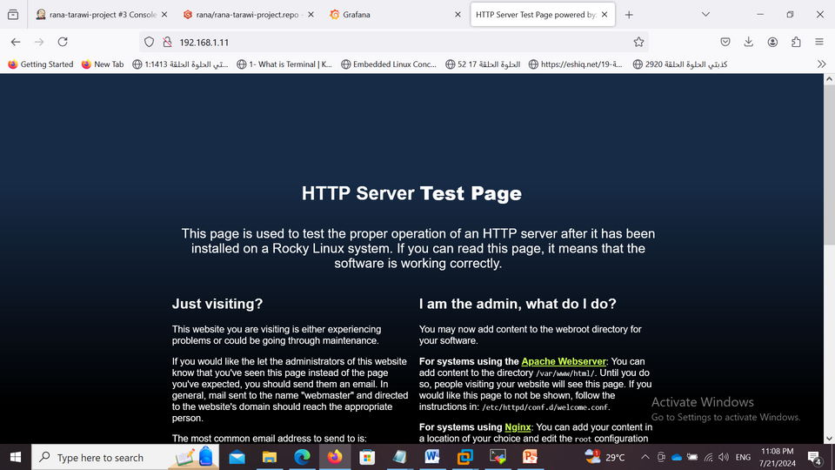
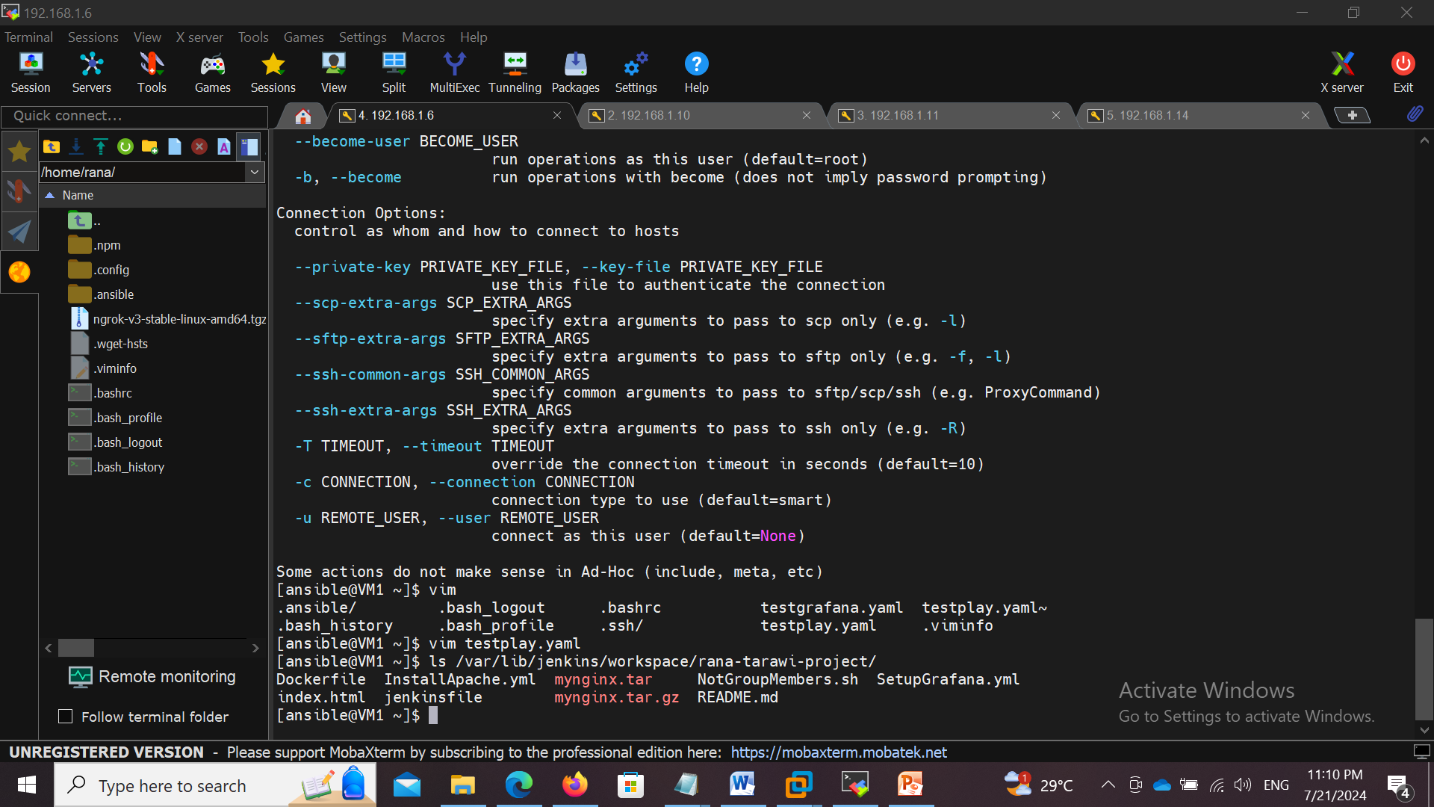
CONTINUE...

