Slide 1
ALU Design and Verfication

Slide 2
Agenda
Introduction
Design
Verificaton
Demo

Slide 3
1.
Introducion

Slide 4

Brief Reminder
a_en
b_en
a_op
b_op
Arithmetic logic unit as the following signals:
clk, rst, alu_esn, a_en, b_en: input signals (1 bit).
a_op: input signals (3 bits).
b_op: input signals (2 bits).
A , B: input signals (5 bits).
C: output signals (6 bits).
ALU
A
C
B
clk
rst
alu_en
a_en = 1
a_op
b_en =0
a_en = 0
a_en = 1
b_op
Set 1
b_op
Set 2
b_en =1
b_en =1

Slide 5
A and B operations
A operations
B operations
Set 1
Set 2
b_op | operation
0 | ~ (A & B)
1 | A + B
2 | A + B
3 | NULL
a_op | operation
0 | A + B
1 | A - B
2 | A ^ B
3 | A & B
4 | A & B
5 | A || B
6 | ~ (A ^ B)
7 | NULL
0 | A ^ B
1 | ~ (A ^ B)
2 | A - 1
3 | B + 2

Slide 6
2.
Design

Slide 7
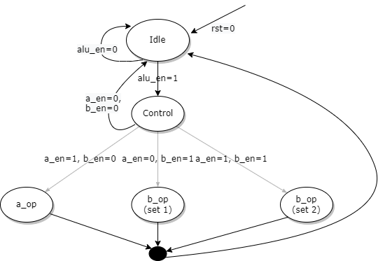
FSM diagram
Control the a_op, and b_op states by case statements.

Slide 8
Add and substraction
Add
If the 2 numbers have the same sign, add the first 4 bits and shift the sign.
If the 2 numbers have different signs, take the 1’complement of the second argument and add “1” to the first argument and complemented second argument. The sign is the sign of the bigger argument.
Subtraction
The same operation as add but change the sign of the second argument.
Add example
Add(1,3) = 4
Add(1,-3) = -2
0 | 0 | 0 | 0 | 1
0 | 0 | 0 | 1 | 1
0 | 0 | 0 | 0 | 1
0 | 0 | 0 | 1 | 0 | 0
1 | 0 | 0 | 1 | 1
1 | 0 | 0 | 0 | 1 | 0

Slide 9
3.
Verification

Slide 10
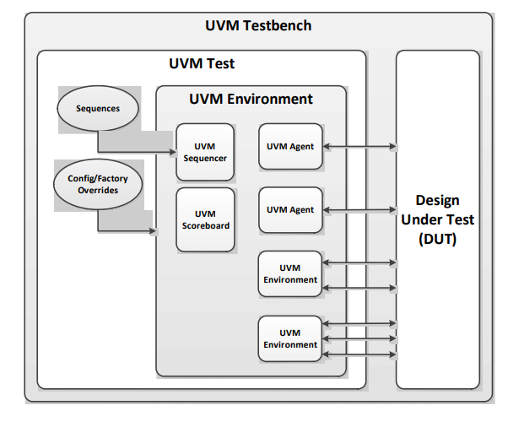
UVM Methodology
Testbench
Test
Environment
Coverage collector
Scoreboard
Agent
Monitor
Driver
Sequencer

Slide 11
Traceability matrix
 | clk | rst_n | alu_en | a_en | b_en | a_op | b_op | A | B | C
Test 0 | 0 | X | X | X | X | X | X | X | X | 0
Test 1 | positive edge | 0 | X | X | X | X | X | X | X | 0
Test 2 | positive edge | 1 | 0 | X | X | X | X | X | X | 0
Test 3 | positive edge | 1 | 1 | 0 | 0 | Valid input | Valid input | Valid input | Valid input | Valid output
Test 4 | positive edge | 1 | 1 | 0 | 1 | Valid input | Valid input | Valid input | Valid input | Valid output
Test 5 | positive edge | 1 | 1 | 1 | 0 | Valid input | Valid input | Valid input | Valid input | Valid output
Test 6 | positive edge | 1 | 1 | 1 | 1 | X | X | X | X | 0

Slide 12
Constraint and DPI
a_op can not be 7
If a_en is 0, and b_en is 1, then b_op can not be 3.
Usage of the C code as reference code to test the design.

Slide 13
Coverage
Exclude a_op = 7 at coverage
Exclude b_op = 3 @ a_en = 0, and b_en = 1
Simulation tool is Synopsys VCS 2020., and UVM version is 1.2
Compile options: -timescale=1ns/1ns +vcs+flush+all +warn=all -sverilog -sverilog test.cc -covg_enable_cross_queue
95.03% coverage achieved.

