Slide 1


Slide 2


Music Recommendation System
Pre-Final Year Progress Presentation
Submitted by
ROLL | NAME
2201730085 | Maanav Aditya Sinha
2201730093 | Tannu Rana
2201730097 | Muskaan Jain
2301731117 | Sachin Kumar
Industry Mentor:
Faculty Mentor:
Notes:
New Courses replaced with New Programmes

Slide 3

Project Overview
This project is designed to develop a personalized music recommendation system that combines custom-built dataset with the power of the Spotify API to deliver highly tailored album of the selected artist. The system focuses on recommending song albums, based on user’s mood and taste through selected genre. Also , predicting the most likable artists by users based on their system inputs.
Here, prediction will be based on limited static data because real time data (dynamic data ) will require deep learning and natural language processing which is the part of evolution done by data scientist.
Notes:
New Courses replaced with New Programmes

Slide 4
Specific Objectives
AIM- Creating a frontend to collect user specified data and storing it into our database(relational). Also , the database contains the preferred artist and albums that has been fetched from Spotify Api. Album is the final display when the user is engaged onto the frontend.
TASKS
Creating frontend using HTML, JavaScript and CSS.
Creating Database (relational dataset with preferred attributes)
Connecting flask to frontend to classify data that is to be displayed through frontend.
Fetching data(Artists and Albums) from Spotify API to our database.
Connecting finalized database which already contains data fetched from the API and displayed on frontend through flask to the frontend again so that users’ preferences could be stored and hence predicted.
Notes:
New Courses replaced with New Programmes

Slide 5
Key Features
Custom Database Creation: The system utilizes a database that has been designed and built specifically for this project.
Data Compression to Meet Specific Requirements:
Data compression ensures that the recommendation model remains scalable, fast, and resource-efficient.
New Application with Existing API Integration: The system uses Spotify's API to access track details and album metadata, which forms the foundation for generating personalized recommendations.
Notes:
New Courses replaced with New Programmes

Slide 6
Project Usecases & Scope
This project seeks to create a dynamic and personalized music recommendation system that enhances user engagement by offering mood-based album suggestions and predicting artists that users will likely enjoy, all based on their unique listening patterns and preferences.
By combining the power of custom data management with the Spotify API, the system will provide an enriched and highly personalized music discovery experience for each user.
Notes:
New Courses replaced with New Programmes

Slide 7
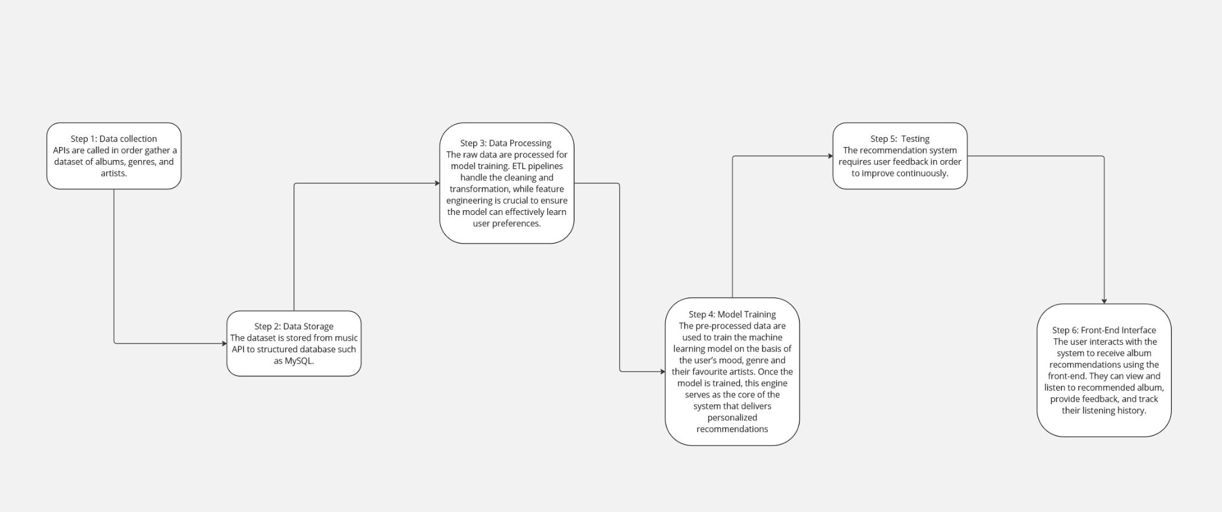
Project Flow diagram
Notes:
New Courses replaced with New Programmes

Slide 8
Resources Used
To achieve the goal of this project, Spotify API, Python, Mysql, Html, CSS and Javascript were used for following purposes:
Spotify API was used to get information about the albums of artists.
HTML , CSS and JavaScript were used designing the Frontend, where HTML provides a basic structure for the frontend and CSS provides formatting.
Mysql was the software used to store data in the database from the frontend.
Python was used to fetch data from Mysql and transferring it to the excel file.
Notes:
New Courses replaced with New Programmes

Slide 9
Resources Used
In Python, following libraries were used:
Json: A data-interchange format which is easy to read and write. Here, this library was used to store the data of the artists in dictionaries.
Flask: A Python web framework which provide useful tools and features to create a web application. Here, it was used to include options for the parameters need to be stores for the front end.
MySql-Connector-Python: A database connector for python which allow user to access Mysql database. Here, it was used to extract data from the database.
Spotipy: An API library for Spotify Web API written in Python. Here, it was used to extract the albums of the popular artists.
Notes:
New Courses replaced with New Programmes

Slide 10
Methodology
The database for the music recommendation system consists of following tables:
user_table: This table stores information about users and their preferred artists through the front end.
mood_table: This Table stores the different mood that could influence the user’s music preference. Following mood were considered:
“Happy & Uplifting"
"Sad & Melancholic"
"Motivated & Empowering"
"Relaxed & Chill"
"Romantic"
Notes:
New Courses replaced with New Programmes

Slide 11
Methodology
genre_table: This tables stores genres and the mood associated with it which shows a relation between the genre and mood.
artist_table: Artists and their associated genres are stored in this table.
album_table: Artists and their albums are stored in this table.
user_genre_table: This table displays the user and their preferred genres. A user can prefer many genres and a genre is preferred by many users, establishing a many-to-many relationship between the user and genres.
Notes:
New Courses replaced with New Programmes

Slide 12
Methodology
user_mood_table: This table displays the user and their preferred mood. A user can prefer a genre on the basis of more than one mood and a mood of the genre is preferred by many users, Thus establishing a many-to-many relationship between the user and their mood.
prediction_model_table: This table tracks recommended artists for each user based on predictions.
Notes:
New Courses replaced with New Programmes

Slide 13
Methodology
user_table
user_id int Primary Key username varchar artist_id int Foreign Key
Mood_table
mood_id int Primary Key mood_name varchar
genre_table
genre_id int Primary Key genre_name varchar mood_id int Foreign Key
artist_table
artist_id int Primary Key artist_name varchar genre_id int Foreign key
album_table
album_id int Primary Key album_name varchar artist_id int Foreign key
user_genre_table
user_id int Foreign Key genre_id int Foreign Key
user_mood_table
user_id int Foreign Key mood_id int Foreign Key
prediction_model_table
genre_id int Primary Key genre_name varchar mood_id int Foreign Key
Notes:
New Courses replaced with New Programmes

Slide 14
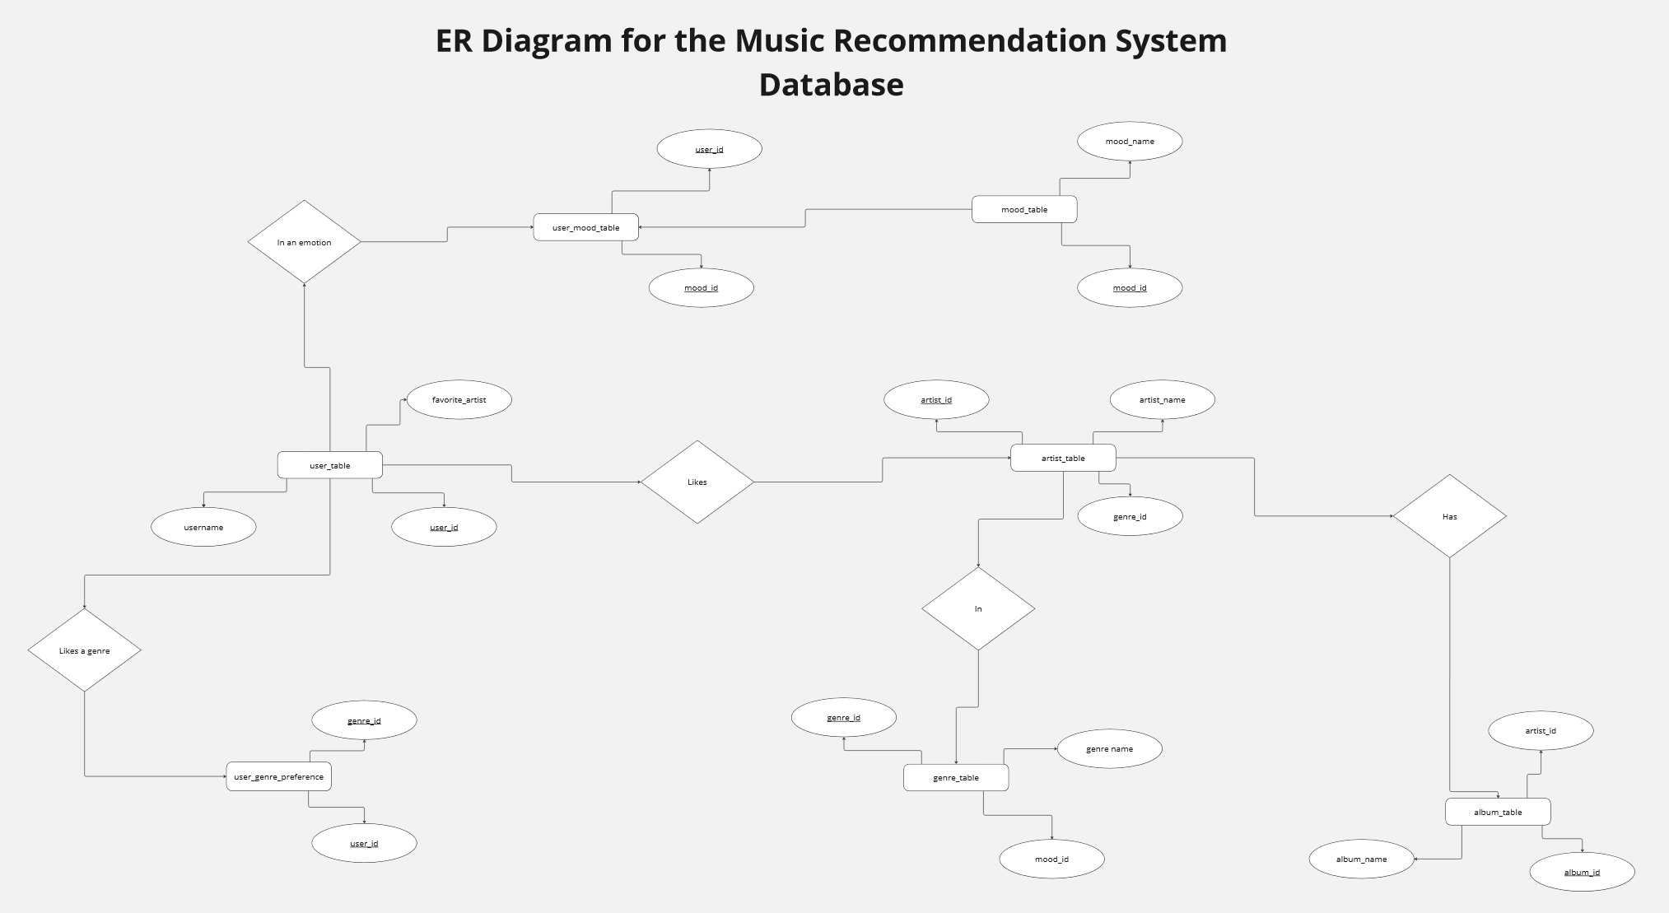
Database Architecture
Notes:
New Courses replaced with New Programmes

Slide 15
ACCESS THE SOURCE CODE BY CLICKING ON THE FOLLOWING LINK::
https://github.com/maanav69420/Music-Recommendation-System-Machine-Learning-Project.git
Presentation
Notes:
New Courses replaced with New Programmes

Slide 16
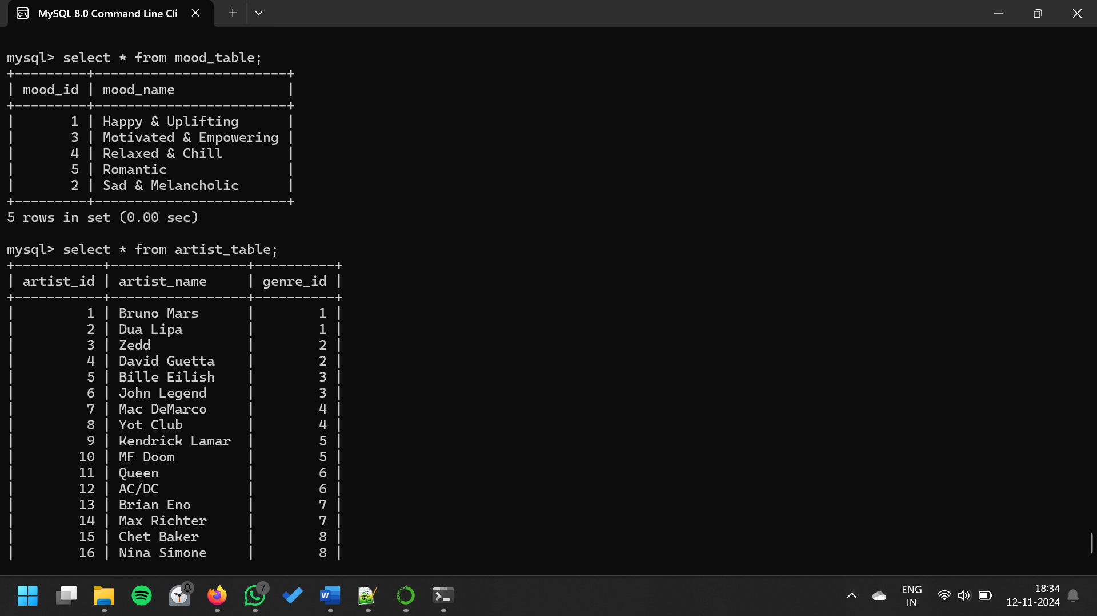
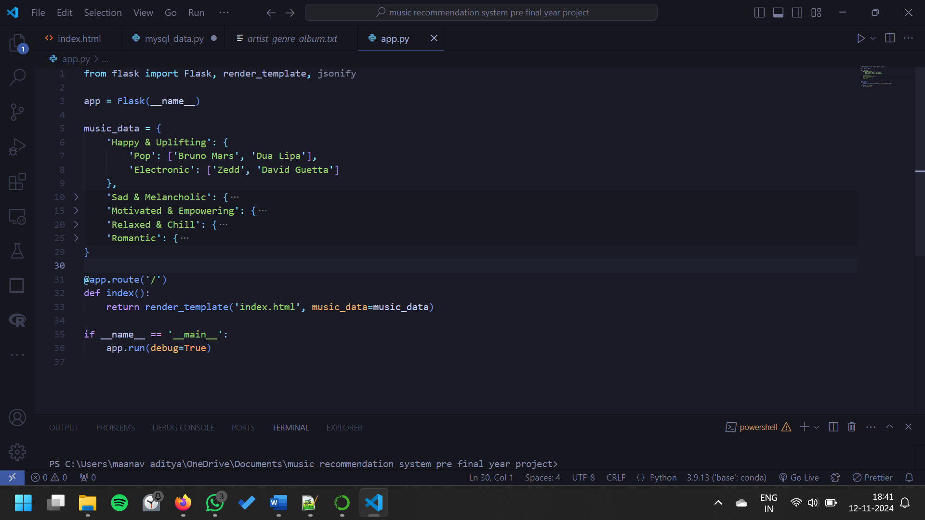
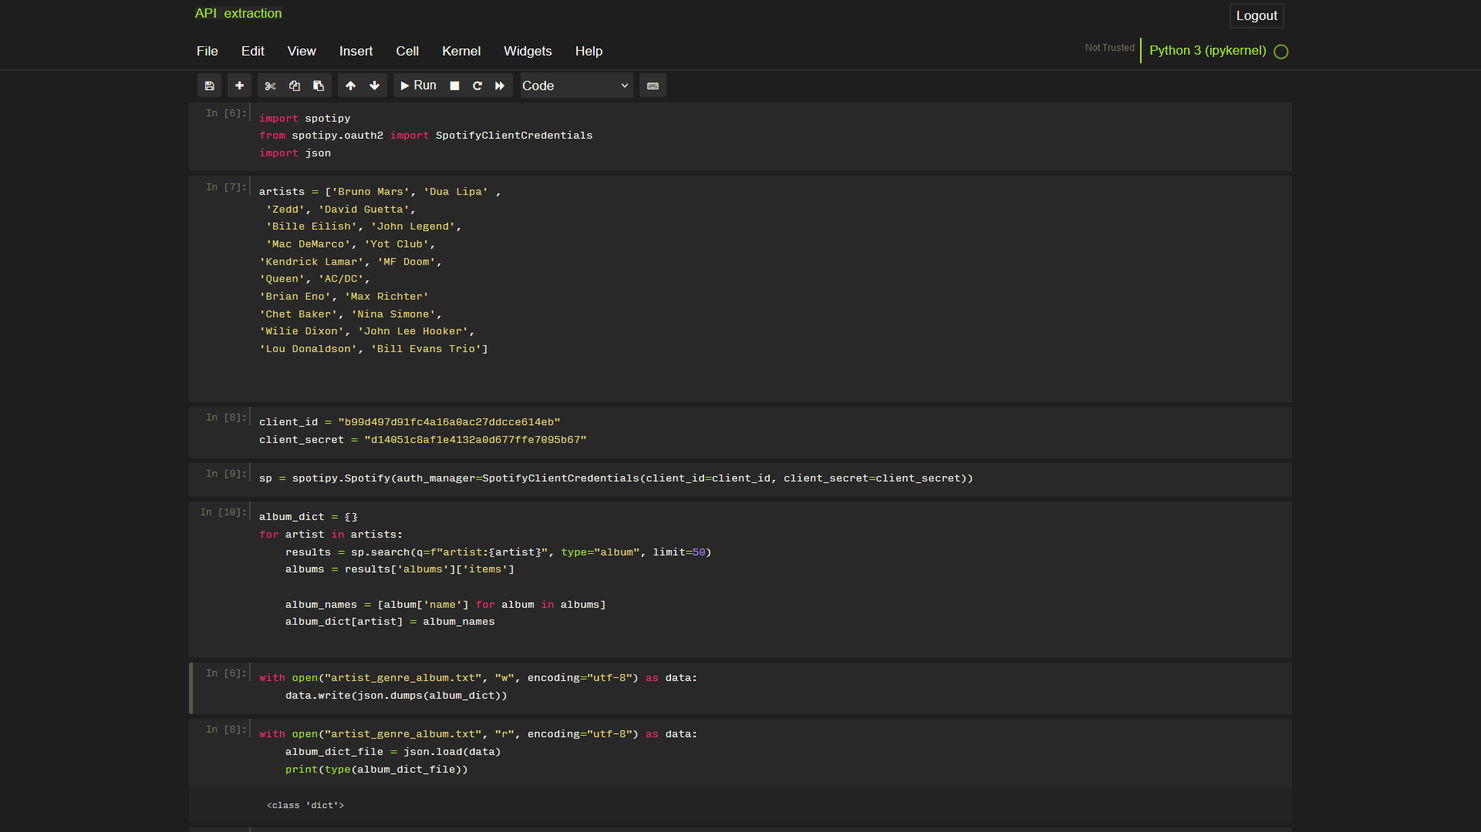
Screenshots of the progress
Extracted data stored in Mysql Database
Dictionaries to be displayed on front end
Album data extraction of artists using Spotify API
Notes:
New Courses replaced with New Programmes

Slide 17
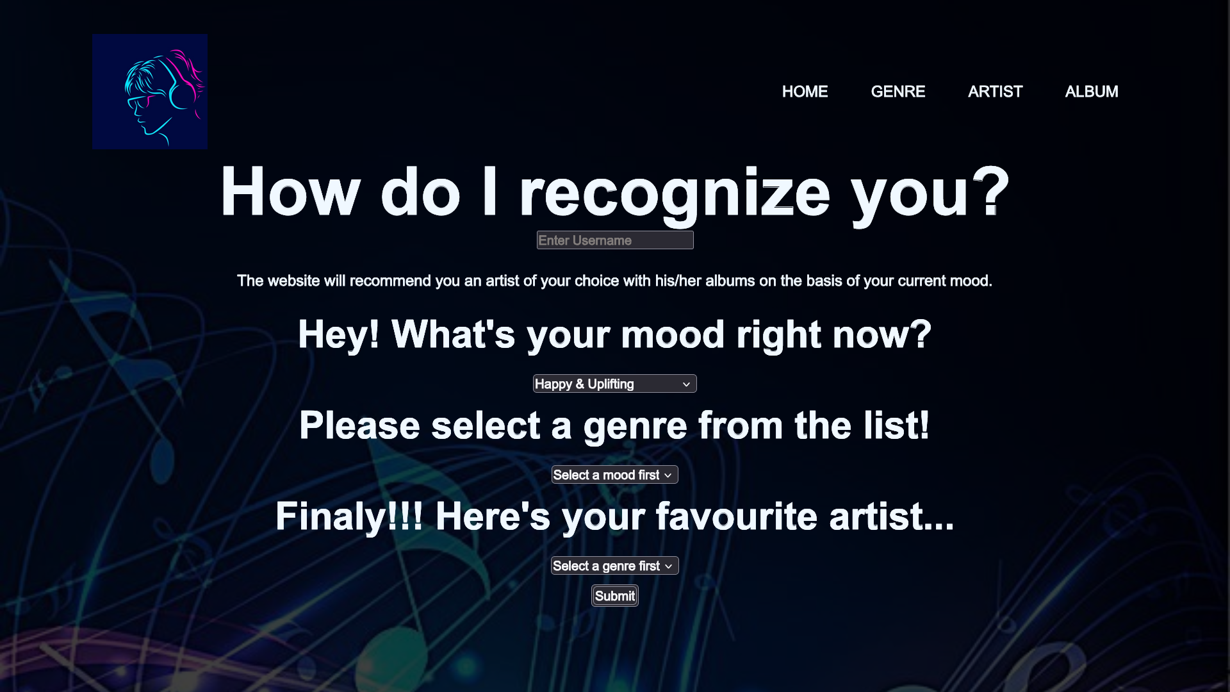
Screenshots of the progress
Front end using HTML and CSS
Notes:
New Courses replaced with New Programmes

Slide 18
Expected Results & Impact
This recommendation system will not only enhance the user's overall experience but also provide a more dynamic, personalized, and engaging way to interact with music platforms. By utilizing custom data strategies, predictive modeling, and API integration, the system aims to bridge the gap between the user's emotional state, their musical taste, and the vast catalog available on Spotify.
Notes:
New Courses replaced with New Programmes

Slide 19
Future Tasks:
Deploying the Frontend for Data Collection.
Conversion of MySQL Data into csv format.
Model Preparation.
Deploying the Prepared Model
Notes:
New Courses replaced with New Programmes

Slide 20
THANK YOU

