Slide 1
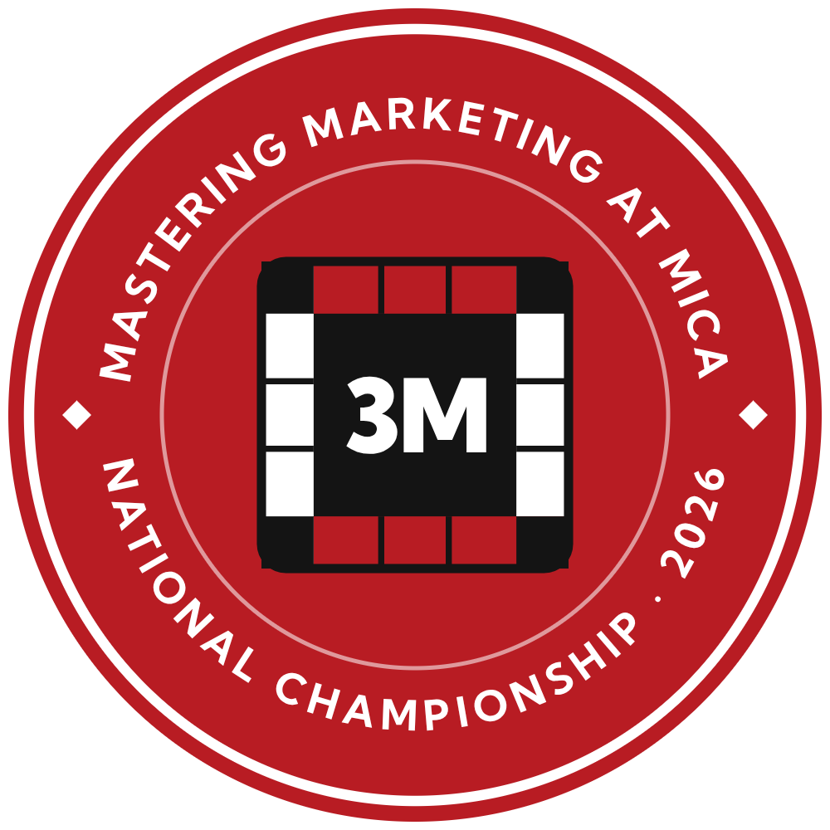


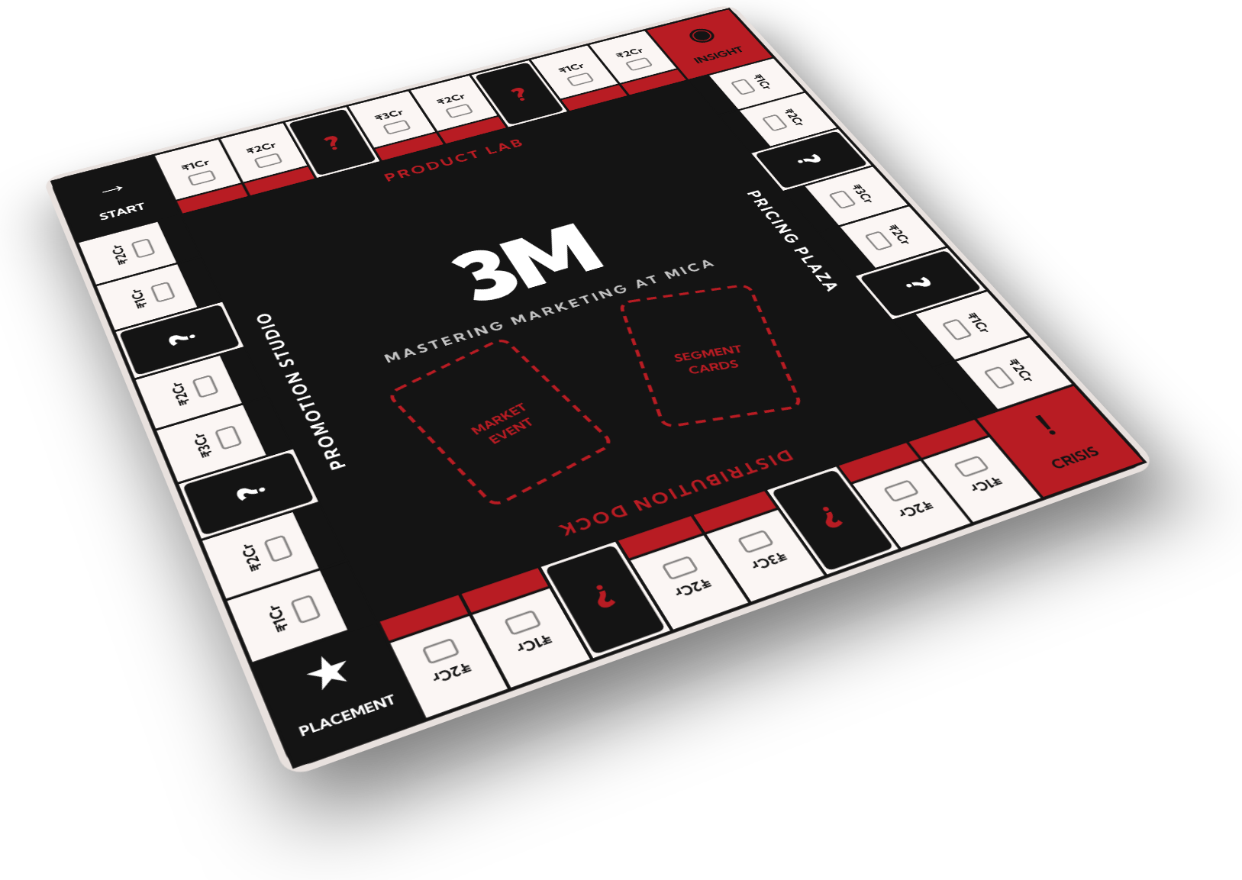

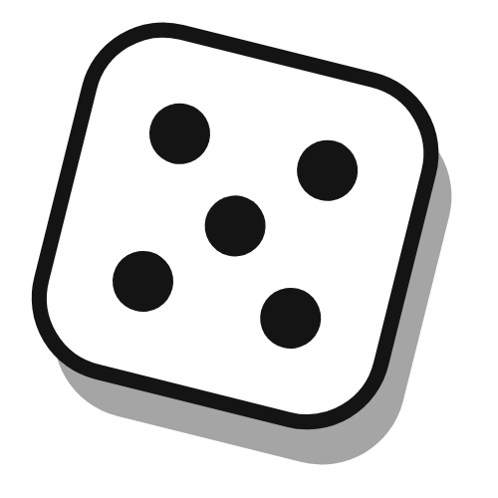
3M Championship 2026
Hosted by
MASTERING MARKETING AT MICA
THE CAMPAIGN RULEBOOK
NATIONAL BOARD GAME TOURNAMENT FOR BUSINESS STUDENTS
Think you can market?
Prove it on the board.
PLAY THE MARKET. WIN THE MARKET.
2–4
75
5
16
PLAYERS PER TABLE
MINUTES A GAME
CITY QUALIFIERS
FINALISTS · 1 CHAMPION
PLAYERS
GROUP [No.] · [Course name]
P1 [Group member name]
P4 [Group member name]
P2 [Group member name]
P5 [Group member name]
P3 [Group member name]
Faculty [Faculty name]
Student project for MICA coursework · The 3M game and tournament are fictitious
Notes:
TALKING POINTS
This is our campaign, written as the rulebook that comes in the 3M box. 3M: Mastering Marketing at MICA is a paid, offline national board game tournament for business students: 2 to 4 players per table, 75 minutes a game, qualifiers in 5 cities and 16 finalists at MICA. Big idea: "Think you can market? Prove it on the board." Tagline: Play the Market. Win the Market.
CANVA ANIMATION RECIPE (Animate panel, apply top to bottom)
- Page: Fade
- 3D game board: Pan (in from the right)
- Red and white pawns: Stomp
- Die: Tumble
- Headline: Typewriter
- Tagline pill + tagline: Pop
- Four box badges: Pop
- Players score pad (select the group): Rise
- Optional: red pawn with "Create an Animation" - drag it in a short hop onto the board's START corner.
Shortcut: Magic Animate applies a consistent style to the whole deck in one go.

Slide 2
3M CHAMPIONSHIP 2026 · THE CAMPAIGN RULEBOOK
§ 02 · BRIEF · GOAL · PLAYERS · INSIGHT
02
Object of the game
THE BRIEF
THE PLAYERS · TARGET SEGMENTS
THE INSIGHT
Create a campaign for a paid tournament of the fictitious board game 3M: Mastering Marketing at MICA that gets 500 enrolments.
3M
3M
SEGMENT · PRIMARY
INSIGHT · MARKET EVENT
Business & management students
!
Business students want competitive, CV-worthy wins that prove they can actually do marketing. But most case competitions need a team, weeks of prep and a slide deck.
WIN CONDITION
BBA, BMS, MBA and PGDM students aged 18–26 in Ahmedabad, Mumbai, Delhi, Bengaluru and Pune, especially members of marketing clubs.
500
paid
enrolments
3M: solo entry, 75 minutes, real cash.
Values: CV-worthy wins · cash · speed
Plan delivers 504 · Break-even ≈ 370
SEGMENT · SECONDARY
3M
WHY PAY ₹299
Marketing-curious students
A guaranteed cash prize pool that grows with every player
A participation certificate for everyone
A merit certificate for every finalist
Finals on the MICA campus
A fun day out with other marketing students
BIG IDEA
Think you can market? Prove it on the board.
Students from other streams who love marketing, and MBA aspirants who want a head start.
TAGLINE
Values: a fun, low-risk way in
Play the Market. Win the Market.
IN THIS RULEBOOK §3 What’s in the box · §4 How to play · §5 Tournament rules · §6 The map · §7 The bank · §8 Path to 500 · §9 Awareness · §10 Conversion · §11 Turn order · §12 Final score
MASTERING MARKETING AT MICA
PAGE 02 / 12
Notes:
TALKING POINTS
The brief: a campaign that gets 500 paid enrolments for a paid tournament of our fictitious game. Our plan delivers 504 and breaks even at about 370. Primary players are business and management students (BBA, BMS, MBA, PGDM, 18-26) in five cities, especially marketing-club members; secondary are marketing-curious students and MBA aspirants. Insight: they want CV-worthy wins, but case competitions demand a team, weeks and a deck. 3M is solo entry, 75 minutes and pays cash.
CANVA ANIMATION RECIPE
- Page: Fade
- Win condition card + "500": Pop
- Big idea and tagline: Typewriter
- Segment cards: Rise (one after the other)
- Insight card: Tumble
- Why pay list: Rise
- Contents strip: Fade

Slide 3
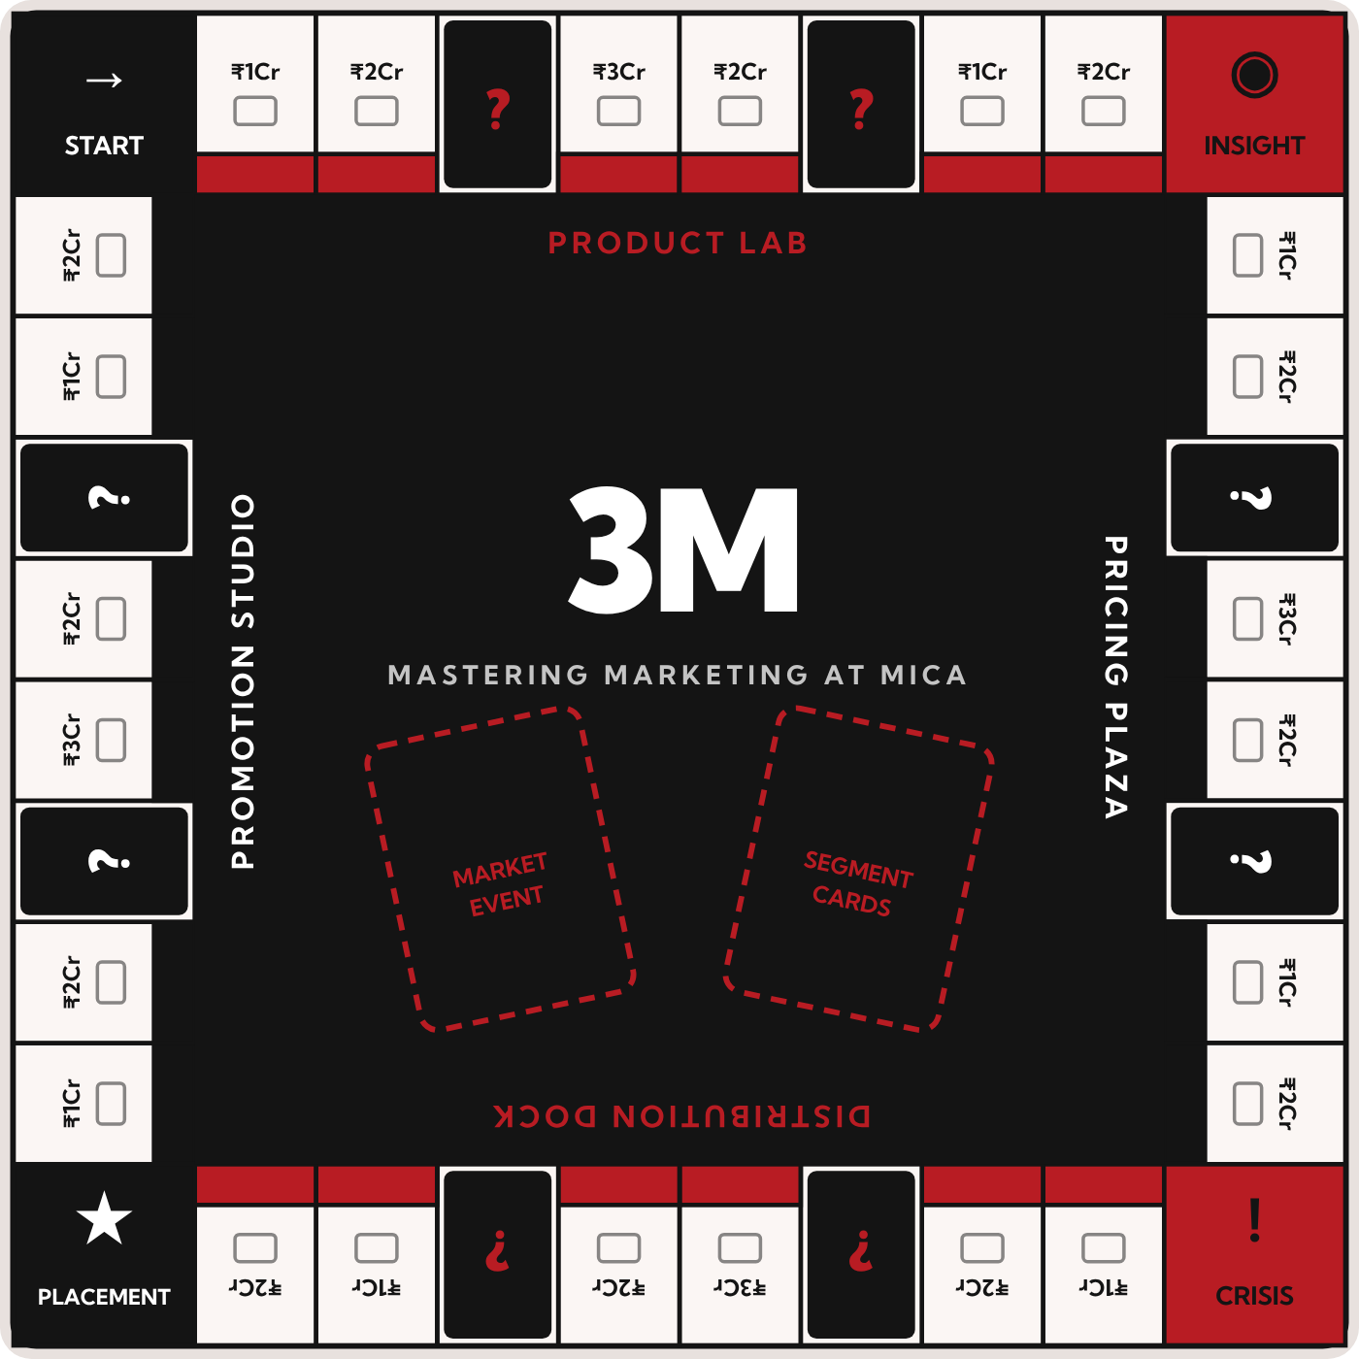
3M CHAMPIONSHIP 2026 · THE CAMPAIGN RULEBOOK
§ 03 · THE GAME · BOARD & COMPONENTS
03
What’s in the box
2–4
75
6
1
7
8
PLAYERS PER TABLE
MINUTES A GAME, MAX
QUARTERS A GAME
WINNER: TOP SHARE
1
THE BOARD · FOUR CAMPUS ZONES, ONE PER P
1
Product Lab
5
Segment cards
2
Buy Product cards
Each lists what a segment values on each of the 4Ps
2
Pricing Plaza
6
Market Event deck
Buy Price cards
Trends and shocks that hit every brand
6
5
3
Distribution Dock
7
? spaces & Crisis corner
Buy Place cards
Where Market Event and Crisis cards come into play
4
4
Promotion Studio
8
₹1–3 Cr spaces
Buy Promotion cards
Mix cards cost money from the same fixed budget
3
IN EACH TOURNAMENT SET
7
Laminated A2 board · Segment cards · 4P marketing-mix cards (Product, Price, Place, Promotion) · Market Event and Crisis cards · tokens and pawns · box
About ₹400 a set · 40 sets, reused across both qualifier weekends
MASTERING MARKETING AT MICA
PAGE 03 / 12
Notes:
TALKING POINTS
3M is a board and card strategy game for 2 to 4 players; a game takes up to 75 minutes over 6 quarters. Each player runs a brand. The board has four campus zones, one for each P: Product Lab, Pricing Plaza, Distribution Dock and Promotion Studio, where players buy marketing-mix cards from a fixed budget. Segment cards say what each target segment values; Market Event and Crisis cards shake up the game. Each tournament set (laminated A2 board, card decks, tokens, box) costs about Rs 400; we need 40.
CANVA ANIMATION RECIPE
- Page: Fade
- Game board: Rise
- Numbered callouts 1-8 on the board: Pop
- Pawns: Stomp (or "Create an Animation" to hop them off START)
- Stat tiles: Pop
- Legend (titles + text): Rise
- Components box: Fade

Slide 4

3M CHAMPIONSHIP 2026 · THE CAMPAIGN RULEBOOK
§ 04 · THE GAME · TURN SEQUENCE & SCORING
04
How to play
STEP 1
→
STEP 2
→
STEP 3
→
STEP 4
Pick your brand and segment
Build your 4P mix
Survive the market
Score Fit Points
Choose a brand, secretly pick a target segment card and write a one-line positioning statement.
Move around the four campus zones and buy marketing-mix cards from a fixed budget.
Market Event and Crisis cards hit every player. Adapt, or lose share.
Each quarter, every mix card that matches what your segment values earns Fit Points. Market share is split in proportion; chase a rival’s segment and you split it.
EXAMPLE
EXAMPLE
EXAMPLE
EXAMPLE
You pick D2C skincare and the Gen Z students segment. Positioning: “Clean skincare that fits a hostel budget.”
Gen Z values low price and Instagram. A Value Pricing card and an Influencer card each earn +2 Fit Points.
Crisis card: Influencer scandal. Spend ₹1 Cr on PR, or lose 1 Fit Point on every Promotion card.
You score 9 Fit Points, a rival in your segment scores 6. You take 60% of that segment’s share.
1-MIN HOW-TO-PLAY VIDEO
SEGMENT
MARKET EVENT
!
WHAT IT TEACHES
Gen Z students
Trend alert
HOW YOU WIN
Instagram changes its algorithm. Brands without video lose 2% share.
Highest total market share after 6 quarters.
STP
Positioning
The 4Ps
Consumer insight
Values: low price, Instagram, quick commerce.
Competitive response
Crisis & PR
Budgeting for ROI
MASTERING MARKETING AT MICA
PAGE 04 / 12
Notes:
TALKING POINTS
Four steps a turn. 1) Pick a brand, secretly pick a target segment card and write a one-line positioning. 2) Move around the four zones and buy 4P mix cards from a fixed budget. 3) Market Event and Crisis cards hit everyone: adapt or lose share. 4) Every quarter, cards that match what your segment values earn Fit Points and market share is split in proportion; two brands on one segment split it. Highest total share after 6 quarters wins. It teaches STP, positioning, the 4Ps, consumer insight, competitive response, crisis and PR, and budgeting for ROI. The video on the right is our 1-min how-to-play video; click it to play.
CANVA ANIMATION RECIPE
- Page: Fade
- Step dice 1-4: Tumble
- Step titles and rules: Rise
- Example boxes: Pop (one after another, left to right)
- How you win box: Stomp
- Skill chips: Pop
- Sample cards: Tumble
- Video: set to autoplay when presenting (video settings in Canva)

Slide 5
3M CHAMPIONSHIP 2026 · THE CAMPAIGN RULEBOOK
§ 05 · FORMAT · SCORING · WHY OFFLINE
05
Tournament rules
STAGE 1 · 26 OCT – 22 NOV
STAGE 2 · 28 NOV – 6 DEC
STAGE 3 · SAT 12 DEC
Register
→
City qualifiers
→
Finals · MICA, Ahmedabad
Solo entry. Pick your city and a Saturday or Sunday slot. ₹299, or ₹249 as an early bird or a referred friend.
Five cities, at partner B-school campuses, hosted free by their marketing clubs. 16 finalist seats across the cities.
16 finalists, 3 rounds on 4 tables, then one final table of 4 decides the champion.
QUALIFIER DAY
FINALS · 12 DEC
HOUSE RULE · WHY OFFLINE
Every player plays 3 rounds at 4-player tables (3-player tables when numbers don’t divide by 4).
Round 1 seating is random; rounds 2 and 3 seat players on similar points together.
Tiebreak: total market share across the 3 games.
16 players play 3 rounds on 4 tables, same points system. The top 4 then play one final table, which decides 1st to 4th.
Fully offline. A game of skill at physical venues.
The Promotion and Regulation of Online Gaming Act, 2025 came into force on 1 May 2026. It bans online money games and allows only recognised e-sports and online social games. A paid online tournament with cash prizes could be treated as an online money game; an offline one avoids that risk completely.
TABLE 1 · 4
TABLE 2 · 4
FINAL TABLE
Top 4
PLACEMENT POINTS PER GAME
1st
5
2nd
3
3rd
2
4th
1
TABLE 3 · 4
TABLE 4 · 4
TIP · PRACTICE
Free practice keeps players coming back and arriving ready: a free print-and-play PDF of the game, a 1-min how-to-play video, and free practice nights at partner clubs in November. All three double as marketing hooks.
MASTERING MARKETING AT MICA
PAGE 05 / 12
Notes:
TALKING POINTS
Three stages: register (26 Oct to 22 Nov, solo entry, Saturday or Sunday slot), city qualifiers (28 Nov to 6 Dec) and finals at MICA on 12 Dec. On qualifier day everyone plays 3 rounds at 4-player tables: random seating first, then players on similar points meet. Placement points are 5-3-2-1, tiebreak on total market share. At the finals, 16 players play 3 rounds on 4 tables and the top 4 play one final table. We stay fully offline because the Online Gaming Act, 2025 (in force since 1 May 2026) bans online money games. Free practice material doubles as marketing.
CANVA ANIMATION RECIPE
- Page: Fade
- Stage spaces 1-3: Pan (left to right)
- Arrows: Fade
- Qualifier rules: Rise
- Placement point tiles: Pop
- Finals tables + bracket lines + final table: Rise, then Stomp on the final table
- House rule box: Rise
- Tip box + die: Tumble on the die, Fade on the box

Slide 6
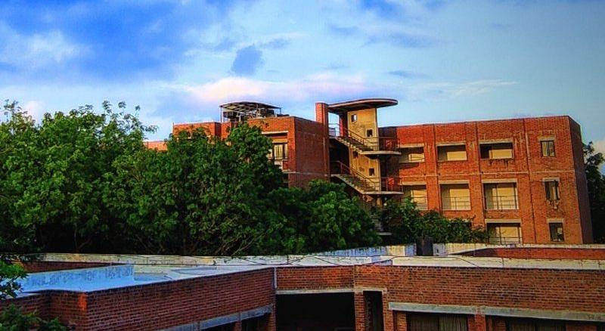
3M CHAMPIONSHIP 2026 · THE CAMPAIGN RULEBOOK
§ 06 · QUALIFIER CITIES · SEATS · LOGISTICS
06
The map: cities & seats
WEEKEND 1 · SAT–SUN 28–29 NOV
WEEKEND 2 · SAT–SUN 5–6 DEC
Ahmedabad
Delhi
Mumbai
Bengaluru
Pune
28–29 NOV
28–29 NOV
5–6 DEC
5–6 DEC
5–6 DEC
140
90
110
90
74
FINALS · SAT 12 DEC
MICA, Ahmedabad
players expected
players expected
players expected
players expected
players expected
Tables per day 18
Finalist seats 4
Ambassador colleges 10
Tables per day 12
Finalist seats 3
Ambassador colleges 7
Tables per day 14
Finalist seats 4
Ambassador colleges 9
Tables per day 12
Finalist seats 3
Ambassador colleges 7
Tables per day 10
Finalist seats 2
Ambassador colleges 7
16 finalists. Meals and a hostel stay on campus.
TOTAL 504 players expected · 40 game sets (36 needed on weekend 2 + 4 spare) · 16 finalist seats
SLOTS
SEAT RULE
VENUES & SET ROUTE
Players pick a Saturday or Sunday slot when they register, which halves the tables needed per day. The expected split follows the number of ambassador colleges in each city.
The 16 finalist seats are split by each city’s actual paid enrolments (largest-remainder method, minimum 2 per city). Shown at expected numbers; final seats are announced on 23 Nov.
Venues are free through partner clubs; players pay their own travel. Sets ship to Delhi before weekend 1, then on to Mumbai, Bengaluru and Pune. Dates are checked against exam calendars.
MASTERING MARKETING AT MICA
PAGE 06 / 12
Notes:
TALKING POINTS
Qualifiers run over two weekends so the same 40 game sets can be reused: Ahmedabad and Delhi on 28-29 Nov, Mumbai, Bengaluru and Pune on 5-6 Dec. We expect 504 players, split by the number of ambassador colleges per city. Players pick a Saturday or Sunday slot, which halves the tables per day. The 16 finalist seats are split by actual paid enrolments (largest remainder, minimum 2 per city), announced on 23 Nov. Finals are at MICA on 12 Dec.
CANVA ANIMATION RECIPE
- Page: Fade
- Weekend brackets: Fade
- City spaces: Pan (left to right, one after another)
- Player counts: Pop
- Finals space: Stomp
- Totals band: Rise
- Three notes: Rise
- Optional: a pawn moving across the city spaces with "Create an Animation" ending on the Finals space

Slide 7

3M CHAMPIONSHIP 2026 · THE CAMPAIGN RULEBOOK
§ 07 · ENTRY FEE · PRIZE POOL · PAYOUTS · REFUNDS
07
The bank: fees, prizes & refunds
ENTRY FEE
PRIZE POOL
PAYOUTS & PERKS
₹299
REGULAR ENTRY
₹20,000
Paid within 7 days
The standard fee for every solo entry.
Bank transfer to winners within 7 days of the finals.
guaranteed, up to ₹30,000
₹249
EARLY BIRD
+₹50 for every paid enrolment after 300, capped at ₹30,000 (reached at 500 players). Guaranteed in writing, whatever the turnout.
Tax, said upfront
First 150 players or until 1 Nov, whichever comes first.
TDS is deducted on any prize above ₹10,000, with a certificate issued. The FAQ says so.
12 Nov: 312 players → ₹20,600
₹20,000 GUARANTEED
+₹50 / PLAYER
Trophies and merch
₹249
REFERRED FRIEND
0 players
₹20,000
300 players
₹20,000
500 players
₹30,000
For all 16 finalists.
Your friend pays ₹249 with your referral code.
PRIZE SPLIT AT THE CAP (₹30,000)
1st place | ₹12,000
2nd place | ₹8,000
3rd place | ₹6,000
4th place | ₹4,000
Certificates
Participation certificate for every player; merit certificate for every finalist.
REFUNDS
Full refund if we cancel or reschedule a city event.
50% refund on requests made up to 22 Nov.
No refunds after registrations close; no-shows forfeit the fee.
Finals at MICA
Meals and a hostel stay for finalists on 12 Dec. Players pay their own travel.
Below the cap, the pool is split in the same 40 / 27 / 20 / 13 ratio.
MASTERING MARKETING AT MICA
PAGE 07 / 12
Notes:
TALKING POINTS
Entry is Rs 299; early birds (first 150 or until 1 Nov) and referred friends pay Rs 249. The prize pool is Rs 20,000 guaranteed, plus Rs 50 for every paid player after 300, capped at Rs 30,000 at 500 players; at the cap it splits 12,000 / 8,000 / 6,000 / 4,000. Prizes are paid by bank transfer within 7 days; TDS applies to any prize above Rs 10,000 and we say so upfront. Everyone gets a certificate, finalists get merit certificates, trophies, merch, meals and a hostel stay. Refunds: full if we cancel, 50% until 22 Nov, none after.
CANVA ANIMATION RECIPE
- Page: Fade
- Money notes: Pan (in from the left, one after another)
- Rs 20,000 figure: Stomp
- Trophy: Tumble
- Meter bars: Rise (or "Create an Animation" to slide the red part in from the left)
- Prize split table: Rise
- Payouts & perks card: Rise
- Refunds card: Fade

Slide 8
3M CHAMPIONSHIP 2026 · THE CAMPAIGN RULEBOOK
§ 08 · FUNNEL & CHANNELS
08
Path to 500
REACH
CLICKS
SIGN-UPS
PAID
REFERRALS
PAID ENROLMENTS
3,30,000
→
6,400
→
648
→
438
→
+66
→
504
across 4 channels
1.9% of reach
10.1% of clicks
67.6% of sign-ups
15% of payers bring a friend
Goal of 500: cleared
CHANNEL ASSUMPTIONS
FEE MIX OF THE 504
CHANNEL | REACH | CLICK RATE | SIGN-UP RATE | PAY RATE | PAID
Instagram paid ads | 2,00,000 | 1.2% | 8% | 60% | 115
Organic posts and student creators | 80,000 | 1.5% | 10% | 65% | 78
Campus ambassadors (40 colleges, WhatsApp groups) | 20,000 | 8% | 12% | 75% | 144
Competition platforms (e.g. Unstop) and club emails | 30,000 | 4% | 12% | 70% | 101
Referrals (15% of payers bring one friend) | – | – | – | – | 66
Total | 3,30,000 | 6,400 clicks | 648 sign-ups |  | 504
Early bird
150 × ₹249
Regular
288 × ₹299
Referred
66 × ₹249
Ambassadors are the biggest channel: 144 paid from 20,000 reach, through WhatsApp groups in 40 colleges.
ASSUMPTIONS Click, sign-up and pay rates are planning assumptions per channel; the 5 Nov checkpoint tests them. If fewer than 200 have paid by then, ad spend shifts to the best-performing channel.
MASTERING MARKETING AT MICA
PAGE 08 / 12
Notes:
TALKING POINTS
Reach of 3.3 lakh gives 6,400 clicks, 648 sign-ups and 438 paid; 15% of payers bring a friend for 66 more, so 504 paid. Instagram ads bring the most reach, but campus ambassadors (40 colleges, WhatsApp groups) are the strongest converters with 144 paid. Fee mix: 150 early birds and 66 referred friends at Rs 249, 288 at Rs 299. We test these assumptions at the 5 Nov checkpoint.
CANVA ANIMATION RECIPE
- Page: Fade
- Funnel spaces: Pan (left to right, one after another)
- Red pawn: "Create an Animation" - drag it along the track from REACH to the red 504 space
- 504 space: Stomp
- Channel table: Rise
- Fee mix bars: Rise; fee mix rows: Fade
- Ambassador callout: Pop

Slide 9
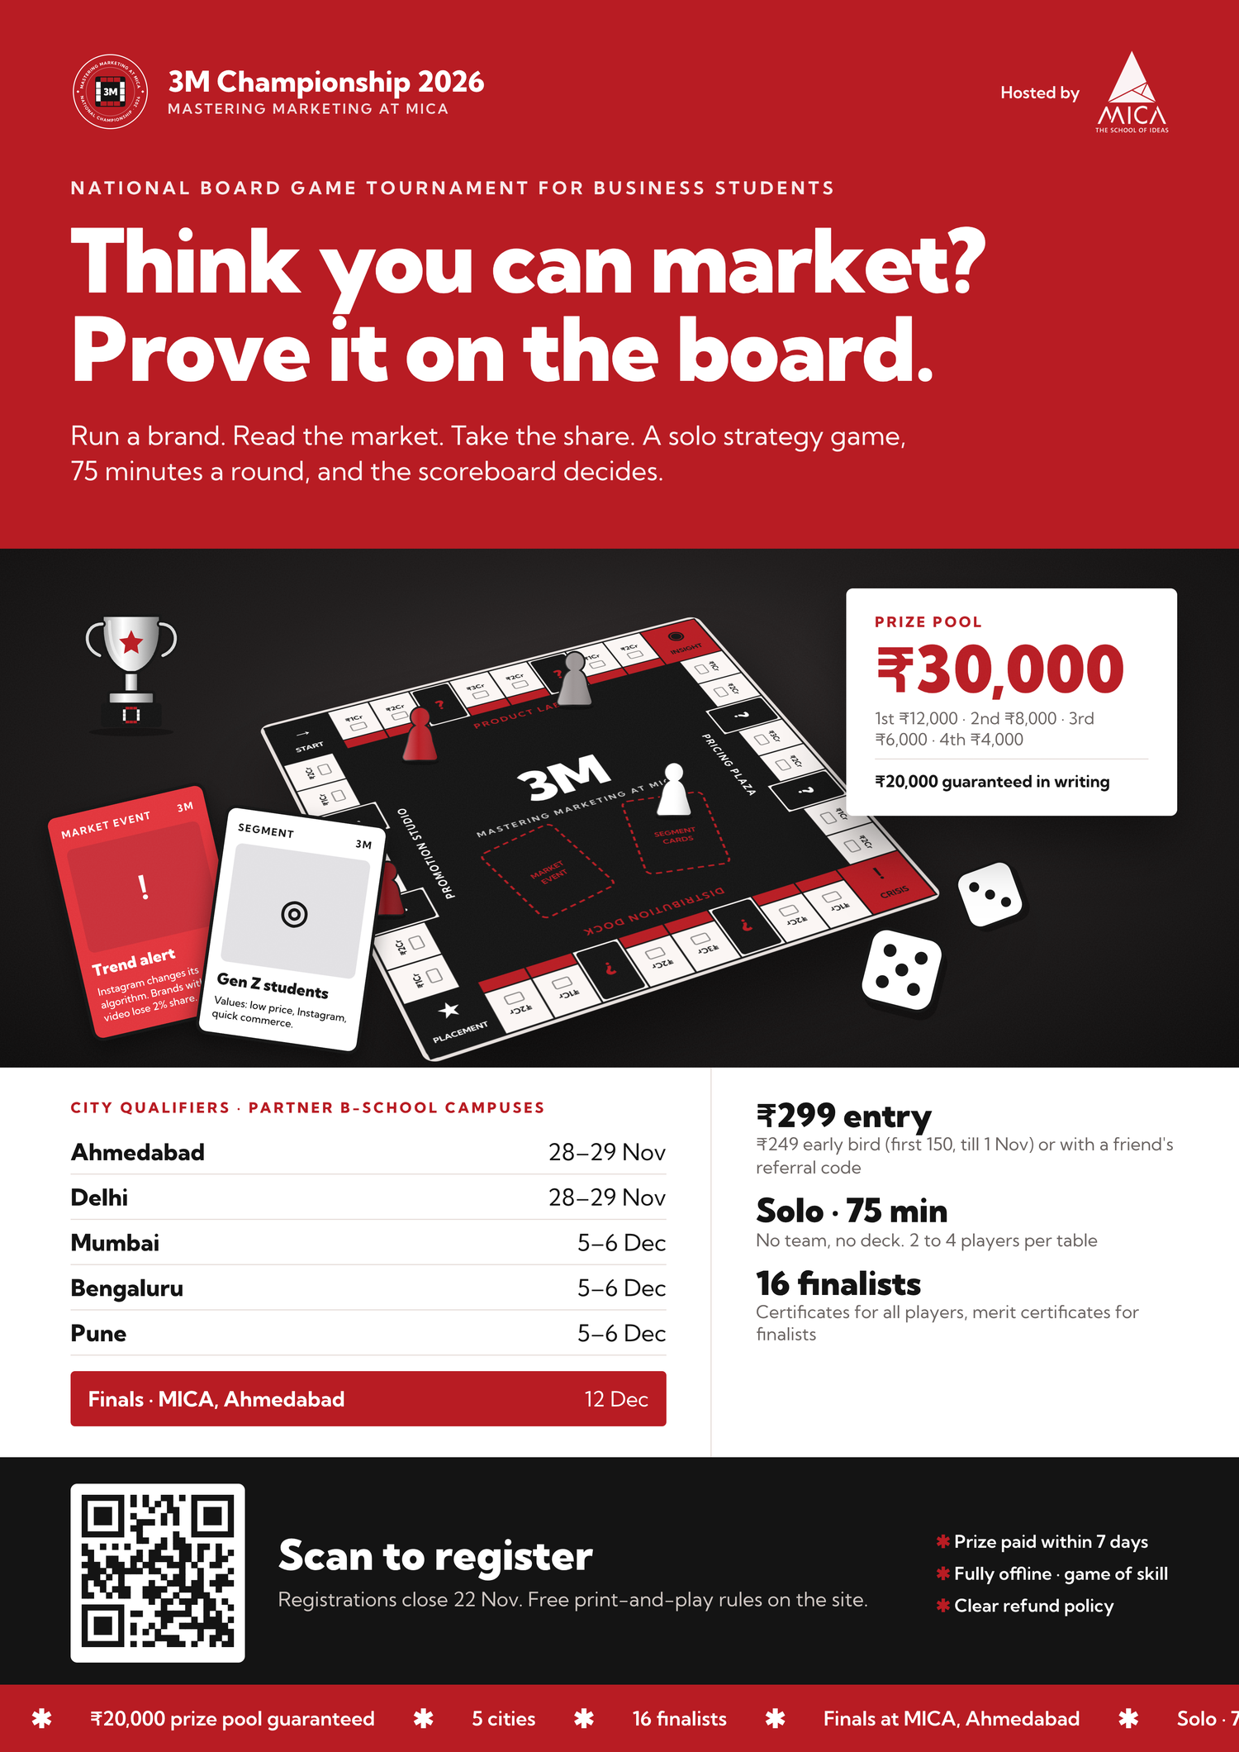
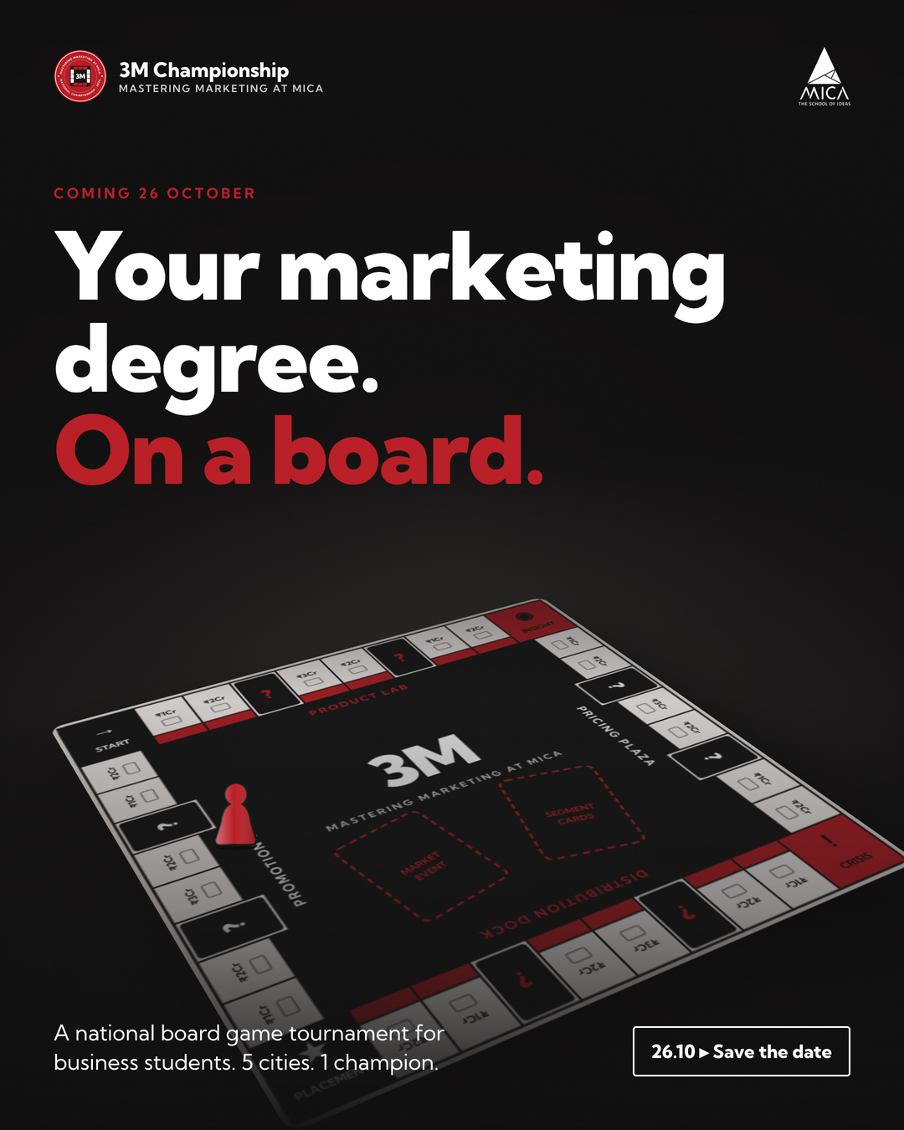
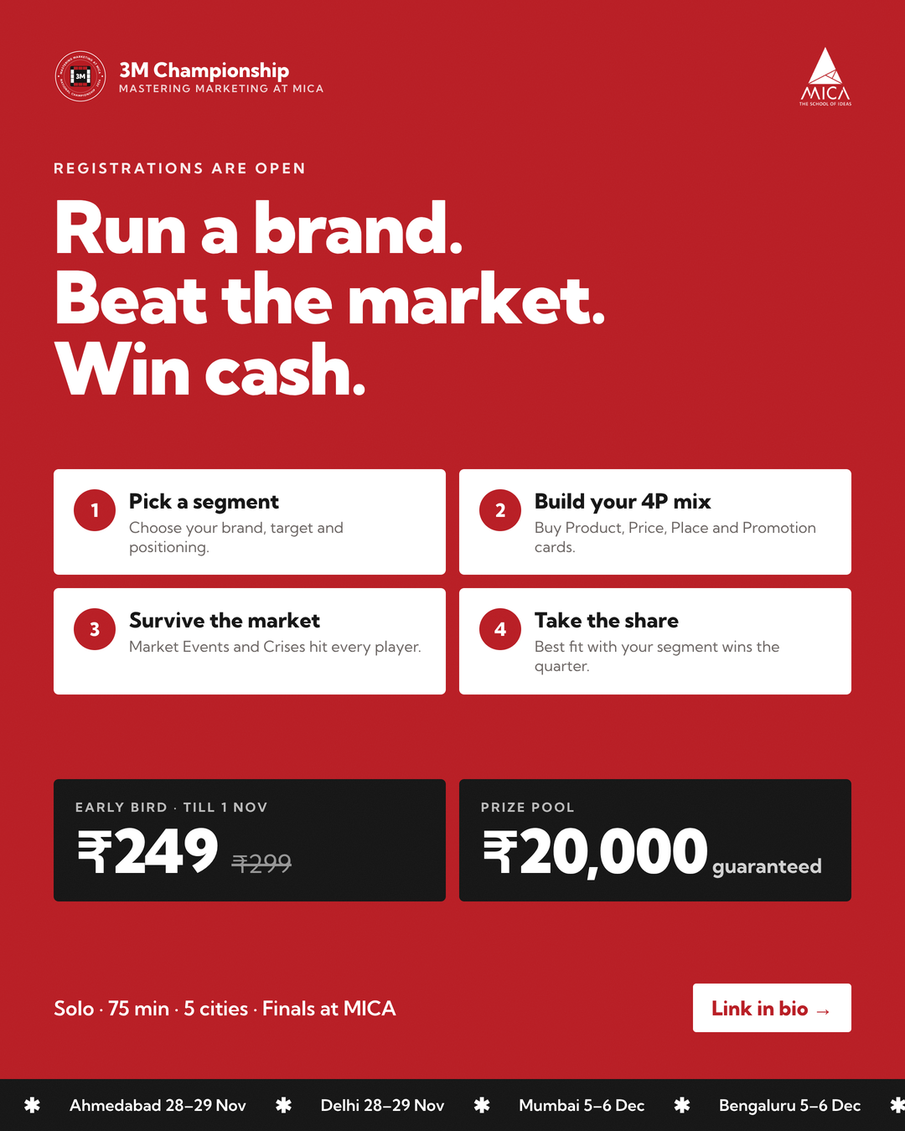
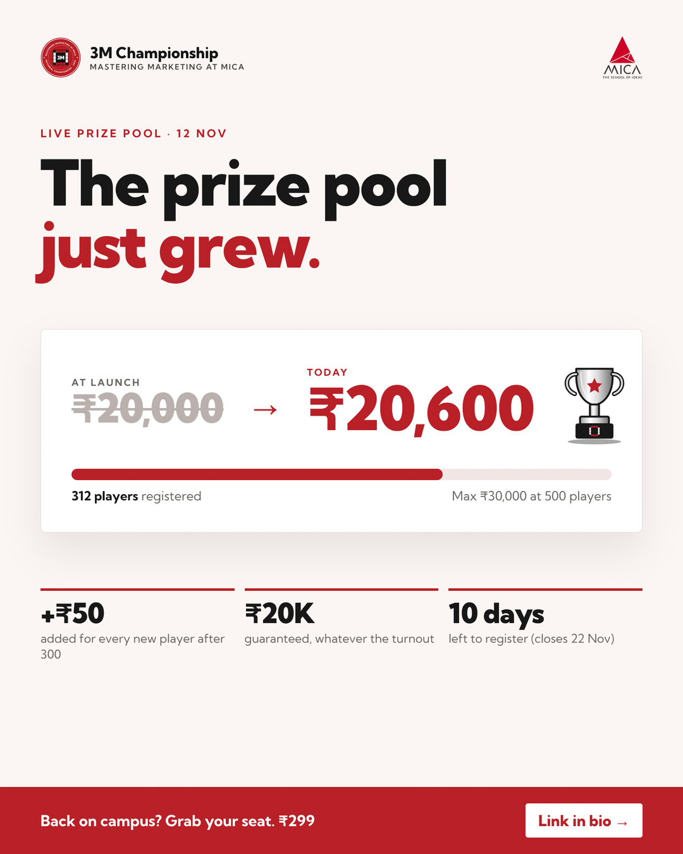
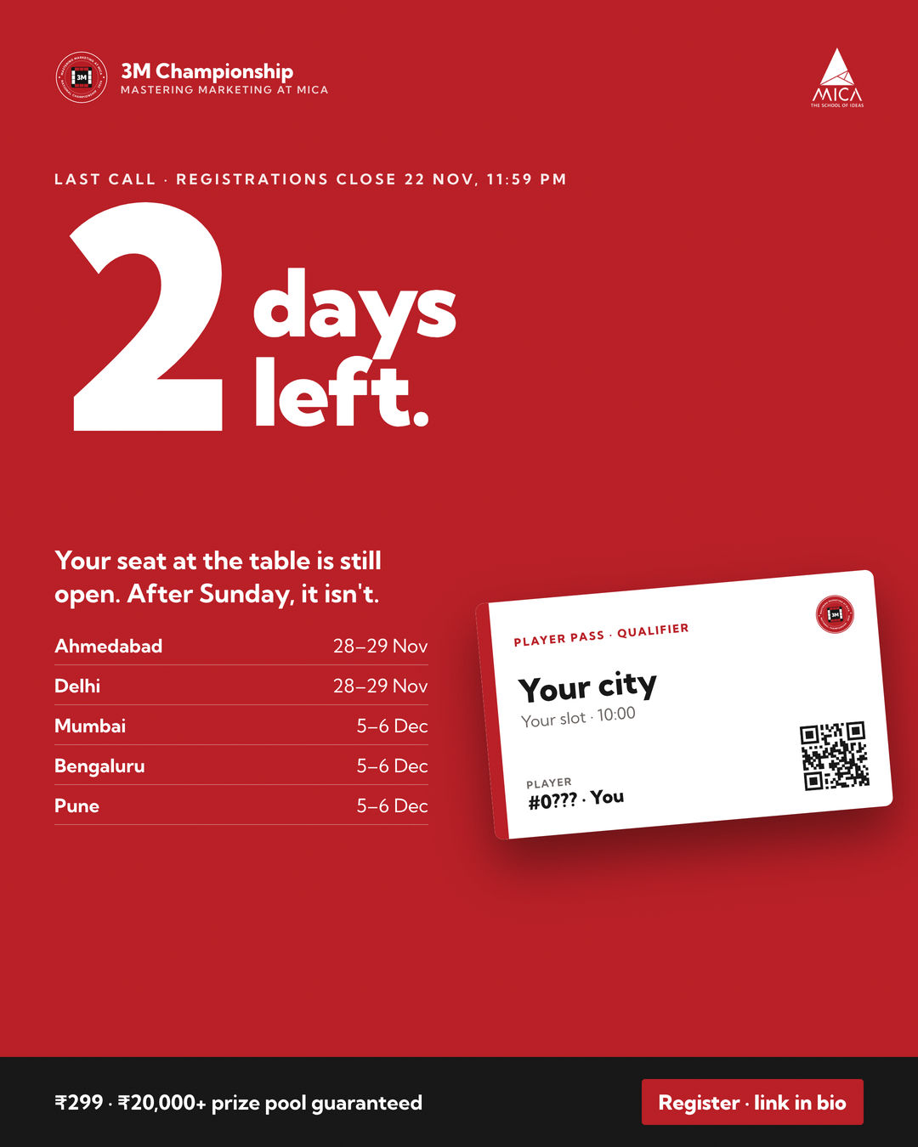
3M CHAMPIONSHIP 2026 · THE CAMPAIGN RULEBOOK
§ 09 · POSTER · 4 SOCIAL POSTS · STORIES · DIWALI DUO
09
Awareness pieces
A3 POSTER
SAT 24 OCT · 7 PM
MON 26 OCT · 6 PM
THU 12 NOV · 7 PM
FRI 20 NOV · 6 PM
Poster
Post 1 · Teaser
Post 2 · Launch
Post 3 · Pool grew
Post 4 · Last call
Board-game visual, big idea, dates, fee, prize pool and a QR code to register.
“Your marketing degree, on a board.” Registrations open Monday.
“Registrations are open.” How 3M works in 4 steps + early bird ₹249.
“Back on campus after Diwali? The pot got bigger.” ₹20,600 and rising.
“2 days left.” Closes Sun 22 Nov, 11:59 PM.
PRINT · PARTNER CAMPUSES
STORY · COUNTDOWN TO 26 OCT
STORY · LINK + QUIZ: WHICH P MATTERS MOST TO GEN Z?
STORY · POLL: WILL WE HIT ₹30,000?
STORY · COUNTDOWN TO 22 NOV + LINK
REFERRAL PUSH · 6–11 NOV
3M
HASHTAGS & FORMAT
Diwali Duo: “Gift a friend a seat at the table.”
#3MChampionship #MasteringMarketingAtMICA #MICA #MarketingStudents #MBA #BBA #BSchool #CaseCompetition #PrizePool #LastCall
Stories and WhatsApp while campuses are on break. Your friend pays ₹249 with your referral code.
1080 × 1350 feed posts from the tournament handle, collab-posted with MICA and partner marketing clubs.
MASTERING MARKETING AT MICA
PAGE 09 / 12
Notes:
TALKING POINTS
Awareness runs on one A3 poster and four Instagram feed posts, each paired with a Story sticker: the teaser (24 Oct, countdown), launch and how to play (26 Oct, link + quiz), "the prize pool just grew" as students return after Diwali (12 Nov, poll) and last call (20 Nov, countdown). During the Diwali break (6-11 Nov), the Diwali Duo referral push runs on Stories and WhatsApp: gift a friend a seat; the friend pays Rs 249 with your code. Posts are collab-posted with MICA and partner clubs.
CANVA ANIMATION RECIPE
- Page: Fade
- Poster and four posts: Rise (one after another, left to right) - like dealing cards
- Date pills: Pop
- Titles, hooks and story lines: Fade
- Diwali Duo card: Tumble; its two pawns: Stomp
- Hashtags card: Typewriter on the hashtag line

Slide 10
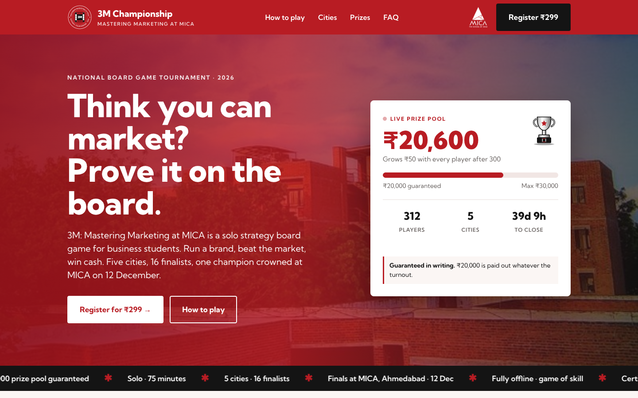
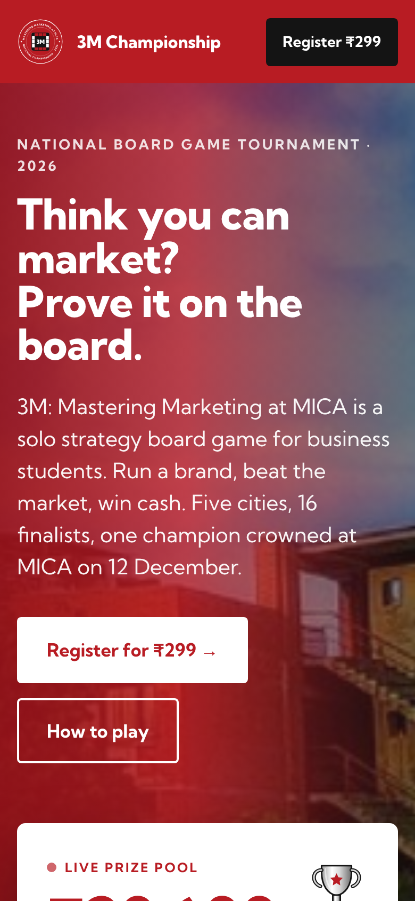
3M CHAMPIONSHIP 2026 · THE CAMPAIGN RULEBOOK
§ 10 · LANDING PAGE · WHATSAPP SEQUENCE
10
Conversion pieces
landing page mock-up
3M Championship
To: signed up, not yet paid
1 · RIGHT AFTER SIGN-UP
Hi {Name}, your seat at the 3M Championship is almost yours. Your {City} qualifier slot ({Sat/Sun}) is on hold. Pay ₹299 to lock it in: {link}
Free print-and-play rules + 1-min video: {link}
2 · TWO DAYS LATER
{Name}, 312 players are in and the prize pool is now ₹20,600. It grows ₹50 with every new player, up to ₹30,000, and ₹20,000 is guaranteed. Your {City} seat is still open: {link}
3 · SAT 21 NOV · 24 H BEFORE CLOSE
Last call, {Name}. Registrations close tomorrow, Sun 22 Nov, at 11:59 PM. After that, your seat goes to someone else. ₹299 · solo entry · 75 min. Pay here: {link}
WHAT THE LANDING PAGE DOES
1
Hero + “Register for ₹299” button
5
Format + city and slot picker
2
Live prize-pool counter + countdown
6
Prize calculator slider
3
Why play: cash, 75 min, CV
7
Pay → player pass + referral code
4
How to play + click-the-dice game
8
FAQ: refunds, TDS, legality, travel
Live player count and pool filled in at send time. Every message ends with “Reply STOP to opt out”.
MASTERING MARKETING AT MICA
PAGE 10 / 12
Notes:
TALKING POINTS
The landing page does the converting: hero and Register Rs 299 button, a live prize-pool counter with countdown, why play, how to play with a click-the-dice mini-game, the format, a city and slot picker, a prize calculator, the registration form that issues a player pass and referral code, and an FAQ covering refunds, tax, legality and travel. Anyone who signs up but does not pay gets a three-message WhatsApp sequence: a welcome with the payment link, social proof two days later (players in, pool size), and a last call 24 hours before registrations close.
WHATSAPP SEQUENCE (draft copy)
1) Right after sign-up: Hi {Name}, your seat at the 3M Championship is almost yours. Your {City} qualifier slot ({Sat/Sun}) is on hold. Pay Rs 299 to lock it in: {link}. Free print-and-play rules + 1-min video: {link}
2) Two days later: {Name}, 312 players are in and the prize pool is now Rs 20,600. It grows Rs 50 with every new player, up to Rs 30,000, and Rs 20,000 is guaranteed. Your {City} seat is still open: {link}
3) Sat 21 Nov, 24 h before close: Last call, {Name}. Registrations close tomorrow, Sun 22 Nov, at 11:59 PM. After that, your seat goes to someone else. Rs 299 - solo entry - 75 min. Pay here: {link}
CANVA ANIMATION RECIPE
- Page: Fade
- Laptop (frame + screenshot): Rise
- Phone (frame + screenshot): Pan (in from the right)
- Landing callouts 1-8: Pop
- WhatsApp panel: Fade; bubbles 1-3: Rise (one after another, like messages arriving)

Slide 11
3M CHAMPIONSHIP 2026 · THE CAMPAIGN RULEBOOK
§ 11 · 15 OCT → 12 DEC 2026
11
Turn order: campaign timeline
1
15–25 OCT
2
SAT 24 OCT
3
26 OCT – 1 NOV
4
2–5 NOV
5
6–11 NOV
6
12–15 NOV
Prepare
Tease
Launch & early bird
Push
Diwali window
Back-to-campus push
Build assets, recruit 40 ambassadors, release print-and-play PDF and 1-min video, confirm venues and exam calendars, order 40 sets, start sponsor outreach.
Teaser post (Post 1) with a countdown Story.
Launch post (Post 2). Early bird ₹249 for the first 150 players.
Ads, creators, ambassador campus drives, practice nights. 5 Nov checkpoint.
Campus drives pause; ads, creators and the Diwali Duo referral push continue.
“Prize pool just grew” post (Post 3), practice nights, social proof.
POST
POST
POST
7
16–22 NOV
8
23–27 NOV
9
28–29 NOV
10
5–6 DEC
11
SAT 12 DEC
Last call
Logistics
Qualifiers · wk 1
Qualifiers · wk 2
Finals at MICA
Urgency push, last-call post (Post 4, 20 Nov) and WhatsApp. Closes Sun 22 Nov, 11:59 PM.
Confirm slots, announce finalist seats (23 Nov), ship sets to Delhi.
Weekend 1: Ahmedabad and Delhi.
Weekend 2: Mumbai, Bengaluru and Pune.
16 finalists, one champion crowned in Ahmedabad.
POST
PACING CHECKPOINTS
1 NOV
5 NOV
12 NOV
22 NOV
150 early birds in
→
Checkpoint: under 200 paid? Shift ad spend to the best channel and escalate the sponsor ask
→
312 paid · pool ₹20,600
→
504 paid · pool ₹30,000
MASTERING MARKETING AT MICA
PAGE 11 / 12
Notes:
TALKING POINTS
The campaign runs like turns on the board: prepare (15-25 Oct), tease (24 Oct), launch with the early bird (26 Oct-1 Nov), push and the 5 Nov checkpoint, the Diwali window with the Diwali Duo referral push (6-11 Nov), the back-to-campus push (12-15 Nov), last call (16-22 Nov), logistics, two qualifier weekends and the finals at MICA on 12 Dec. Pacing: 150 early birds by 1 Nov, at least 200 paid by 5 Nov, 312 by 12 Nov and 504 when registrations close on 22 Nov.
CANVA ANIMATION RECIPE
- Page: Fade
- Timeline spaces 1-6, then 7-11: Pan (left to right, one after another)
- POST tags: Pop
- Finals space + trophy: Stomp, then Tumble on the trophy
- Pacing checkpoints: Rise
- Optional: a pawn with "Create an Animation" travelling space to space

Slide 12
3M CHAMPIONSHIP 2026 · THE CAMPAIGN RULEBOOK
§ 12 · REVENUE · COSTS · SURPLUS · SENSITIVITY
12
Final score: budget & break-even
REVENUE AT 504 PAID
RUNNING COSTS (₹)
SENSITIVITY
150 early bird × ₹249 | ₹37,350
288 regular × ₹299 | ₹86,112
66 referred × ₹249 | ₹16,434
Gross revenue | ₹1,39,896
Gateway fees (≈2.36%) | −₹3,302
Net revenue | ₹1,36,594
Instagram ads | 15,000 | About 2 lakh reach
Student creators | 5,000 | Micro-creators, 5 cities
Ambassador incentive | 5,000 | ₹20/paid + ₹2,000 top 3
Game sets | 16,000 | 40 sets × ≈₹400
City event costs | 10,000 | ₹2,000 per city
Shipping | 6,000 | Delhi, then 3 cities
Finals meals & hostel | 8,000 | 16 finalists
Trophies, merch, certs | 5,000 | For finalists; certs for all
Contingency | 5,000
Total | 75,000 | Venues free via clubs
SCENARIO | PAID | POOL (₹) | SURPLUS (₹)
Base case | 504 | 30,000 | 31,594
Instagram click rate falls to 0.8% | 460 | 28,000 | 21,042
Ambassadors deliver half (72, not 144) | 421 | 26,050 | 11,850
Every channel at 75% of plan | 377 | 23,850 | 1,498
FINAL SCORE AT 504
Even if the riskiest channel delivers half, or every channel falls short by a quarter, the campaign still breaks even.
Net revenue
− Running costs
− Prize pool (at cap)
₹1,36,594
₹75,000
₹30,000
CREDITS & AI LOG
Campaign by [Group name / members]
Made with Claude (Anthropic), used across the whole process: game and tournament design, funnel and budget model, copywriting, landing page, poster, social posts and captions, WhatsApp sequence, and this campaign deck.
BREAK-EVEN & DOWNSIDE
₹31,594
≈ 370 paid enrolments to break even
At 300 paid we would lose about ₹16,600, because the ₹20,000 prize is guaranteed. The hosting marketing club’s events budget covers any shortfall, and sponsors are approached from launch to set a funding floor.
surplus
Kept as a reserve for refunds; anything left funds Season 2. Sponsor money and game-kit sales are upside, not counted.
Play the Market.
Win the Market.
MASTERING MARKETING AT MICA
PAGE 12 / 12
Notes:
TALKING POINTS
At 504 paid we take Rs 1,39,896 gross and Rs 1,36,594 after gateway fees. Running costs are Rs 75,000 and the prize pool at the cap is Rs 30,000, leaving a surplus of about Rs 31,600, kept as a refund reserve and seed money for Season 2. Break-even is about 370 paid. The downside: at 300 paid we would lose about Rs 16,600 because the Rs 20,000 prize is guaranteed; the hosting club's events budget and sponsors cover it, and the 5 Nov checkpoint lets us react early. Even if every channel delivers only 75% of plan, we still break even. Credits: this whole campaign was made with Claude.
CANVA ANIMATION RECIPE
- Page: Fade
- Revenue score pad: Rise
- Final score card: Rise, then Stomp on the surplus figure
- Costs score pad: Rise
- Break-even card: Pop
- Sensitivity table: Rise
- Credits box: Fade
- Tagline sign-off: Typewriter

