Slide 1
Delay tolerant linear partition
Nelson Jaimes
Rana Alsaadi

Slide 2


Team Introduction
Nelson Jaimes
Rana Alsaadi
Specializing in Computer Science
Neuroscience background
Likes art
Specializing in Computer Security
Business Informatics background
Likes cats

Slide 3
Problem Outline
Let A[1:n] be a real array, and let k be an integer, 1 ≤ k ≤ n.
A linear k-partition of A
a sequence of subarrays of the form
[1:x1],[x1+1:x2],[x2+1:x3],…,[x(k-1)+1:n], for some x1< x2 <… < x(k−1).
From this, we calculate the sums of each of k subarrays.
The weight of this linear k-partition is the maximum of those sums
Goal: minimize the weight of the linear k-partition of the given array in O(nk).
http://notexponential.com/382/minimizing-weight-of-a-linear-partition

Slide 4
Problem Outline
6 | 8 | 3 | 7
3
Min
11
K contiguous subdivisions
n numbers of various sizes
Find minimum subdivision weight that can fit all objects in sequence

Slide 5
Why is this problem important?
Finds minimum container size
Has similarities to the bin packing problem
Examples
Loading trucks with weight capacity constraints ¹
Video-on-demand ²
Multiprocessor scheduling ³
Job scheduling ⁴
Cloud computing ⁵

Slide 6
Solution Overview
Use Dynamic Programming
Populate array with the minimum weights for each number of partitions and array lengths.
Reuse those minimum weights of k-1 partitions to calculate partition k’s weights
The last item calculated is the result of interest.

Slide 7
Solution
Recursive
Let S[i,j] represent the minimum weight of the linear i-partition of array[1:j]
S[i,j] = min_for_all x_from_1_to_ j ( max( S[i-1,x] , sum(array[x+1:j]) )
Optimality
All relevant terms are evaluated and we continually select the minimum, so optimality holds.
http://notexponential.com/382/minimizing-weight-of-a-linear-partition

Slide 8
Solution
Base Case
S[1,j] = sum(array[1:j])
Next Case
Let S[i,j] represent the minimum weight of the linear i-partition of array[1:j]
Increase i from 2 to k
S[i,j] = min_for_all x_from_1_to_ j ( max( S[i-1,x] , sum(array[x+1:j]) )
S[k,n] is solution
Stored in S[n,k] array
http://notexponential.com/382/minimizing-weight-of-a-linear-partition

Slide 9
Solution
Finding the boundary

Slide 10
5 | 9 | 3 | 2 | 8 | 4 | 6 | 11
2
Min
43
5
5
43
9 | 3 | 2 | 8 | 4 | 6 | 11

Slide 11
5 | 9 | 3 | 2 | 8 | 4 | 6 | 11
2
Min
34
14
5 | 9
34
3 | 2 | 8 | 4 | 6 | 11

Slide 12
5 | 9 | 3 | 2 | 8 | 4 | 6 | 11
2
Min
31
17
5 | 9 | 3
31
2 | 8 | 4 | 6 | 11

Slide 13
5 | 9 | 3 | 2 | 8 | 4 | 6 | 11
2
Min
29
19
5 | 9 | 3 | 2
29
8 | 4 | 6 | 11

Slide 14
5 | 9 | 3 | 2 | 8 | 4 | 6 | 11
2
Min
27
27
5 | 9 | 3 | 2 | 8
21
4 | 6 | 11

Slide 15
5 | 9 | 3 | 2 | 8 | 4 | 6 | 11
2
Min
27
31
5 | 9 | 3 | 2 | 8 | 4
17
6 | 11

Slide 16
5 | 9 | 3 | 2 | 8 | 4 | 6 | 11
2
Min
27
5 | 9 | 3 | 2 | 8 | 4 | 6
37
11
11

Slide 17
Solution
Insights

Slide 18
Solution: Insights
5 | 9 | 3 | 2 | 8 | 4 | 6 | 11
3
Min
17
2
Min
12
2
Min
17
Min weight of (k-1 partitions) useful for min weight of (k partitions)

Slide 19
Solution: Insights
1 | 2 | 1 | 5
2
Min
4
1 | 2 | 1 | 5 | 8
2
Min
9
if (increasing partition lengths from left)
and (left component < right component)
boundary will not move left

Slide 20
Solution: Insights
5 | 9 | 3 | 2 | 8 | 4 | 6 | 11
{
3
S[i-1,j] with no delay tolerance
2
S[i-1,j]
+
Sum(j+1 : j + <delay tolerance>)
For a delay tolerant solution, add the next b items to the calculated weight of any portion of the array.

Slide 21
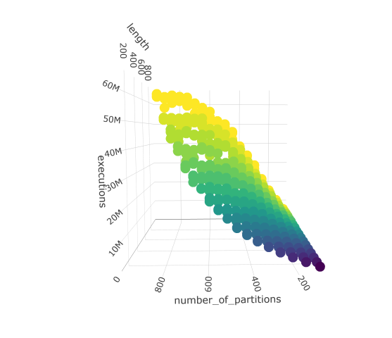
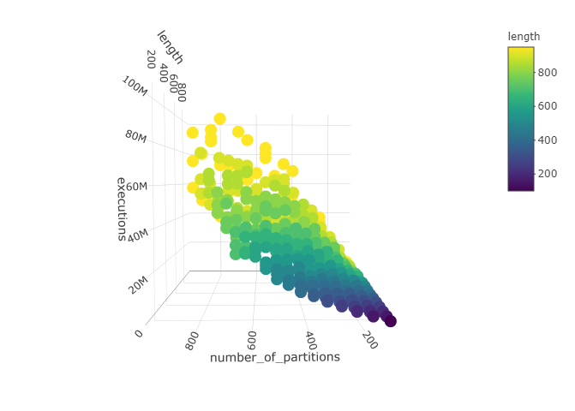
Empirical Results
60 n k = O( n k )

Slide 22
References
Wikipedia “bin packing problem”
Aydın, N., Muter, İ. and Birbil, Ş.İ., 2020. Multi-objective temporal bin packing problem: An application in cloud computing. Computers & Operations Research, 121, p.104959.
Coffman, Jr, E.G., Garey, M.R. and Johnson, D.S., 1978. An application of bin-packing to multiprocessor scheduling. SIAM Journal on Computing, 7(1), pp.1-17.
Leinberger, W., Karypis, G. and Kumar, V., 1999, September. Multi-capacity bin packing algorithms with applications to job scheduling under multiple constraints. In Proceedings of the 1999 International Conference on Parallel Processing (pp. 404-412). IEEE.
Aydın, N., Muter, İ. and Birbil, Ş.İ., 2020. Multi-objective temporal bin packing problem: An application in cloud computing. Computers & Operations Research, 121, p.104959.
http://notexponential.com/382/minimizing-weight-of-a-linear-partition

Slide 23
Thanks!

