Slide 1

Microprocessors I Final Project
Rana Seif

Slide 2
Design Steps
Old Design Analysis
Identified old components and sensors from provided slides.
Component Research
Researched sensors already being used for Market Availability, Cost and Specs.
Sensor Replacement Research
Identified Sensors that need to be replaced and looked for alternatives with similar features.
Edited Design
Created updated version of block diagram.
PCB Layout and Routing
Completed PCB Layout and Routing on kiCAD.
Drew Block Diagram for Old Design.
Created schematic on KiCAD based on new block diagram.
Final Calculations
Calculated Cost, Weight and Power Consumption based on Final Design created.

Slide 3
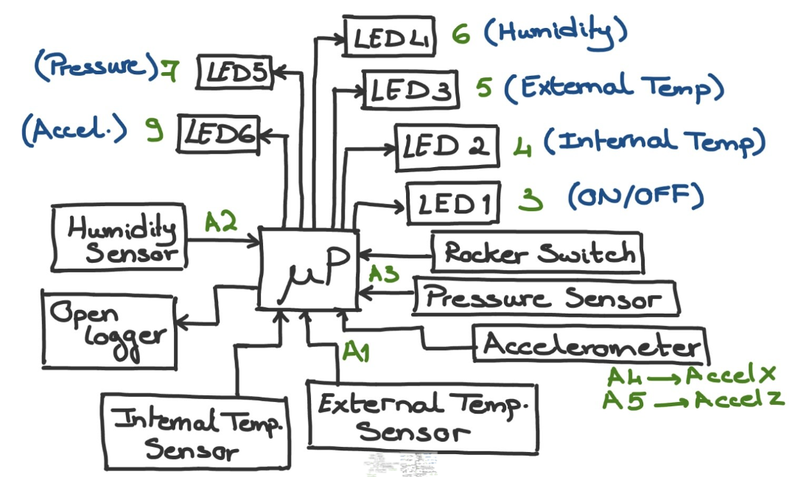
Old Design

Slide 4
Old Component Details
Humidity Sensor’s IC (HIH-4030) has been discontinued by Honeywell.
*This table only includes sensors and ICs. Refer to BOM excel sheet for more details on wires, pin headers, resistors and diodes.

Slide 5
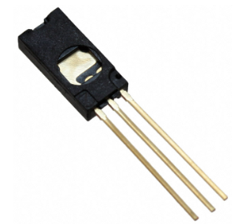
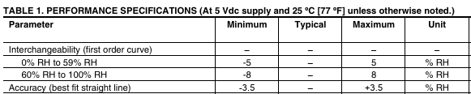
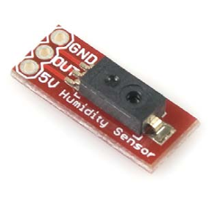
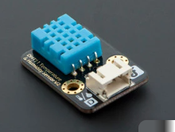
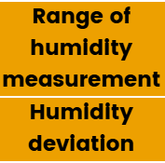
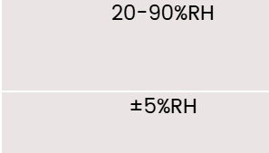
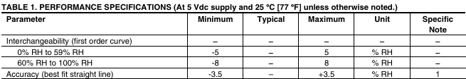
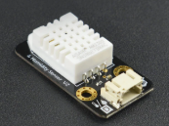
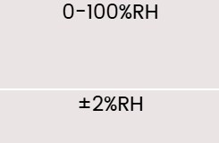
Alternatives for Humidity Sensor
OLD
NEW Alternatives
HIH-4010-002
SEN-09569
Price:$26-70
DHT11
Price:$4.20
DHT22
Price:$8.90

Slide 6
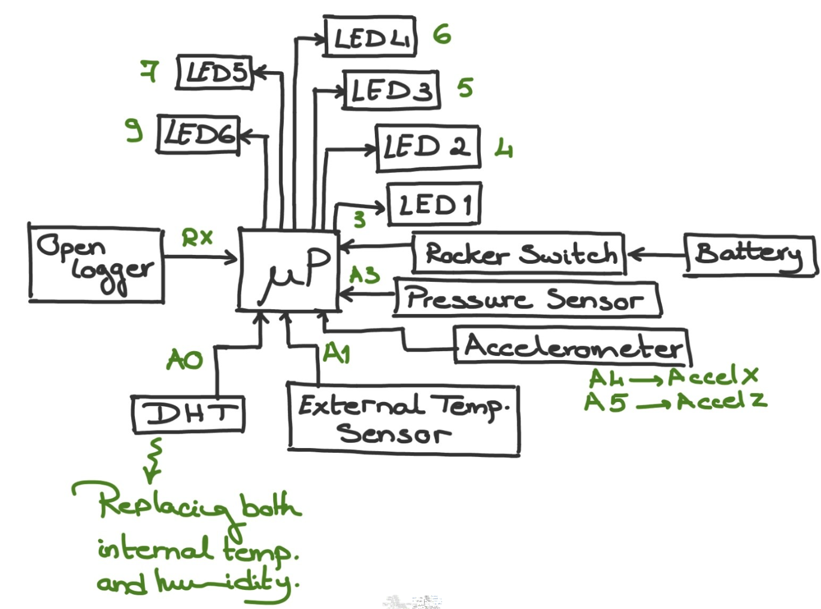
New Design Block Diagram

Slide 7
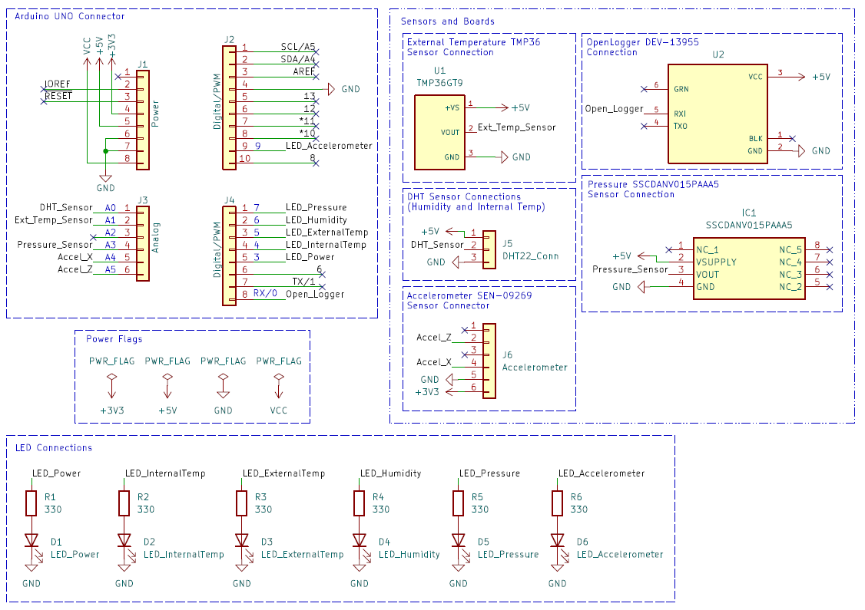
New Design Schematic

Slide 8
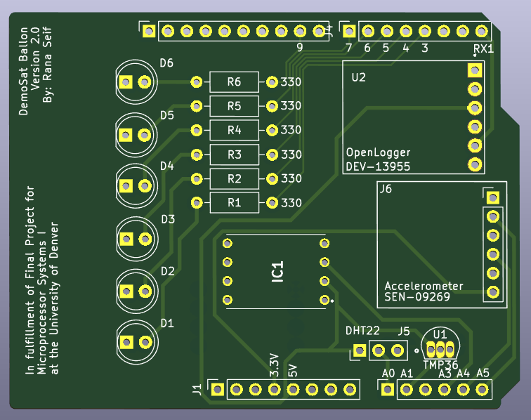
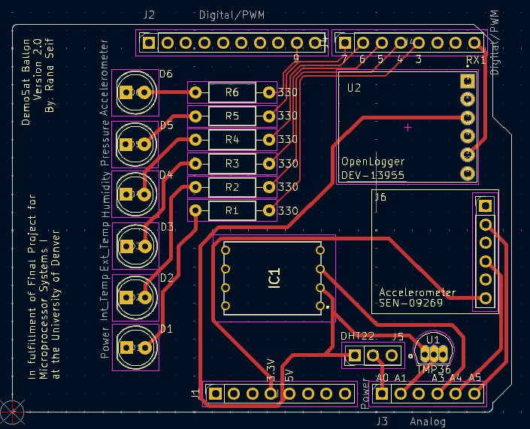
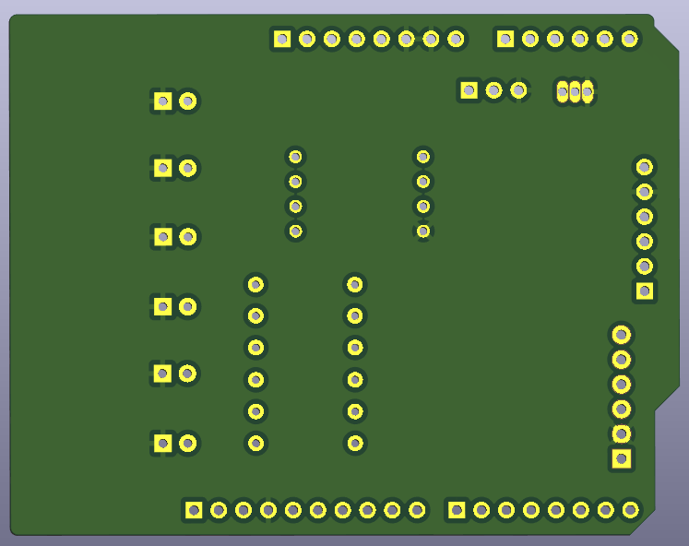
PCB Layout and Routing
FRONT
BACK

Slide 9
Final Cost and Weight
OLD DESIGN
NEW DESIGN
LIMIT
$140
$130
$145
COST
COST
COST
Weight
105g
Weight
87g
Weight
200g
+ Full detailed calculation for new design cost and weight are in BOM excel sheet submitted in Docs.

Slide 10
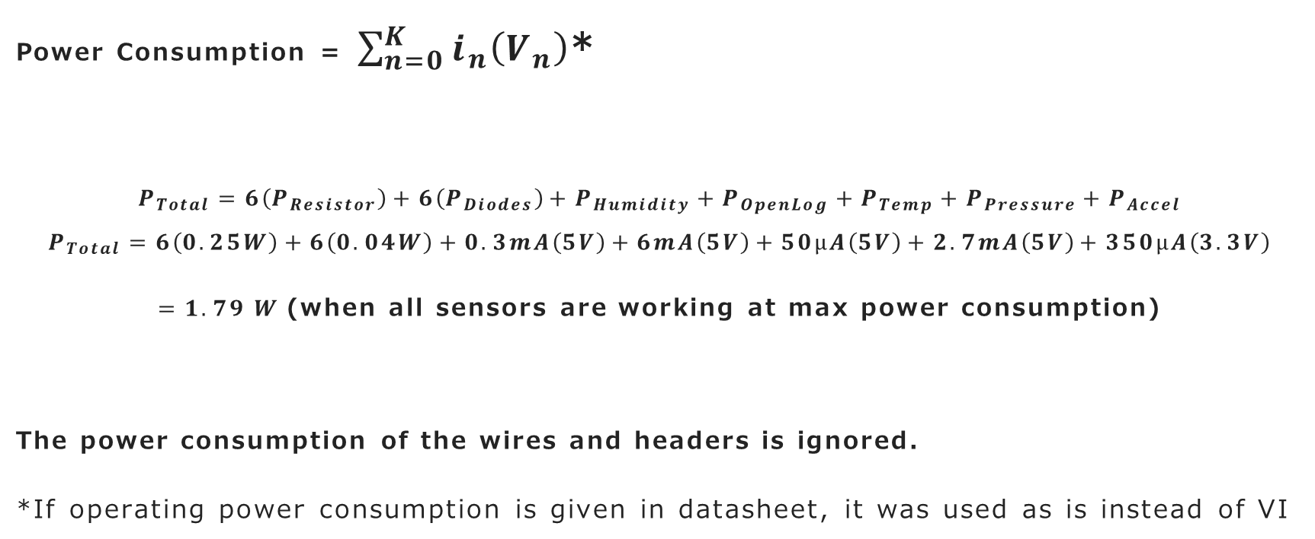
Final Calculation (Power Consumption)
Power Consumption = $\sum_{n=0}^{K}{i_{n}\left(V_{n}\right)}$*
$$P_{Total}=6\left(P_{Resistor}\right)+6\left(P_{Diodes}\right)+P_{Humidity}+P_{OpenLog}+P_{Temp}+P_{Pressure}+P_{Accel}$$
$$P_{Total}=6\left(0.25W\right)+6\left(0.04W\right)+0.3mA\left(5V\right)+6mA\left(5V\right)+50μA\left(5V\right)+2.7mA\left(5V\right)+350μA\left(3.3V\right)$$
$=1.79 W$(when all sensors are working at max power consumption)
The power consumption of the wires and headers is ignored.
*If operating power consumption is given in datasheet, it was used as is instead of VI

Slide 11
Resources
Slides and Code from Old Design (including PCB)
https://www.colorado.edu/center/spacegrant/statewide-programs/remote-kits-learning-modules/high-altitude-balloon-payload-remote-skill-module-0
Component Datasheets (Submitted with PCB files)
Digital Footprints, symbols and CAD models from snapeda.com and componentsearchengine.com

