Slide 1
Breast Cancer DataBase
Team Members
Reem Atef
Doaa Mohammed
Rasha Hamdy
Rana Hamed
Sara Ashraf

Slide 2
We downloaded our DataBase from Kaggle with title
“Breast Cancer Proteomes” and used it in our project…

Slide 3
About Dataset:
This data set contains published iTRAQ proteome profiling of 77 breast cancer samples generated by the Clinical Proteomic Tumor Analysis Consortium (NCI/NIH). It contains expression values for ~12.000 proteins for each sample, with missing values present when a given protein could not be quantified in a given sample.

Slide 4
Data content…
File:cancer.csv
RefSeq_accession_number: RefSeq protein ID (each protein has a unique
ID in a RefSeq database)
gene_symbol: a symbol unique to each gene (every protein is encoded
by some gene)
gene_name: a full name of that gene
Remaining columns: log2 iTRAQ ratios for each sample (protein
expression data, most important), three last columns are from healthy
individuals

Slide 5
Data content…
The Cancer Genome Atlas (TCGA) project to identify samples, including tumors and normal tissues, from cancer patients
File: clinical_data_breast_cancer.csv
First column "Complete TCGA ID" is used to match the sample IDs in the main cancer proteomes file .
All other columns have self-explanatory names, contain data about the cancer classification of a given sample using different methods. 'PAM50 mRNA' classification is being used in the example script.

Slide 6
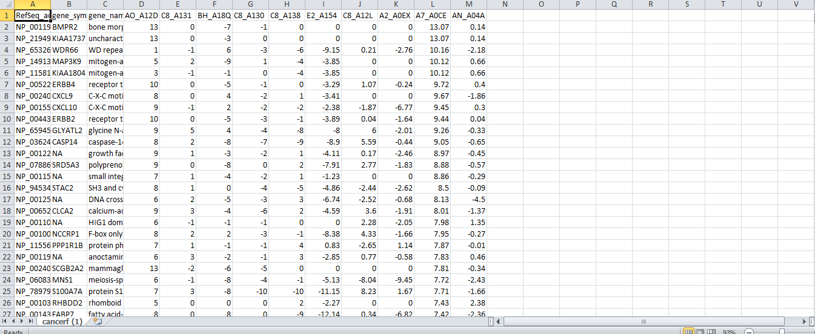
File:cancer.csv

Slide 7
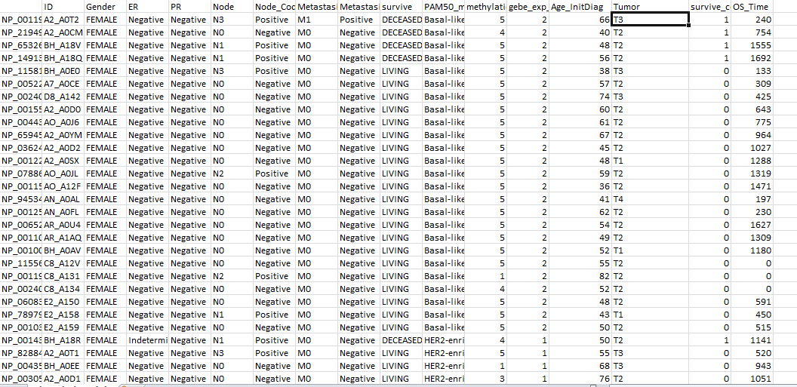
File: clinical_data_breast_cancer.csv

Slide 8
Cancer.csv content:
This dataset contains iTRAQ proteome profiling data for 77 breast cancer samples generated by the Clinical Proteomic Tumor Analysis Consortium (NCI/NIH).
The dataset includes expression values for approximately 12,000 proteins for each sample. Missing values are present when a given protein could not be quantified in a particular sample.
iTRAQ (isobaric tags for relative and absolute quantification) is a mass spectrometry-based proteomics technique used for relative quantification of proteins across multiple samples

Slide 9
clinical_data_breast_cancer content:
This is tabular dataset various information about breast cancer patients from The Cancer Genome Atlas (TCGA)
Each row represents a specific patient, and the columns contain information about the patient, such as the TCGA ID, patient age, tumor characteristics (e.g., ER, PR Statues), cancer stage, and clinical outcomes (e.g., living or deceased).
1-TCGA ID :
The TCGA ID is a unique identifier used by The Cancer Genome Atlas (TCGA) project to identify samples, including tumors and normal tissues, from cancer patients.
in the TCGA breast cancer dataset, the TCGA ID for each sample consists of four parts: TCGA, the cancer type (BRCA for breast cancer), a two-letter code for the institution where the sample was processed, and a four-digit number that identifies the specific patient sample.

Slide 10
2- patient’s Gender
3- patient’s Age
4-ER Status & PR Status
are the Receptor status , Receptor statue is one of the tumor characteristics . Many tumors have receptors on their surface that can bind to certain hormones or growth factors.
5 Node & Node_ coded
refer to the involvement of nearby lymph nodes in the cancer. "Node" indicates the number of lymph nodes that have cancer cells present, while "Node-Coded" is a binary variable indicating whether any lymph nodes have cancer cells present (coded as "Positive") or not (coded as "Negative").

Slide 11
6- Metastasis & Metastasis-Coded
refer to the presence of distant metastases, or cancer cells that have spread to other parts of the body. "Metastasis" indicates the specific sites where metastases have been detected, while "Metastasis-Coded" is a binary variable indicating whether any metastases have been found (coded as "Positive") or not (coded as "Negative").
7-PAM50 mRNA
PAM50 mRNA is a gene expression-based assay that is used to classify breast cancer into distinct subtypes based on patterns of gene expression. It classifies breast cancer into one of five intrinsic subtypes: Luminal A, Luminal B, HER2-enriched, Basal-like, and Normal-like.

Slide 12
8-survival status & survival_code
9-OS Time
represents the number of days from the initial diagnosis to the time of death or last follow-up.
10-methylation Clusters
clustering methods that group samples based on similarities in
DNA methylation
11- Tumor (cancer stage)
Cancer stage is a way of describing the extent or spread of cancer in the body. It is typically determined by a combination of diagnostic tests

Slide 13
First: we link pymongo with python
Second: we create “breast” database
Third: convert our dataset to two collections “cancer”,”clinical-data”
Forth: we make relation between two collections
Fifth : upload the data in pymongo and read them and store them in the two collections
Sixth: we parsing data to dictionaries

Slide 14
And we performed some queries in our data(cancer) like….

Slide 15
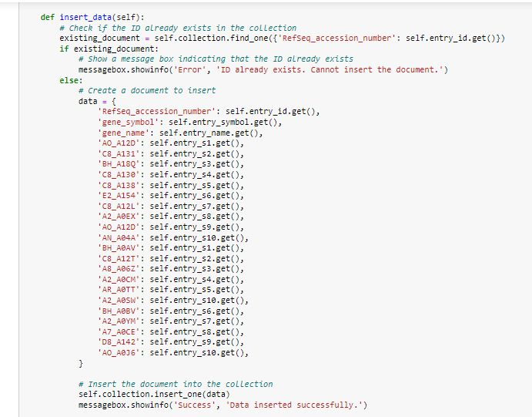
Insert Query:
This query add one document in cancer collection

Slide 16
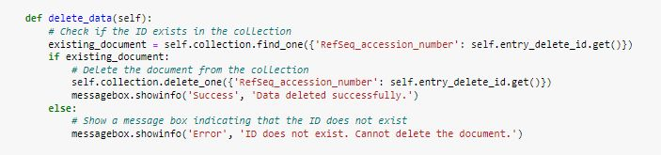
Delete Query:
This query takes the “Refseq-accession-number” and delete it’s document

Slide 17
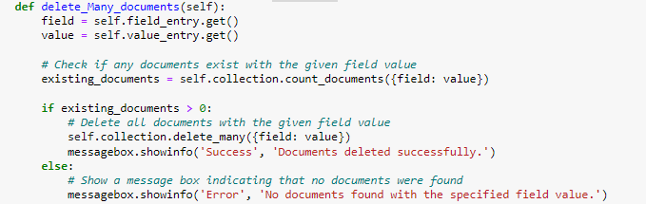
DELETE_MANY Query:
that deletes one or more documents from a collection, first checks if any documents exist with the given field value using the count_documents() method. If there are any existing documents, it deletes all documents with the given field value using the delete_many() method.

Slide 18
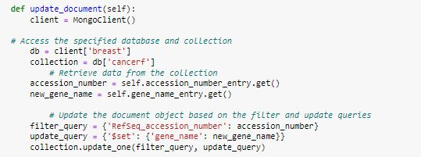
Update Query:
This query takes the “Refseq-accession-number” and “new gene name” and update the “old gene name”

Slide 19
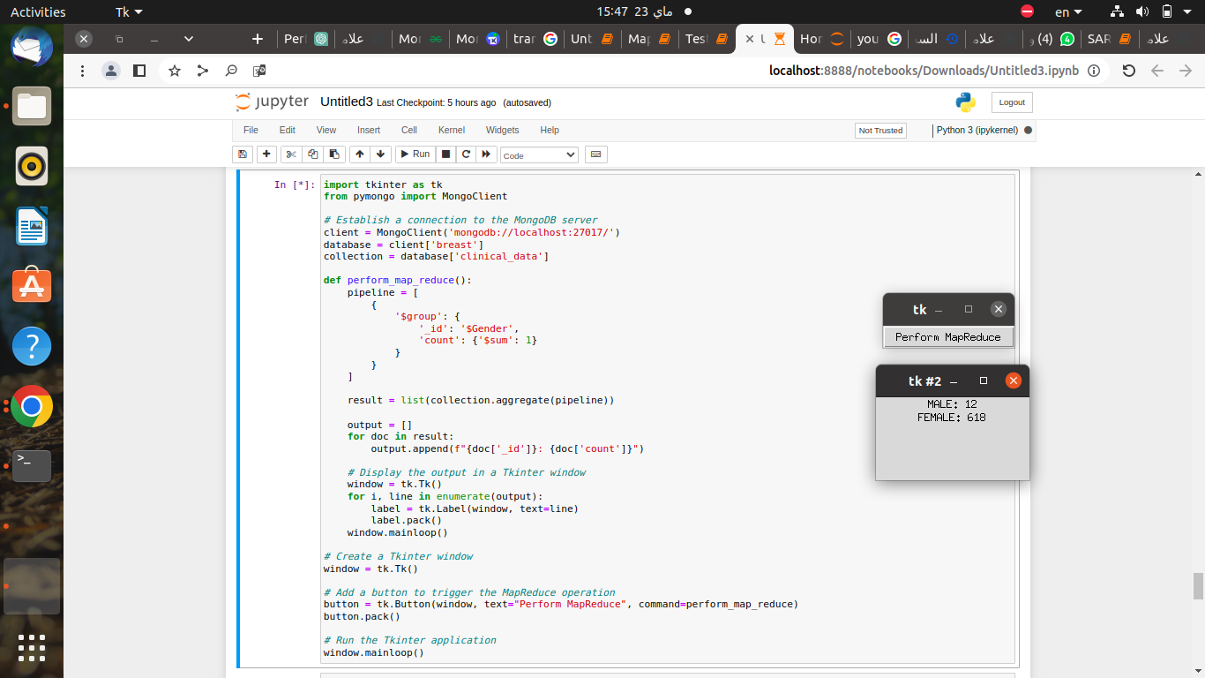
Map_Reduce Query:
Do it query in the gender field return the number of male and female

Slide 20
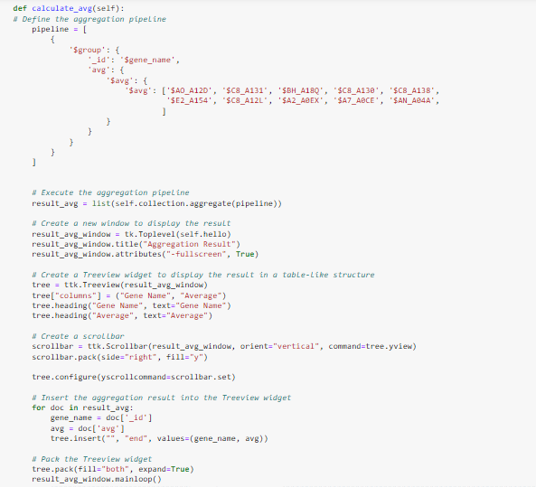
Aggregation Query:
This query group the data by gene name and calculate the average

Slide 21
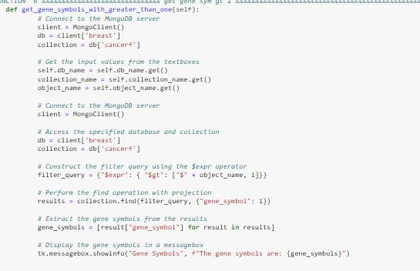
get_gene_symbols_with_greater_than_one Query:
This query return gene sample with value greater than one

Slide 22
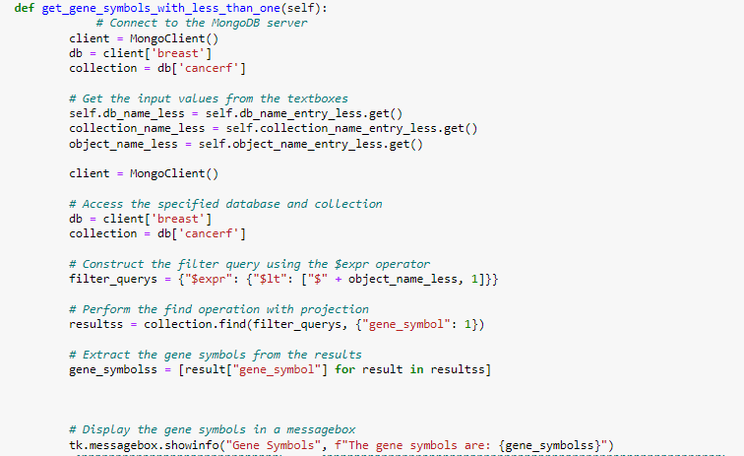
get_gene_symbols_with_less_than_one Query:
This query return gene sample with value less than one

Slide 23
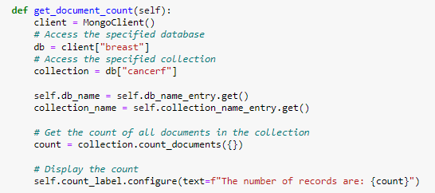
get_document_count Query:
Get the count of all documents in the collection

Slide 24
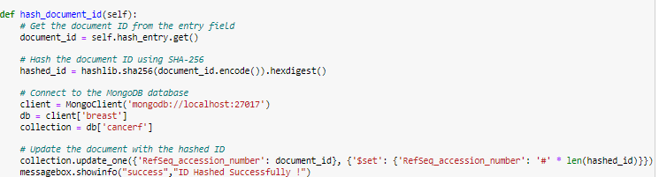
HASH Query :
It takes the “RefSeq_accession_number” and replace it with Hash symbol “#”

Slide 25
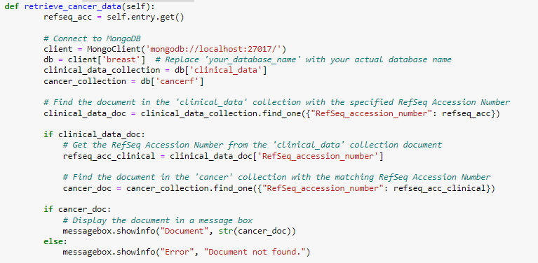
Reference to cancer data Query:
that retrieves a document from a collection based on user input. The function takes one input value (refseq_acc), then finds the document in the clinical_data collection with the specified RefSeq Accession Number using the find_one() method.

Slide 26
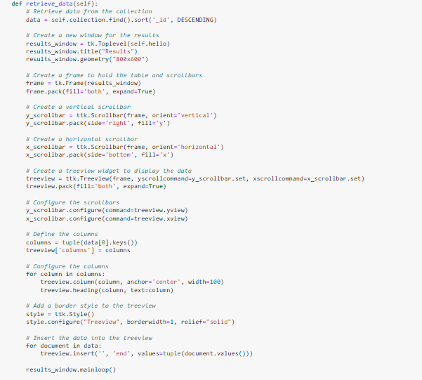
retrieve_data Query (find):
Retrieve data from the collection

Slide 27
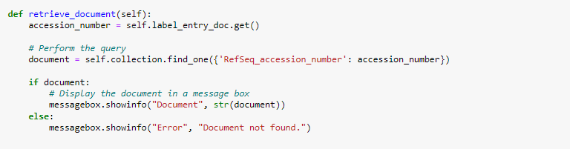
retrieve_document Query:
Retrieve one document from the data

Slide 28
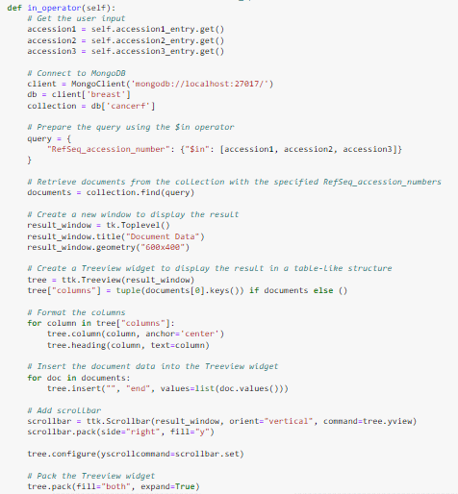
Retrieve with “$In_ operator” Query:
It prepares the query using the $in operator to retrieve documents from the collection with the specified RefSeq Accession Numbers.

Slide 29
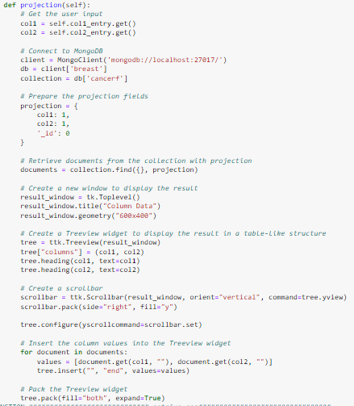
Retrieve “Projection fields” :
It then prepares the projection fields to retrieve the specified fields from the documents and exclude the _id field.

Slide 30
We performed the same queries on the other data(clinical)…

Slide 31
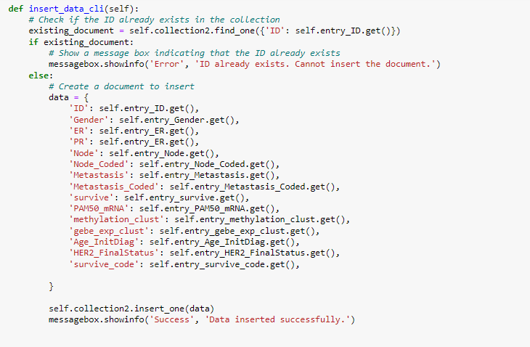
Insert Query:

Slide 32
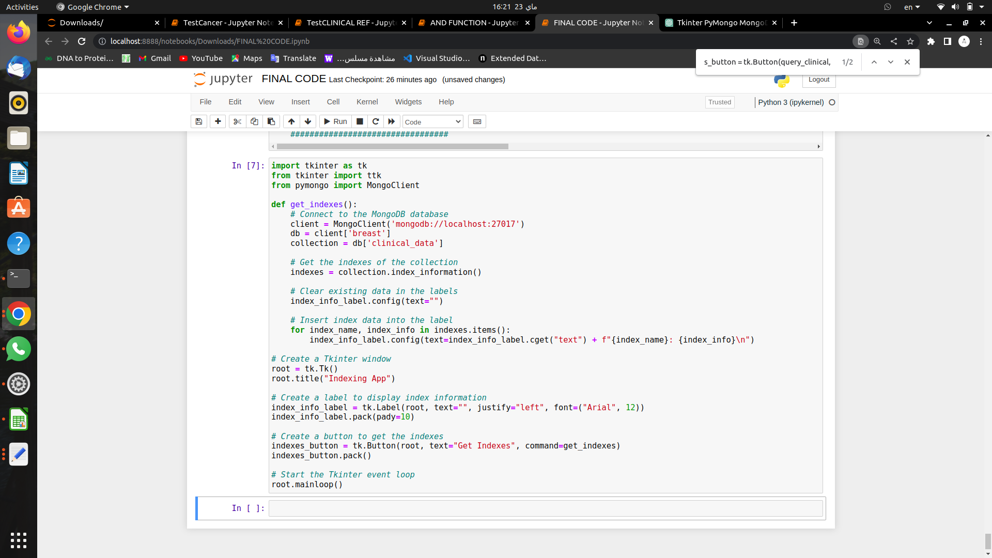
Ensure _index
Function takes field from the fields in the clinical data and make it as index

Slide 33
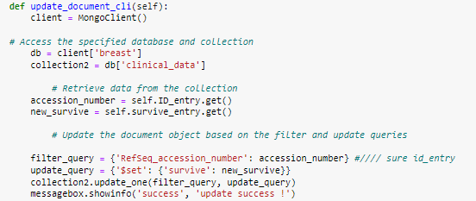
update_document_clinical Query:
this query allows the user to update a document in a collection based on a specified RefSeq Accession Number and new survive value.

Slide 34
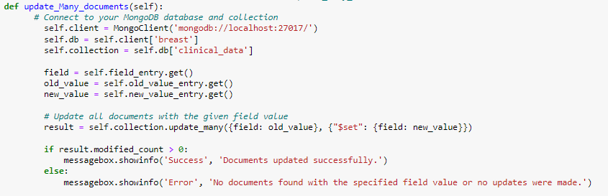
Update_Many_documents Query:
this function allows the user to update one or more documents in a collection based on specified field, old value, and new value

Slide 35
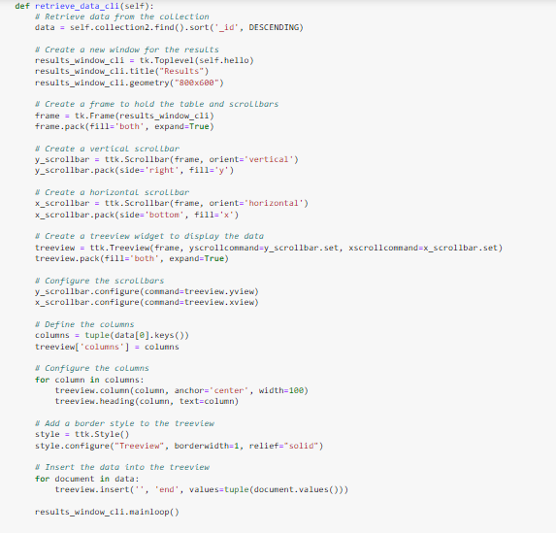
Retrieve_data Query (find):

Slide 36
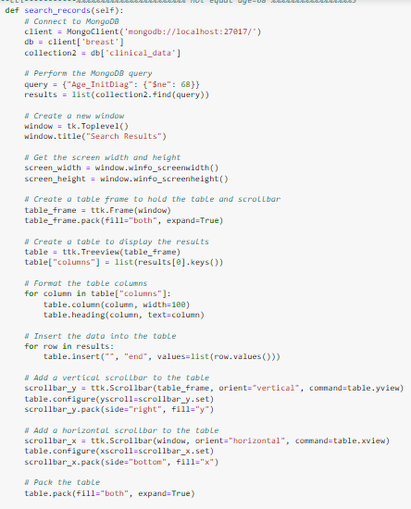
Retrieve “search_records” Query:
The function performs a MongoDB query to retrieve all documents from the clinical_data collection where the Age_InitDiag field is not equal to 68. It stores the results in the results variable.

Slide 37
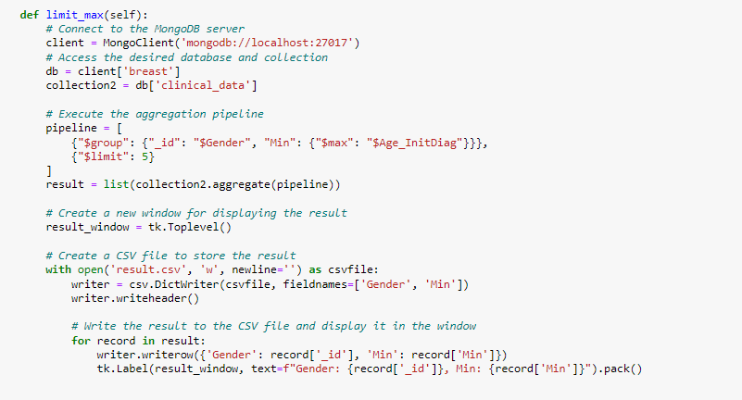
Aggregation Query:
This query executes the aggregation to find the maximum age for each gender in the collection, groups documents by gender and calculate the maximum age of diagnosis and limits the number of documents returned to 5.

Slide 38

Aggregation Query:
This query executes the aggregation to find the minimum age for each gender in the collection, groups documents by gender and calculate the minimum age of diagnosis and limits the number of documents returned to 3.

Slide 39
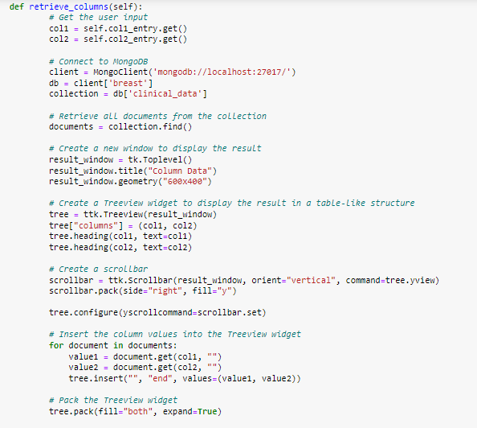
Retrieve_columns(2COL) Query:
that retrieves specific columns from a collection, it retrieves all documents from the collection using the find() method and iterates over each document to extract the values of the specified columns.

Slide 40
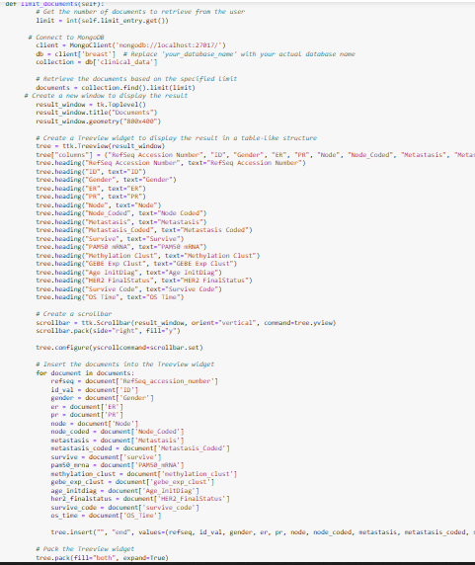
limit_documents Query:
retrieves a limited number of documents from a collection, it retrieves the specified number of documents from the collection using the find().limit() method.

Slide 41
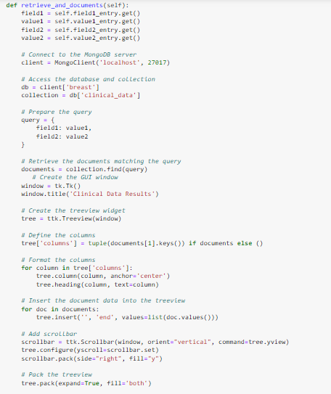
retrieve_and_documents Query(AND):
It retrieves documents from a collection based on user input, It then prepares a query using the specified fields and values. It retrieves the documents matching the query using the find() method.

Slide 42
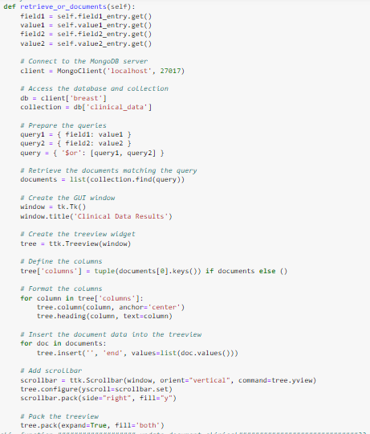
retrieve_or_documents Query (OR):
It prepares two separate queries using the specified fields and values. It creates a third query using the $or operator that combines the two previous queries.The function retrieves the documents matching the combined query using the find() method and stores them in a list.

Slide 43
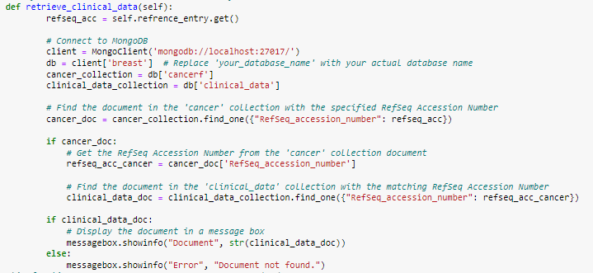
Retrieve clinical data Query:
retrieves clinical data from a collection based on a specified RefSeq Accession Number. It then searches for the document in the 'cancer' collection with the specified RefSeq Accession Number using the find_one() method. If the document is found, it gets the RefSeq Accession Number from the 'cancer' collection document and then searches for the document in the 'clinical _data' collection with the matching RefSeq Accession Number using the find_one() method.

Slide 44
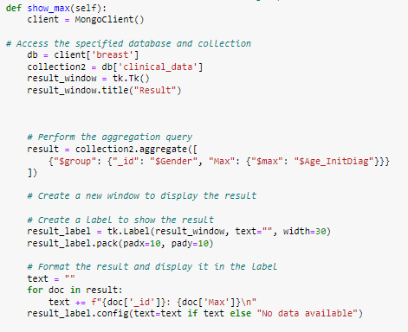
Aggregation (show_max) Query:
It performs an aggregation query to find the maximum value of the Age_InitDiag field for each gender in the clinical_data collection.

Slide 45
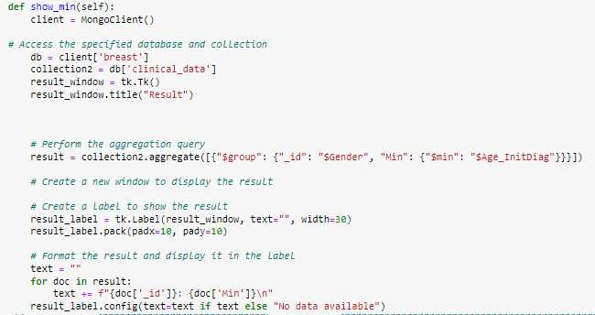
Aggregation (show_min) Query:
It performs an aggregation query to find the minimum value of the Age_InitDiag field for each gender in the clinical_data collection.

Slide 46
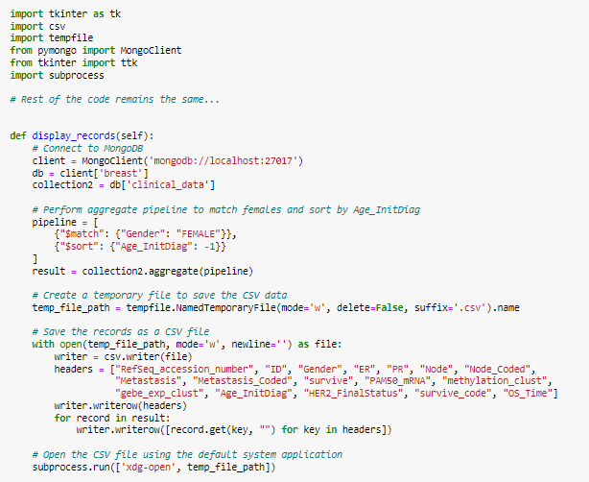
Sort female Age_InitDiag Query:
It performs an aggregation pipeline to retrieve specific records from the clinical_data collection. The function filters the records to match only those for female patients and sorts them in descending order by Age_InitDiag.

Slide 47
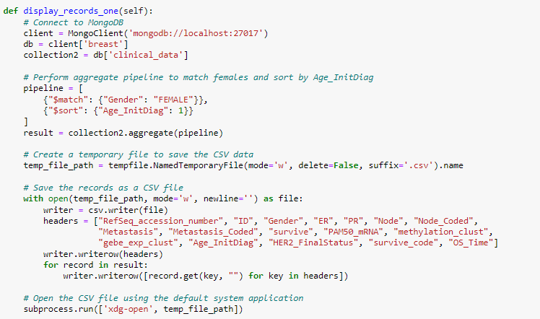
Sort in ascending order Query:
that performs an aggregation pipeline to retrieve specific records from the clinical_data collection. The function filters the records to match only those for female patients and sorts them in ascending order by Age_InitDiag.

Slide 48
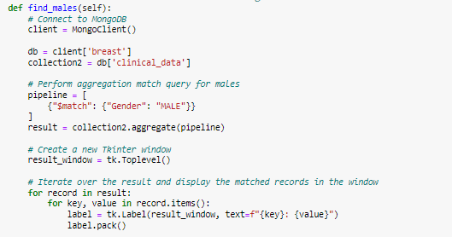
Aggregation find_males (match) Query:
It performs an aggregation pipeline to retrieve specific records from the clinical_data collection. The function filters the records to match only those for male patients.

Slide 49
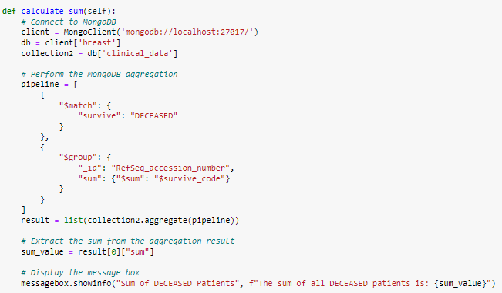
Aggregation “sum operation” Query:
The function performs a MongoDB aggregation using a pipeline that first matches documents where the survive field equals "DECEASED", and then groups the matching documents by RefSeq_accession_number and calculates the sum of the survive_code field for each group.

Slide 50
Then we visualized our data using visualization plots like…

Slide 51
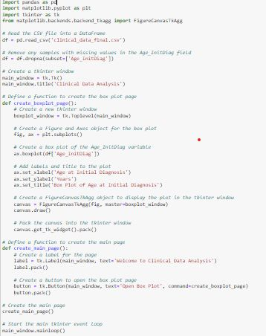
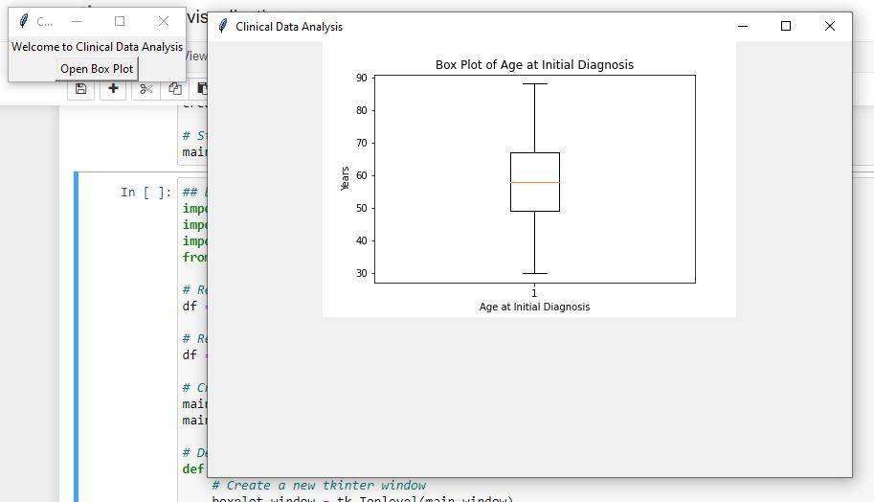
Using BoxPlot…
boxplot about Age at Initial Diagnosis & RefSeq_accession_number

Slide 52
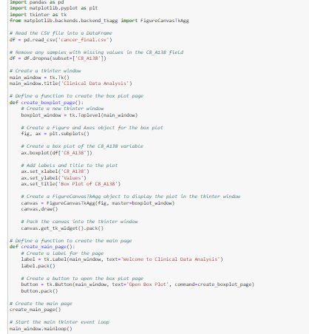
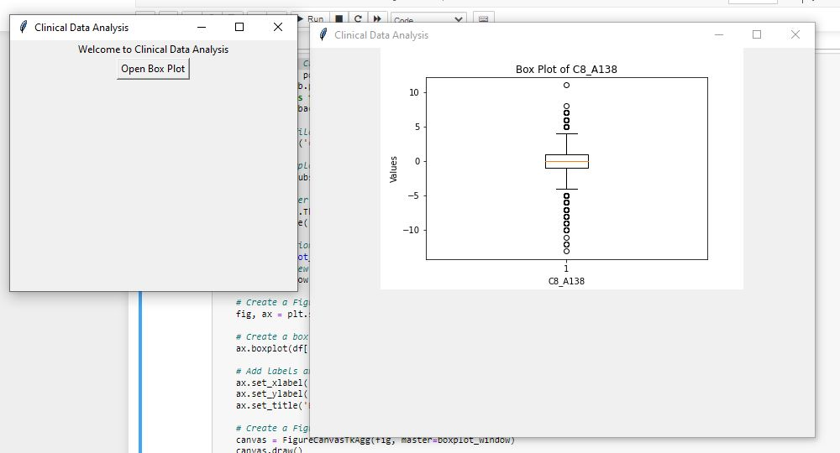
Using BoxPlot…
boxplot about C8_A138 Sample from cancer collection

Slide 53
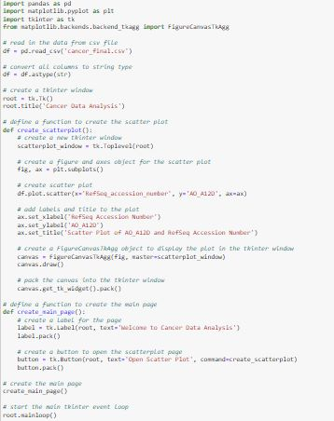
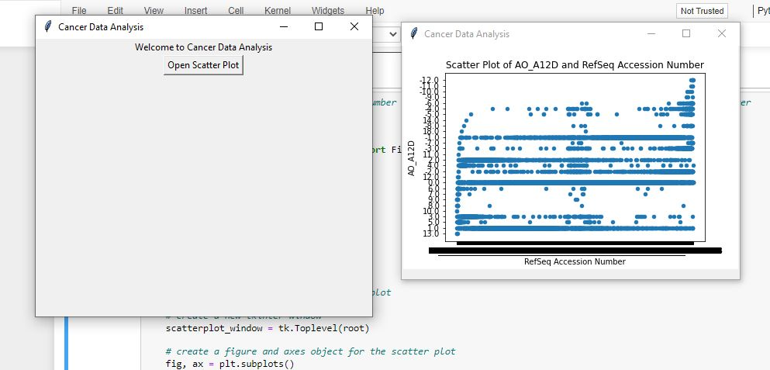
Using Scatter Plot…
scatter plot between RefSeq_accession_number on x-axis and AO_A12D on y-axis from cancer data

Slide 54
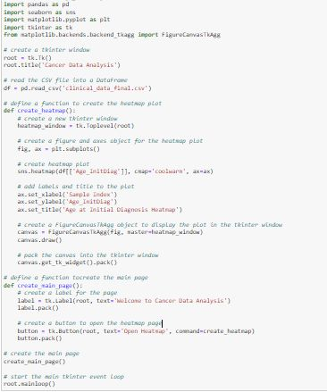
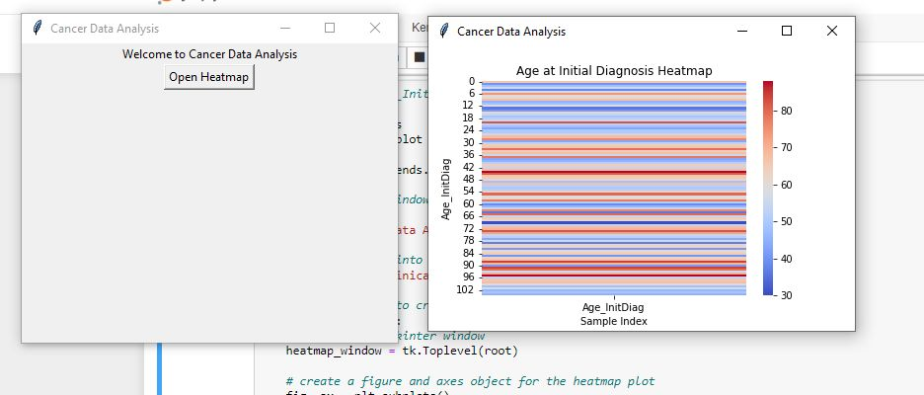
Using Heatmap…
heatmap about Age_InitDiag

Slide 55
Reference
Link download dataset from kaggle:
https://www.kaggle.com/datasets/piotrgrabo/breastcancerproteomes?resource=download&select=clinical_data_breast_cancer.csv

Slide 56
Thanks

