Slide 1
Emergent altermagnetism and pairing
in the checkerboard Hubbard model
Weekly update | finite-size validation and the pairing mechanism
Rana Imran Mushtaq and Ho-Kin Tang 5 August 2026
Notes:
25 minute talk. Aim: the pairing mechanism is now established at L=12, four meeting points closed, and the manuscript has a structure.

Slide 2
Where we were last week
Established
Interactions drive Néel order near half filling. With δ ≠ 0 that order becomes an altermagnet with d(xy) symmetry.
The equal-time vertex is CP-biased, so we moved to the integrated vertex.
Open
Everything rested on a 6 × 6 lattice. Was any of it a small-cluster artifact?
Did the pairing follow the magnetic order, or just the anisotropy?
This week answers both.
A complete finite-size study at L = 8, 10 and 12 tests the first question, and it changed one of our conclusions. A magnetic cube at L = 12 tests the second, and it confirmed the mechanism.
Four meeting points closed: 4, 9, 11 and 12.
Notes:
Set up the two questions this week answers.

Slide 3
What was run this week
3900
6
6
~150
measurements in the
completed pairing cube
compute nodes
running in parallel
independent seeds at
every single point
node-hours of
CPQMC this week
run | grid | status
Pairing cube | L = 8, 10, 12 × U = 0–8 × 6 fillings × 5 δ × 6 seeds | complete
Magnetic cube | L = 12, 10, 8 × U = 0–8 × 6 fillings × 5 δ × 6 seeds | U = 0 and U = 4 done
Dense filling scan | L = 12, U = 4, 19 fillings, Δn = 0.028 | 7 of 19
Spectral machinery | G(k,τ), dispersion fit, ALF bridge | built and validated
Six seeds at every point throughout, so the error bars are real rather than indicative. The pairing cube merges with the earlier L = 6 grid into a single 3900-row dataset.
Notes:
Emphasise the scale and that six seeds everywhere is publication quality, not a scan.

Slide 4
The model
Single-band Hubbard on the checkerboard lattice. Hopping is strictly spin independent.
t = 1
nearest neighbour, sets the energy unit
t′ = −0.3
diagonal bonds, on alternating plaquettes only
t± = t′ ± δ
the two diagonals differ. δ is a one-body geometric parameter and produces no spin splitting by itself.
Δn(k) vanishes at δ = 0 and grows into a d(xy) pattern with δ. The state is compensated: zero net moment, but the bands are spin split at generic k. Crucially, this requires the interaction. The hopping matrix itself is spin independent, so at U = 0 there is no splitting for any δ.
Notes:
The key point: nothing is imposed. Spin splitting needs U and delta together.

Slide 5
Why the form factor is d(xy), and why that is not a choice
The two sublattices are defined by the parity of x + y, and they differ only in which diagonal of a crossed plaquette carries the larger hopping.
They are exchanged by a 90° rotation, not by a translation or an inversion. That is the defining property of an altermagnet.
Under the same 90° rotation, sin(kx)·sin(ky) changes sign. So any sublattice-staggered spin polarisation must carry d(xy) symmetry.
Consequences
The lattice geometry fixes the symmetry. It is not fitted or assumed.
Square-lattice altermagnet models give d(x²−y²) instead, so the checkerboard picks a different pairing channel.
At δ ≠ 0 the unit cell has two sites and the spectrum has two bands. Verified from the hopping matrix: only the (1,1) translation survives.
This is the load-bearing observation for the whole paper. Because the magnetic form factor is fixed to d(xy) by geometry, we can ask a question the imposed-splitting studies cannot: if the magnetic order has d(xy) symmetry, which pairing channel survives?
Notes:
Spend a minute here. This licenses the whole argument.

Slide 6
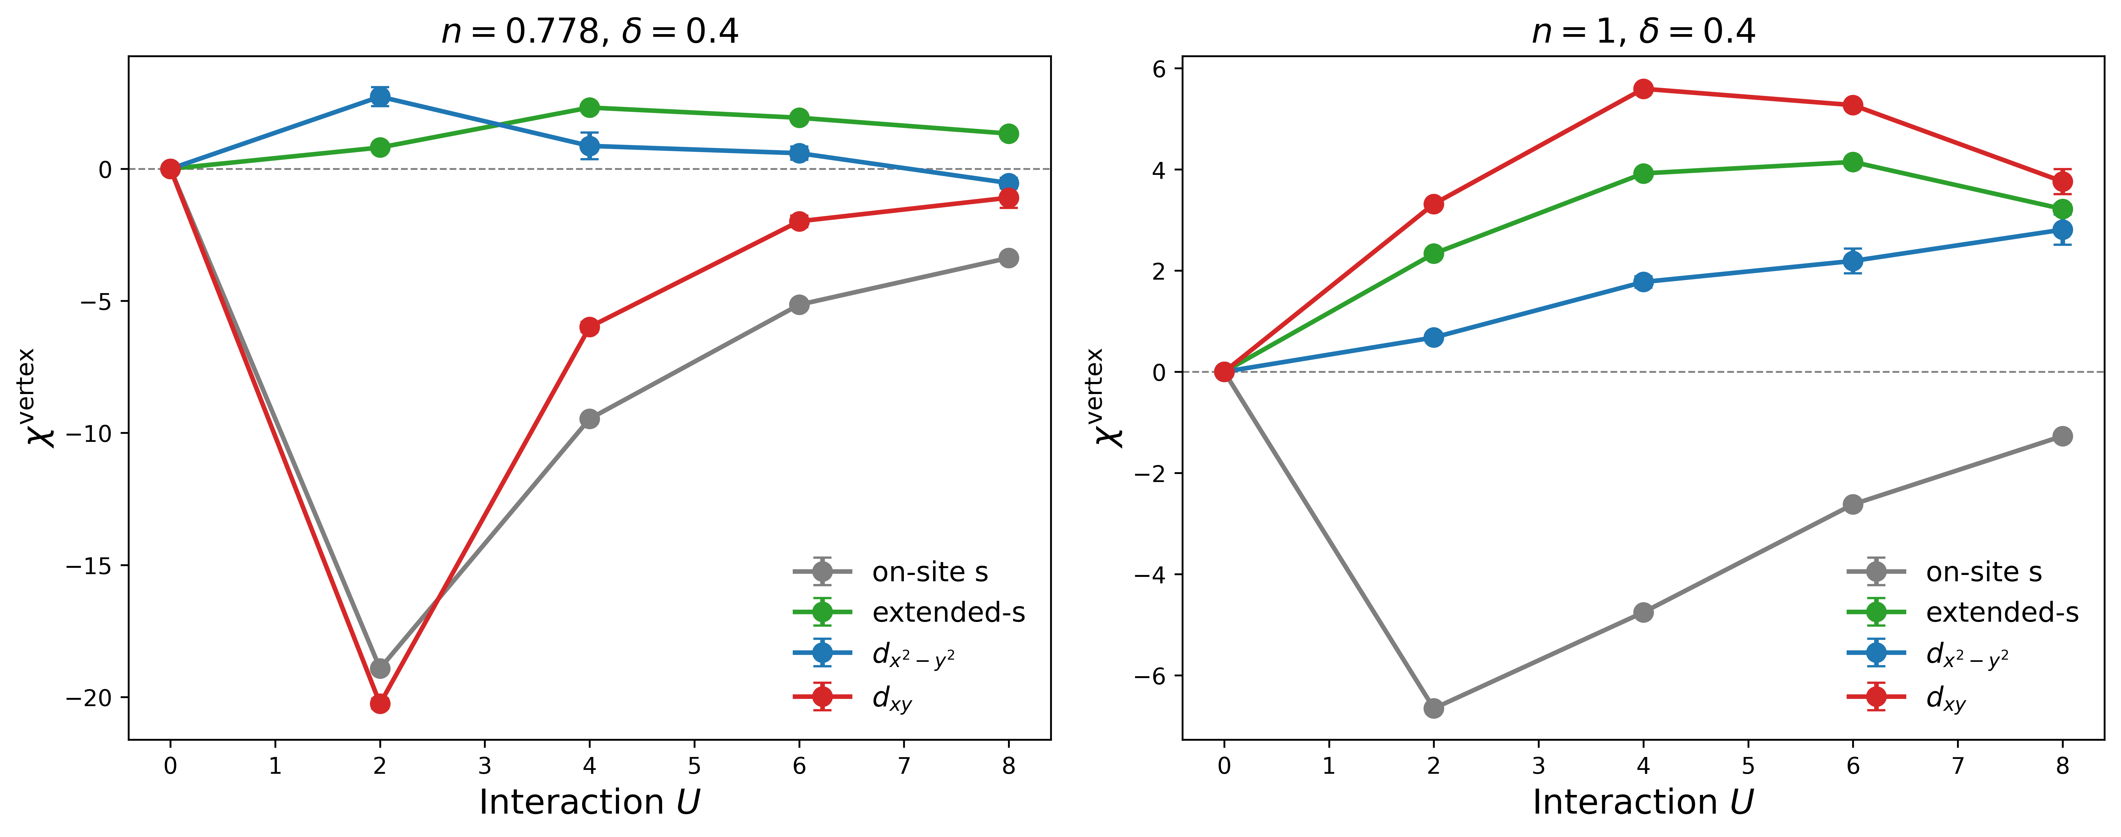
What we measure, and the null test that validates it
Pair operator with zero centre-of-mass momentum (the Γ point). The internal symmetry is carried entirely by the form factor f(i,j).
Four channels: on-site s, extended s, d(x²−y²), d(xy).
We report the connected VERTEX, χ = full − bubble, integrated over imaginary time. The vertex isolates the interaction-induced part, and positive means attractive.
The equal-time vertex is CP-biased, as the ED gate showed. The integrated form is the one that passed the benchmark.
Null test
At U = 0 the full correlator IS its own bubble, so the vertex must vanish identically.
We recover 10⁻¹³ to 10⁻¹⁴ in all four channels, at every size, filling and δ.
Meeting point 4, answered: we compute at q = 0, the Γ point.
Notes:
The U=0 null test does double duty: validates the code and shows the physics is interaction driven.

Slide 7
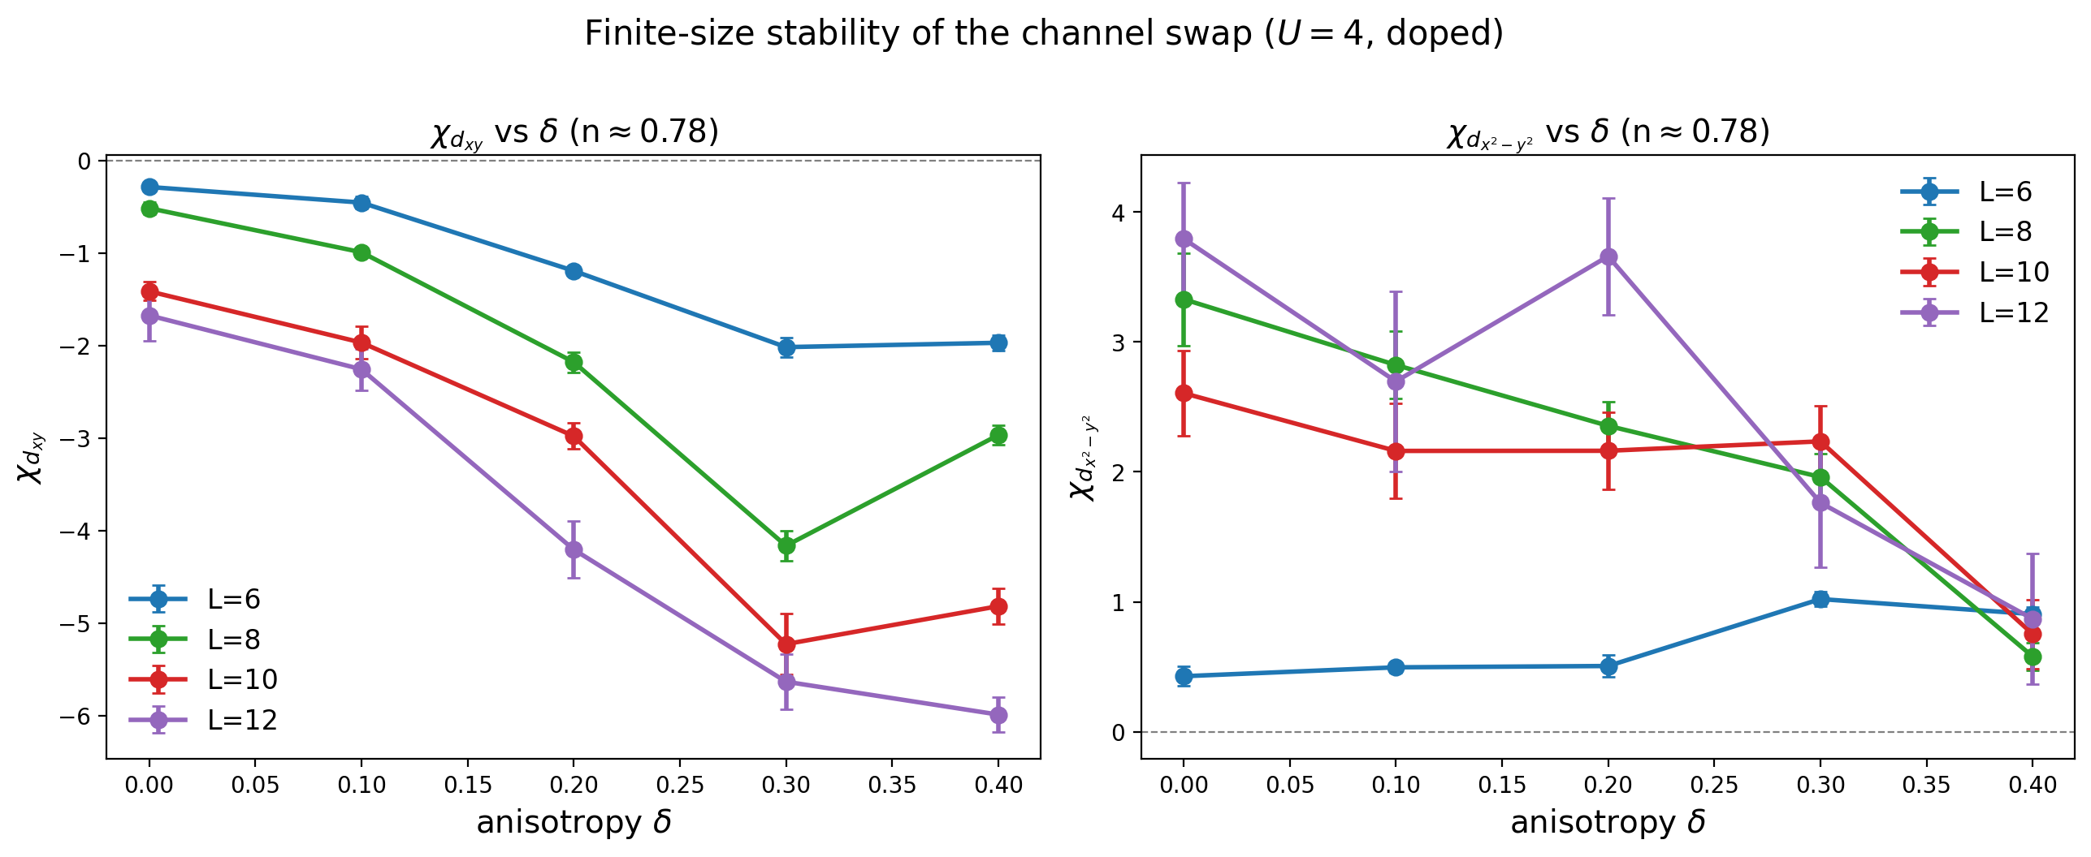
Main result: the anisotropy selects the pairing channel
L = 12, U = 4, doped filling n ≈ 0.78.
δ = 0 → δ = 0.4
d(xy): −1.68 → −5.99
d(x²−y²): +3.79 → +0.87
Both weaken. d(xy) is destroyed. d(x²−y²) survives and stays attractive.
This is not a competition in which one channel grows as the other shrinks. Both weaken. The order parameter has d(xy) symmetry, so it couples to the pairing channel of the same symmetry and leaves the orthogonal one comparatively untouched. d(x²−y²) wins by surviving.
d(x²−y²) exceeds d(xy) at n ≈ 0.78 in all 16 combinations of four lattice sizes and four interaction strengths, and the margin grows with L.
Notes:
The headline. Stress 'both weaken' - the selection is which survives.

Slide 8
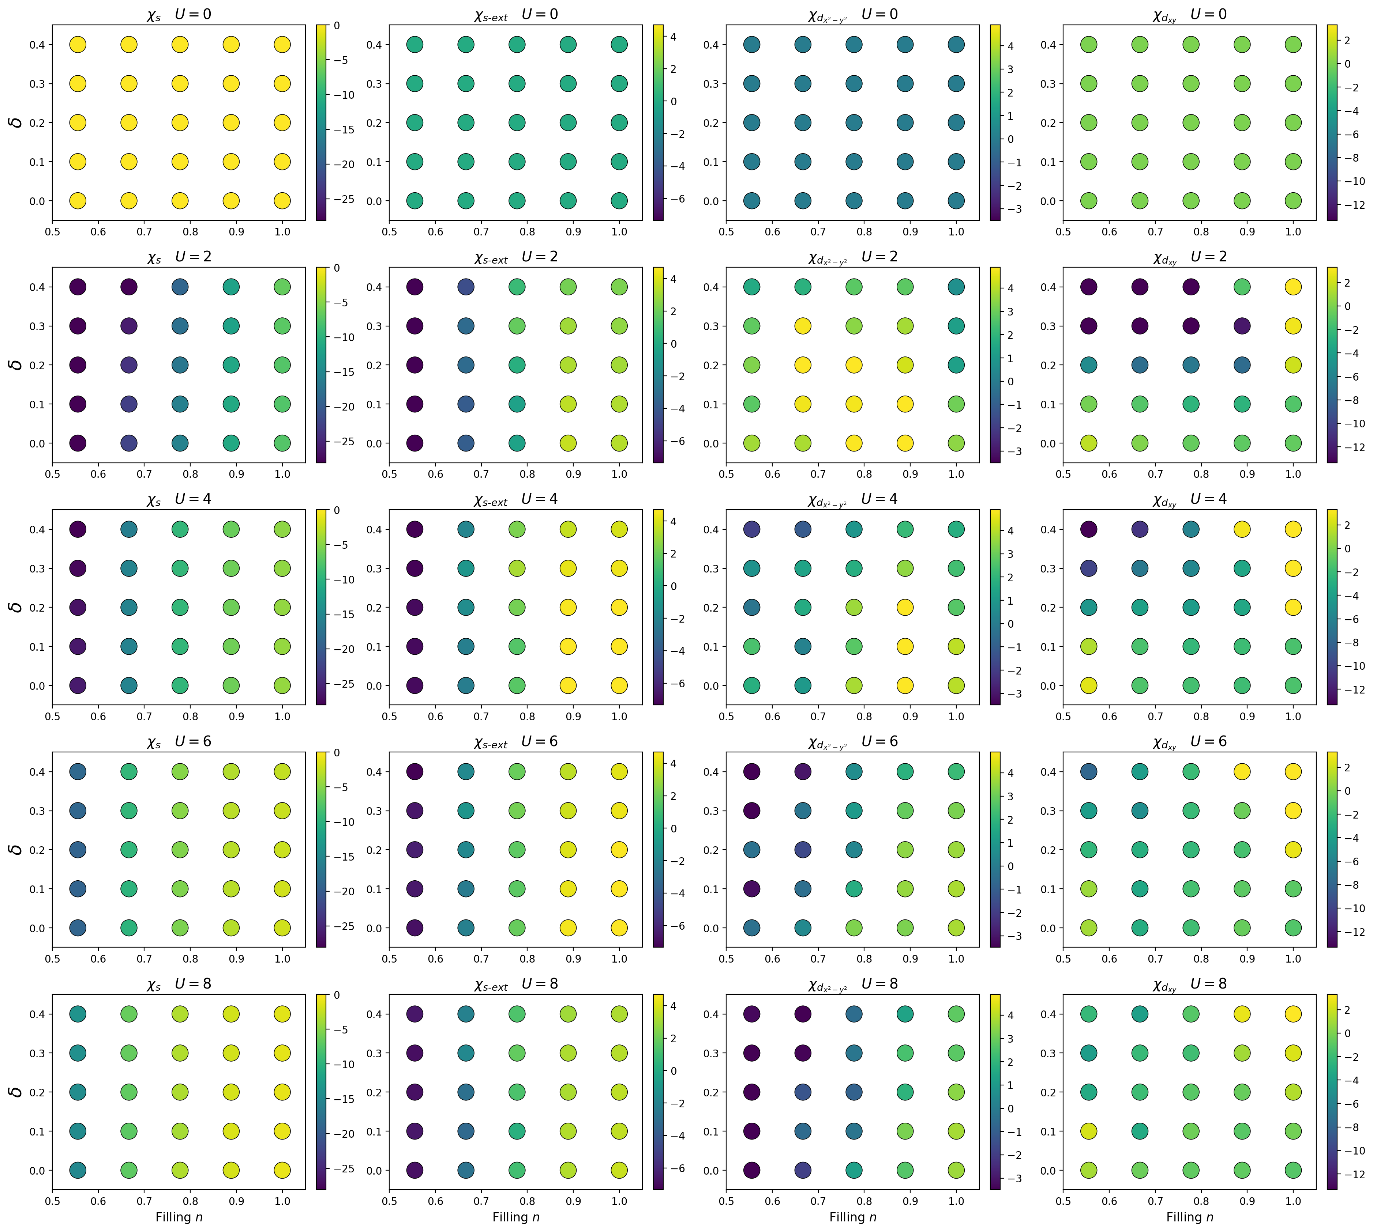
All four channels, all interaction strengths, L = 12
Notes:
Columns: on-site s, extended s, dx2-y2, dxy. Rows: U = 0 to 8. Top row is the null test.

Slide 9
Only d(xy) reverses sign with filling
Change in χ between δ = 0 and δ = 0.4, at L = 12, U = 4. Both channels shown.
filling n | d(xy) δ = 0 | d(xy) δ = 0.4 | d(xy) change | d(x²−y²) δ = 0 | d(x²−y²) δ = 0.4 | d(x²−y²) change
0.500 | +3.41 | −21.39 | −24.79 | −2.04 | −1.94 | +0.11
0.556 | +2.57 | −13.62 | −16.19 | +1.80 | −1.91 | −3.71
0.667 | −1.36 | −10.79 | −9.43 | +1.01 | −1.11 | −2.12
0.778 | −1.68 | −5.99 | −4.31 | +3.79 | +0.87 | −2.93
0.889 | −1.87 | +2.99 | +4.86 | +6.17 | +2.14 | −4.03
1.000 | −1.42 | +5.60 | +7.02 | +3.98 | +1.78 | −2.21
Sign of the change, filling by filling
d(xy): − − − − + +
d(x²−y²): + − − − − −
Only d(xy) reverses. d(x²−y²) weakens uniformly, with no structure.
d(xy) is about eight times more responsive to δ.
Its change spans a range of 32 (−24.79 to +7.02). The d(x²−y²) change spans 4 (+0.11 to −4.03). The channel sharing the order parameter's symmetry responds strongly and with filling-dependent sign. The orthogonal one only drifts down, as a control should.
The reversal sits between n = 0.778 and n = 0.889. The dense-filling scan now running resolves that region in steps of 0.028 and will locate it properly.
Notes:
The contrast between the two tables IS the symmetry argument, made quantitative. Only the channel carrying the order parameter symmetry reverses. Note also this explains the apparent conflict with the old equal-time figures, which were plotted in the doped region.

Slide 10
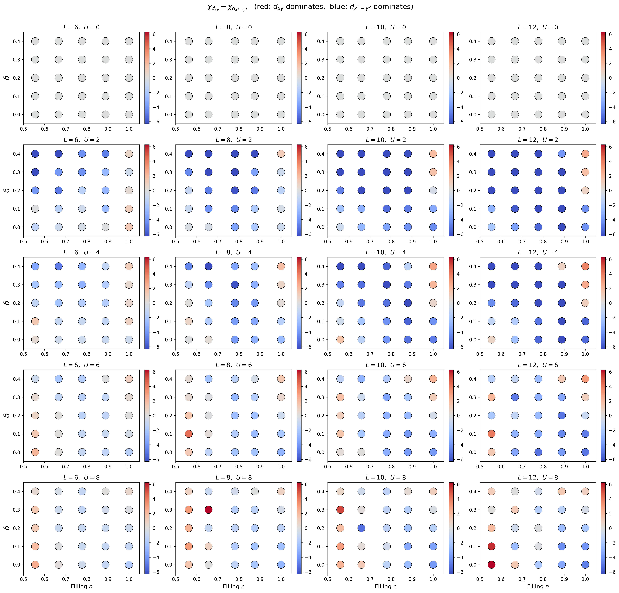
The selection across the whole phase diagram
χ(d_xy) − χ(d_x²−y²). Blue: d(x²−y²) dominates. Red: d(xy) dominates.
Notes:
Rows U, columns lattice size. Blue fills the doped region at every size and U. Red is confined to the half-filling column.

Slide 11
Half filling: a sharp threshold near δ ≈ 0.2
χ(d_xy) − χ(d_x²−y²) at n = 1.0, L = 12. Positive means d(xy) dominates.
 | δ = 0 | δ = 0.1 | δ = 0.2 | δ = 0.3 | δ = 0.4
U = 2 | −4.19 | −4.31 | +0.82 | +1.77 | +2.64
U = 4 | −5.40 | −5.54 | +1.05 | +2.64 | +3.82
U = 6 | −5.03 | −4.81 | −0.88 | +1.05 | +3.08
U = 8 | −4.79 | −4.06 | −2.08 | −0.41 | +0.95
Caveat
n = 1 under periodic boundaries is open-shell: the bands touch at (0,π) and (π,0), so the trial state is degenerate.
Too systematic across sizes and U to be noise, but it needs the twist-averaged run before we publish it.
A clean sign change at the same δ for every interaction strength. Combined with the previous slide, δ acts with opposite sign either side of half filling.
Notes:
Flag the open-shell caveat before anyone asks.

Slide 12
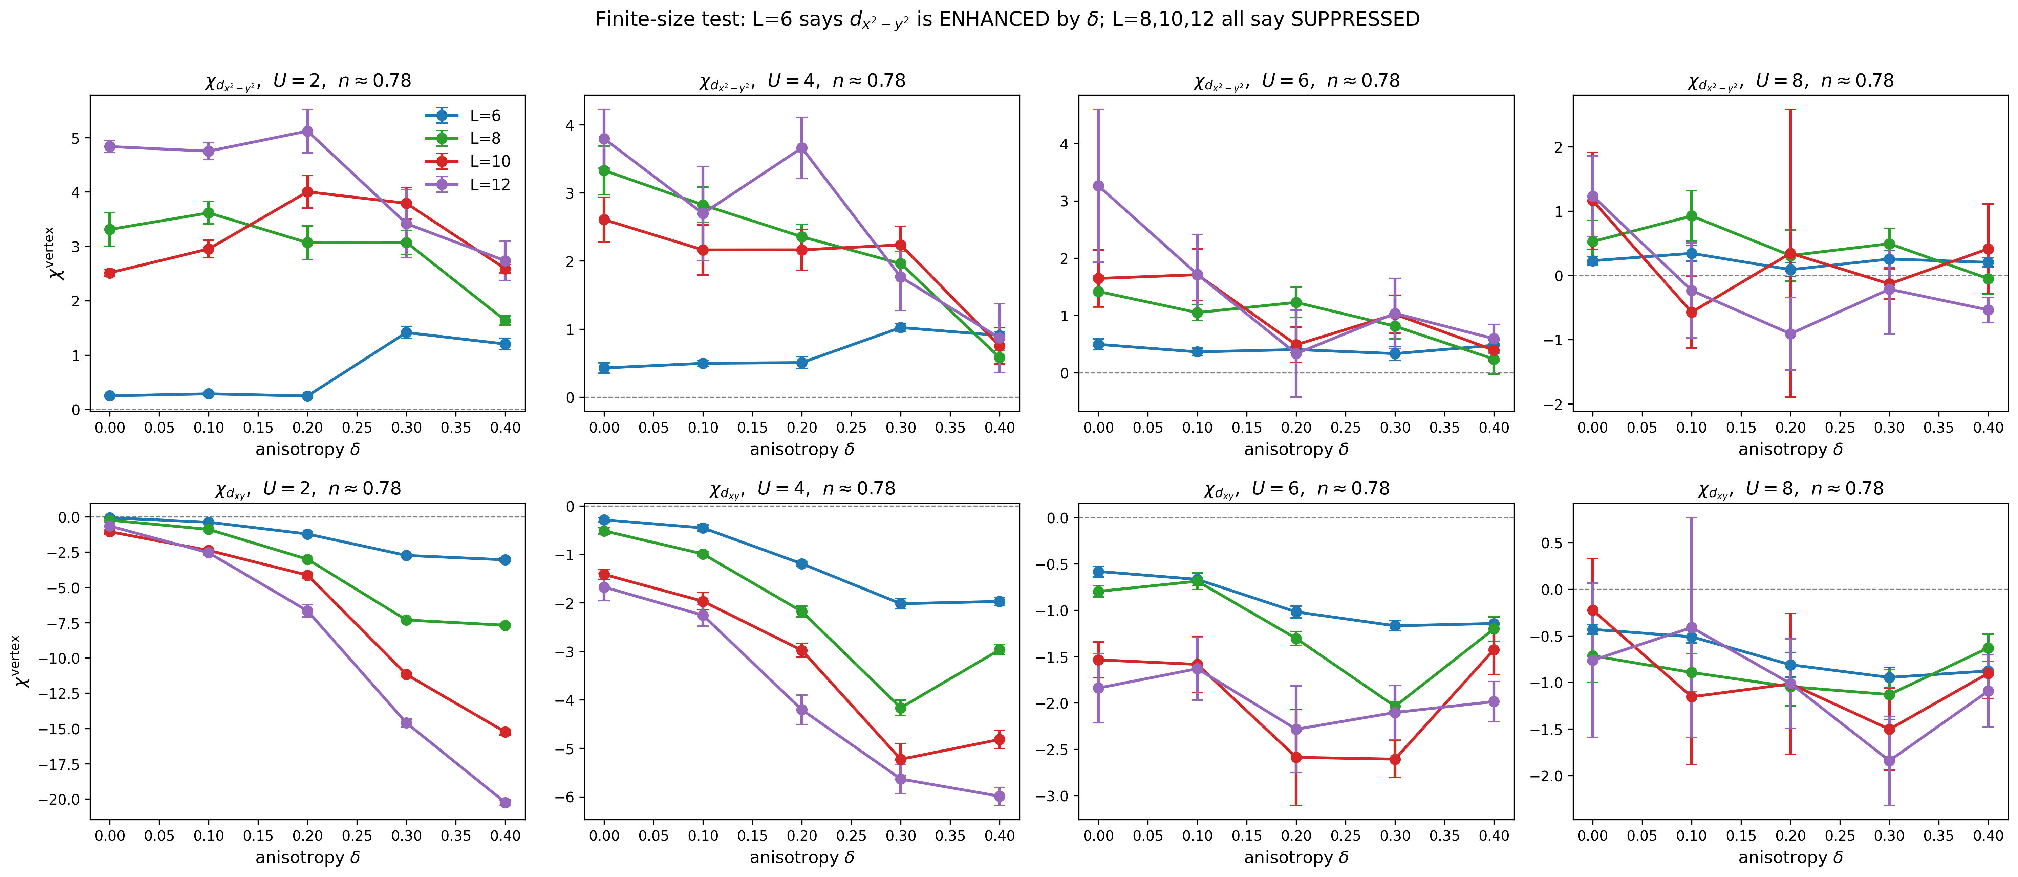
A previous result did not survive
On 6 × 6, d(x²−y²) appears ENHANCED by δ at 5.3σ. Every larger lattice reverses the sign, at 4 to 7σ.
χ(0.4) − χ(0)
L = 6: +0.48 ± 0.09
L = 8: −2.75 ± 0.37
L = 10: −1.85 ± 0.42
L = 12: −2.93 ± 0.66
The L = 6 trend has a small error bar and a consistent sign across seeds. It is significant, and it is wrong.
Only the comparison across sizes reveals it. Consequence: L = 6 is no longer used for any physics claim, and every number we report is L = 12.
Notes:
Frame as a strength. The finite-size study caught a wrong claim before publication.

Slide 13
The same audit found a second L = 6 error
Ranking all four channels point by point over the (n, δ) plane at U = 4:
lattice | extended s leads | d(x²−y²) leads | d(xy) leads
L = 6 | 13 of 25 | 8 | 4
L = 8 | 8 | 13 | 4
L = 10 | 7 | 15 | 3
L = 12 | 7 | 15 | 3
L = 6 puts extended s first. All three larger lattices put d(x²−y²) first.
Our committed figure uses U = 8, where the sizes happen to agree, so it is safe.
Magnitudes are wrong too, even where signs agree.
At δ = 0, U = 4, n ≈ 0.78: χ(d(x²−y²)) is +0.43 at L = 6 and between +2.61 and +3.79 on the larger lattices. Quoting L = 6 would understate the attraction sixfold.
This belongs in the paper. 6 × 6 clusters remain common in this literature, and the failure is invisible from within a single lattice size.
Notes:
Two independent L=6 failures found by the same audit.

Slide 14
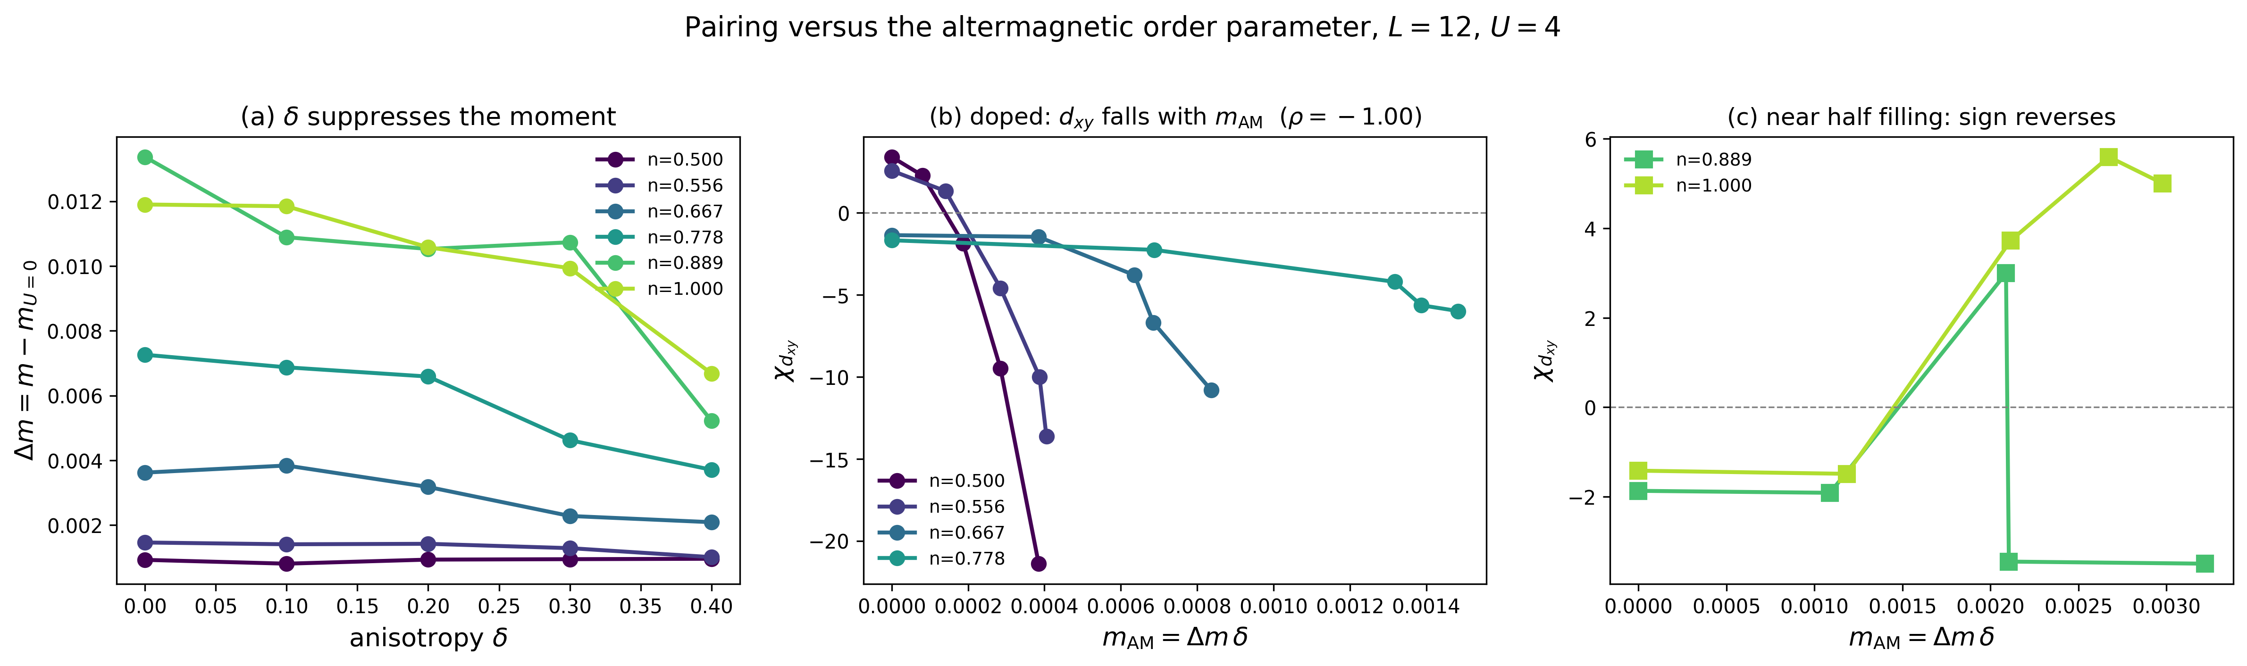
New: the anisotropy destroys the magnetism that creates it
Interaction-induced moment Δm = m − m(U=0), at L = 12, U = 4.
filling n | Δm at δ = 0 | Δm at δ = 0.4 | change
0.667 | 0.0036 | 0.0021 | −42%
0.778 | 0.0073 | 0.0037 | −49%
0.889 | 0.0134 | 0.0052 | −61%
1.000 | 0.0119 | 0.0067 | −44%
Meeting point 9, answered.
The altermagnetic anisotropy weakens the Néel order that it converts into an altermagnet. The mechanism is self-limiting.
Notes:
Point 9 has been open since the first meeting. Note also that m must be sqrt(S/N), not sqrt(S) - S(pi,pi) is extensive once there is long-range order.

Slide 15
The order parameter needed fixing first
M = √S(π,π) is not an order parameter. At U = 0 we measure M between 0.24 and 0.43 across fillings, where by construction there is no order at all.
It is the structure-factor amplitude. Also, S(π,π) is extensive once long-range order develops, so the size-comparable moment is m = √(S(π,π)/N).
The replacement
m_AM = Δm · δ, Δm = m − m(U=0)
Vanishes if either the interaction or the anisotropy is absent, as an altermagnetic order parameter must.
This matters for the manuscript: the current abstract states that the splitting scales as the product Mδ. That claim does not survive the U = 0 measurement and needs rewriting.
A candidate we tested and rejected.
Ψ = (1/N) Σq sin(qx) sin(qy) S(q) looked like a general definition, but it failed its null test on the L = 14 archive: the δ = 0 value is the same size as the δ ≠ 0 values, with no monotonic trend. The reason is structural, since (π,π) is invariant under the 90° rotation, so any rotation-odd weight vanishes exactly where the magnetic weight sits.
Notes:
Honest negative result. Worth showing that we tested and discarded it for a reason.

Slide 16
Pairing tracks the order parameter at every U
Rank correlation of χ(d_xy) with m_AM = Δm · δ, at fixed filling and fixed U. L = 12, complete magnetic cube.
filling n | U = 2 | U = 4 | U = 6 | U = 8
0.500 | −1.00 | −1.00 | −1.00 | −1.00 | doped
0.556 | −1.00 | −1.00 | −1.00 | −0.60 | doped
0.667 | −1.00 | −1.00 | −0.60 | −0.60 | doped
0.778 | −1.00 | −1.00 | −0.50 | −0.60 | doped
0.889 | −0.70 | −0.70 | +0.50 | +0.80 | crossover
1.000 | +0.80 | +0.80 | +1.00 | +0.90 | half filling
Same sign structure at every U.
Negative wherever the system is doped.
Positive at half filling.
Four independent interaction strengths agree.
This is the mechanism.
The order parameter carries d(xy) symmetry, so it suppresses the d(xy) pairing channel. That the correlation reverses sign at half filling, at every U independently, is what makes this a property of the magnetic order rather than of δ alone.
One limit worth stating: pooling all four U values together, the correlation survives at n ≤ 0.667 (ρ = −0.92, −0.80, −0.62) but not at n = 0.778. So m_AM is not yet a single universal variable, since the magnitude still depends on U.
Notes:
Complete L=12 magnetic cube, all five U. Within-U the pattern is unambiguous and consistent across four independent interaction strengths. The pooled collapse fails at n=0.778 because the magnitude is U-dependent - say so if asked.

Slide 17
Point 7: the spectral function needs ALF
Investigated, machinery built and validated, and the limit measured rather than guessed.
Signal-to-noise of G(k, τ)
τ | k(0,0) | k(1,1) | k(3,3) | k(2,4)
0.0 | 7.7 | 11.8 | 356 | 239
0.5 | 2.6 | 3.7 | 11.0 | 48.9
1.0 | 0.5 | −0.4 | 0.7 | 14.3
2.4 | 1.0 | 0.1 | −0.5 | 1.7
4.0 | 0.1 | −0.9 | −0.6 | 0.4
Beyond τ ≈ 1 the signal is gone.
G(k, τ) turns negative, which is impossible for a particle Green function. Reaching τ ≈ 3 would need roughly 10⁵ times more samples.
This is the exponential signal-to-noise wall, not a tuning problem. ALF reaches τ = 10 because DQMC measures time-displaced Green functions directly instead of back-propagating walkers, which is very likely why the group's honeycomb spectral paper used it.
Delivered anyway:
G(k,τ) extraction validated exact against the free bands at U = 0, a dispersion fit from the log-slope that needs no analytic continuation, and a working bridge that writes ALF Max_SAC g_dat input files. Ready if we take the ALF route.
Notes:
Also found: at delta non-zero the model has two bands, so G(k,tau) is a sum of two exponentials. Documented for whoever does this next.

Slide 18
Meeting points: 10 of 13 done
Completed
Remaining
1 Closed-shell trial wavefunction
2 s-wave and extended-s channels
3 Susceptibility versus filling
4 Γ versus max-q — answered: q = 0 (Γ)
5 U = 0 and several U values
6 Interaction-driven, not δ-driven
9 Magnetic stability — δ suppresses the moment
11 Pairing versus m_AM — confirmed at L = 12
12 Finite-size stability — and it caught two errors
13 Head-to-head channel comparison
7 Spectral function
— answered: needs ALF
8 Equal-time vertex
— known CP-biased
10 Novelty framing
— writing task
None of the three needs new CPQMC. Point 7 needs a different code, point 8 is already understood and handled by using the integrated vertex, and point 10 is writing.
Notes:
Four points closed this week: 4, 9, 11 and 12.

Slide 19
Manuscript: five sections, weighted toward pairing
I
Introduction
5 paragraphs
outline
What altermagnetism is · how it has been modelled (imposed splitting, mean field) · the gap
our model and method · summary of results, closing on the central claim
II
Model and method
Fig. 1
drafted
Hamiltonian, t± = t′ ± δ, spin-independent hopping · why the form factor is d(xy)
CPQMC and the constrained-path approximation · observables: m = √(S/N), connected vertex, Γ point
III
Emergent altermagnetic order
Figs. 2-5
data in
Non-interacting structure, Fermi surface, van Hove · no spin splitting at U = 0
(n, δ) magnetic phase diagram · the order parameter m_AM = Δm · δ
IV
Pairing
Figs. 6-10
data in
Four channels and the U = 0 null test · symmetry-selective suppression · interaction dependence
reversal with filling · half filling · finite-size analysis, L = 6 to 12
V
Discussion and conclusions
—
outline
Generality: any altermagnet suppresses the channel sharing its symmetry
prediction for square-lattice d(x²−y²) altermagnets · limits: CP bias, no T_c, no spectral function
Three edits before drafting:
1. Abstract drops the Mδ scaling claim, since M is finite at U = 0. 2. Old equal-time pairing figures out, integrated vertex in. 3. New title.
Target
PRB. If the mechanism holds with the full U range, PRL first with PRB as fallback.
Proposed title: Symmetry-selective suppression of pairing by an emergent altermagnet in the checkerboard Hubbard model
Notes:
Sec. IV is the paper: six subsections against three for the magnetism. Ask about the journal target here.

Slide 20
Next
Running tonight
Magnetic cube at U = 2, 6 and 8 completes the mechanism test. The dense-filling scan locates the doped-to-half-filling boundary to ±0.014 in n.
Then
Rewrite the abstract, replace the pairing figures, and draft Secs. II and IV.
Later, if we want it
Twist-averaged run to make the half-filling threshold publishable, and the ALF route for the spectral function.
Question for discussion
Journal target. PRB is safe and near-certain with this data. If the mechanism section holds with the full U range, the claim may be sharp enough to try PRL first.
Notes:
End on the journal question - that is the decision I want from the meeting.

